Slide 1

Rehoboth Solar Project
Engineering W83

Slide 2

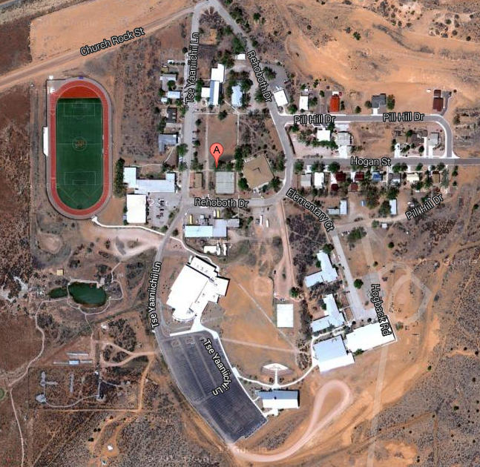
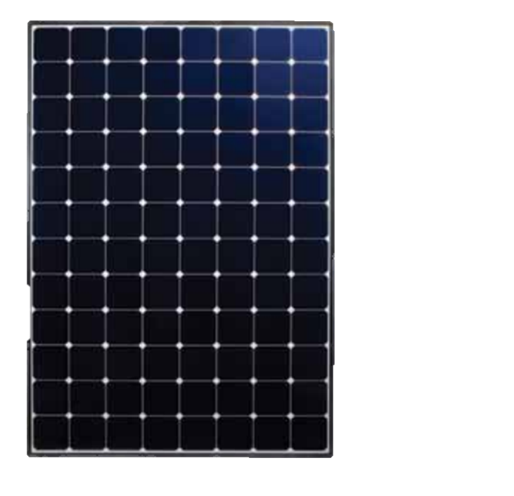
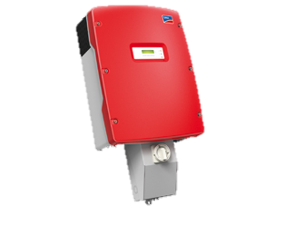
Project Objective
What would it take for Rehoboth Christian School to construct, own, operate, and maintain a solar PV energy system?

Slide 3
Site
Presented by: Claire Phillippi, Jack Amick, Jordan Veltema, Jordan Mast
Notes:
Mast

Slide 4
Outline
Work Accomplished
Location Options
  Decision Matrix
Climate
  Issues and Concerns
Installation Proposal
  Current Plan
  Future Options
Mounting System
Costs
Notes:
Mast

Slide 5
Work Accomplished
Survey
Decision Criteria
Decision Matrix
Meetings
Site Alternatives
Researched Cultural implications
Roof Loads Researched
Additional Weather Details
Final Construction Outline
Final Site Decisions
Notes:
Mast

Slide 6
Location Options
New High School
Existing Fitness Center
Existing Band Room
Fields
Carport
Bus Depot
Middle School
Dormitories
Notes:
Mast

Slide 7
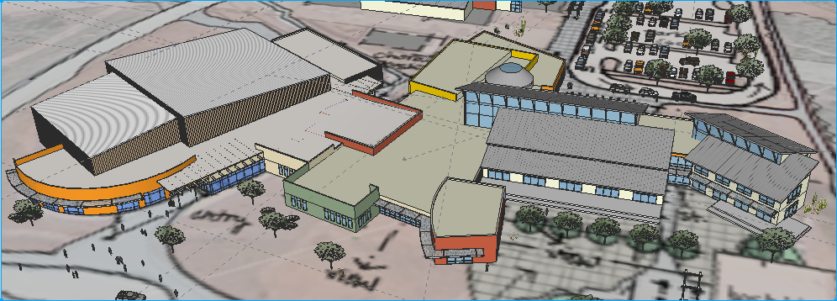
Buildings
Notes:
Mast

Slide 8
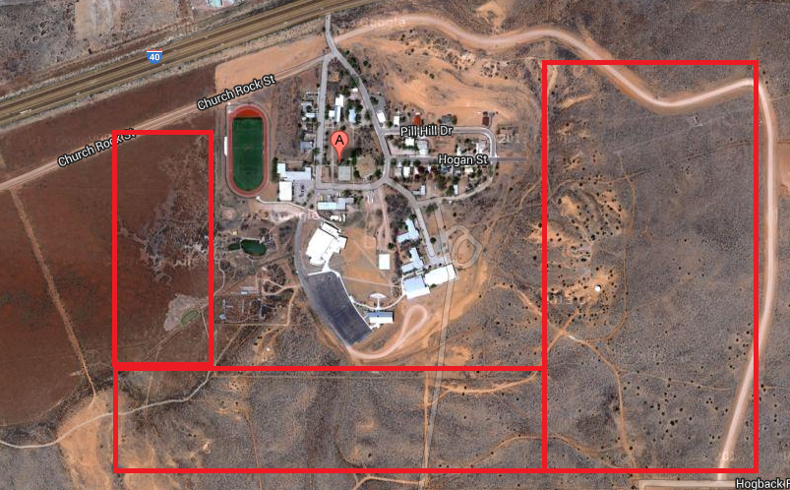
Fields
Notes:
Mast

Slide 9
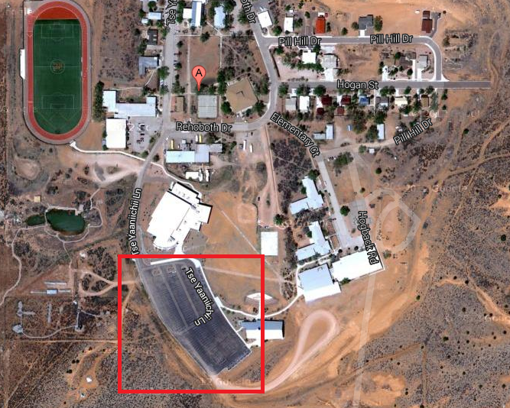
Carport
Notes:
Mast

Slide 10
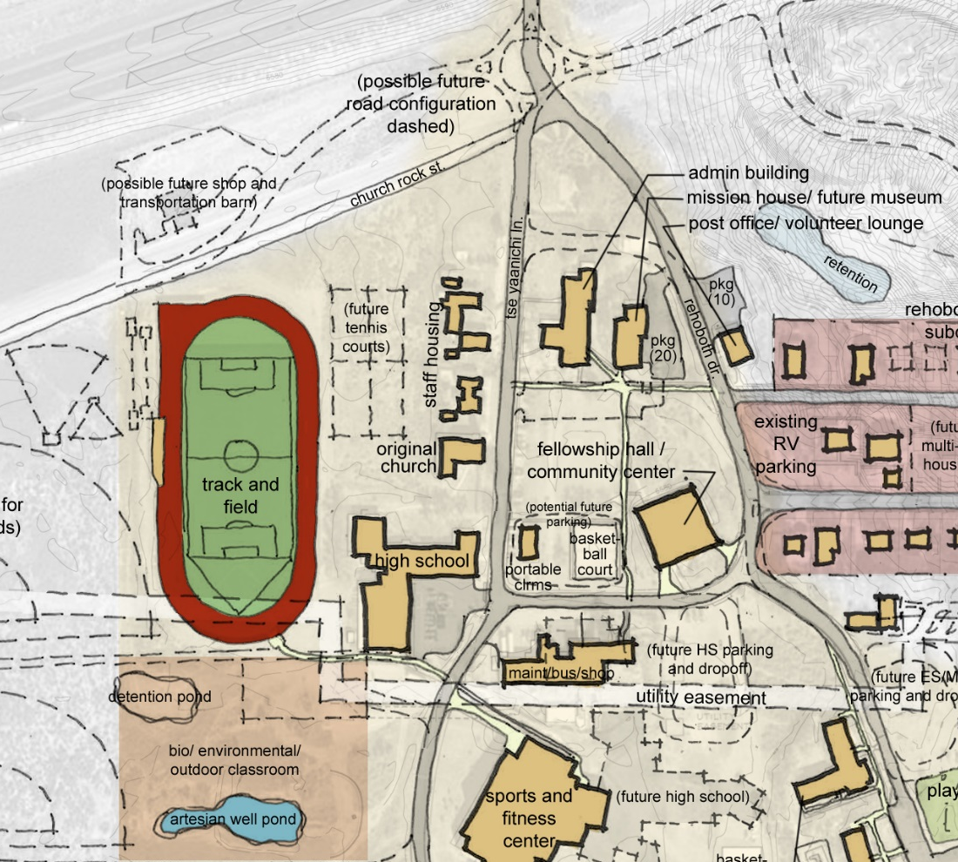
Bus Depot
Notes:
MAST

Slide 11
Decision Criteria
Survey
Decision Matrix
  Aesthetics
  Placement
  Security
  Cost
  Ease of Construction
  Tie-In Distance
  Total Area
  Cleanliness
Notes:
Mast

Slide 12
Decision Matrix
Notes:
Mast

Slide 13
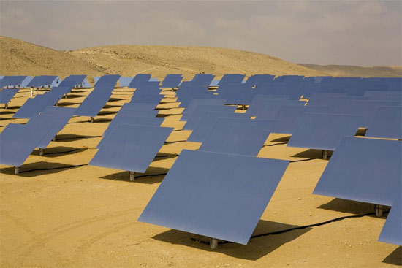
Environmental Issues
Wind
Dust Accumulation
Precipitation
Temperature
Notes:
Veltema

Slide 14
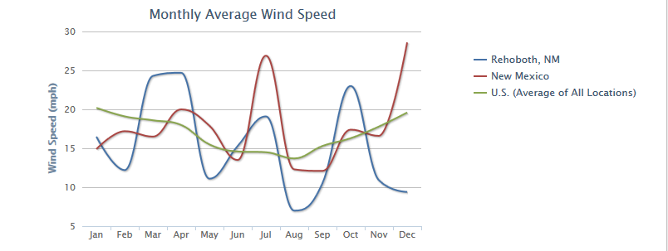
Rehoboth Climate
Annual Average Wind Speed = 15.33 mph
Notes:
Veltema

Slide 15
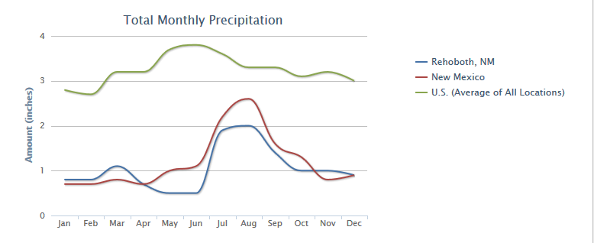
Rehoboth Climate
Annual Average Precipitation = 12.55 inches
Notes:
Veltema

Slide 16
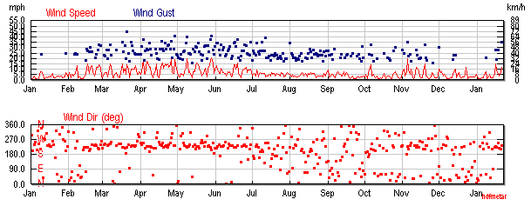
Rehoboth Climate
Notes:
Veltema

Slide 17
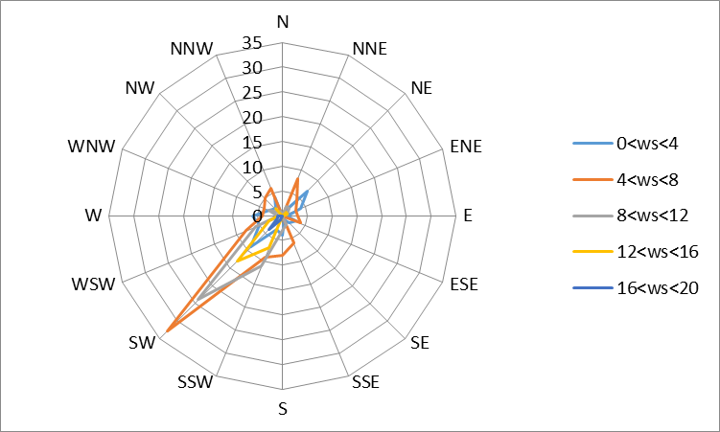
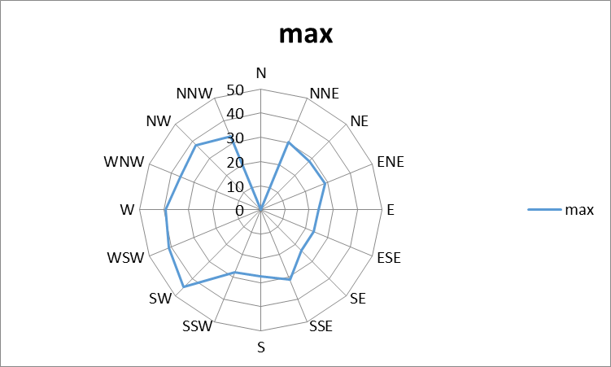
Rehoboth Climate
Notes:
Veltema

Slide 18
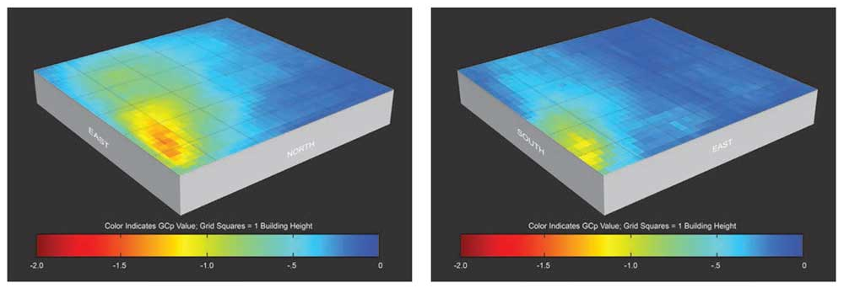
Wind on Roofs
Notes:
Veltema

Slide 19
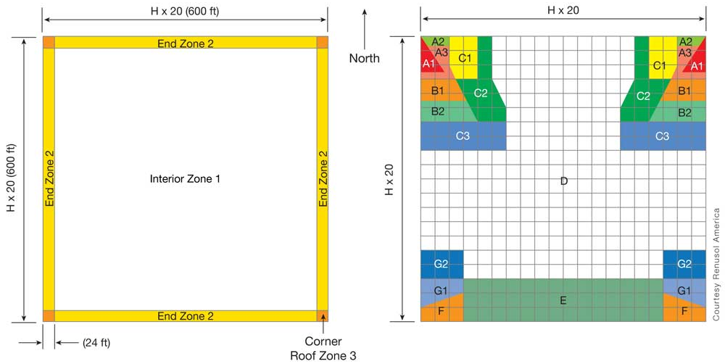
Wind on Roofs
Notes:
Veltema

Slide 20
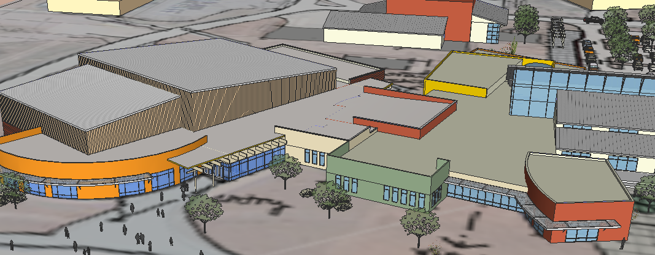
Installation Plan
New High School and Band Room
Fitness Center Roof
Future Options
Notes:
Jack

Slide 21
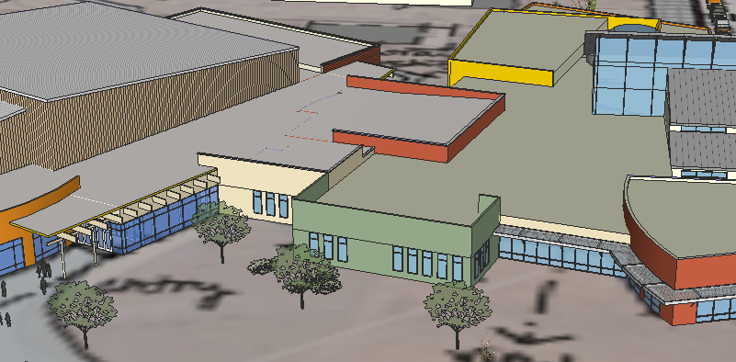
1a. Band Room
Preexisting Structure
3600 ft²
0˚
North
Notes:
Jack

Slide 22
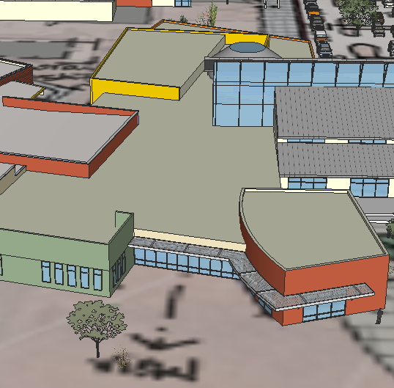
1b. New High School
Future Structure
12192 ft²
0˚
North
Notes:
Jack

Slide 23
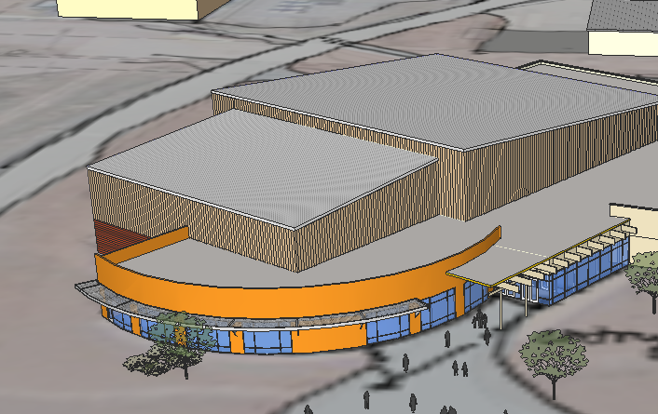
2. Fitness Center
Preexisting Structure
6050 ft²
5˚ SW
North
Notes:
Jack

Slide 24
3. Future Options
Middle School
  No structural plans or maximum roof loads available
Fitness Center (North Facing Roof)
  5 degree angle facing north east
New High School (Metal Roof)
  Not aesthetically pleasing
Notes:
Jack

Slide 25
Roof Materials
TPO Roofing
  Flat roof sections
  Cheaper to install onto
  Some obstructions
  20 year warranty, possible maintenance afterwards
Metal Roofing
  Slanted roof sections
  No obstructions
  No maintenance
Notes:
Claire

Slide 26
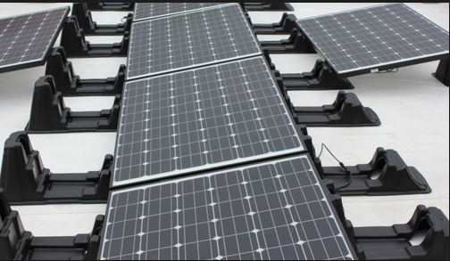
Ballast Mounting
Source: http://energyemp.com/
Notes:
Claire

Slide 27
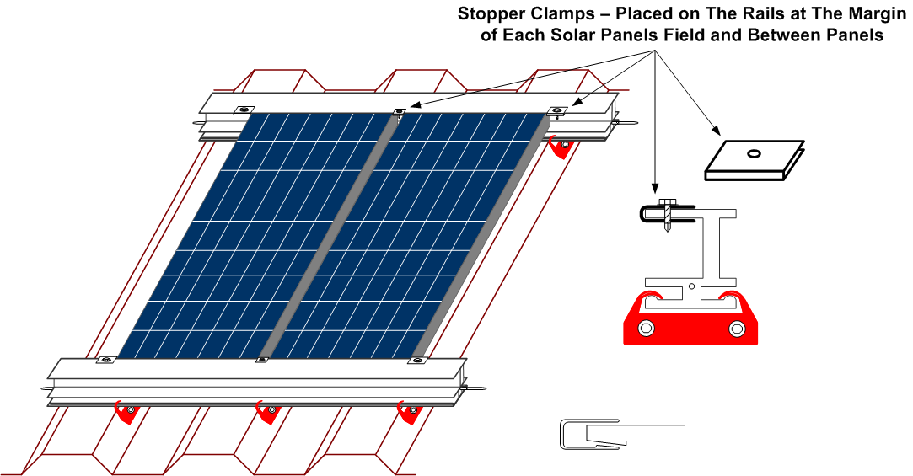
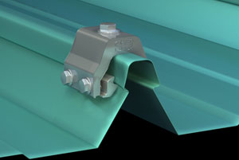
Inclined Mounting
Notes:
Claire

Slide 28
Roof Loads
Existing roofs have room for 3 pounds per square foot
Band Room .9 psf
Fitness 1.42 psf
High School 1.28 psf
High School 1.51 psf
Fitness Center .9 psf
Notes:
Claire

Slide 29
Costs
Upfront Costs
  Racking system: $ 20,091
  Labor: $ 281,272 Total: $ 301,363
Notes:
Claire

Slide 30
Questions?

Slide 31
Panel Selection
Presented by: Mr. Nate Hiemstra
Mr. Mitch Hopkins
Mr. Mike Houtman
Mr. Tae-Hyung Lim
Mr. Josh Vanderkamp

Slide 32
Outline
Status
  Overview
  Final Decisions
Work accomplished
  Panel Choice
  Panel Layout
  Energy Yield
  Cost Analysis
  Obstacles
Future Plan
  3 Possibilities

Slide 33
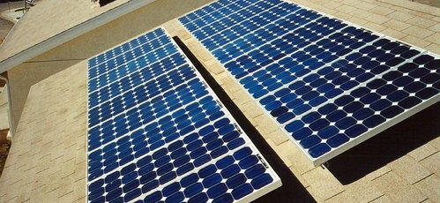
Monocrystalline
The most efficient type of solar panels (about 15-20%)
More expensive
Ideal for roofs
Notes:
Made out of silicon ingots
If the solar panel is partially covered with shade, dirt or snow, the entire circuit can break down.

Slide 34
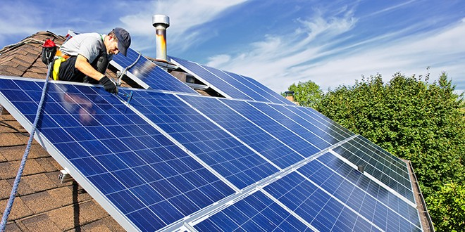
Polycrystalline
Less cost
Efficiency of approximately 13-16%
Performance decreases at higher temperatures

Slide 35
Thin-Film Solar Panels
Categories by material
  Amorphous silicon (a-Si)
  Cadmium telluride (CdTe)
  Copper indium gallium selenide (CIS/CIGS)
  Organic photovoltaic cells (OPC)
Efficiencies between 7–13%
Mass-production is simple
Can be made flexible
Strong against high temperatures and shading

Slide 36
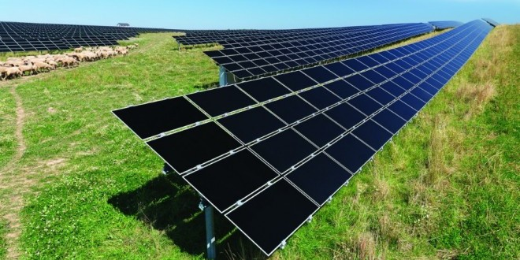
Thin-Film Solar Panels
Spatial limitations (about 4 times more space needed)
Structural costs
Degrade faster over time

Slide 37
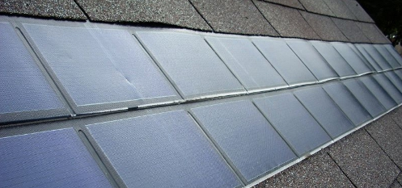
Building-Integrated Photovoltaics (BIPV)
Expensive
Good looks but less efficient
Easy installation

Slide 38
Suggestions
Limitations
  Space - Monocrystalline Silicon, BIPV
  Cost – Thin Film, Polycrystalline
Install Site
  Rooftop – Crystalline Silicon, BIPV
  Field – Thin Film
  Parking lot shade – Thin Film, Crystalline Silicon

Slide 39
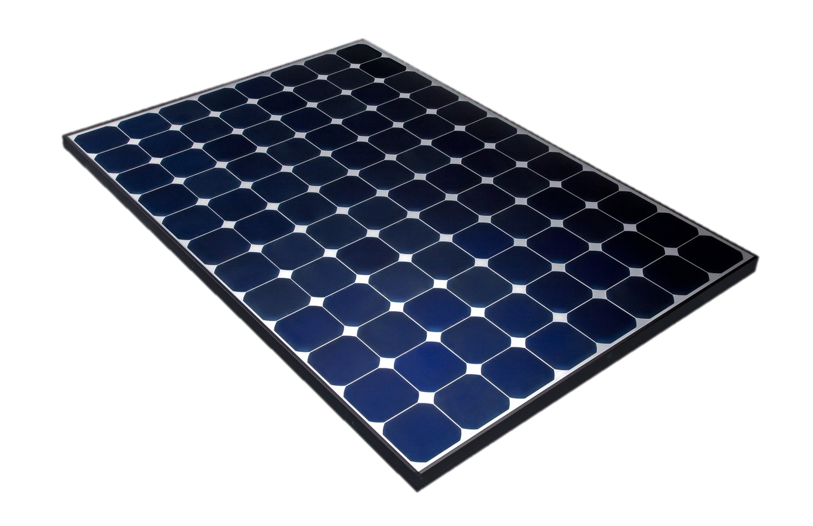
Panel Types
5 Panels Compared:
  SunPower E20 327W Mono
  Yingli 270W Mono
  Yingli 310W Poly
  SolarWorld 245W Poly
  SunPower E18 305W Mono
8 Criteria Weighted:
  Panel Efficiency (18%)
  Cost (23%)
  Weight (9%)
  Size (5%)
  Rated Power (15%)
  Company Reputation (8%)
  Aesthetics (10%)
  Warranty/Degradation (12%)
Notes:
Leads to Decision Matrix

Slide 40
Decision Matrix
SunPower E20 327W
Yingli YL270
270W
SolarWorld Poly 245W
SunPower E18 305 W
Notes:
Sunpower E18 is Best

Slide 41
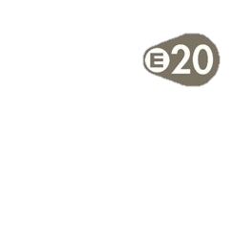
Panel Choice
SunPower E20/327
  20.1% efficient
  327 Watts
  Degrades at 0.25% yearly
  25 year warranty

Slide 42
Energy Yield
Goal to offset 50% of annual consumption due to power company constraints
  296,000 kWh annual yield
Notes:
Looked at all areas

Slide 43
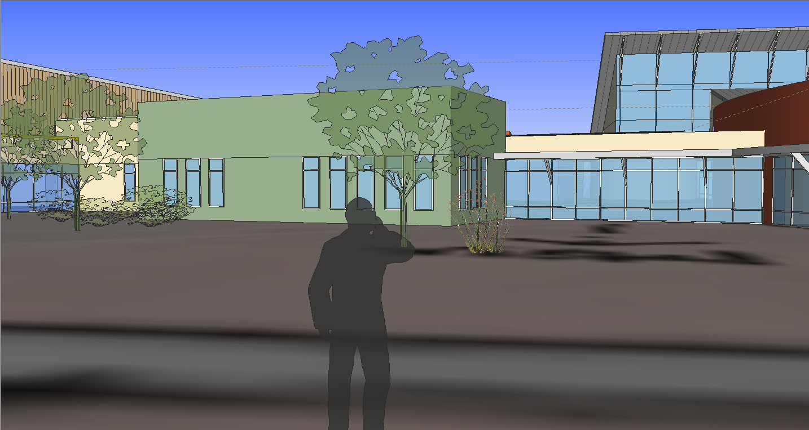
Panel Layout Factors
Panel Spacing
  Roof obstacles
  6 ft from roof edges
  2 ft spacing between panels
Panel Orientation
  15 degrees
  Standard to mounting system
  Aesthetics

Slide 44
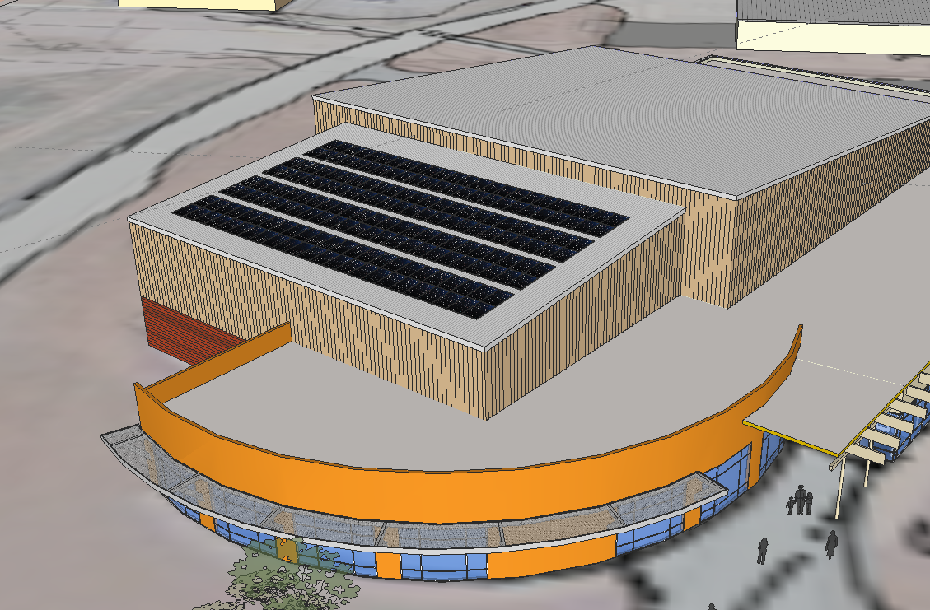
Fitness Center
192 Panels
108,300 kWh
N
Notes:
Jack

Slide 45
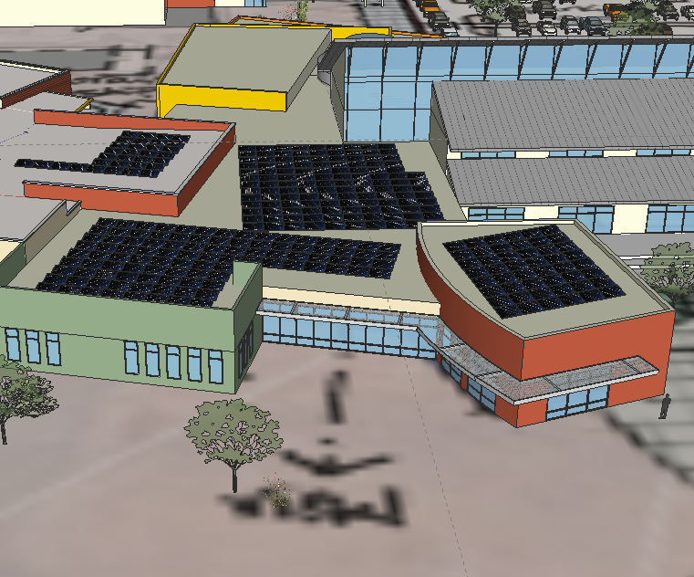
New High School/Band Room
320 Panels
183,200 kWh
N
Notes:
Jack

Slide 46
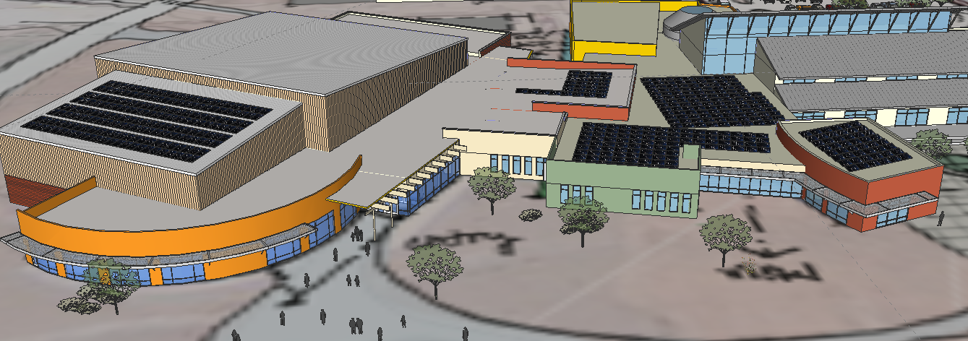
Total System Overview
N
512 Panels
291,500 kWh
47% of total energy consumption
Notes:
Jack

Slide 47
System Costs
Upfront Costs
  Panel: $ 210,944
  Total: $ 210,944
Annual Costs
  Replacement Units (% 0.05 Upfront) $ 2,845
  Labor: $ 60 Total: $ 2,905
Notes:
Claire

Slide 48
Obstacles
Fitness Center Loads
  Obtain official civil engineering approval
New High School Design Loads
  Civil Engineering design work for additional loads

Slide 49
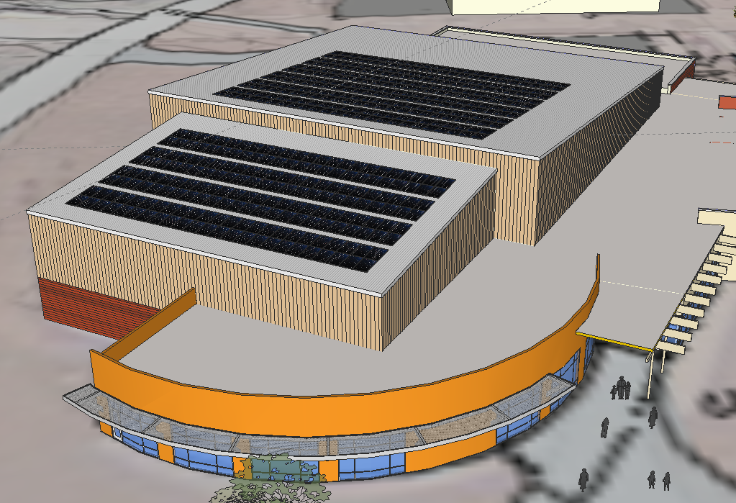
Fitness Center North Roof
288 Panels
150,300 kWh
73.2%
Pros: Not visible from ground, large space available, close to flat
Cons: North facing, loss of ~8% energy production

Slide 50
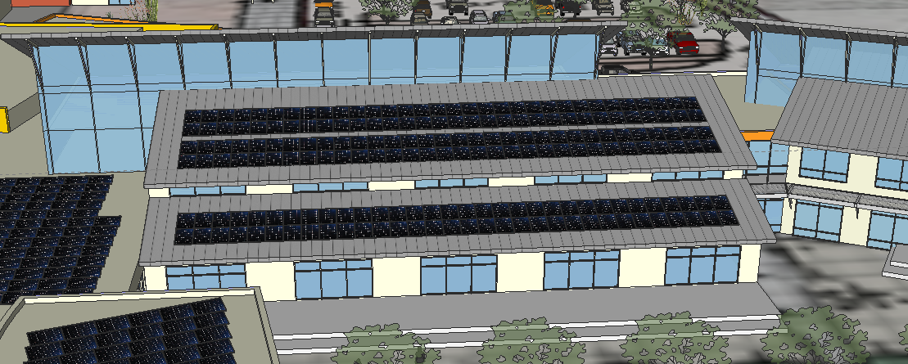
New High School (cont.)
192 Panels
114,300 kWh
67.1%
Pros: Faces directly South, 15 degree incline
Cons: Aesthetics, small area compared to alternatives

Slide 51
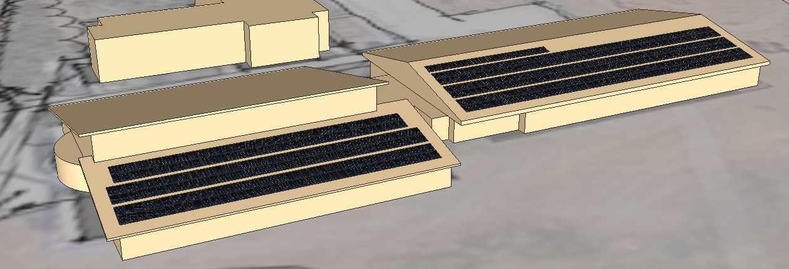
Middle School
480 Panels
283,300 kWh
95.7%
Pros: large space available, South facing, ~50% additional energy production
Cons: Lack of building information (age, structure, loading capability, etc…)

Slide 52
Questions?

Slide 53
Inverters
Presented by: Brandon Koster, Andrew Vriesema, and Lukas Woltjer

Slide 54
Outline
Introduction
Considerations for Selection
Equipment Selection
  Inverter Type
  Sunny Design Optimization
  Monitoring Options
  Tie in, Combiner Boxes, Panels, and Cutoff Switches
System Design and Location
Areas of Concern
Questions

Slide 55
Introduction
Purpose of Inverters
  DC to AC
  Power Quality
Importance of Monitoring
  Ensure Maximum Production
  Alerts for Equipment Failure

Slide 56
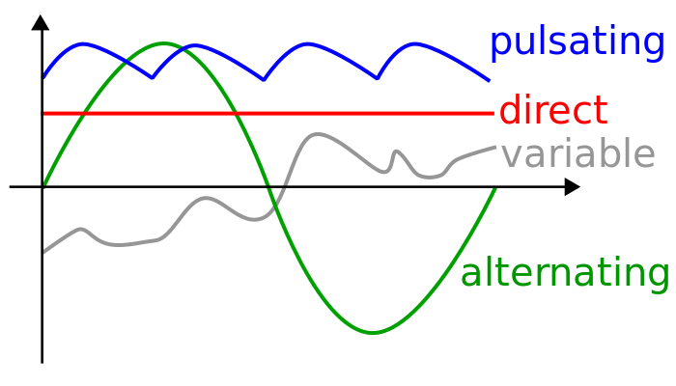
AC and DC
Image source: Wikipedia

Slide 57
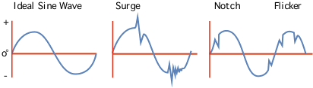
Power Quality
http://oikos.com/library/energy_outlet/pq.gif

Slide 58
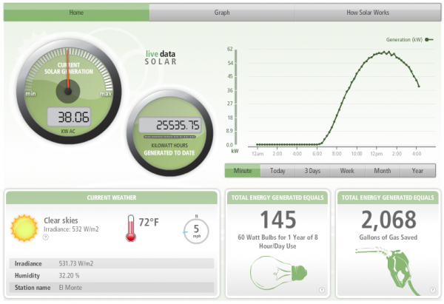
Monitoring
http://www.sunterrasolar.com/
Notes:
Monitoring checks to make sure that all inverters are performing equally. If they are not, then it is likely that panels are shaded or some equipment has failed.

Slide 59
Equipment Selection
Cost
Reputation
Ease of installation and maintenance
Compatibility with existing equipment

Slide 60
Inverter Types
Micro inverters
String inverters
Central inverter

Slide 61
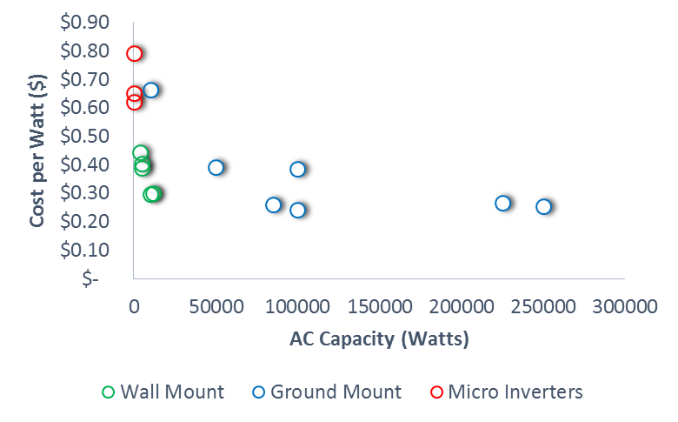
Inverter Cost Comparison

Slide 62
Cost Estimations
String Inverters (SB-8000TLUS) $0.27 / Watt
Central Inverter (SMA SC-125U) $0.26 / Watt
Central Inverter (Solectrica 75kW) $0.31 / Watt
Notes:
SC-125U no longer available, used for system model

Slide 63
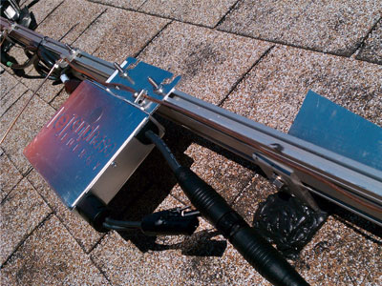
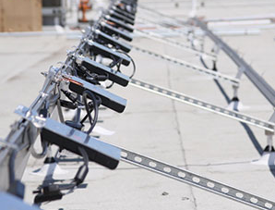
Micro Inverters
http://leosunergy.com/images/solar-inverter-technology.jpg
Notes:
One per panel
Enables accurate monitoring
Maximizes power production
High cost per watt

Slide 64
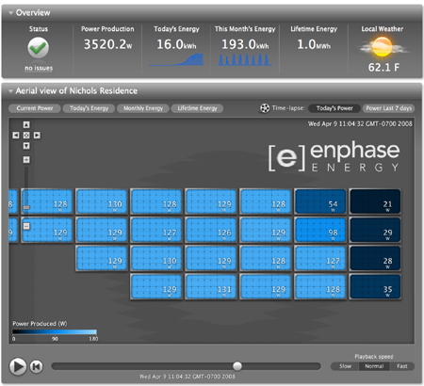
http://gigaom2.files.wordpress.com/2008/09/enlighten-nichols-residence2.jpg

Slide 65
Micro Inverter Advantages
Each panel is constantly optimized for highest production
Entire string does not suffer for shading on one panel
Production of each panel can be monitored
Troubleshooting the system is very easy

Slide 66
Micro Inverter Disadvantage
Highest cost per watt

Slide 67
Micro Inverters
http://leosunergy.com/images/solar-inverter-technology.jpg
Notes:
One per panel
Enables accurate monitoring
Maximizes power production
High cost per watt

Slide 68
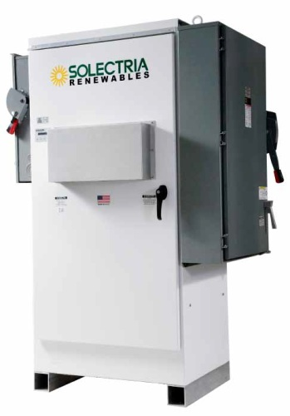
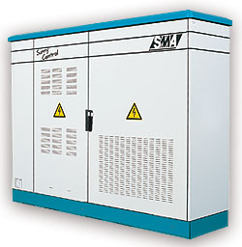
Central Inverter
www.abcsolar.com
Notes:
SMA central inverters start at 250 kW. Other central inverters come as small as 100 kW.

Slide 69
Central Inverter Advantages
Lowest cost per watt
Fewer inverters to operate and maintain

Slide 70
Central Inverter Disadvantages
Array would be very large and potentially difficult to monitor and troubleshoot
New DC lines would have to be run to the location of the inverter

Slide 71
Central Inverter
www.abcsolar.com
Notes:
SMA central inverters start at 250 kW. Other central inverters come as small as 100 kW.

Slide 72
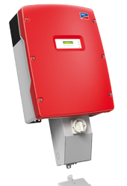
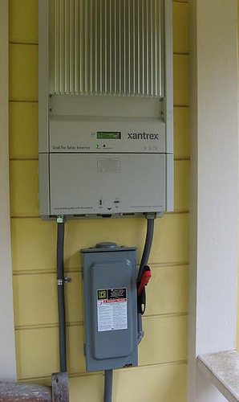
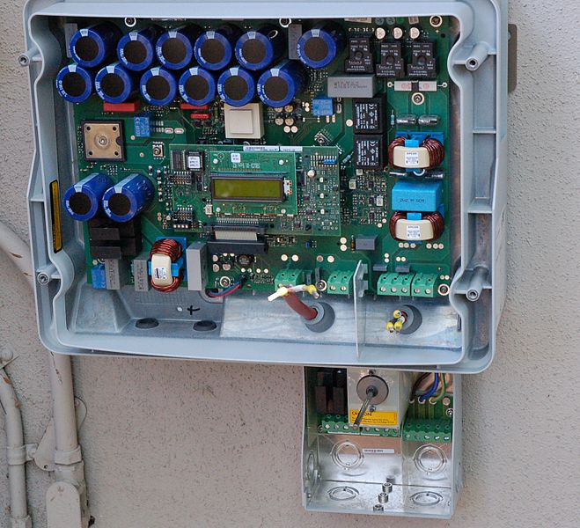
String Inverters
www.sma-america.com
Notes:
Generally handles 2-5 strings, up to 600 volts
Similar cost per watt to central inverters. Substantially cheaper than micro inverters

Slide 73
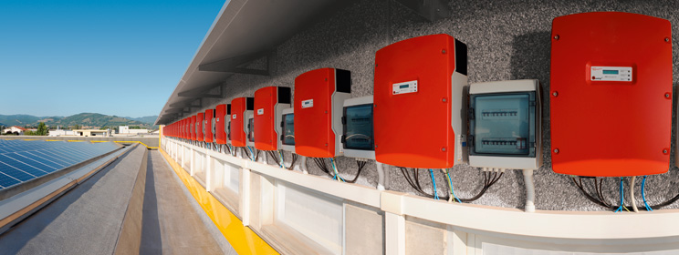
String Inverters
Notes:
Generally handles 2-5 strings, up to 600 volts
Similar cost per watt to central inverters. Substantially cheaper than micro inverters

Slide 74
Wall Mount Advantages
Most commonly produced inverter
A few strings come together to form an independent array
Smaller capacities allow easy integration to existing building electrical systems
Easier monitoring of production than ground mount commercial inverters

Slide 75
Wall Mount Disadvantages
Higher cost per watt than ground mount commercial inverters
More inverters to install, operate, and maintain

Slide 76
Transformer Types
Transformer
  Proven reliability
  Less efficient
  Larger and heavier
Transformerless
  Use a multi-step computerized process to invert DC power
  Lighter design
  Higher efficiency
  Must have ungrounded wiring, held to higher safety standards
  Additional overcurrent protection required
Recommend Transformerless

Slide 77

Inverter Selection

Slide 78
Inverter Selection
SMA Sunny Boy transformer-less (SBxxxxTL-US) series inverters
  High efficiency
  Light weight
  Competitive cost per watt
  Able to tie into single and three phase electrical systems
  Available in different sizes

Slide 79
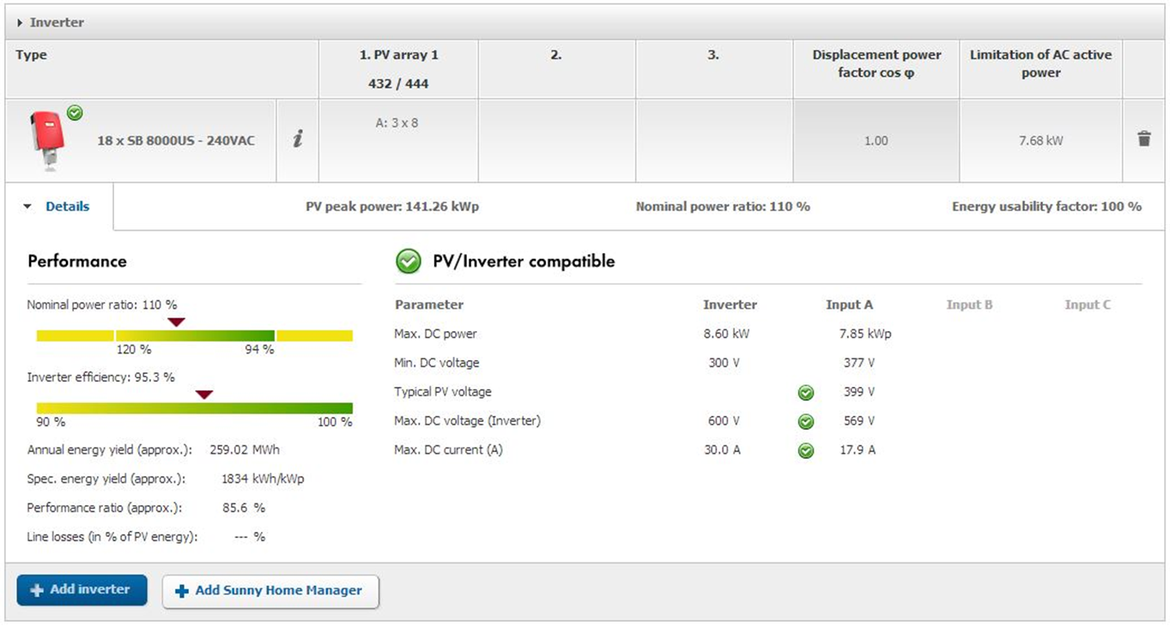
Sunny Design
Used to select inverters for a specified type and number of panels
Chose inverters and panel wiring options for 100% power ratio

Slide 80
Sunny Design

Slide 81




Monitoring Options
Notes:
Monitoring systems can be inverter integrated or be an extra component. ECHS used DECK to handle the data, and recommends them.
ALSOenergy quoted “less than 1% of total system cost”

Slide 82
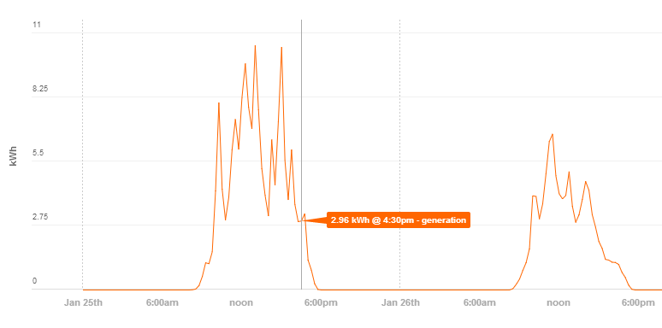
Monitoring Recommendation
Use installer-recommended provider
No accurate quotes to date
Cost: less than 1% of total system cost (ALSOenergy)
Eastern Christian High School has used DECK monitoring

Slide 83


Grid Tie-in Equipment
Load centers (breaker panels)
AC safety disconnect switches
Wiring and conduit

Slide 84

Tie-In Diagram
Source: www.energy.ca.gov
Notes:
First three elements are generally built into inverter.
Two AC disconnects are for convenience when working on the inverter.

Slide 85

Tie-In Restrictions
Agreement for Parallel Connection
  System of up to 75 kW in parallel with the grid
  Commercial Agreement
Can connect to grid once the following conditions are met:
  Agreement signed
  Installation complies with Appendix A
  Installation inspected by State CID Electrical Inspector
  Approval Form signed by CID and GJU
  Appendix B signed
GJU has right to terminate agreement within 30 days written notice
Notes:
CID = Construction Industries Division

Slide 86

Appendix A
RRGS and associated equipment complies with:
  UL Standards
  Applicable IEEE Standards
  2005 National Electric Code
  State and Local Codes and Regulations
Prior to installation
  Agreement needs to be executed
  Applicable permits obtained
Prior to Connection
  Inspection by GJU and CID
  Anti-Islanding and Power Quality Inspected and Tested
  An accessible, manual, lockable load break disconnect between inverter output and connection to grid
  Permanent weatherproof diagram of the system at metering point

Slide 87
Appendix A: Net Metering
Apply for Net Metering after Agreement has been executed
Excess energy results in a credit that will be applied to the account and carried from month to month
GJU can reconcile the account annually by buying-back the credits
Liability Protection
Appendix B

Slide 88
Conversations with GJU
75 kW is negotiable
Might have to pay a flat fee
Must go before city council
GJU has never ruled on a proposal above 75 kW

Slide 89


Placement Options
Parapet Wall
Side Wall
  Near Meter

Slide 90
Costs
Upfront Costs
  SunnyBoy 5000 TL (3): $ 6,642
  SunnyBoy 8000 TL (2): $ 4,548
  SunnyBoy 10000 TL (13): $ 39,806
  Deck Monitoring System: $ 5,633
  Tie-in components: $ 4,226
  Total: $ 60,855
Notes:
Claire

Slide 91
Issues and Concerns
School electrical system
  Can tailor PV system for multiple grid configurations
Integrating monitoring system
  Waiting for DECK about integration with SMA inverters
75kW limit set by Gallup
  Negotiate 150 kW system, tied in at two locations

Slide 92
Questions?

Slide 93
Financial
Presented by: Allen Bosscher, Karl Bratt, Jonathan Haines
Notes:
JON

Slide 94

Outline
Work Accomplished
Issues and Concerns
Next Steps
Summary
Questions
Notes:
JON

Slide 95

Work Accomplished
Financing Options
Additional Grant & Tax Incentives
Electric Bill Analysis
PPA & Solar Lease Research
Cost Models and Analysis
L.L.C. Research
Notes:
JON

Slide 96

Financing Options
Direct Financing
Limited Liability Corporation
Power Purchase Agreement
Solar Lease

Slide 97

Direct Financing
Process
PV System is Purchased
Donation vs. Loan
Advantages
Independent
Higher Potential
One-time Cost
Disadvantages
High Upfront Cost
Responsible for Damages
Non-profit Company
High Risk

Slide 98


Privately Owned L.L.C.
Process
Donation vs. Loan
Roof is Rented Property
Billed for Electricity
  At least 50% utility cost rate
Annual donation of revenue back to school (lawyer)
Advantage
For-profit federal and state tax incentives

Slide 99

Power Purchase Agreement
Process
Roof is Rented Property
PV System 3rd Party Owned
Billed for Electricity Usage
Advantages
For-profit federal and state tax incentives
Reduced Cost of Electricity
No Upfront Cost
Disadvantages
20-25 Year Contract

Slide 100

Solar Lease
Process
PV System is Leased
Set Monthly Payment
Advantages
For-profit federal and state tax incentives
Set Monthly Payment
Low Upfront Cost
Disadvantages
20-25 Year Contract
Responsible for Damages

Slide 101


Grant Possibilities
USDA High Energy Cost Grant
  Federal Grant
  Applicable to: Nonprofits and Schools
  Max Incentive = $3 million
  Eligible in areas where average
  home energy costs are 275%
  above national average
    NOT applicable to Rehoboth
      New Mexico Avg. Home Energy Cost = $0.0809/kWh
      National Avg. = $0.113/kWh

Slide 102

Grant Possibilities
USDA Rural Energy for America Program (REAP)
  Federal Grant
  Applicable to: “Schools”
  $2,500 - $500,000
  Max Incentive = 25% of total project cost
  Eligible for colleges and universities
    NOT applicable to Rehoboth (K-12 School)
  Might be available with a L.L.C.

Slide 103
State Incentives
New Mexico Corporate Tax Credit
  6% tax credit
  Max incentive = $60 million
  Applicable to commercial sector
Sustainable Building Tax Credit
  Based upon LEED certification
  $0.30 - $6.25/ft²
Non-profit = No tax
  Receive credit and sell to a for-profit entity

Slide 104
Federal Incentives
Business Energy Investment Tax Credit
  30% Tax Credit on Capital Investment
  No Max Incentive
  Applicable to commercial sector
Applicable To:
  PPA
  Solar Lease
  L.L.C.

Slide 105
Electricity Invoice Analysis
Annual Total = $ 69,892
Notes:
KARL

Slide 106
Electricity Invoice Analysis
Annual Total = $ 79,621
Difference ≈ $10,000
Notes:
KARL

Slide 107
Electricity Rate Analysis
Tier Bill Sections | General Service Medium | General Service Small
First 100 kW or Less ($) | 1,534.43 | -
Additional Demand ($/kW) | 15.90 | -
First 100 kWh ($) | - | 14.45
Energy Charge ($/kWh) | 0.0791 | 0.1285
General Service Medium Requirements:
For 3 Consecutive Months…
  40,000 kWh Monthly Usage
  ~OR~
  100 kW
  Monthly Peak Usage
Notes:
KARL

Slide 108
Electricity Rate Analysis
32,000 kWh
Notes:
KARL

Slide 109
Electricity Rate Analysis
Average ≈ 5%

Slide 110


PPA & Solar Lease Research
Contacts
Patricia Mattioli
  Consolidated Solar Technologies
Mark Durmmond
  Positive Energy Solar
Notes:
JON

Slide 111
Cost Modeling

Slide 112
Cost Modeling

Slide 113
Cost Modeling
TOTAL Upfront Costs
  Site $ 301,363
  Panel $ 210,944
  Inverter $ 60,855
  Total: $ 573,162
TOTAL Annual Costs
  Panel $ 2,905
  Total: $ 2,905
Notes:
Claire

Slide 114
Cost Modeling

Slide 115
Cost Modeling
≈ 23 Years
12 Years
10 Years

Slide 116

Effective Rates

Slide 117

Issues & Concerns
Solar Lease Quote
75 kW Capacity Limit
Legal Concerns with School Owned L.L.C.
Cost Flow Assumptions
Donation Fundraising
Financial Institution Financing
Notes:
JON

Slide 118

Next Steps
Poster 1/28
Final Report 1/28
Solar Lease Quote 1/30
Engineering Department Seminar 2/12
Notes:
KARL

Slide 119
Summary
What would it take for Rehoboth Christian School to construct, own, operate, and maintain a solar PV energy system?
Rehoboth Strategic Objectives:
  Offset 50% of total electricity
  demand by 2020
  Focus on managing school,
  not managing energy infrastructure
Notes:
Prefer to minimize energy aspect
Remove as much responsibility as possible
Place responsibility on outside company

Slide 120
We recommend that Rehoboth install a 167 kW Solar PV system in 2015, financed by a Solar Lease
N

Slide 121
Questions?
Notes:
KARL

