Slide 1
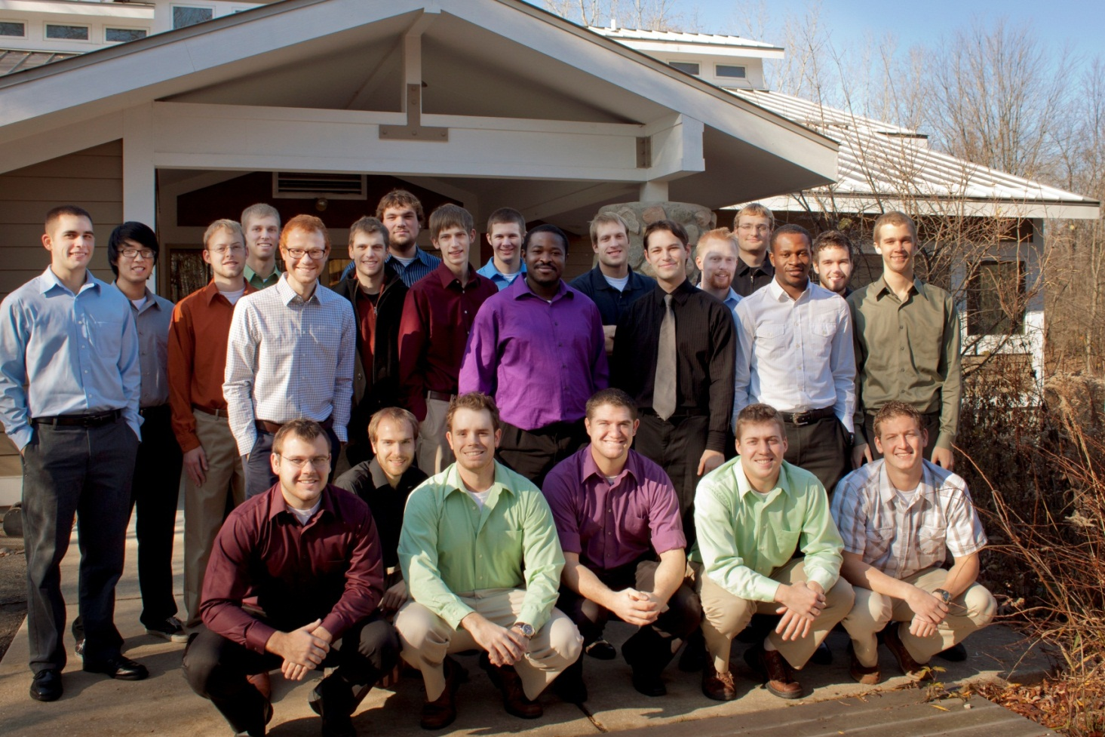
Bunker Interpretive Center Energy Efficiency Project
Engineering 333
December 6, 2011

Slide 2

Introduction: LEED®
LEED: Leadership in Energy and Environmental Design Certification
Ratings:
  Certified (40-49 points)
  Silver (50-59 points)
  Gold (60-79 points)
  Platinum (80+ points)
Encourages design of energy efficient buildings
LEED (to date) does not address actual energy use
Does LEED work?
Notes:
- Leadership in Energy and Environmental Design
- LEED is a set of standards laid out by the US Green Building Council
Address upcoming modification: LEED will not only consider the design/construction of the building but also energy usage
How can we determine of LEED works? Need a way to address actual energy usage.

Slide 3


Introduction: Energy Star®
Addresses the energy use of a building
Compares your building to “peer group” (e.g. K-12 school, hospital, office, etc.)
Accounts for climate, size, purpose, etc.
Best 25% of a
building category
Notes:
Energy star is a way to address the actual energy usage of a building.
One way to answer the question “does LEED work” is to determine if LEED gets energy star
List (some of) the E.S categories (e.g. K-12, Office, Other, Food Processing, hospital, supermarket, etc)
Energy star does account for climate, size, purpose, etc.

Slide 4
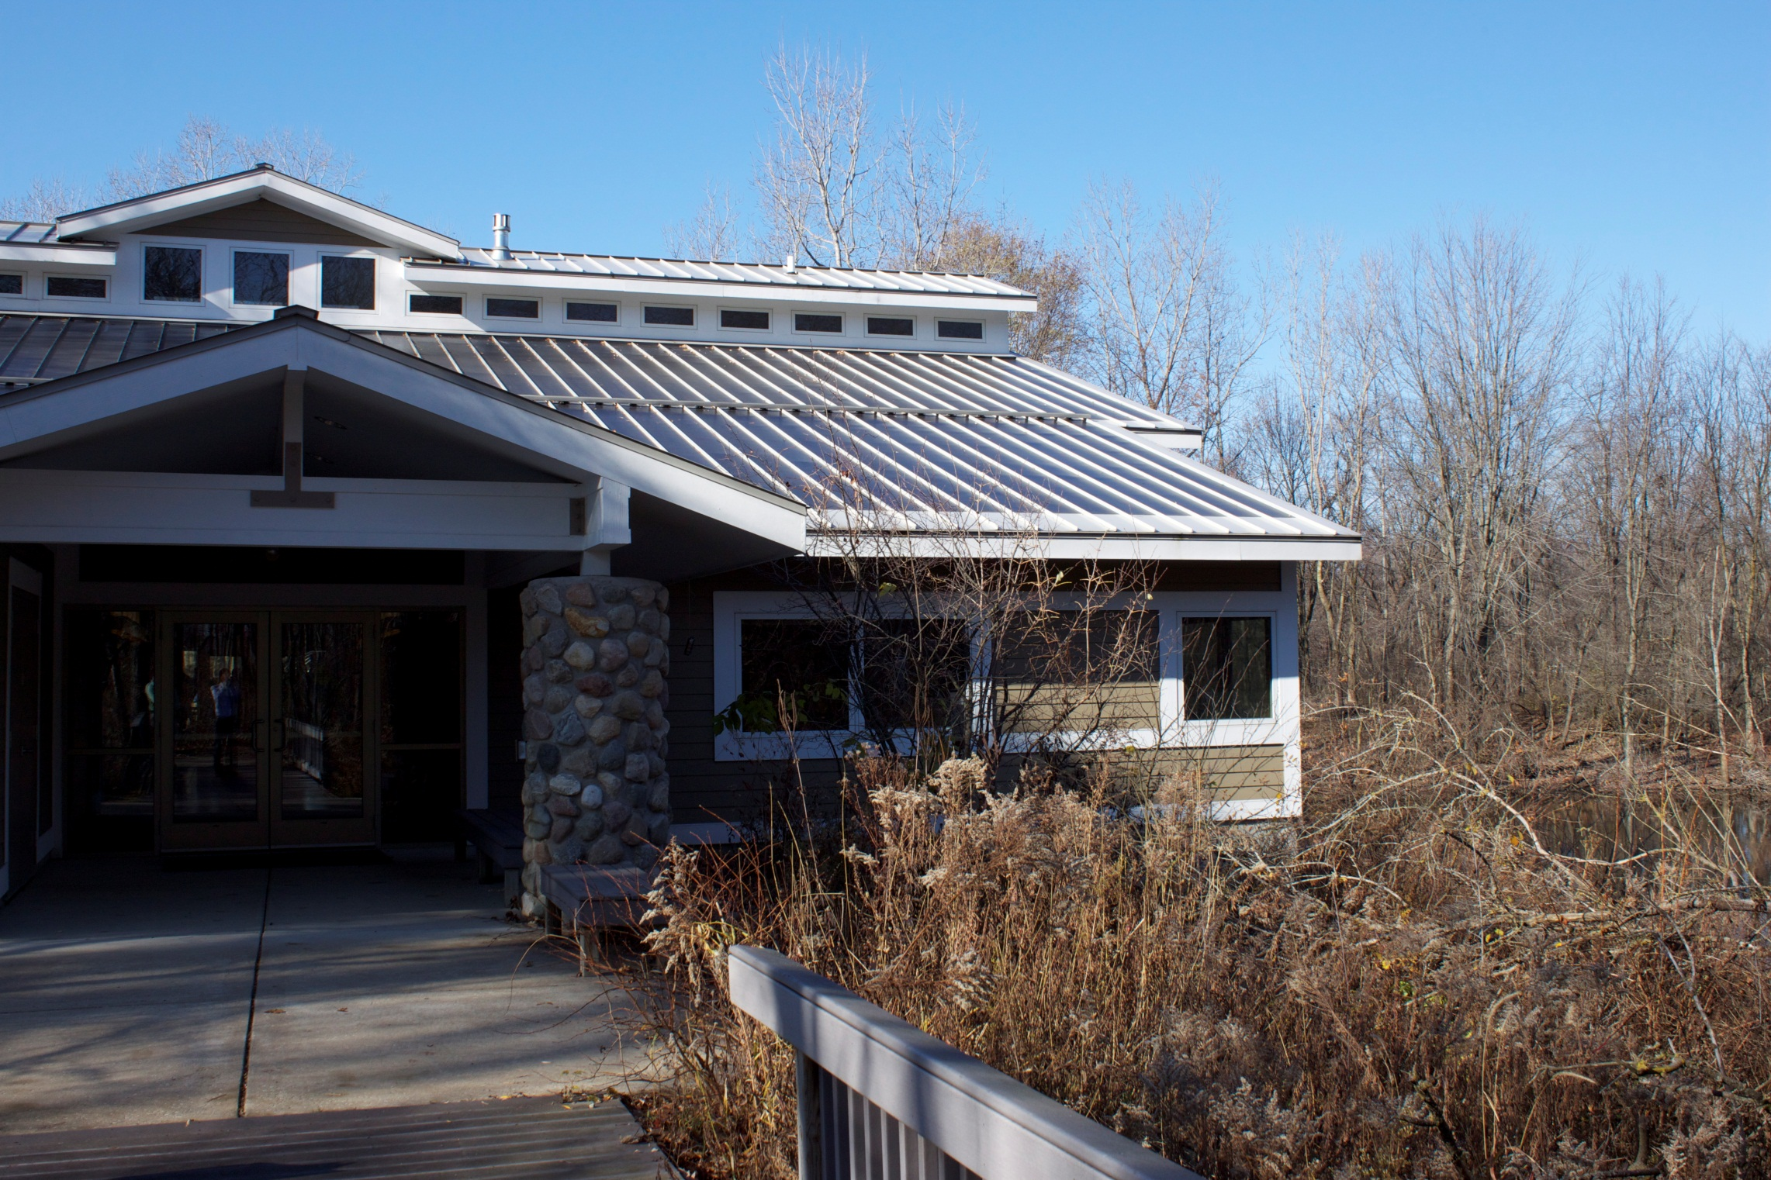
Introduction: BIC
BIC - Bunker Interpretive Center
BIC earned the LEED Gold rating
Test case: if BIC can get Energy Star®, LEED works
Notes:
BIC: “One purpose of the facility is to help visitors understand their role in the world as stewards of creation”
→BIC (opened in 2004) is open to the public
Position BIC as a great opportunity to answer the question about LEED.
“for the purpose of this project…”

Slide 5

Can the Bunker Interpretive Center attain Energy Star® rating?

Slide 6

Portfolio Manager
Created by Environmental Protection Agency (EPA)
Purpose: Generate an Energy Use Intensity (EUI)
  Combines different energy forms into one broad statistic
  Units of kBtu/ft²-yr
ENGR 333 used Portfolio Manager as a tool to determine if BIC meets Energy Star® requirements
Notes:
Site EUI – only the use on a site
Source EUI – the use on a site AND the energy involved in transportation and storage of energy
→ More useful and informative than Site EUI
“Greener” buildings will have less of a difference between Site EUI and Source EUI

Slide 7
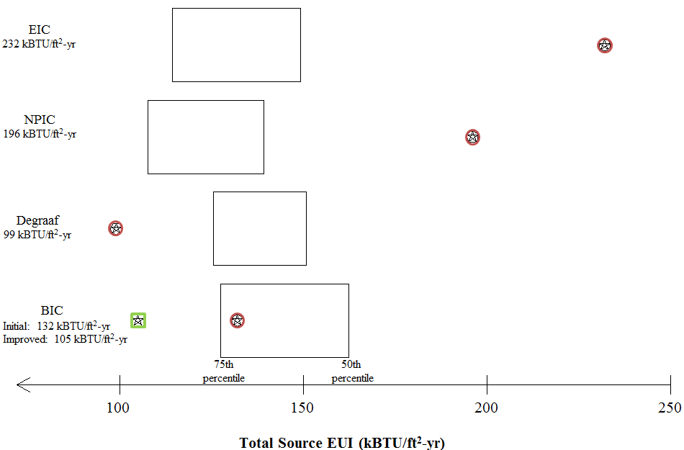

Understanding EUI
Qualify
Notes:
Transition: So where does the BIC fall?

Slide 8
BIC Star
Can only obtain Energy Star® in predefined categories
BIC doesn’t fit. Closest are:
  K-12 School Building
  Office
Solution: Create “BIC Star”

Slide 9
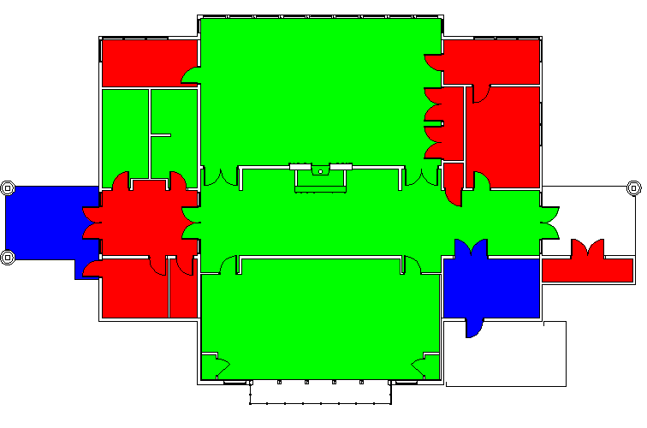
BIC Floor Plan
N
K-12 (68%)
Office (23%)
Other (9%)
Notes:
Combined data and set floorspaces according to schematic
→ Used this to create our own BIC Star category.

Slide 10
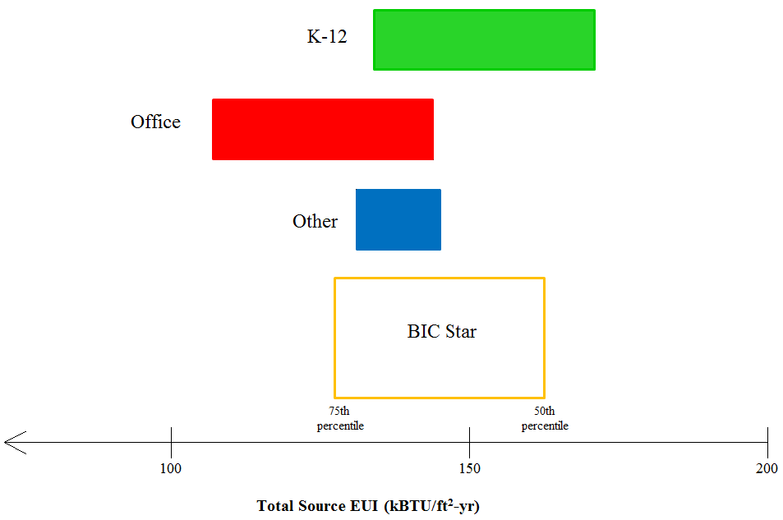
68%
23%
9%

Slide 11
How does the BIC perform?

Slide 12

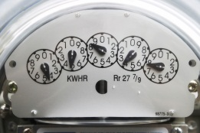
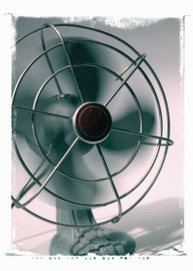
Investigation Overview
Lighting
Natural Gas
Outlets & Small
Appliances
Air &
Water Flow
What is the BIC’s actual performance?
Notes:
Introduce the instrumentation systems from last semester.
Answers the question: What is the BIC’s actual performance

Slide 13
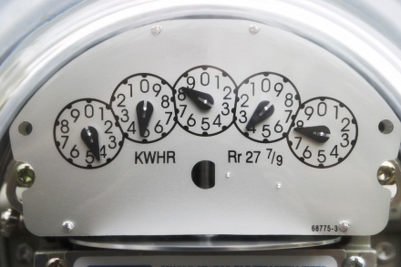
BIC Performance: Natural Gas
Boiler
  Floor heating
  Domestic water (taps)
Fireplace
  Aesthetic value
  Space heating
Notes:
BOILER
don’t forget fireplace –R
2 main headings, boiler and fireplace (subheading – aesthetic value and space heating), subheading of floor heating and taps
Picture of hobbs meter and outside natural gas (Karl should have the pic from 382)

Slide 15
91%
9%
Notes:
Add percentages to the graph

Slide 16
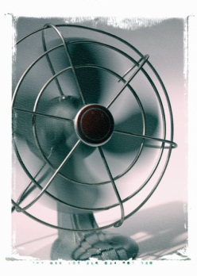

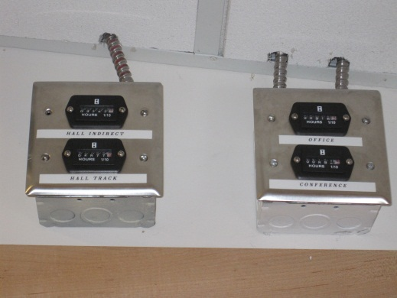
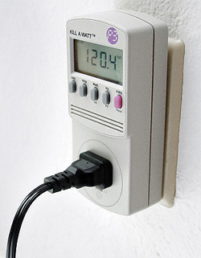
BIC Performance: Electricity
Air and Water Flow:
  Circulation Fans
  Pumps
Outlets and Small Appliances:
  Refrigerator & microwave
  Wall outlets
Lighting
  All interior lights
Hobbs Meter
Kill-A-Watt Meter
Notes:
Pictures of Hobbs meter and kiill-a-watt meter (room on the slide for them)

Slide 17
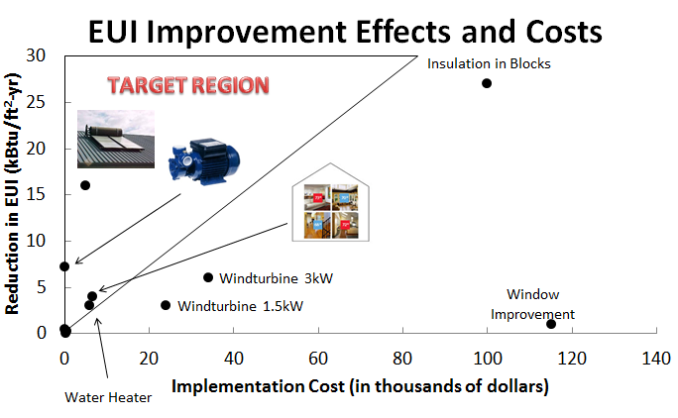
LED Lights
Light Timer
Boiler
Notes:
Not sure what font sizes or styles are on this figure -R
-added LED Lights, Light Timer, and Boiler (make sure we call everything the boiler!) -R

Slide 18
Outlets and Small Appliances
Lighting
Air and Water Flow

Slide 19
Outlets and Small Appliances
Lighting
Air and Water Flow
Circulation Fan

Slide 21
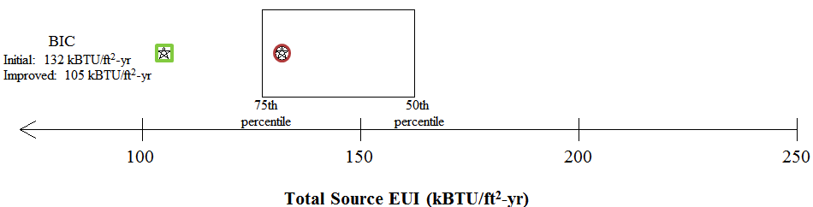


BIC Performance
Qualify
Notes:
Energy star logo put BIC photo to the right pass/fail change
move the 132 to closer to the star

Slide 22
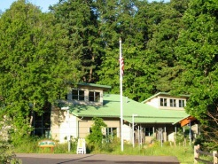
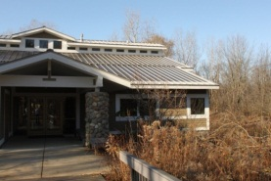
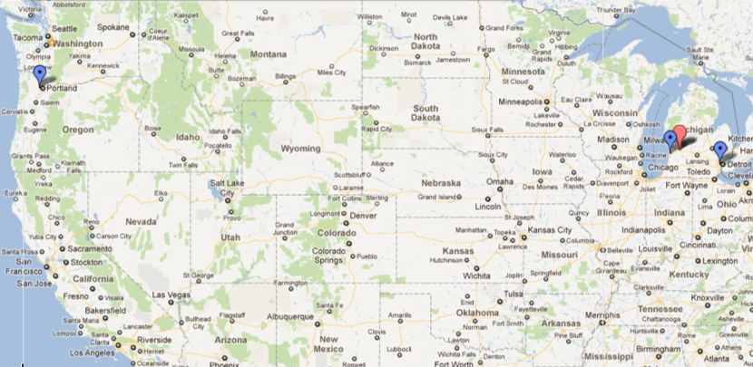
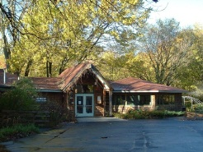
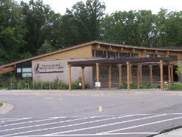
Building Comparisons
Nature Park
Interpretive Center
Bunker
Interpretive
Center
De Graaf
Nature
Center
Environmental
Interpretive
Center
Notes:
Our team took on the responsibility of gathering and processing the specs from other buildings.
Overview on bdgs:
NPIC:
De Graaf:
IEC:
Put the organization that runs each facility

Slide 23
Building Comparisons
Building | Operated by | Location | Area (ft²)
Bunker Interpretive Center (BIC) | Calvin College | Grand Rapids, MI | 5,300
DeGraaf Nature Center (DeGraaf) | City of Holland | Holland, MI | 3,100
Environmental Interpretive Center (EIC) | University of Michigan | Dearborn, MI | 13,000
Nature Park Interpretive Center (NPIC) | Tualatin Hills Park & Recreation District | Beaverton, OR | 7,700
Notes:
Table that includes the BIC
Rows (places)
Columns (location, size, who operates picture)

Slide 24
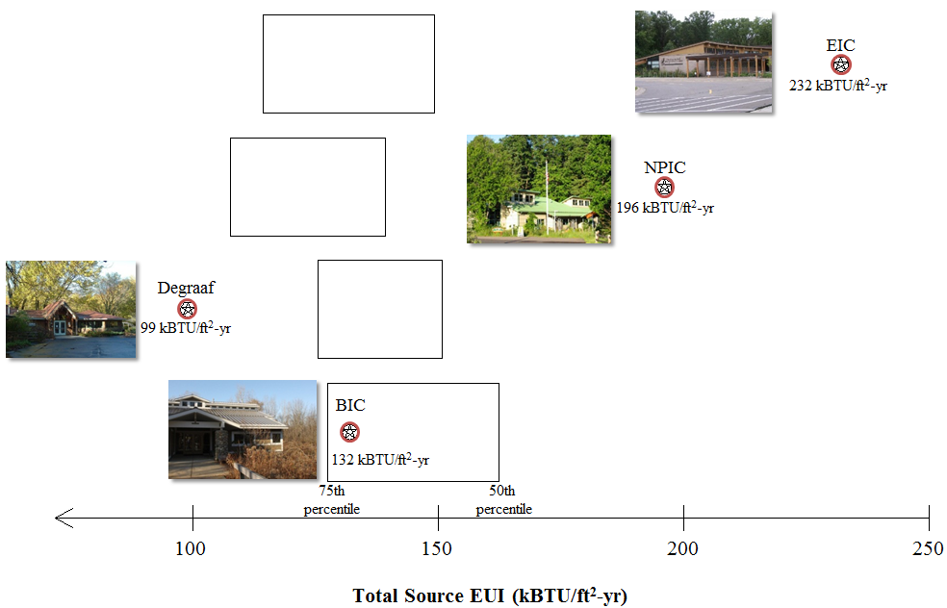
Notes:
Put energy star logo on the left, move the numbers, add pictures

Slide 25
What can we do?

Slide 26
Options for Reducing EUI
Behavior modification
Natural gas efficiency
Electricity efficiency
Renewables

Slide 27
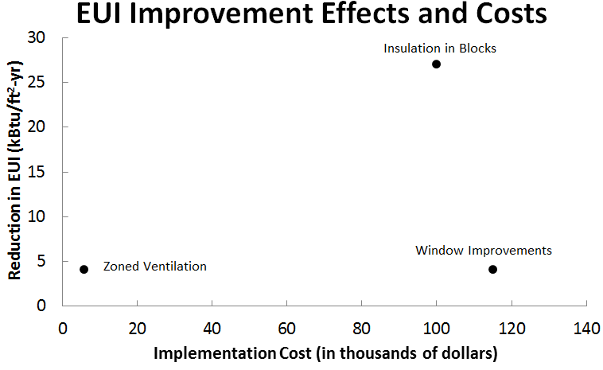
Notes:
Get rid of the numbers

Slide 28

Notes:
Get rid of the numbers

Slide 29
BIC Improvements
Behavioral
  Leaving the BIC closed on Monday
  Closing the BIC 30 minutes early every day
  Turning off the fireplace
  Shades on the windows
→All violate the intended purpose of the BIC!
  “One purpose of the facility is to help visitors understand their role in the world as stewards of creation”
  -Professor Randy Van Dragt
Notes:
Cite the quote Van Dragt on the website

Slide 30
BIC Improvements (cont.)
Natural Gas
  High-efficiency Boiler
  Improving Insulation
  Replacing Windows
Notes:
Add small graph on the right, EUI due to Natural gas and EUI due to electricity

Slide 31
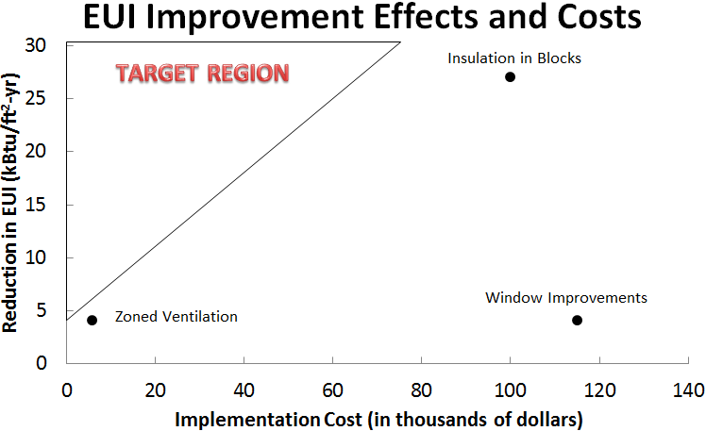
Boiler

Slide 32
BIC Improvements (cont.)
Electricity
  LED lights
  Replacing appliances
  Shutting off water pumps
  Zoned Ventilation

Slide 33
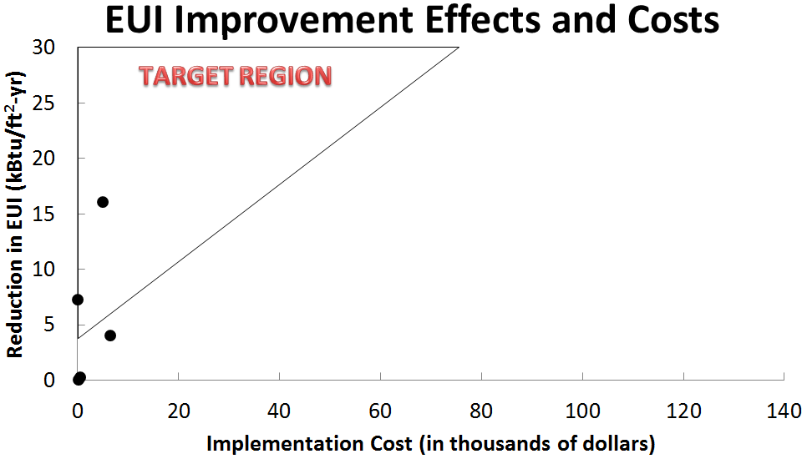
Pumps
Zoned Ventilation
LED Lights
Light Timer

Slide 34
BIC Improvements (cont.)
Renewable Energy Improvements
  Increased Solar PV Panels
  Wind Turbine
  Solar Water Heater

Slide 35
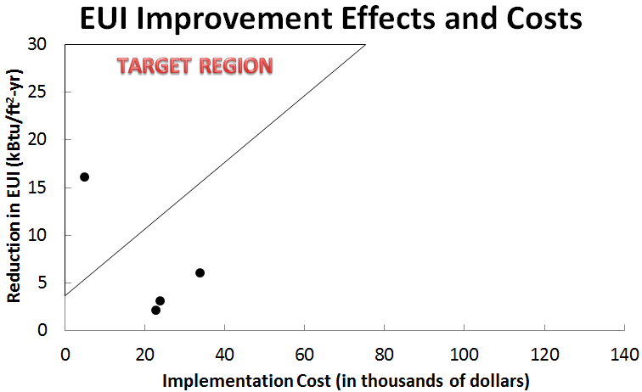
Solar Water Heater
Wind turbine 3kW
Wind turbine 1.5kW
Solar Panels

Slide 36
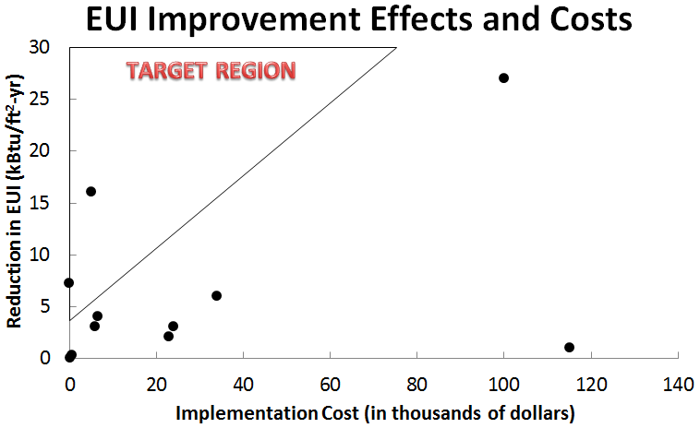
Insulation in Blocks
Solar Water Heater
Zoned Ventilation
Pumps
Boiler
Wind turbine 3kW
Wind turbine 1.5kW
Window Improvements
Solar Panels
Light
Timers
LED
lights

Slide 37
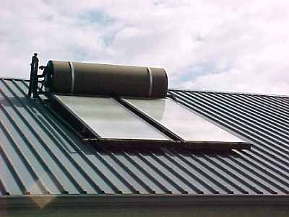
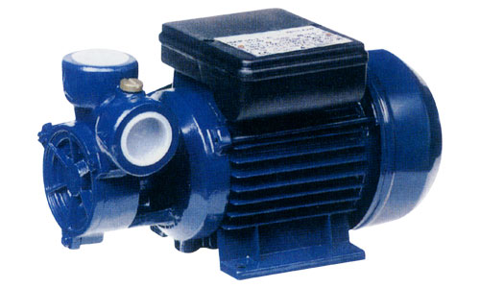
Recommendations
Solar Water Heater
Pump Operation

Slide 38
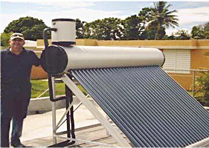
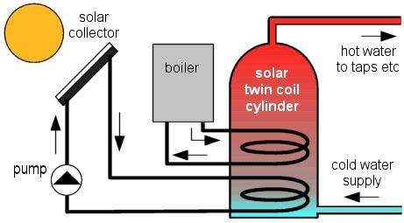
Solar Water Heater
Notes:
-increased picture size, resolution too low for this size? -R

Slide 39
Solar Water Heater Specifications
Solar Water Heater: heats water inside concentrated tubes using sun’s energy
Total Cost Estimation
  $615 for system
  $5,000 estimated installation
EUI reduction of 16 kBtu/ft²-yr
Payback in 2 years
Notes:
Solar heated water reduces amount of work the boiler has to do – reduction in natural gas usage = reduction in EUI
Note that: Solar Photovoltaic panels already on BIC Roof – easy to estimate expected solar patterns from existing panel data
Expect 159 MBtu less natural gas usage

Slide 40
Notes:
Series w/ demand and a series w/ savings
Or a stacked graph (btm what you can’t meet, top what you can meet)

Slide 41
Pump Description
Turn off pumps for the floor radiant heating loops during the summer months
Total Cost Estimation:
  Electronic Controller - $200
EUI Reduction: 7 kBtu/ft²-yr
Payback in 56 days
Notes:
Make kind of a big deal that nobody knew this was true until we took data in 382
Highlight the discovery

Slide 42
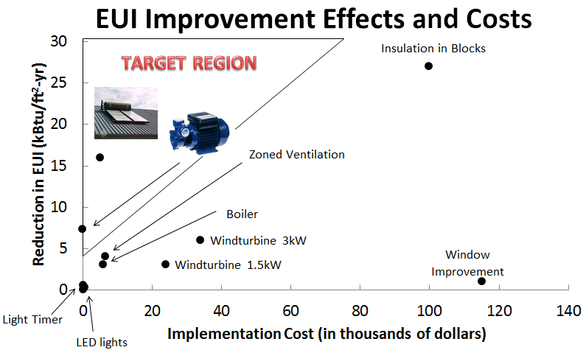

Slide 43
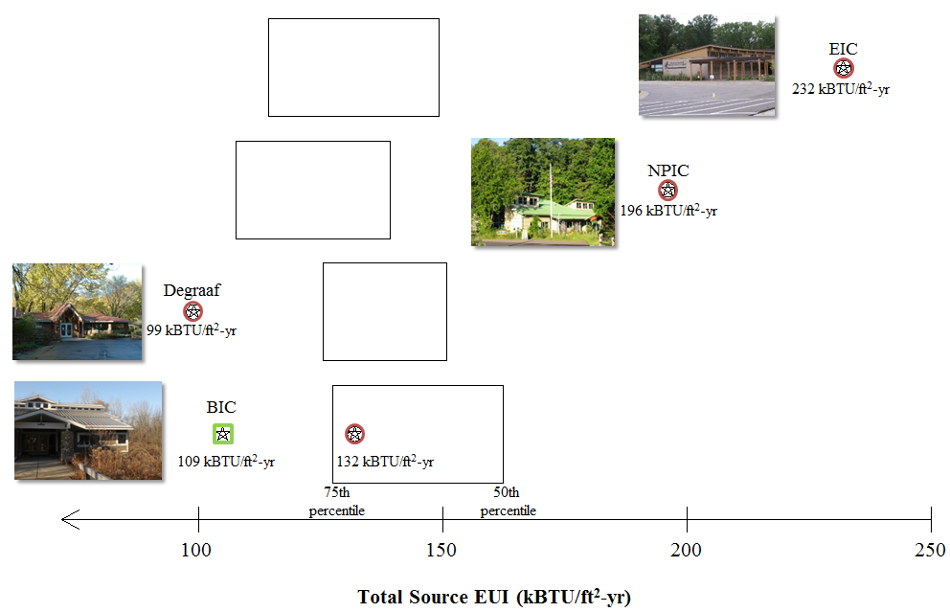
Notes:
Add pictures, move numbers
Change to reflect the elimination of zoned ventilation

Slide 44
Summary
Does LEED work?
→ Almost
What will it take for the BIC to get Energy Star®?
→ Can’t!
Small improvements will earn BIC Star
  Solar Water Heater
  Pump Operation
Notes:
Bic photo
Enegy star graphic
Pics of pumps and water heater

Slide 45
Future Work
Continue monitoring BIC energy use
Design a solar water heater system
Modify pump operation

Slide 46
Acknowledgements
Dr. Henry DeVries
  Calvin College VP Finance
Professor Randy Van Dragt
  Calvin College Ecosystem Preserve Director
Jeanette Henderson
  Calvin College Ecosystem Preserve Manager
Dan Slager
  Calvin College Energy Purchasing
Paul Pennock
  Calvin College Physical Plant Mechanical Dept.
Eric DeVries
  Midwest Energy Group
Mike Troupos
  Calvin College CERF Intern
Professor Matthew Heun
  ENGR 333

Slide 47
Questions or Comments?

Slide 49
Appendix

Slide 50
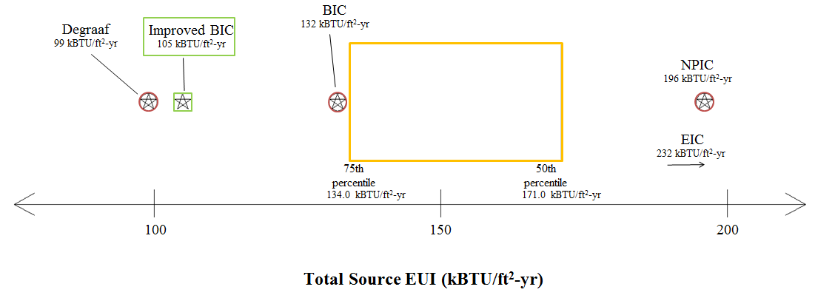
Upper BIC-Star Range

Slide 51
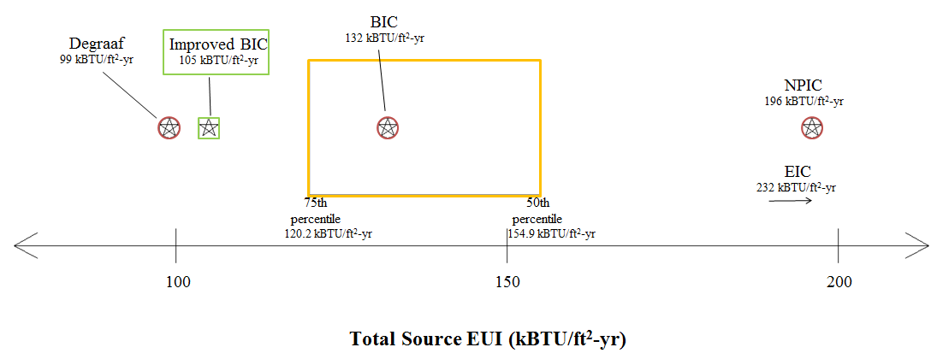
Lower BIC-Star Range

Slide 52
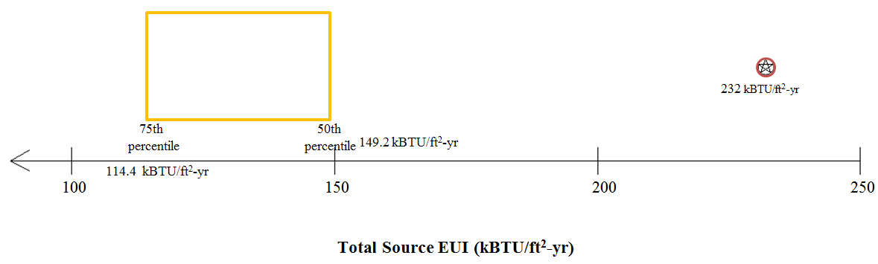
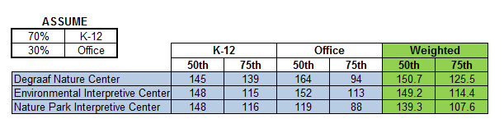
Environmental Interpretive Center
NOTE: 50th and 75th percentiles numbers have units of kBtu/ft²-yr

Slide 53
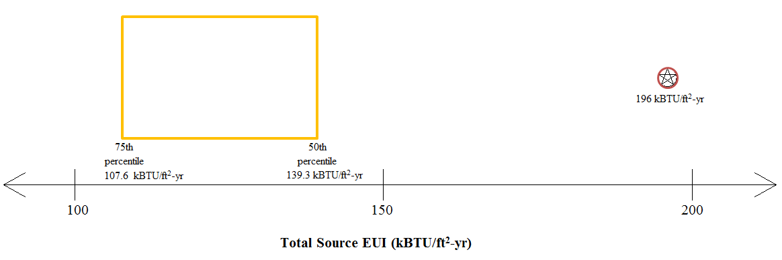
Nature Park Interpretive Center
NOTE: 50th and 75th percentiles numbers have units of kBtu/ft²-yr

Slide 54
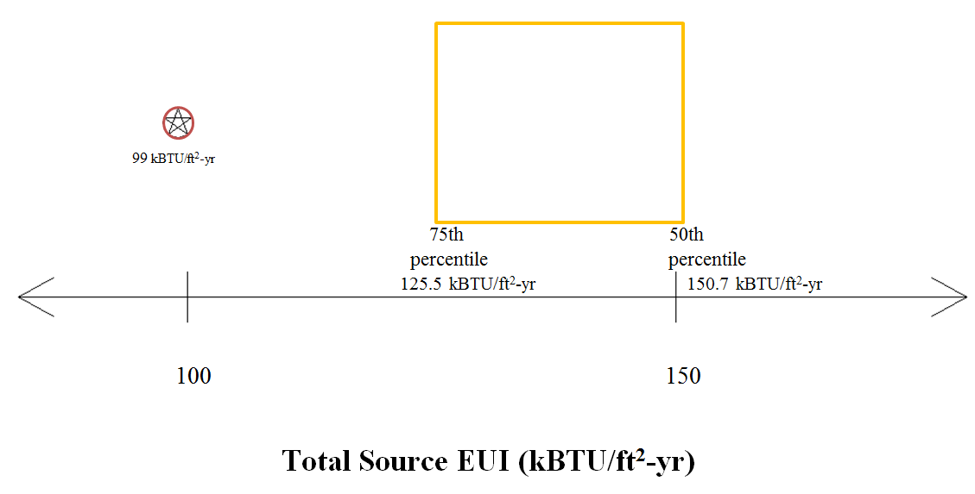
Degraaf Nature Center
NOTE: 50th and 75th percentiles numbers have units of kBtu/ft²-yr

Slide 55

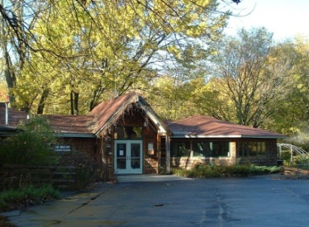
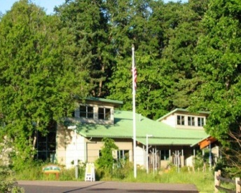
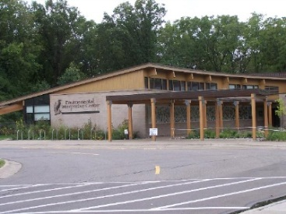

Slide 57
Cost Analysis
Assumes Constant $0.12/kW-hr to account for consumption during peak hours

Slide 58
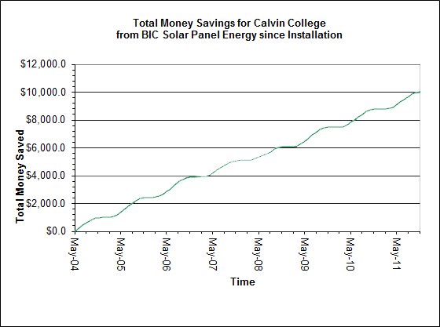
Install additional solar panels
Notes:
The last thing which must be considered is not just the cost of the system. But its potential pay-back period. The money saved by the current system is only about 1/10th of the way through it’s own payoff period.

