Slide 1
West Wing Geothermal Presentation
ENGR 333
December 4, 2012

Slide 2
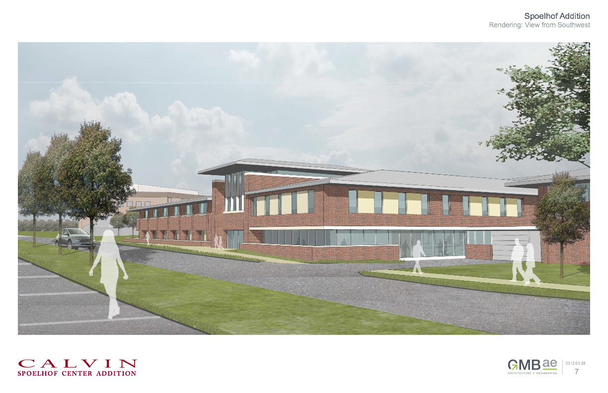
Spoelhof center west wing addition
Introduction Infrastructure Above Ground Recommendation
Energy Modeling Below Ground Financial

Slide 3
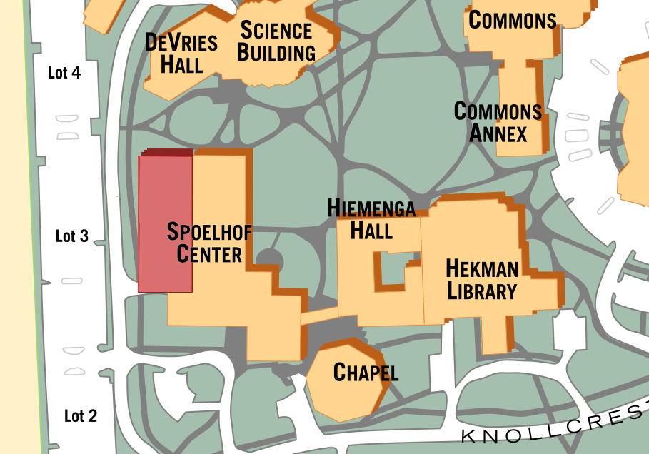
location
Proposed West Wing Addition
Introduction Infrastructure Above Ground Recommendation
Energy Modeling Below Ground Financial

Slide 4


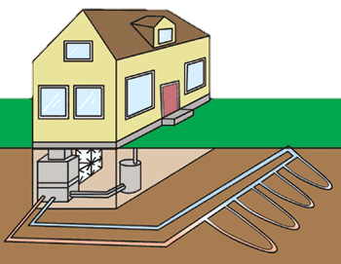
How does Geothermal work?
HEAT
http://www.drenergysaver.com/renewable-energy/geothermal-heat.html
Introduction Infrastructure Above Ground Recommendation
Energy Modeling Below Ground Financial

Slide 5
Geothermal Benefits and costs
Benefits
Costs
Reduced energy consumption
Reduced maintenance
More complex
Installation
Introduction Infrastructure Above Ground Recommendation
Energy Modeling Below Ground Financial

Slide 6
Project Overview
Objective:
  As a class we are to determine what it would take to use a geothermal Heating, Ventilation, and Air Conditioning (HVAC) system in the West Wing Addition
5 groups for analysis
  LEED & Energy Modeling
  Infrastructure
  Below Ground
  Above Ground
  Financial
Introduction Infrastructure Above Ground Recommendation
Energy Modeling Below Ground Financial

Slide 7
LEED & Energy Modeling
Introduction Infrastructure Above Ground Recommendation
Energy Modeling Below Ground Financial

Slide 8
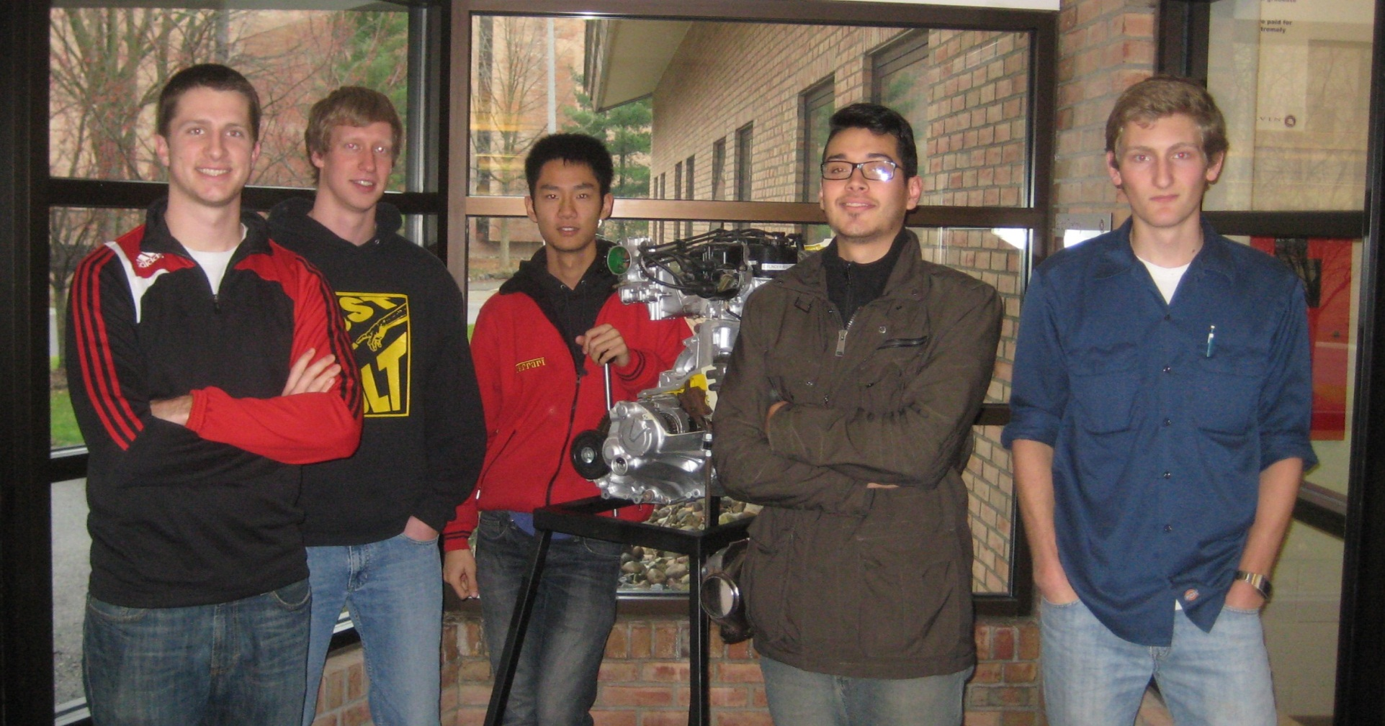
Team Members
Introduction Infrastructure Above Ground Recommendation
Energy Modeling Below Ground Financial

Slide 9
Key questions
How will a geothermal system contribute to achieving LEED certification?
What are the heating & cooling loads for the West Wing addition?
Introduction Infrastructure Above Ground Recommendation
Energy Modeling Below Ground Financial

Slide 10

LEED Rating System
LEED = Leadership in Energy and Environmental Design
Aiming for LEED silver rating, according to Henry DeVries
  Requires 50-59 points out of possible 110 points
LEED
Introduction Infrastructure Above Ground Recommendation
Energy Modeling Below Ground Financial

Slide 11
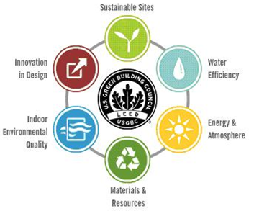
LEED Point categories
6 categories
  Sustainable Sites
  Water Efficiency
  Energy and Atmosphere
  Materials and Resources
  Indoor Environmental Quality
  Innovation in Design
LEED Core Concepts and Strategies Online Couse
Introduction Infrastructure Above Ground Recommendation
Energy Modeling Below Ground Financial

Slide 12
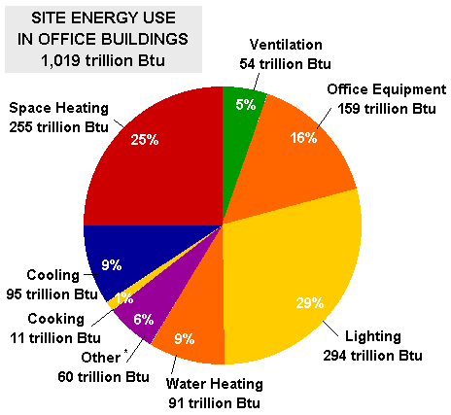
Energy consumption breakdown
Heating and Cooling accounts for approximately 34% of a building’s energy usage
US Energy Information Administration
Introduction Infrastructure Above Ground Recommendation
Energy Modeling Below Ground Financial

Slide 13
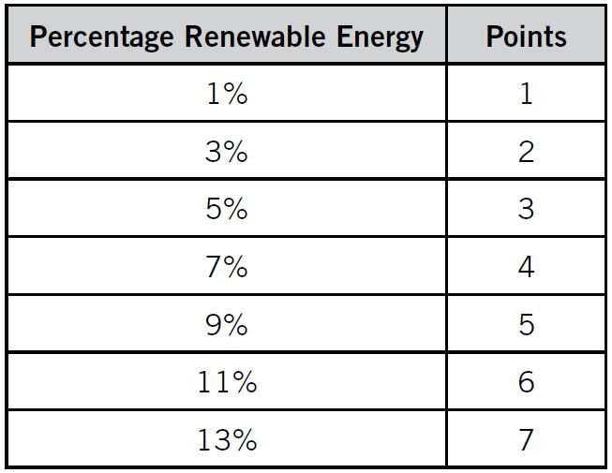
On-Site renewable energy leed points
From LEED 2009 for New Constructions and Major Renovations
Introduction Infrastructure Above Ground Recommendation
Energy Modeling Below Ground Financial
Notes:
-75% of the heating and cooling is provided by energy from the earth. The other 25% is electricity used to power pumps
-Results in 26% of building energy provided by renewable sources
-Safely achieve maximum 7 points
-Contributes in LEED certification, but requires more points from several other categories

Slide 14
Importance of Heating/Cooling Loads
“Load” is the heat that must be removed in the summer and added in the winter.
Prevent oversized/undersized HVAC system
Directly affect the progress of other teams.
Introduction Infrastructure Above Ground Recommendation
Energy Modeling Below Ground Financial

Slide 15
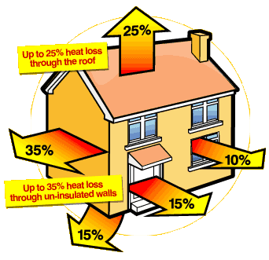
Heat Losses
http://www.momgoesgreen.com/keeping-warm%E2%80%A6-while-staying-green/
Introduction Infrastructure Above Ground Recommendation
Energy Modeling Below Ground Financial
Notes:
The buildings heat loss is affected several factors (picture shown for winter conditions, reverse for summer conditions)
-Number and size of windows
-Surface area of building and construction materials
-Quality of insulation
-Inside temperature
-Outside temperature
-Ventilation
There are also heat gains provided by people, lights, and equipment

Slide 16
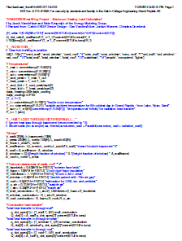
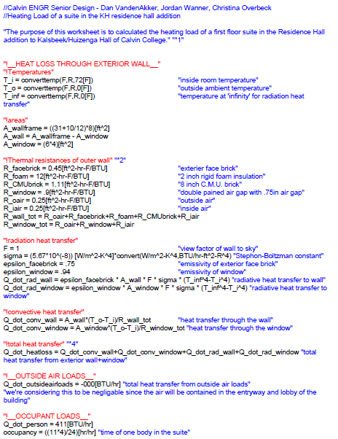
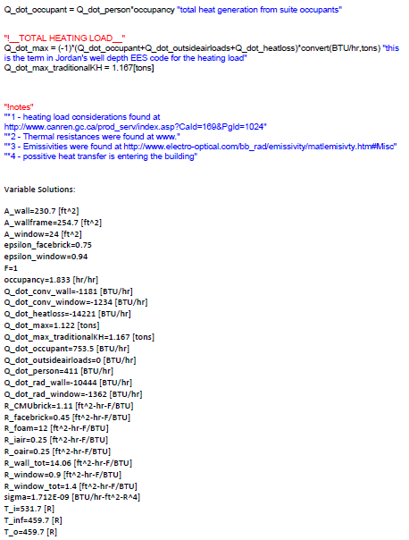
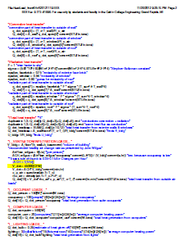
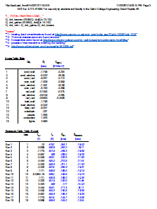
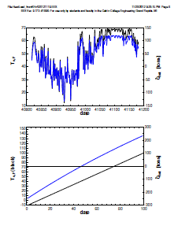
Calculation method
Started with calculations from KHvR geothermal suite
Made additions
Introduction Infrastructure Above Ground Recommendation
Energy Modeling Below Ground Financial

Slide 17
Daily heating & cooling requirements
Introduction Infrastructure Above Ground Recommendation
Energy Modeling Below Ground Financial
Notes:
-Using the EES calcs we were able to find the thermal resistance of the building
-Taking into account weather data for GR we could find the heating/cooling needs of the building for each day
-Maximum heating in January and February
-Maximum cooling in July and August
-Heating dominant, as would be expected in GR

Slide 18
heating & cooling loads Best estimate
Heating: 174 Tons
Cooling: 86 Tons
Tons are a standard unit of heating and cooling: 1 ton = 12,000 Btu/hr
Introduction Infrastructure Above Ground Recommendation
Energy Modeling Below Ground Financial
Notes:
-Values represent the 98% maximum for heating and cooling. System will not be able to handle exceptionally warm or cold days, but this is standard practice to have a system of reasonable cost.
-These value were provided to other groups and allowed them to more accurately design the geothermal borefield and system components

Slide 19
Final answers
How will a geothermal system contribute to achieving LEED certification?
  7 points towards the goal of 50
What are the heating & cooling loads for the West Wing addition?
  Heating: 174 Tons
  Cooling: 86 Tons
Introduction Infrastructure Above Ground Recommendation
Energy Modeling Below Ground Financial

Slide 20
Infrastructure
Introduction Infrastructure Above Ground Recommendation
Energy Modeling Below Ground Financial

Slide 21



Team Members
Introduction Infrastructure Above Ground Recommendation
Energy Modeling Below Ground Financial

Slide 22
Key questions
How will the geothermal system fit in at Calvin College?
What type of loop configuration will be used?
Where will the geothermal ground loop be located?
Introduction Infrastructure Above Ground Recommendation
Energy Modeling Below Ground Financial

Slide 23
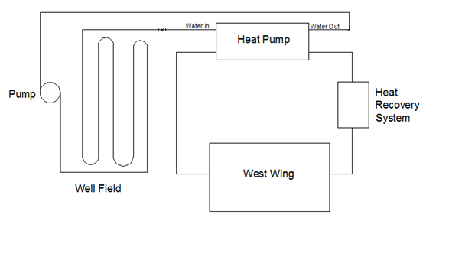
Integrated system
Introduction Infrastructure Above Ground Recommendation
Energy Modeling Below Ground Financial

Slide 24
Stand alone system
Introduction Infrastructure Above Ground Recommendation
Energy Modeling Below Ground Financial

Slide 25
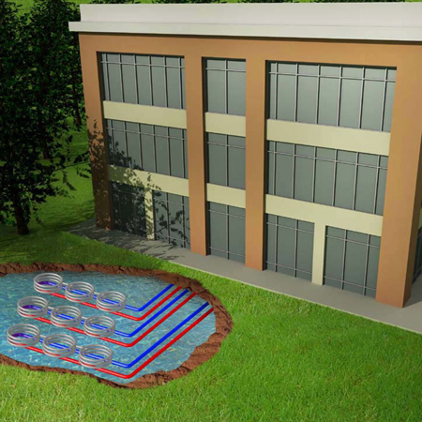
Pond Loop
http://www.fhp-mfg.com/files/images/common/coupCx03.jpg
Introduction Infrastructure Above Ground Recommendation
Energy Modeling Below Ground Financial
Notes:
Pros
Inexpensive
Simple installation
Minimal impact to surroundings
Cons
Requires access to a body of water

Slide 26
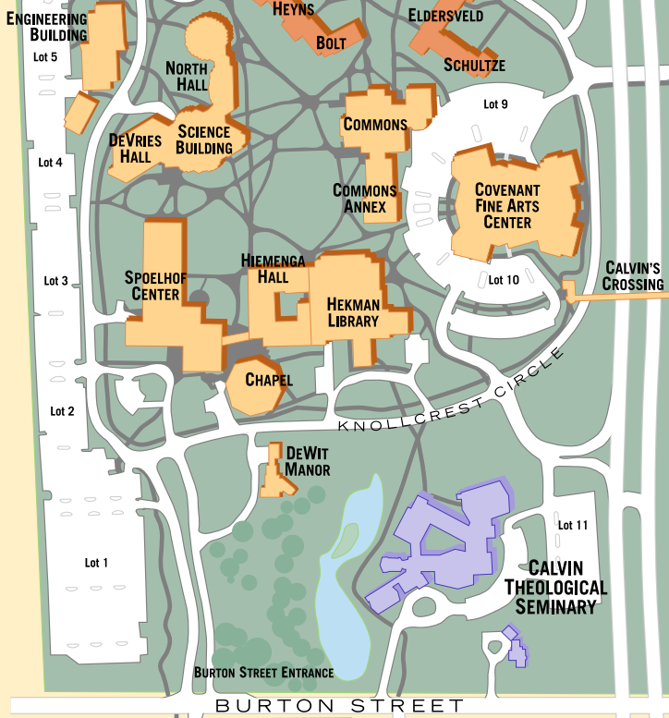
Campus Map
Building Addition
Pond Loop
Introduction Infrastructure Above Ground Recommendation
Energy Modeling Below Ground Financial

Slide 27
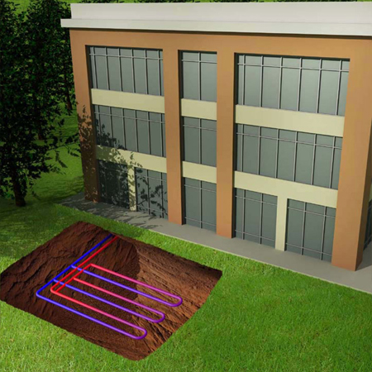
Horizontal loop
http://www.fhp-mfg.com/files/images/common/coupCx02.jpg
Introduction Infrastructure Above Ground Recommendation
Energy Modeling Below Ground Financial
Notes:
Pros
Easy to install
Less expensive
Cons
Shallow (inefficient heat transfer)
Larger footprint

Slide 28
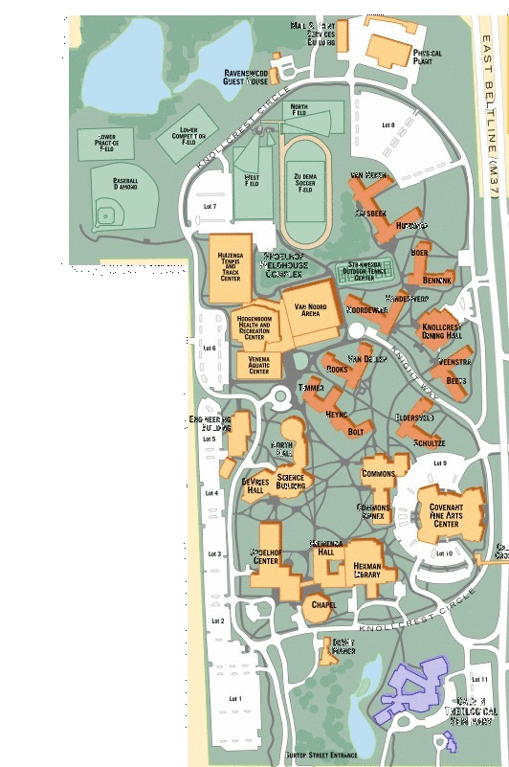
Campus Map
Horizontal Loop
Building Addition
Introduction Infrastructure Above Ground Recommendation
Energy Modeling Below Ground Financial

Slide 29
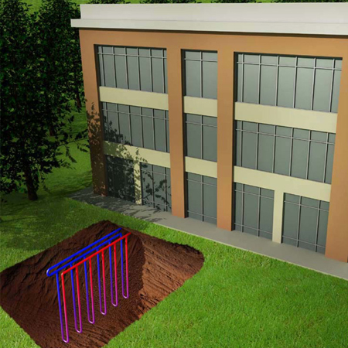
Vertical loop
http://www.fhp-mfg.com/files/images/common/coupCx01.jpg
Introduction Infrastructure Above Ground Recommendation
Energy Modeling Below Ground Financial
Notes:
Pros
Efficient
Small footprint
Cons
High construction costs (deep drilling)

Slide 30
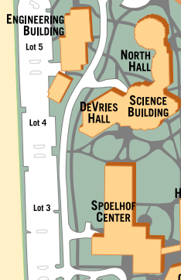
Campus Map
Building Addition
Vertical Loop
Introduction Infrastructure Above Ground Recommendation
Energy Modeling Below Ground Financial
Notes:
Mention piping…
Optimized pipe diameter for min cost

Slide 31
Answers
How will the geothermal system fit in at Calvin College?
  Mechanical Separation
What type of loop configuration will be used?
  Vertical
Where will the geothermal ground loop be located?
  West Parking Lot
Introduction Infrastructure Above Ground Recommendation
Energy Modeling Below Ground Financial

Slide 32
Below ground
Introduction Infrastructure Above Ground Recommendation
Energy Modeling Below Ground Financial

Slide 33
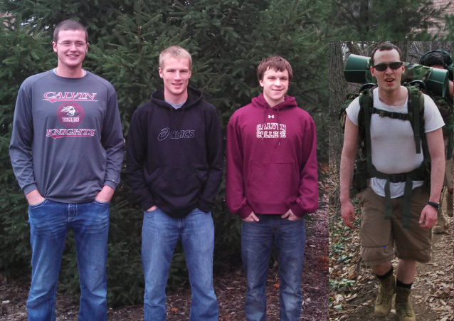
Team members
Introduction Infrastructure Above Ground Recommendation
Energy Modeling Below Ground Financial

Slide 34
Key questions
What is the Design of the Borefield?
  How many bores?
  How deep?
  How far apart?
  Will local geology affect the design?
  How much will it cost?
  How long will it last?
Introduction Infrastructure Above Ground Recommendation
Energy Modeling Below Ground Financial
Notes:
Given Infra. Proposal for Vertical Design

Slide 35
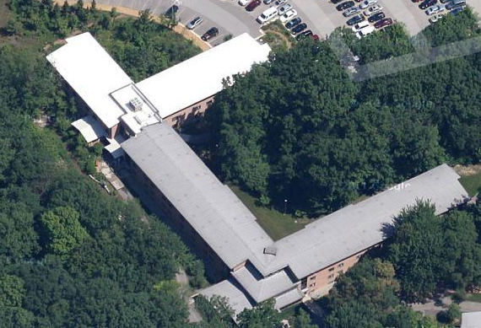
KHvR Geothermal Installation
https://maps.google.com/maps?q=calvin+college&aq=f&sugexp=chrome,mod%3D0&um=1&ie=UTF-8&hl=en&sa=N&tab=wl
Cleanly Cooling Calvin (Senior Design 2008)
Introduction Infrastructure Above Ground Recommendation
Energy Modeling Below Ground Financial
Notes:
-looked for advice from KHvR system
-Senior Design (2008)
-Suite 124 of van Reken Hall
Goal: “To address the inefficiency of Calvin College’s heating and cooling systems in the dorms by presenting an alternate heating and cooling system: Geothermal”
-Thermal model based off of KHvR analysis
Engineering Equation Solver (EES)
Made similar assumptions for Base Case
Scaled up model (1 suite → 1 building)

Slide 36
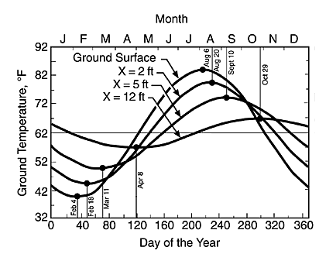
Thermal modeling - initial
  Factors to account for:
    Temperature Gradient vs. Constant Ground Temperature
    Soil Composition/Location
http://www.geo4va.vt.edu/A1/A1.htm
Introduction Infrastructure Above Ground Recommendation
Energy Modeling Below Ground Financial
Notes:
More detail for Final Calculations
To answer our questions…..
-Temperature Gradient
Oklahoma State Soil Physics
Sinusoidal Behavior
-the deeper….the more constant (50 degree F)
-Western Michigan Stratigraphy
Ease of Installation
…..found that digging would not be a problem, but accurate Thermal Conductivity is important (spacing)

Slide 37
Thermal Modeling - initial Summary
Heating Load: 140 ton
Borehole Depth: 300 – 420 feet
Number of Boreholes: 175 – 200
Introduction Infrastructure Above Ground Recommendation
Energy Modeling Below Ground Financial
Notes:
-Building off KHvR thermal model
-created own thermal model using EES and Excel
-left ranges to search for optimization
-Initial Summary….needed refining…reached out to Midwest Geothermal

Slide 38

Refined Borefield design
http://mwgeothermal.com/
Introduction Infrastructure Above Ground Recommendation
Energy Modeling Below Ground Financial
Notes:
-Ryan, David, and I visited Scott Skoog, President of MWGT
-helped with KHvR
-explained more about how geothermal systems worked
-allowed us to use their modeling program, LoopLink
-thermal conductivity test
-test bore
-done at same time
-give info about optimal bore depth, thermal conductivity, heat flow
-IGSHPA: International Ground Source Heat Pump Assoc.
-ASHRAE equivalent
-supply codes/regulations for geothermal systems

Slide 39
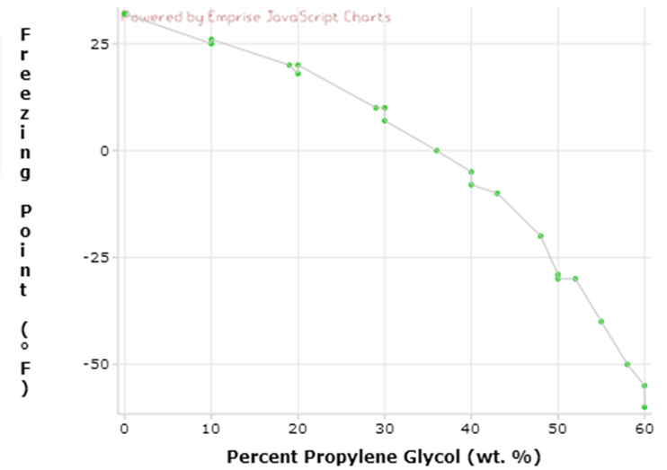
Refined Borefield design
Thermal Conductivity: 1.35 Btu/hr-ft-°F
Operating Fluid: Water/Glycol Mix
Bore Feet needed to accommodate loads
  28,447 feet
Effective Bore Feet
  33,180 feet
http://www.xydatasource.com/xy-showdatasetpage.php?datasetcode=234654&dsid=67
Introduction Infrastructure Above Ground Recommendation
Energy Modeling Below Ground Financial
Notes:
Thermal Conductivity = 1.35 Btu/hr-ft-°F
determines spacing
greater thermal k -> spread apart
lower thermal k -> closer
Bore Feet needed to accommodate loads
28,447 feet
Effective Bore Feet
33,180 feet
Accounts for energy loss within first 30 feet for each bore
Design for 30°F - 90°F operating temp. (ENTERING WATER TEMP TO HEAT PUMP)
Because 30°F, must use water/glycol mix to avoid freezing
Propylene Glycol
Non-toxic antifreeze
10 weight% = Freezing Point drop to 25°F
Already purchased by Phys. Plant
If 40-90….more bores

Slide 40
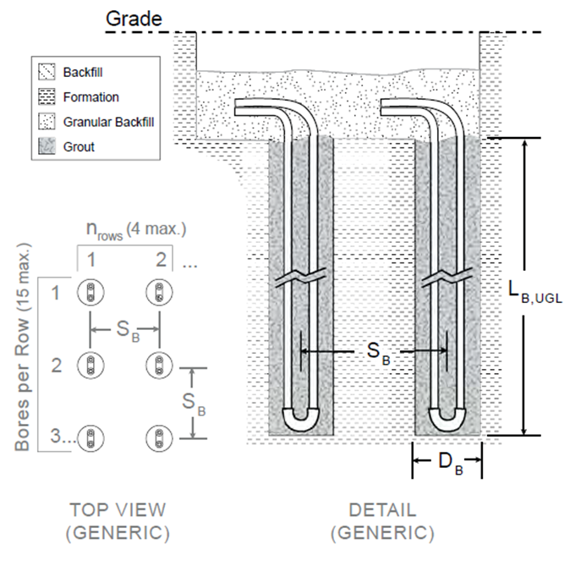
Proposal
What is the Design of the Borefield?
  How many bores?
    88 bore holes
  How deep?
    400 feet deep (L_{B})
  How far apart?
    20 feet center-to-center (S_{B})
Additional Details:
  5 inch bores (D_{B})
  1.25 inch HDPE pipe
Introduction Infrastructure Above Ground Recommendation
Energy Modeling Below Ground Financial
Notes:
Given:
Energy Modeling Heating & Cooling Loads
174 ton = 2,088 kBtu/hr
86 ton = 1,032 kBtu/hr
Industrial Assumptions
Energy loss within first 30 bore feet
Layout:
-Field Dimensions: ~28,000 sq. ft.
Fits within Infrastructure Group’s proposed location

Slide 41
Refined Borefield design
  How must will it cost?
    Total Installation Costs = $478,720
    $13.60/bore feet
    Pipe Costs
    Site Costs
  How long will it last?
  Economic Life
    50 years
Introduction Infrastructure Above Ground Recommendation
Energy Modeling Below Ground Financial
Notes:
Total Installation Costs = $478,720
$13.60/bore feet
Pipe Costs
Site Costs
Economic Life
Warrantied for 50 years (IGSHPA regulation)
Life time often exceeds life of building

Slide 42
Above Ground

Slide 43
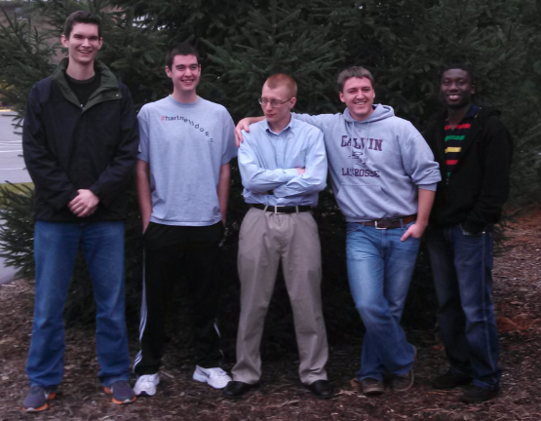
Team members
Introduction Infrastructure Above Ground Recommendation
Energy Modeling Below Ground Financial

Slide 44
Key Questions
What system should be selected to meet the HVAC demands of the new addition?
  Water to Air vs Water to Water?
  Centralized vs Distributed System?
  Energy Recovery Ventilation?
Introduction Infrastructure Above Ground Recommendation
Energy Modeling Below Ground Financial

Slide 45
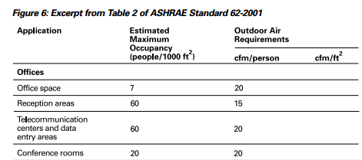
System Requirements
Heating/Cooling Loads
  Heating Load: 174 Tons
  Cooling Load: 86 Tons
Ventilation Requirements
  Estimated Air Flow Required: 48,000 cfm
    Michigan Mechanical Codes/ASHRAE Standards
trane.com/commercial/uploads/pdf/520/ISS-APG001-EN.pdf
Introduction Infrastructure Above Ground Recommendation
Energy Modeling Below Ground Financial

Slide 46
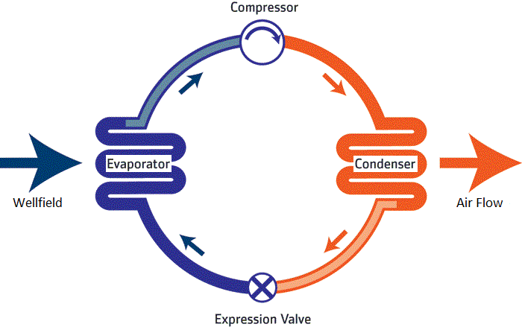
Water to Air vs water to Water systems
  Ventilation System
  Lower Cost
Introduction Infrastructure Above Ground Recommendation
Energy Modeling Below Ground Financial
Notes:
Water to Air
Simpler, less problematic
Water to Water
Similar to what already exists on campus, but more expensive

Slide 47
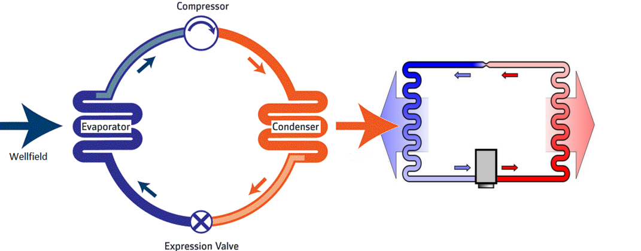
Water to Air vs water to Water systems
  Ventilation System
  Lower Cost
  Air Handlers and Radiators
  Higher Cost
Water Loop
Air Flow
Introduction Infrastructure Above Ground Recommendation
Energy Modeling Below Ground Financial
Notes:
Water to Air
Simpler, less problematic
Water to Water
Similar to what already exists on campus, but more expensive

Slide 48
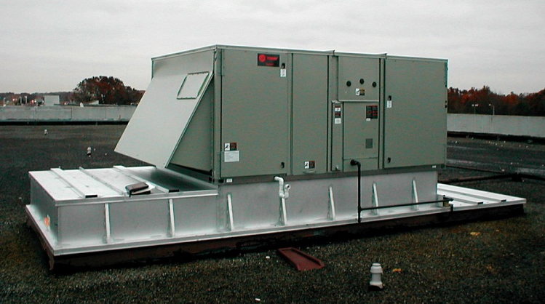
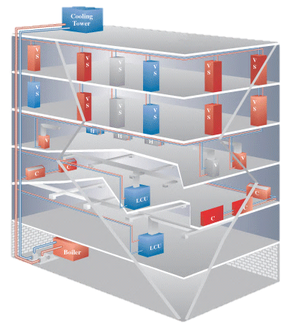
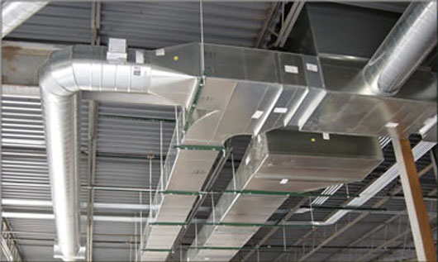
Centralized vs distributed Systems
http://csmdetroit.com/yahoo_site_admin/assets/images/3200_8.345123502_large.jpg
http://4mechanical.com/wp-content/uploads/2011/09/Ductwork1.jpg
http://www.geo4va.vt.edu/A3/A3.htm
Introduction Infrastructure Above Ground Recommendation
Energy Modeling Below Ground Financial
Notes:
Centralized
One large heat pump
Lower Upfront Costs
Lower Maintenance Costs
Localized Noise Generation
Similar to existing campus system
More demand placed on ventilation system
Total Cost of Equipment and Installation: $840,000
Distributed
Many small heat pumps (~30)
Higher Upfront Costs
Higher Maintenance Costs
Distributed Noise Generation
Service zones decrease demands on ventilation system
Total Cost of Equipment and Installation: $1,200,000

Slide 49
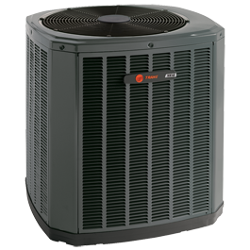
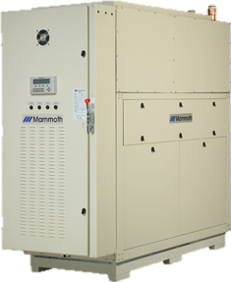

Heat Pump Selection
http://ww.carrier.com/
  $1,200,000
http://www.mammoth-inc.com/
http://www.trane.com/
  $840,000
Introduction Infrastructure Above Ground Recommendation
Energy Modeling Below Ground Financial

Slide 50
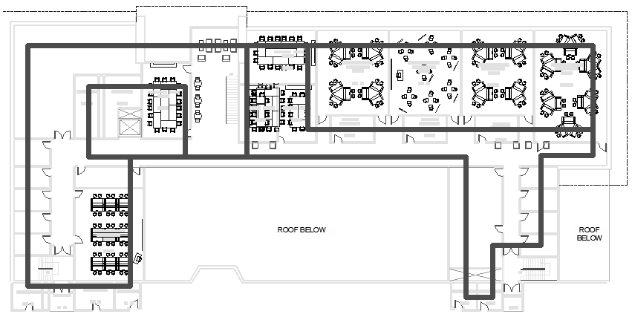
Ductwork
Estimated Length of Ducts Required: 5800ft
  Cost of Installation and Purchase: $54,000
Ductwork diagram (third floor)
Introduction Infrastructure Above Ground Recommendation
Energy Modeling Below Ground Financial

Slide 51
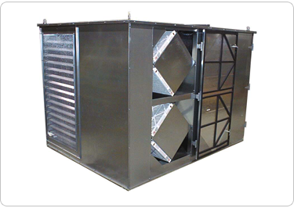
Energy Recovery Ventilation (ERV)
Ventilation unit that preheats or precools incoming air using exiting air streams
  Increases efficiency of the system by roughly 20%
  Additional cost: $400,000
http://www.renewaire.com/index.php/products/commercial-products/he8xrt
Introduction Infrastructure Above Ground Recommendation
Energy Modeling Below Ground Financial

Slide 52

Recommendation
Centralized, Water to Air System
175 Ton rooftop heat pump (Trane)
Energy Recovery Ventilation System
Total Cost: $1,300,000
Introduction Infrastructure Above Ground Recommendation
Energy Modeling Below Ground Financial

Slide 53
Financial Group

Slide 54
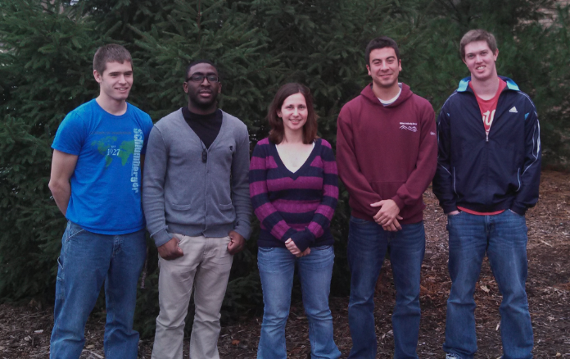
Team members
Introduction Infrastructure Above Ground Recommendation
Energy Modeling Below Ground Financial

Slide 55
Key Question
Is a geothermal system a financially viable option for the West Wing addition?
Introduction Infrastructure Above Ground Recommendation
Energy Modeling Below Ground Financial
Notes:
Compared with installing conventional HVAC system

Slide 56
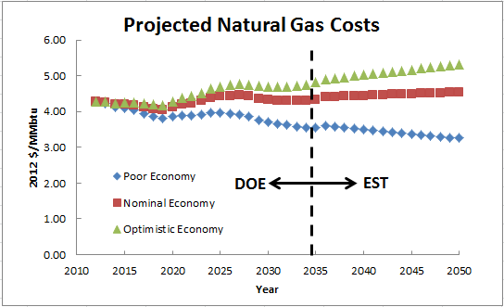
Natural Gas Prices
http://www.eia.gov/forecasts/archive/aeo11/source_natural_gas.cfm
2012-2035: Data from Department of Energy
2035- : Data projected based on best-fit trends
Introduction Infrastructure Above Ground Recommendation
Energy Modeling Below Ground Financial
Notes:
$14/MMBtu a few years ago
Conventional HVAC runs on natural gas in winter (for heating)

Slide 57
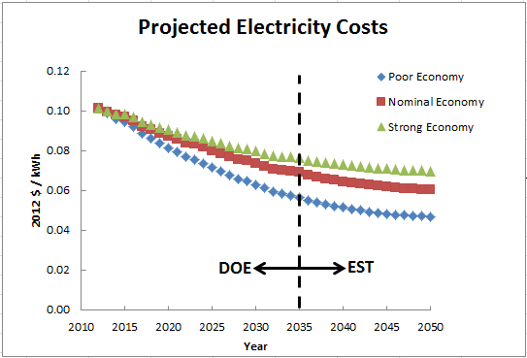
Electricity Prices
http://www.eia.gov/oiaf/aeo/tablebrowser/#release=AEO2012&subject=0-AEO2012&table=8-AEO2012&region=0-0&cases=ref2012-d020112c
2012-2035: Data from Department of Energy
2035- : Data projected based on best-fit trends
Introduction Infrastructure Above Ground Recommendation
Energy Modeling Below Ground Financial
Notes:
Geothermal runs entirely on electricity

Slide 58
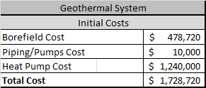
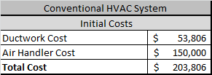
Initial Costs
Introduction Infrastructure Above Ground Recommendation
Energy Modeling Below Ground Financial
Notes:
Borefield cost – below ground
Piping/Pumps cost – infrastructure
Heat pump – above ground
Ductwork – above ground
Air handler – based on estimate for Trane 170 ton air handler + installation and piping

Slide 59
Energy Costs
GEOTHERMAL
  Based on Heating/Cooling Loads and pump usage
  Total Energy Required: 562,040 (kWh/yr)
CONVENTIONAL HVAC
  Heating Load: 7,316 (MMBtu/yr)
  Cooling Load: 143,808 (kWh/yr)
  Total Energy Required: 2,288,350 (kWh/yr)
http://www.duke-energy.com/pdfs/110371-HVAC-Whitepaper.pdf
Introduction Infrastructure Above Ground Recommendation
Energy Modeling Below Ground Financial

Slide 60
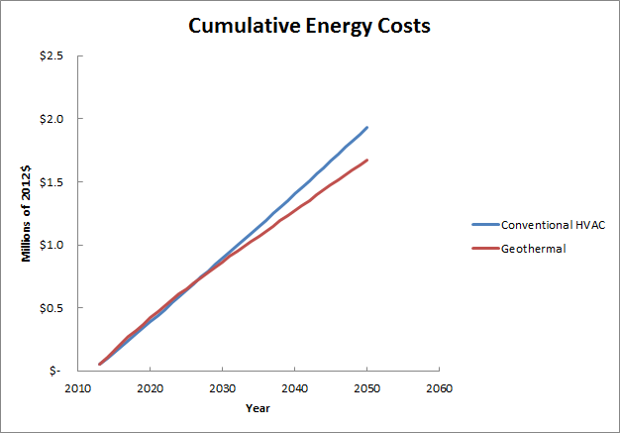
(optimistic economic conditions)
Introduction Infrastructure Above Ground Recommendation
Energy Modeling Below Ground Financial
Notes:
Cross at 2027
Due to projected decrease in electricity costs

Slide 61


Maintenance costs
GEOTHERMAL
  $9,000 per year (ASHRAE)
  Heat Pump replacement after 20 yrs.
CONVENTIONAL HVAC
  $15,000 per year
  Air Handler replacement after 20 yrs.
  Later Maintenance: costs increase by 50% after 10 yrs.
Introduction Infrastructure Above Ground Recommendation
Energy Modeling Below Ground Financial
Notes:
ASHRAE = American Society of Heating, Refrigerating and Air-Conditioning Engineers

Slide 62
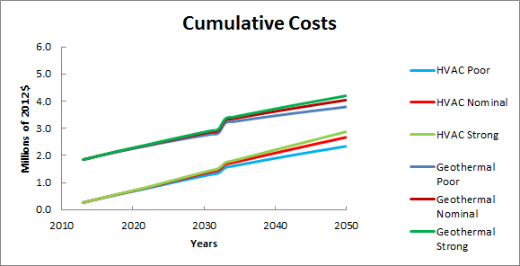
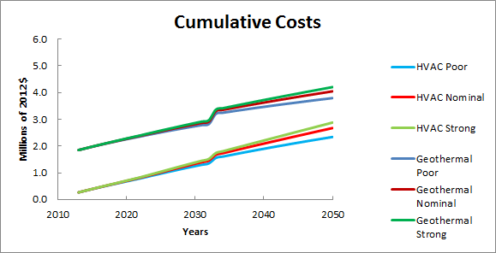
Geothermal
Geothermal
Geothermal
Geothermal
Geothermal
Conventional HVAC
Conventional HVAC
Conventional HVAC
Conventional HVAC
Expanded HVAC
Introduction Infrastructure Above Ground Recommendation
Energy Modeling Below Ground Financial
Notes:
Not enough savings on energy for payback in near future

Slide 63
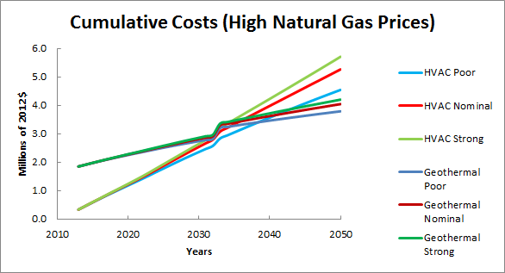
Geothermal
Conventional HVAC
Introduction Infrastructure Above Ground Recommendation
Energy Modeling Below Ground Financial

Slide 64
Financial proposal
As Christians, we have a calling to be stewards of Creation and Money
  (Luke 14:28-30, 1 Corinthians 4:7)
There is no foreseeable financial payback
From a solely financial standpoint, the financial group recommends a geothermal system not be constructed until such time as:
  Natural gas prices rise dramatically
  Entire campus considered
Introduction Infrastructure Above Ground Recommendation
Energy Modeling Below Ground Financial
Notes:
Stewardship of creation and money in conflict in this situation
-geothermal promotes stewardship
-HVAC makes more sense financially

Slide 65
Final Recommendation – engr. 333 Class
Geothermal Advantages
Geothermal Disadvantages
Reduce energy costs
Lower maintenance costs
Promotes stewardship of creation
Contributes to LEED certification
Small scale example of possible campus wide geothermal
Enhancement of college image
High initial cost
Additional construction site – well field
  Coordinate with parking lot construction
Proposal: Utilize existing HVAC system

Slide 66
Acknowledgements
Class Advisors
  Trent DeBoer
  Henry DeVries
  Professor Heun
  Paul Pennock
Additional Help
  Phil Beezhold
  Scott Skoog & Kortney Lull, Midwest Geothermal
  Dan Pabst
  Dean Anderson
  Dan Slager

Slide 67
Questions

Slide 68
Heat Gains
Several factors also provide heat gain to a building
  Occupants (1 person produces around 400 BTU/day)
  Equipment in rooms (computers, projectors, etc)
  Lighting
Introduction Infrastructure Above Ground Recommendation
Energy Modeling Below Ground Financial

Slide 69
Introduction Infrastructure Above Ground Recommendation
Energy Modeling Below Ground Financial
Notes:
-Lighting is the most significant contributer

Slide 70
External Funding
Direct external funding (tax refunds/incentives) are unavailable as Calvin College is a tax-exempt entity
However, according to Scott Skoog of Midwest Geothermal, indirect incentives are a possibility.
In this case, an architect/engineering firm can apply for a tax deduction for designing or building an energy saving building for a non-profit or government agency.
In this way, the firm saves money on designing/building Calvin’s geothermal, and partially passes these savings on to Calvin.

Slide 71
Calvin Energy Recovery Fund (CERF) Utilization
CERF is a revolving fund used to improve energy efficiency and decrease carbon emissions.
CERF is currently growing by investing in smaller scale projects (lighting, computer shutdown)
The scale of this project vs. CERF’s budget (~$65,000) seems to be a bad fit.
Recommendation: Don’t utilize CERF in this project

