Slide 1
Biofuel Production & Implementation Feasibility Study
A Proposal for Calvin College
Presented By: Engineering 333 & Business 380

Slide 2
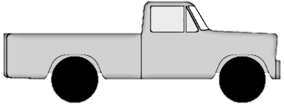
Project Objective
What would it take to operate a biofuel vehicle using only on-campus resources?
Transportation
Processing Plant
Biofuel Vehicle
Feedstock
Application
Waste
Notes:
Explain Process more thoroughly

Slide 3
Project Segmentation
Technical Feasibility
Messaging & Communication
Fuel Selection
Vehicle Selection
Facilities Selection
Future Planning
Students
Prospective Students
Faculty/Staff
Alumni/Community
Donors
Decision-Makers
Notes:
Talk to the audience

Slide 4
Resources
Prof. Matthew Heun – Engineering Department
Prof. Thomas Betts – Business Department
Mr. Phil Beezhold – Physical Plant Director
Mr. David LaGrand – Local Biofuel Producer
Mr. Geoffrey Van Berkel – Physical Plant Grounds
Mr. Rick Balfor – Dining Services
Mr. Rich Huisman – Chemistry Department
Mr. Henry Kingsma– Physical Plant Recycling

Slide 5
Fuel Production and Feedstock
Presented by: Claire Philippi

Slide 6
Processing?
Fuel?
Feedstock
Vehicle Application

Slide 7
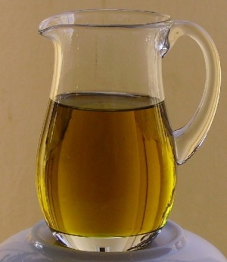
Fuel Options
Image source: nationalgeographic.com
Image Source: baconsrebellion.com
Methane
Ethanol
Image Source: biodieselchemist.webs.com
Image Source: zombiehunters.org/wiki
Biodiesel
Vegetable Oil
Feedstock
Vehicle Application
Notes:
These are the 4 original fuel options. Describe method of choosing the WVO.
Methane via compost
-Forms mushroom clouds
-requires conversion
Ethanol via grass clippings
Biodiesel via vegetable oil and alcohol reaction
Vegetable Oil
-you can run a diesel engine on waste vegetable oil
http://ngm.nationalgeographic.com/2012/12/methane/thiessen-photography#/01-methane-bubbling-from-arctic-lake-670.jpg
http://biodieselchemist.webs.com/
http://www.baconsrebellion.com/2013/09/suspicious-trading-in-gas-ethanol-credits.html
http://www.zombiehunters.org/wiki/index.php/Waste_Vegetable_Oil
l

Slide 8
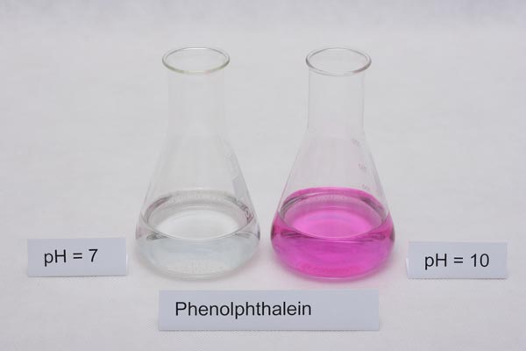
Fuel Quality
Fuel Clarity
Image Source: journeytoforever.org/biodiesel_svo
Acidity
Image Source: titrations.info
Vehicle Application
Notes:
Here is a pic of various oil qualities. Ours is less than E which gave us cause for concern. This implies that we need very good filtration and possible chemical additives to neutralize the oil.
http://journeytoforever.org/biodiesel_svo.html#gnl
http://www.titrations.info/acid-base-titration-indicators-preparation
FFA was the main concern for the oil. Through research it was shown that FFA can be very detrimental to the process if the concentration is too high. In order to determine the concentration of the FFA a titration test was done by Rich Huisman from the Chemistry department. Researched provided us with a step by step test to determine the FFA concentration of our WVO. Simply put a chemical indicator called, phenolphthalein, was added to the oil and the amount of phenolphthalein that caused the oil to turn a pink color determined the concentration of the FFA. If the amount of phenolphthalein added was less than 3mL then the sample would be considered ok to use.
Free Fatty Acid
Concern: The amount of Free Fatty Acid would be too high in the WVO that it would be corrosive to the entire system

Slide 9
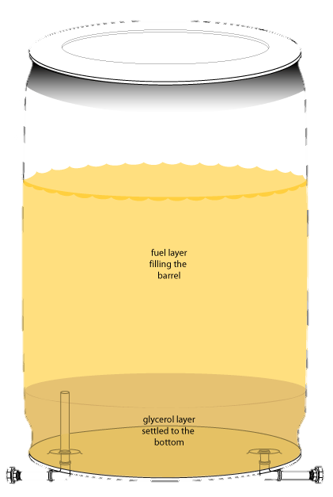
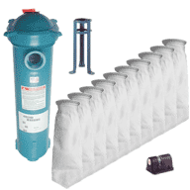
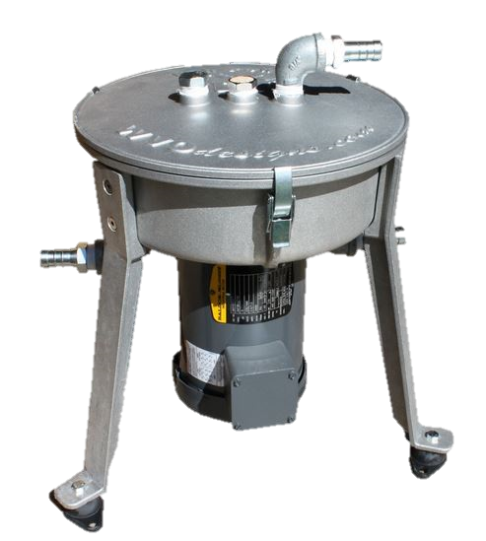
Filtration Methods
Image Source: filterbag.com
Image Source: threedeadflies.com
Image Source: wvodesigns.com
Vehicle Application
Notes:
Requirement: 5 micron filtration
Stages: Typical filtration includes filtering in stages. 400-200-100-50-10-5. This increases the life of the filters because in decreases the likelihood of clogging the smaller filters
Time: 200-300 Gal/Filter for good oil, 20-30 Gal/filter for bad oil
Change Frequency: Once a month for good, 10 times a month
Filters
Requirement
Stages
Time
Filter Change Frequency
http://www.filterbag.com/Waste-Vegetable-Oil-Filtration-16.html
http://www.wvodesigns.com/shop/centrifuges/rpc-basic.html
http://www.threedeadflies.com/settlingtank.asp

Slide 10
Costs
The Upfront Component Costs:
Centrifuge and heating source: $1494
Settling tanks: $ 428
Filter and screens: $ 50
Total: $1972
Monthly Operating Costs:
Filters & Screens $ 4
Heat $ 10
Vehicle Application
Notes:
Equipment costs
Everyone else will have equipment costs

Slide 11
Facilities & Infrastructure
Presented By: Karl Bratt

Slide 12
How to Process?
Where to Process?
12
Vehicle Application

Slide 13
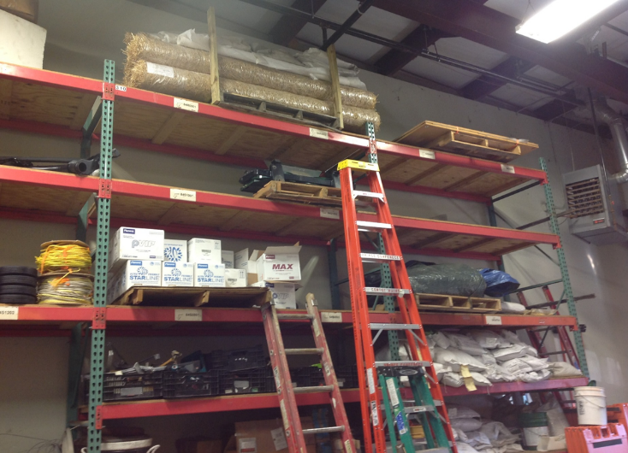
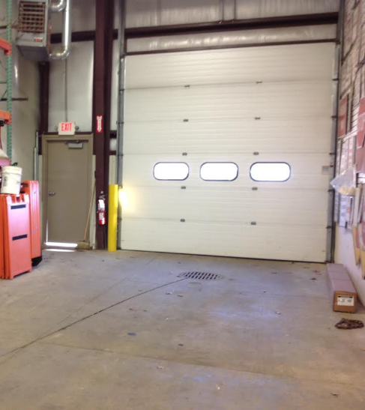
WVO Processing Location
Physical Plant Warehouse
Vehicle Application
Notes:
Options:
Physical Plant Warehouse
Boiler Room Under Commons
Moveable Trailer
Reasons:
Ownership
Ease of Accessibility
Climate Control
Shelving
Under Utilized
120 Sq. Ft Available

Slide 14
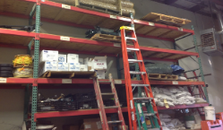
Shelving
Industrial Racking System
Vehicle Application
Notes:
Options:
Custom-Built System
Industrial Racking System
Reasons:
Present Currently
Customizable
OSHA Requirements
Weight Requirements

Slide 15
Heating
Existing Heater & Heating Tape
Vehicle Application
Notes:
Options:
Existing Heater
Heating Blanket
Heating Tape
Waste Incinerator
Reasons:
Present Currently
Fuel Temperature into Centrifuge
Cost

Slide 16
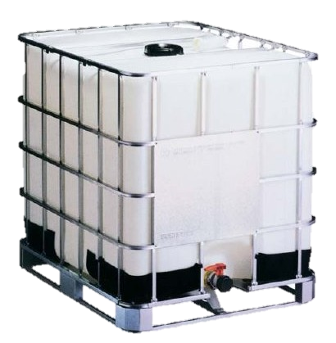
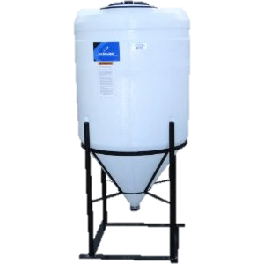
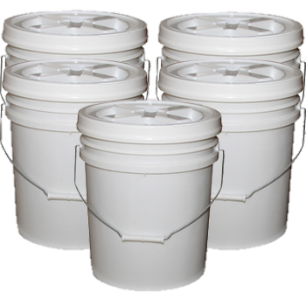
WVO Storage
Image Source: www.automotivetools.com/Liquidynamics
Image Source: www.disasterstuff.com
Image Source: www.amazon.com
Vehicle Application
Notes:
Options:
IBC Totes
55 Gallon Drums
5 Gallon Buckets
Conical Tanks
http://www.automotivetools.com/Liquidynamics/Tote-System-275-Gallon-IBC-Tote-Tank/901071/568/Product.aspx
http://www.disasterstuff.com/store/pc/5-PACK-of-Buckets-with-Standard-Lids-p66.htm#.Uo2nucSshcY
http://www.amazon.com/Gallon-Drain-Bottom-Inductor-Proces/dp/B003T42L7Y
Reasons:
IBC Totes:
Shape
Large Volume
Openings & Valves
Fork-Lift Access
Food-Grade
5 Gallon Buckets
Transportation
Fryer Volume
Conical Tank
Staging
Bulk Sludge Removal

Slide 17
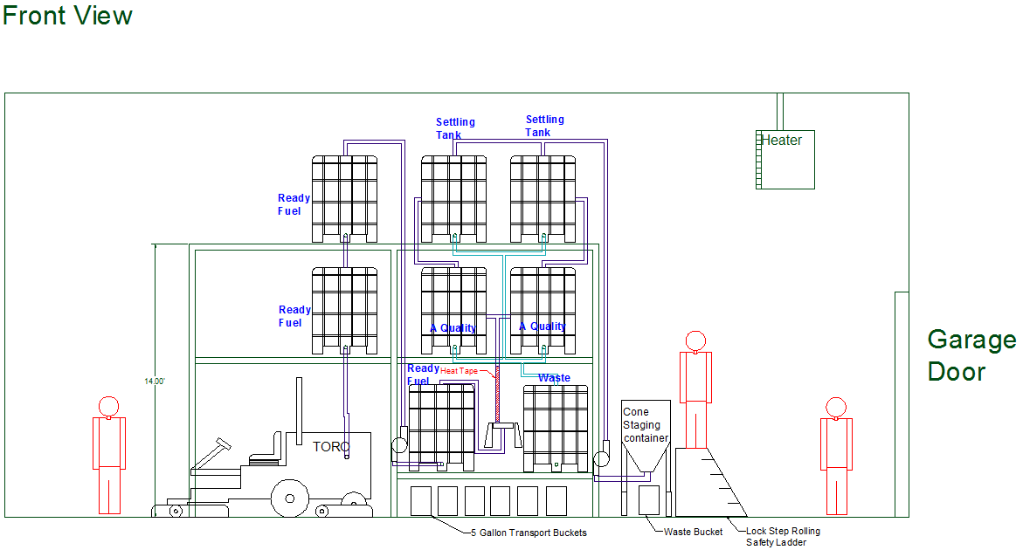
Process Design
Rigid, Parallel System
Wait 1 Month…
*120 Sq. Ft
Vehicle Application
Notes:
Options:
Non Rigid
Batch
Pull System
Hybrid
Reasons:
Cleanliness! (Rigid)
Settling Requirements
Raw VWO Output
Extra Capacity

Slide 18
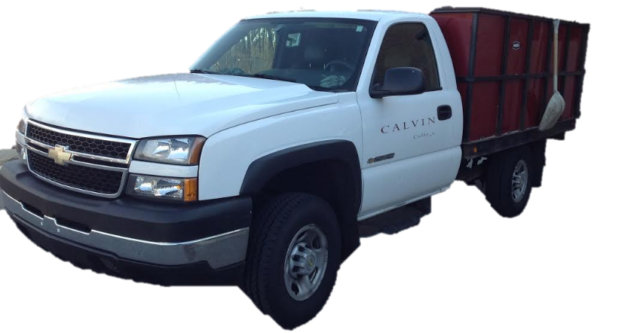
Raw WVO Transportation
Recycling Truck
Vehicle Application
Notes:
Options:
Golf Cart
Recycling Truck
Reasons:
Stops Daily at Dining Halls
WVO is Form of Recycling
Zero cost or Added Labor

Slide 19
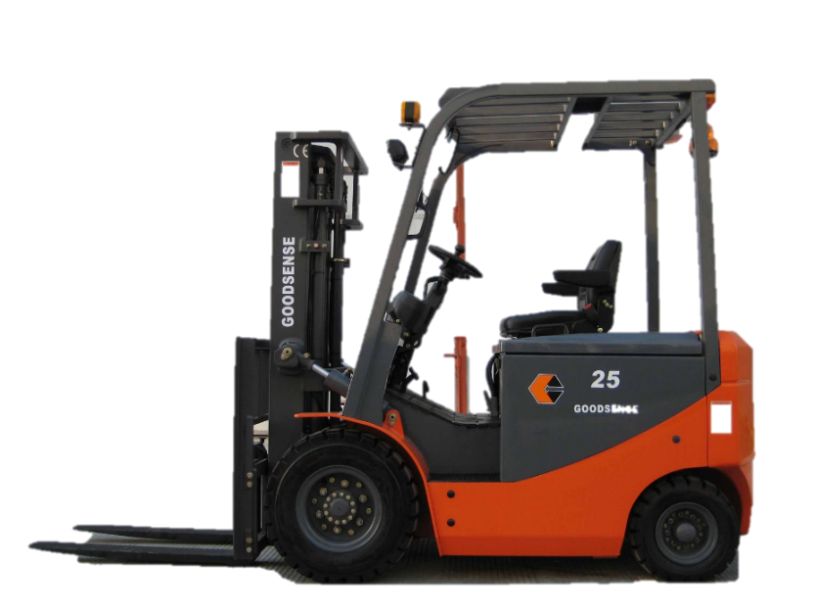
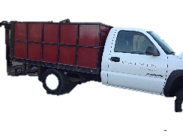
Compost
Vehicle Application
Notes:
Options:
Reuse
Compost
Dispose
Burn
Reasons:
Transportation Hassel
Environmentally Friendly
Fumes

Slide 20
Costs
Upfront Component Costs:
Pipes Pipe Connectors: $ 1,200
Calvin Physical Plant labor: $ 600
Valves & Actuators: $ 428
Electronic Components: $ 185
Total: $2,413
Monthly Operating Costs:
Student Labor (Year 1): $ 450
Student Labor (Year 2): $ 150
Vehicle Application
Notes:
Get rid of totes on pricing

Slide 21
A Biofuel Vehicle
Presented by: Mike Houtman
Notes:
WVO can be used as a fuel….if you did not know

Slide 22
How to Convert?
What Vehicle?
Vehicle Application
Notes:
--->WE NEED TO CONVERT A VEHICLE, IT WILL NOT RUN ON IT’S OWN
2 main questions

Slide 23
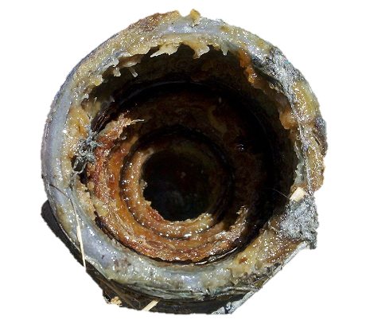
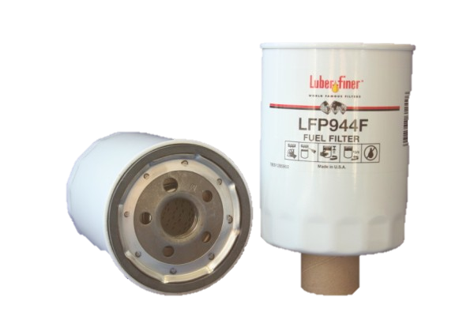
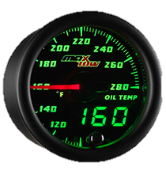
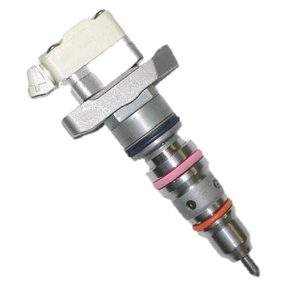
WVO Conversion
WVO criteria to be met:
Diesel Engine
WVO Purge
5 Microns
160°F
Image source: Dieseltronics
Image source: WVO Designs
Image source: Greasecar.com
Image source: Glow Shift Direct
Vehicle Application
Notes:
When deciding what vehicle, certain criteria must be met:
Diesel for compression ratios
Purge to prevent geling
Microns to save injectors
Temperature to maintain flow viscosity

Slide 24
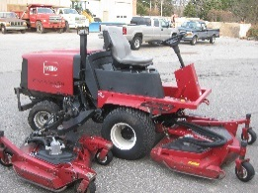
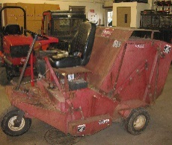
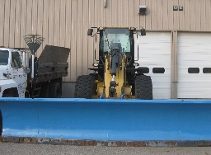
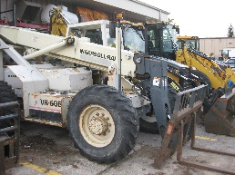
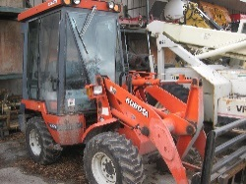
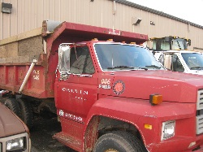
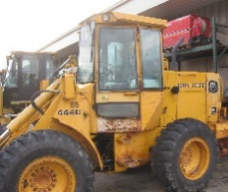
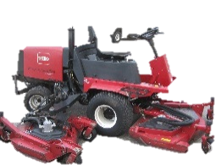
Vehicle Yearly Usage (hours)
Notes:
There are many vehicles
3 mower models
Refer to the footer

Slide 25
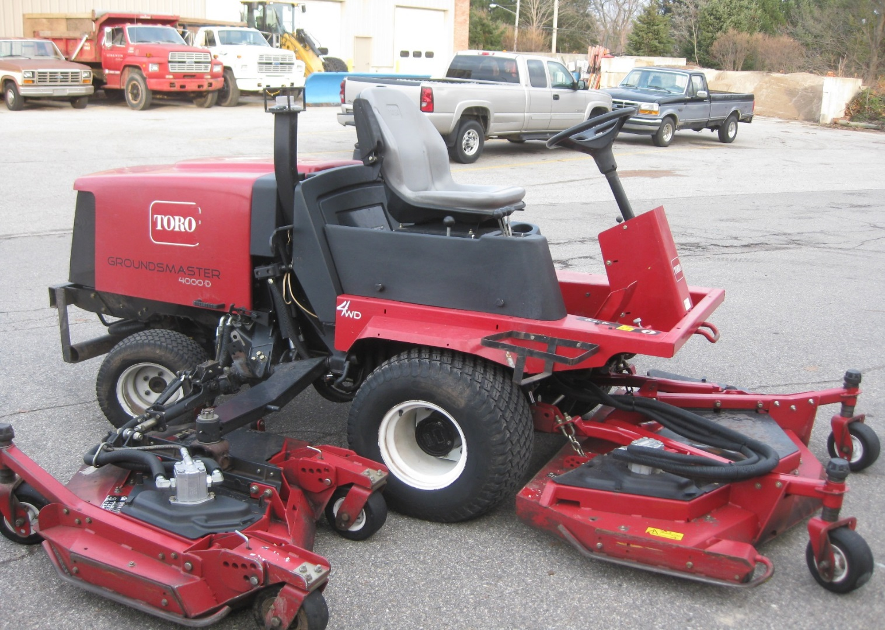
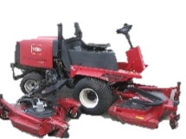
2006 Toro GROUNDSMASTER 4000-D
Notes:
CRITERIA:
Kubota diesel engine
Leads operation time
Expired warranty
High visibility
Duplicate conversion
Nonessential vehicle

Slide 26
Previous Experience
Notes:
Previous colleges to implement or Consider a WVO vehicle include:
Bowling Green State University
Western Michigan
Bowdoin University
Furman College
Warren Wilson College

Slide 27
Vendors
Notes:
Warranty and Tech Support
2 ESTABLISHED Companies
Greasecar was selected, having an excellent customer service and tech support available

Slide 28
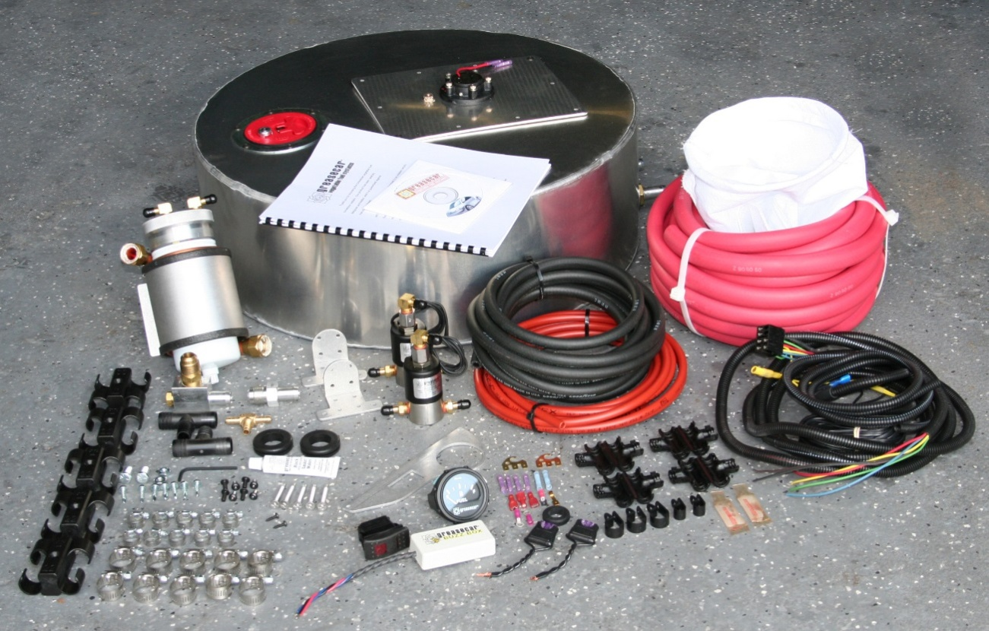
Kits Available
Image source: Greasecar.com
Notes:
contacted Greasecar, a non-specific conversion kit was quoted for this project.
Consisting of:
Additional coolant-heated tank
Additional filter, pump, valves, and hosing

Slide 29
Image source: Greasecar.com
Notes:
Diesel Tank
Heated WVO Tank
Heated Filter
Supply Valve
WVO Lift Pump
Injectors
Return Valve

Slide 30
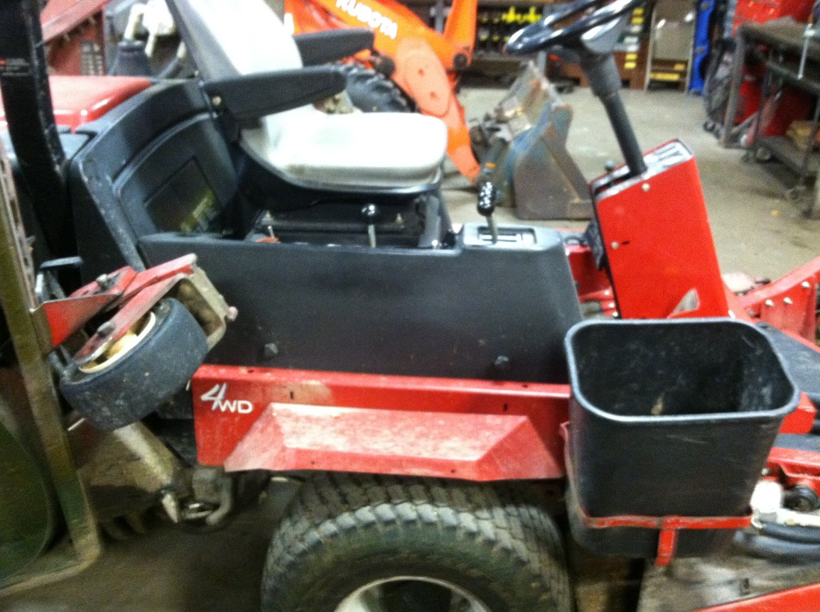
WVO Tank Location
WVO Tank
Notes:
Tank size description
21in x 8in x 12in (L x W x H)
8.7 gallons
5.5 hours of mowing
Placed above right fender
Trash Can may be moved

Slide 31
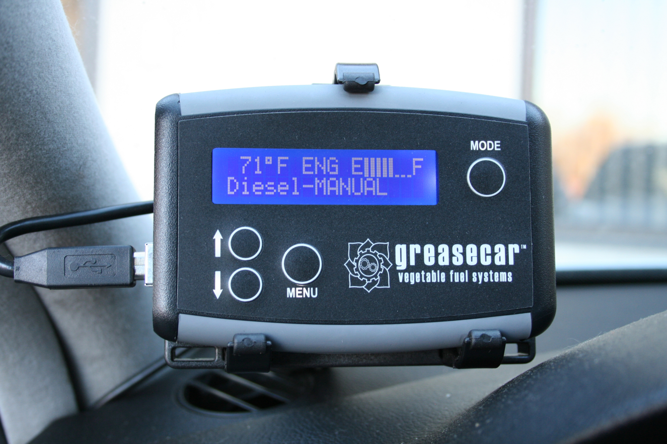
Controller
Image source: Greasecar.com
Notes:
electronic “Co-pilot” controller
automatically switches the supply valve to WVO based on a tank temperature sensor
Tells when to purge
Cost: $300

Slide 32
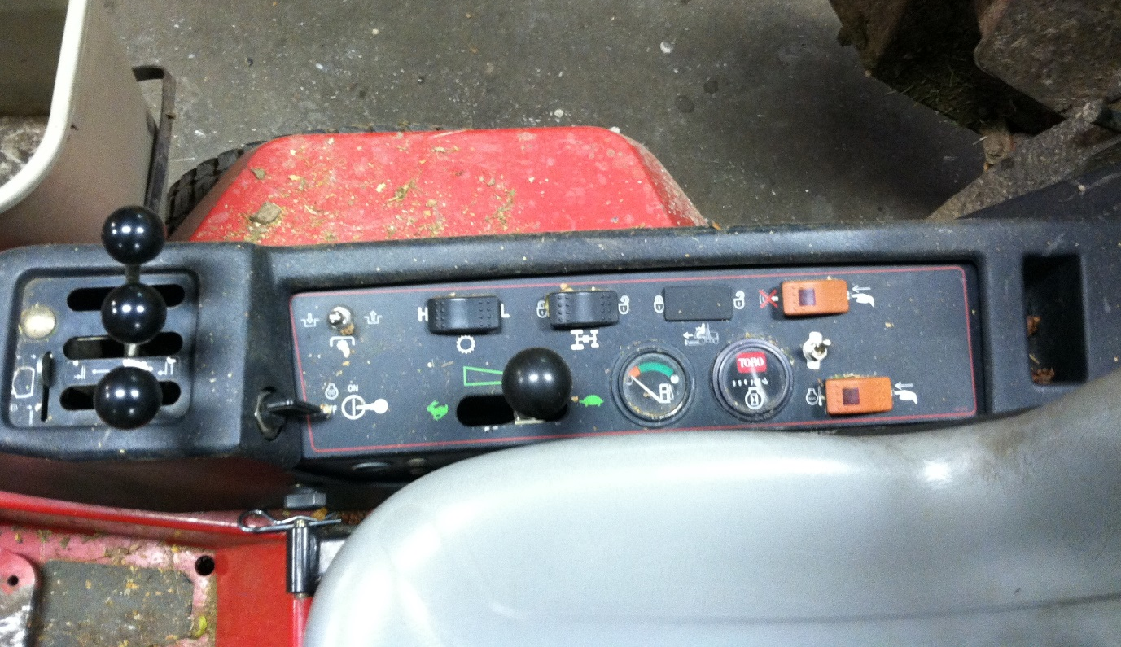
Controller Location
WVO Tank
Notes:
Where to put Co-Pilot?
2 options:
Directly onto operator control dashboard
Tank upper surface

Slide 33
Costs
The purchased equipment costs of this system derive from:
Greasecar WVO kit: $1595
Greasecar “Co-Pilot” controller: $ 300
Calvin Physical Plant labor: $ 360
Insulating tank cover: $ 40
Total: $2295

Slide 34
Long-Term Planning
Presented by Brandon Koster

Slide 35
CERF Involvement?
Mower Maintenance?
Possible Expansion?
Educational Outcomes?
Notes:
How will Calvin prevent unforeseen issues and breakdowns that will come with a new fuel?
How could Calvin expand this project in the future?
How could this project be best integrated with the Calvin Energy Recovery Fund (CERF)?
How could Calvin use this project to achieve desired educational outcomes?

Slide 36
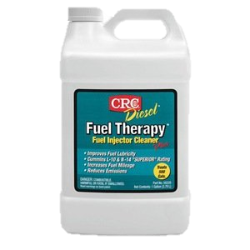
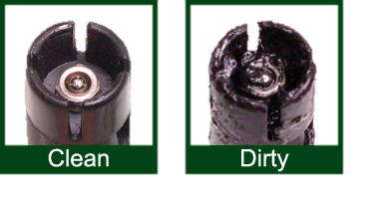
Fuel Injector Maintenance
Image Source: www.standardbrand.com
Image Source ecx.images-amazon.com
Notes:
Get ride of totes on pricing

Slide 37
Fuel Filter Maintenance
Image Source: www.vw-resource.com
Notes:
Get ride of totes on pricing

Slide 38
Engine Oil Analysis
Image Source: www.rockingsconsulting.com
Notes:
Get ride of totes on pricing

Slide 39
Testing Period
Image Source : bestclipartblog.com
Notes:
Get ride of totes on pricing

Slide 40
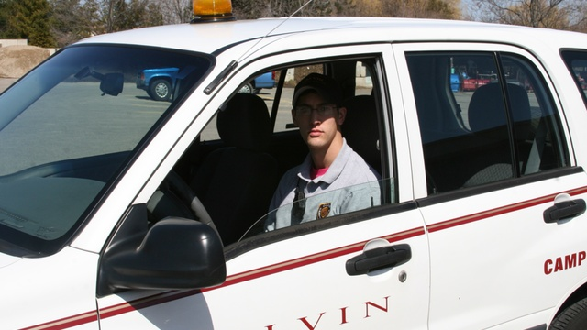
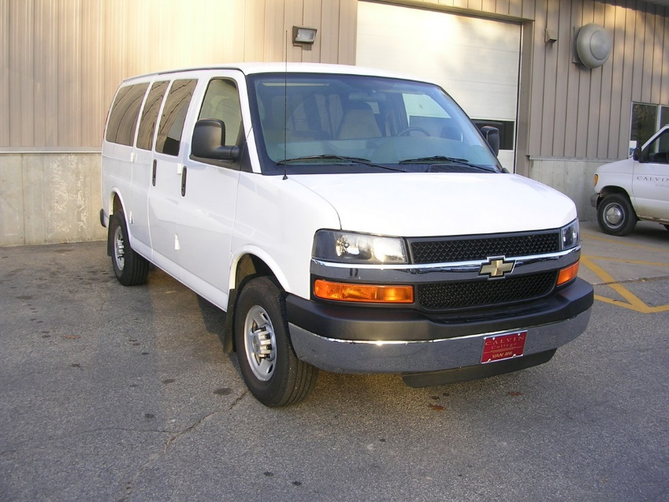
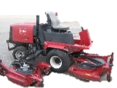
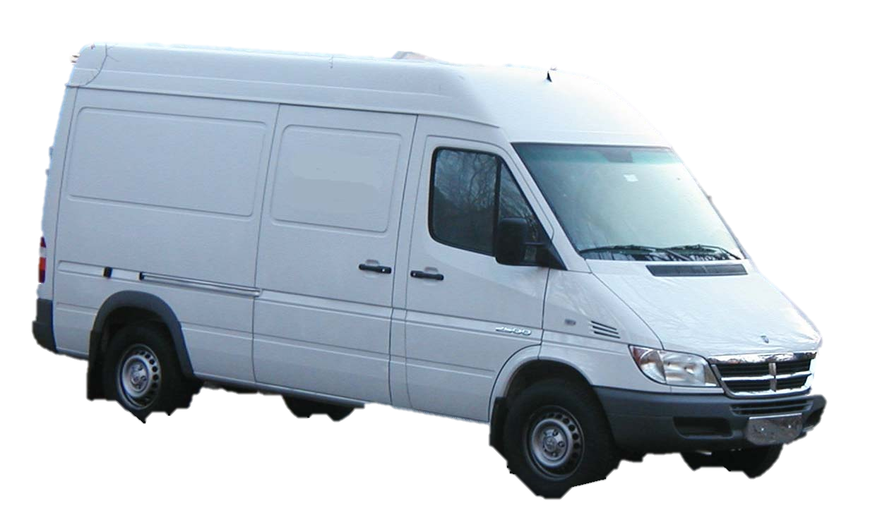
Additional Vehicle Options
Campus Safety Vehicle
Transportation Van
Image Source: vimeo.com
Notes:
Campus Safety Vehicle
Highly visible
Must be reliable
Lots of annual driving on poor roads
Vehicle must be professional looking
Transportation Van
Transporting Calvin groups (under 15 people)
Options
1999-2003 Ford E-350
2002-2006 Dodge Sprinter
1997-2001 Chevy Express Van

Slide 41
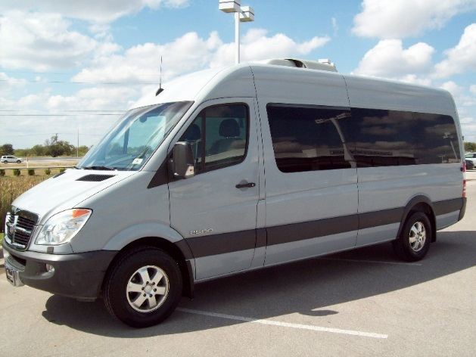
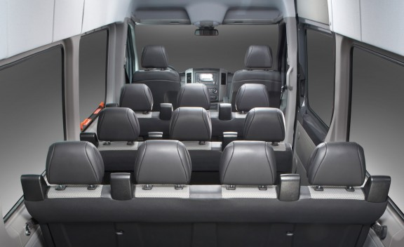
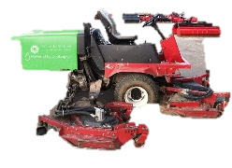
New Vehicle Selection
2002-2006 Dodge Sprinter Van
http://mbgtown.files.wordpress.com/2010/10/2008-sprinter-passenger-van-0061.jpg
http://www.moibibiki.com/images/dodge-sprinter-4.jpg
Notes:
2002-2006 Dodge Sprinter Van
Twice the MPG of Ford E350
WVO conversion kits more widely available
Better selection of acceptable used vehicles

Slide 42
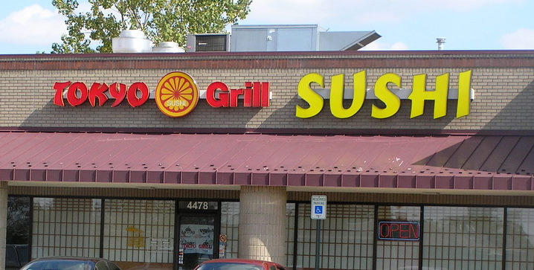
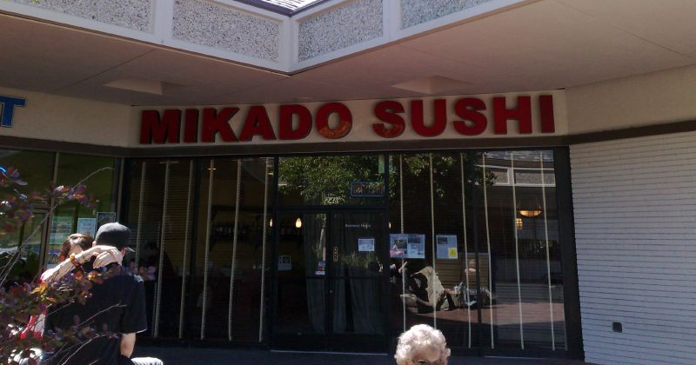
New Feedstock Sources
http://1.bp.blogspot.com/
http://farm4.static.flickr.com/3201/2409592844_f382ca64a7_o.jpg
Notes:
Creative Dining Services
Contacted Richard Balfour, Director of Dining Services at Calvin
The colleges nearby have their own ways of disposal
Local Restaurants
Contacted several restaurants located near Calvin
A few small sized restaurants were willing to give their WVO
Tokyo Grill, Mikado
Hard for larger sized (Franchises) places to give their WVO
Approximately 2-5 gal. per day per restaurant

Slide 43
CERF Integration: Capital Funding
Notes:
Overseeing fuel production
CERF intern
15 hours a month at $10 an hour total cost to college
Overseeing Mower Maintenance
Physical Plant mechanics
1 hour a month at $60 an hour total cost to college
Additional preventative maintenance procedures relating to WVO fuel system supplied by ENGR 333 students
Blue Project
Energy saving projects that result in economic benefit for Calvin
CERF provides project funding
CERF pays itself from the energy/financial savings from break even plus 5 years
Initial payback must be < 4 yrs
Must be able to monitor the savings
Green Project
Energy or environmental project that does not have measurable cost savings or very long payback periods
Demonstrate an environmental benefit for Calvin
CERF has not yet funded a green project
Biofuel Blue Project Requirements
Robust cost analysis must show < 4 yr payback
Establish key measurables and how to record them
Volume of raw oil retrieved from dinning hall
Volume of usable oil
Amount of normal diesel displaced by WVO
Annual cost savings
Biofuel Green Project Requirements
Payback > 4 yrs
Show substantial environmental benefit: reduction of
CO₂, NO_{X}, methane, particulate

Slide 44
CERF Integration: Internship Program
http://www.chamaschools.org/wp-content/uploads/CLIPART_OF_32162_SMJPG_2.jpg
Notes:
Overseeing fuel production
CERF intern
15 hours a month at $10 an hour total cost to college
Overseeing Mower Maintenance
Physical Plant mechanics
1 hour a month at $60 an hour total cost to college
Additional preventative maintenance procedures relating to WVO fuel system supplied by ENGR 333 students
Blue Project
Energy saving projects that result in economic benefit for Calvin
CERF provides project funding
CERF pays itself from the energy/financial savings from break even plus 5 years
Initial payback must be < 4 yrs
Must be able to monitor the savings
Green Project
Energy or environmental project that does not have measurable cost savings or very long payback periods
Demonstrate an environmental benefit for Calvin
CERF has not yet funded a green project
Biofuel Blue Project Requirements
Robust cost analysis must show < 4 yr payback
Establish key measurables and how to record them
Volume of raw oil retrieved from dinning hall
Volume of usable oil
Amount of normal diesel displaced by WVO
Annual cost savings
Biofuel Green Project Requirements
Payback > 4 yrs
Show substantial environmental benefit: reduction of
CO₂, NO_{X}, methane, particulate

Slide 45
Educational Integration
Engineering 101
Fridays at Calvin
Annual Seminars
Prelude
Notes:
Engineering 101
Class tour of the vegetable oil facilities
Hands-on experience
Friday’s at Calvin
Advertise project to perspective students
Through vocal methods and with a poster in the engineering building
Explain lawn-mowers on campus tours
Engineering Seminars
Annual seminar outlining project success and future

Slide 46
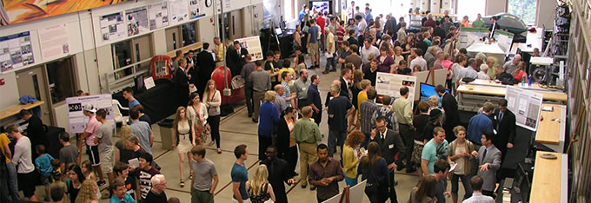
Possible Senior Design Project: Automating the Production System
Two Electrical Concentrations
One Mechanical Concentration
One Chemical Concentration

Slide 47
Costs
The monthly ongoing maintenance costs:
1 hour Physical Plant Mechanic Time: $ 45
Fuel Injector Additive: $ 16
Fuel Filter: $ 15
CERF Intern $ 180
Total: $221/month

Slide 48
Upfront Capital Costs
Fuel Processing Costs: $ 1,972
Vehicle Conversion Costs: $ 2,295
Infrastructure Costs: $ 2,413
Total: $6,680

Slide 49
Monthly Operating Costs
Fuel Processing Costs: $ 14
Vehicle Conversion Costs: $ 221
Infrastructure Costs: $ 150
Total: $ 385

Slide 50
Total Cost Analysis
Breakeven (w/ Student Labor)
1
2
3
4
5
Notes:
No blue line!
No October 2017!

Slide 51
Proposed Timeline
Summer 2014
Construction
Winter 2014/15
Mower Conversion
Spring 2015
Begin Operation
Fall 2014
Senior Design Automation & WVO Collection

Slide 52
Feasibility
Practically Feasible?
Economically Feasibility?
Environmentally Feasibility?
YES
YES
YES
Notes:
Restate Question: What would it take to operate a biofuel vehicle using only on-campus resources?

Slide 53
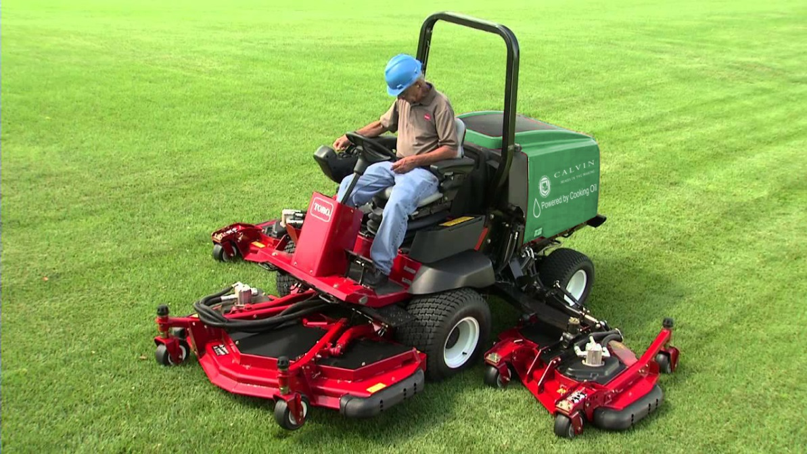
We recommend that Calvin operate one mower on WVO beginning April 2015.
Notes:
1 sentence recommendation
Environmentally Feasible
Reduced emissions
43% Carbon monoxide
56% Hydrocarbons
55% Particles
Sustainability image on campus
Educational opportunities
Fuel savings
1300 gallons of diesel
Cost savings
$4,000 of purchased diesel

Slide 54
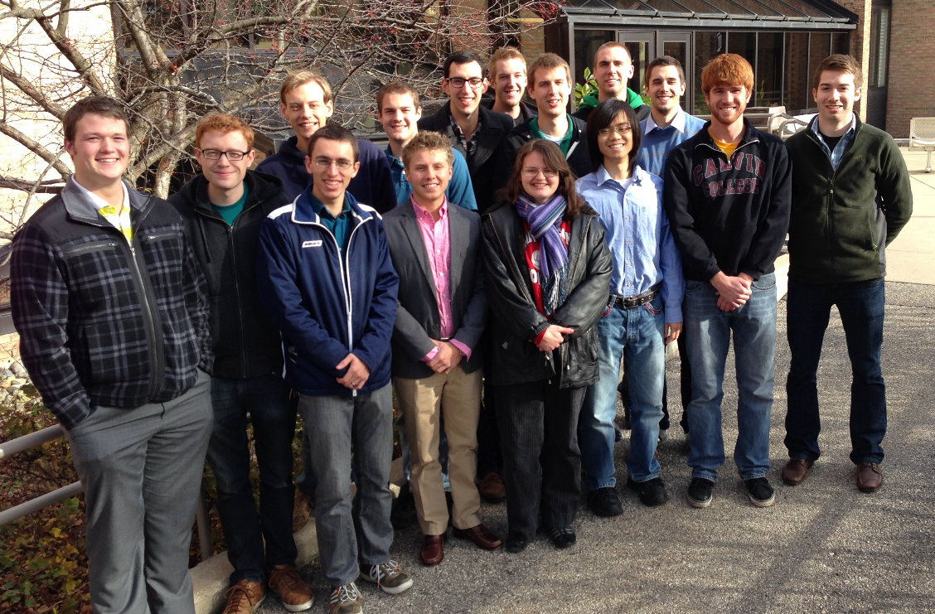
Questions?
Thank you for your time…

Slide 55
Appendix

Slide 56
Operating Procedure
WVO temperature
The system must be started on diesel and the “Co-Pilot” will assist the operator in the fuel switch over
Process takes approximately 5 minutes
System flush
System must be flushed with diesel before final shut-down
Process takes less than 1 minute
Fuel Usage
The tank must be routinely at capacity to prevent air in the lines
The tank must not be stored with WVO throughout winter
The tank must be cleaned and inspected to prevent polymerization
The fuel must be treated with additives to prevent bacterial growth

Slide 57
Total Cost Analysis
Breakeven (w/ CERF Grant)

Slide 58
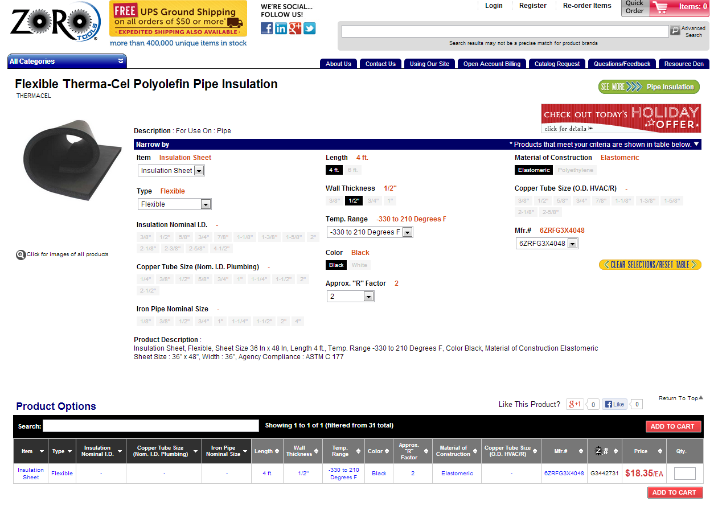
Tank Insulation

Slide 59
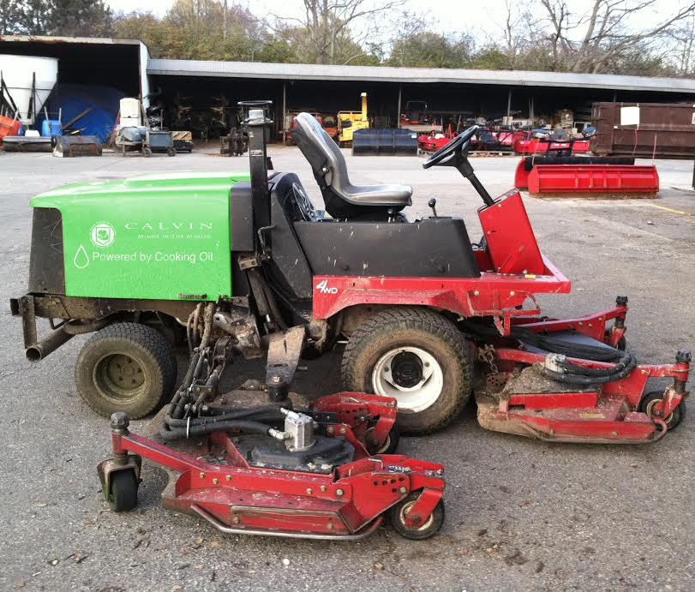
Yearly Savings
Fuel savings
1300 gallons of diesel
Cost savings
$4,000 of purchased diesel

Slide 60
Hardware Locations
Image source: Greasecar.com
Notes:
Mounting of fuel lines, pump, valves, and filters by Physical Plant mechanic
After speaking with Physical Plant, the mechanic, Jeremy, is excited to work on the conversion kit

Slide 61
Temperature Concern
WVO Tank
Vehicle Application
Notes:
The largest concern comes from the tank temperature and its proximity to the operator:
External surface of the tank may reach temperatures up to 200°F
Upper tank surface is directly next to user dashboard

Slide 62
Yearly Lawnmower Usage (hours/model)
Notes:
There are

Slide 63
Temperature Solution
Image source: Zoro Tools
Notes:
Therefore, an insulating cover and warning label has been selected to protect the user from burn hazard.
Flexible Therma-Cel Polyolefin Pipe Insulation
2 sheets needed $18.95 each
Necessary for top and outer surface safety
http://www.zorotools.com/g/00058735/k-G3442731?utm_source=google_shopping&utm_medium=cpc&utm_campaign=Google_Shopping_Feed&kw=%7bkeyword%7d&gclid=CIiFgezslrsCFdE-Mgod4T4Acg

Slide 64
Controller Location
Notes:
In order to implement the “Co-Pilot” controller, it must be both visible and easy to access
2 main components

Slide 65
Presentation Outline
Before:
Transportation
Processing Plant
Biofuel Vehicle
Fuel Source
Vehicle Application
After:
Waste

Slide 66
Process Design
Rigid, Parallel System
Notes:
Options:
Non Rigid
Batch
Pull System
Hybrid
Reasons:
Cleanliness! (Rigid)
Settling Requirements
Raw VWO Output
Extra Capacity

Slide 67
Tank Dispense
Two Outlet, Float Dispense
Image Source: www.vegoilcar.co.uk
Notes:
http://www.vegoilcar.co.uk/wvo_filtering_setup.php
Options:
1 Outlet
2 Outlet
2 Outlet (Float)
Reasons:
Fuel Quality

Slide 68
Total Upfront Costs = $6,850

Slide 69
Operating Costs = $236/month

Slide 70
Valve Design
Actuator Controlled Valves
Image Source: www.praher-valves.com
Notes:
http://www.praher-valves.com/files/big_images/Produkte/pvc/2W-KH-S4-pneum.jpg
Options:
Manual
Actuator Driven
Reasons:
Ease of Use
Safety
Ergonomics

Slide 71
Valve Design
Actuator Controlled Valves
Notes:
Options:
Manual
Actuator Driven
Reasons:
Ease of Use
Safety
Ergonomics

Slide 72
Transportation Van Cost Analysis
Result: 1.5 year payback time
Notes:
Assumptions
Fuel system capital costs already sunk for lawn mower
24,000 miles a year, 2,000 miles a month
Only $150 more operating cost per month to

