Slide 1
Operational Efficiency Project
Engineering 333 - Thermal Systems Design
Professor Heun
Fall 2015
Notes:
Introduce yourself
Introduce co-presenters
Introduce class - class component, semester-long final exam project, and a class project. The class project changes every year but always has something to do with energy and energy efficiency. This year, our project was to examine and propose improvements for Calvin’s building operations.

Slide 2
The Problem
$124,514,962 in total operating expenses (2014)
~ $90 million in debt
$3,151,413.57
Utilities 2014-2015
Notes:
1 animation on this slide
Background - about 125 mill operating expenses in 2014
Calvin carries just under 90 mill in debt, which we’ve been aggressively reducing. One area Calvin would like to reduce costs in is operations. Last year utility budget was just over 3 mill.

Slide 3
The Proposal (2014-2015)
Offer - $600,000 savings
Challenges – Measurement and verification
Opt to pursue savings internally
Notes:
Because we know 600,000 in savings is achievable, Calvin’s VP of Finance has established that the Physical plant will have a portion of their performance evaluated on how they do at hitting the target of reducing operating costs by 600,000

Slide 4
The Project
What would it take for Calvin College to save
$600,000 per year
on campus operations?
Notes:
What better way for senior mech e’s to get involved, use their knowledge on a real problem, and help out their school by bringing a fresh perspective to the physical plant than by attacking this problem.
Posed question
while keeping in mind M&V and Rebound Effect

Slide 5
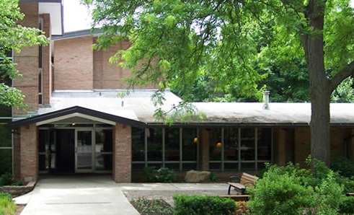
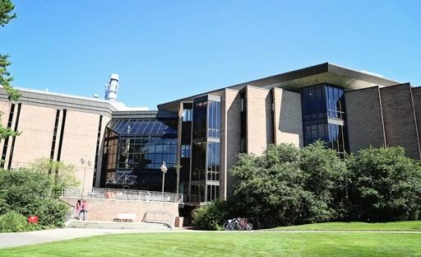
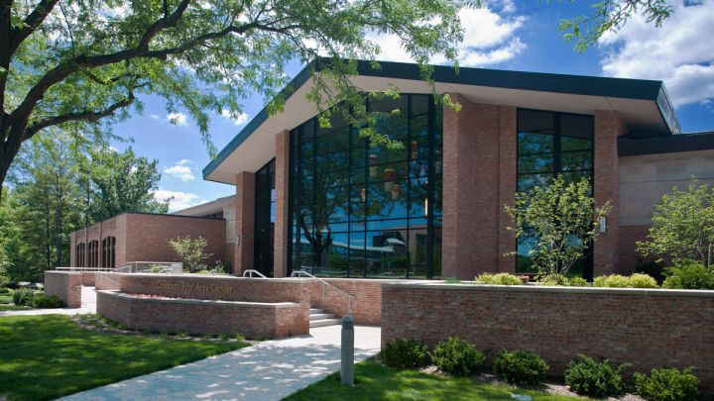
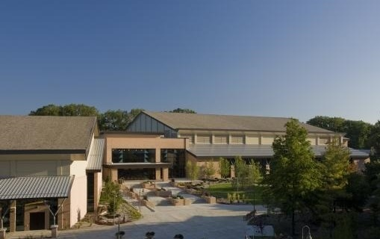
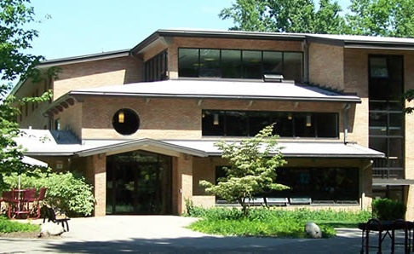
SE
Science Complex
CFAC
Spoelhof Complex
KHvR
Notes:
We broke into 5 teams, with 4 or 5 people per team. Each team selected a building.
To avoid redundant work and better organize our efforts, each person from a building team was also on a cross-cutting team. 4 teams.

Slide 6
 | Lighting | HVAC | Water and Extra Buildings | Executive

Slide 7
Presentation Outline
Cost-Saving Models and Project Initiatives
Building Teams
Major Project Implementation
Special Projects
Project Totals and Summary
Notes:
Transition between major initiatives and building teams with extra-building projects

Slide 8
Major Cost-Saving Project Initiatives

Slide 9
Major Cost-Saving Project Initiatives
Lighting LED conversion
Thermostat adjustments
Window improvements
Heat recovery ventilators
Water savings

Slide 10
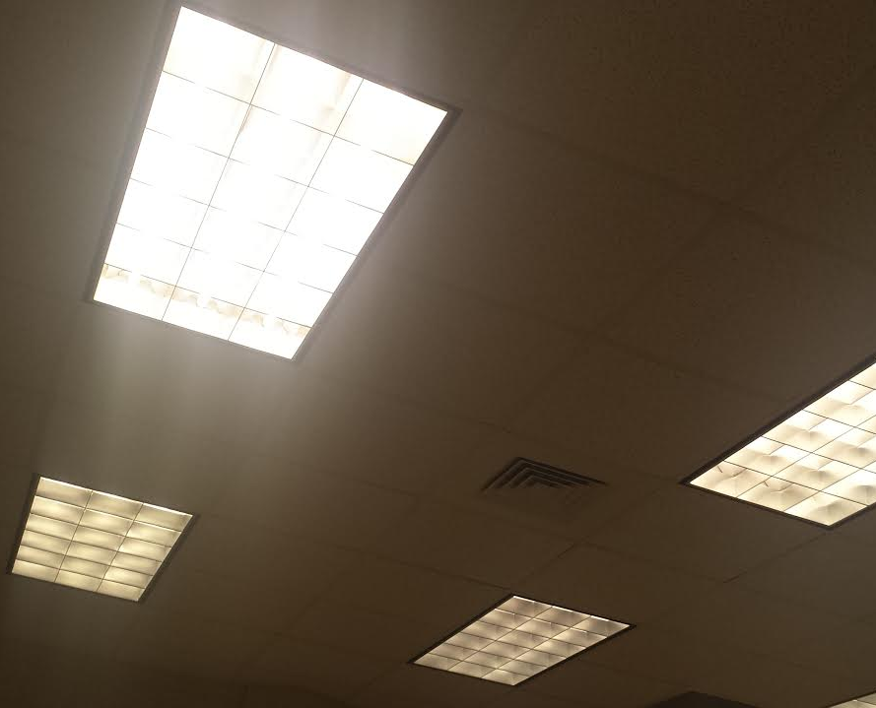
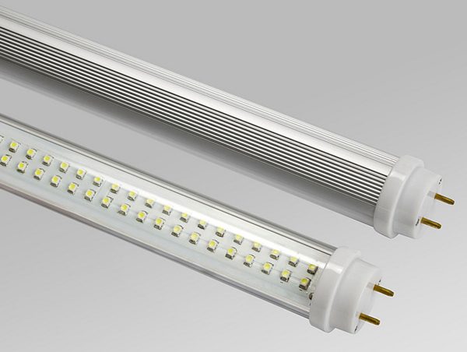
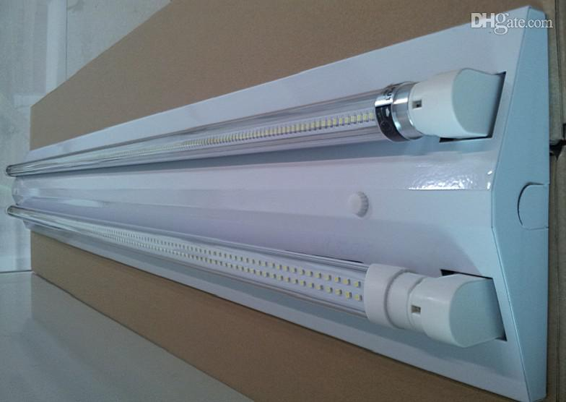
LED Conversion
http://www.thejewelrylightingexperts.com/store/wp-content/uploads/2012/01/t8LED.jpg
http://image.dhgate.com/albu_485628563_00-1.0x0/t8-1-2m-double-lighting-fixture-brackets.jpg
SB 120 (Current)
3 bulbs per fixture
30 watts/bulb
90 Watts
De-lamp and replace with LED’s
2 bulbs per fixture
18 watts/bulb
36 Watts
New LED fixtures
2 bulbs per fixture
As low as 12 watts/bulb
24 Watts
Notes:
Strategies – straight replacement – okay; replace and delamp – good; new fixture - best

Slide 11
Lighting Model
Notes:
Only 5 inputs are required, 3 of them drop-down selections. Super simple to use, should be a handy tool for physical plant. Model accounts for on peak/off peak. Rebates from consumers energy data. I’m not sure how this table will look on a screen. Feel free to delete this slide or rearrange it however you want.

Slide 12
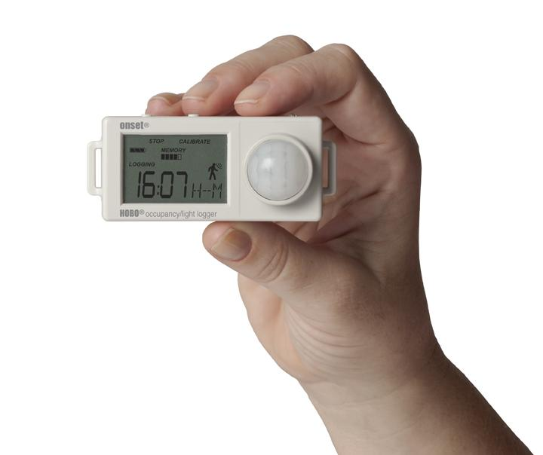
Lighting: Measurement and Verification
Hours of operation
HOBO sensors
data from CERF
(Calvin Energy Recovery Fund)
http://www.hobodataloggers.com.au/content/images/thumbs/0002490_hobo-ux90-occupancylight-logger-ux90-006-12-meter-sensor.jpeg
Notes:
Because we had estimates from CERF for North Hall usage times, and there were limited numbers of sensors and time to take data after we got sensors, we did not do a lot of M&V in our building directly. We would recommend that the Physical Plant do more M&V in DeVries Hall and in the SB basement labs to determine the accuracy of our projections before implementation in those locations.

Slide 13
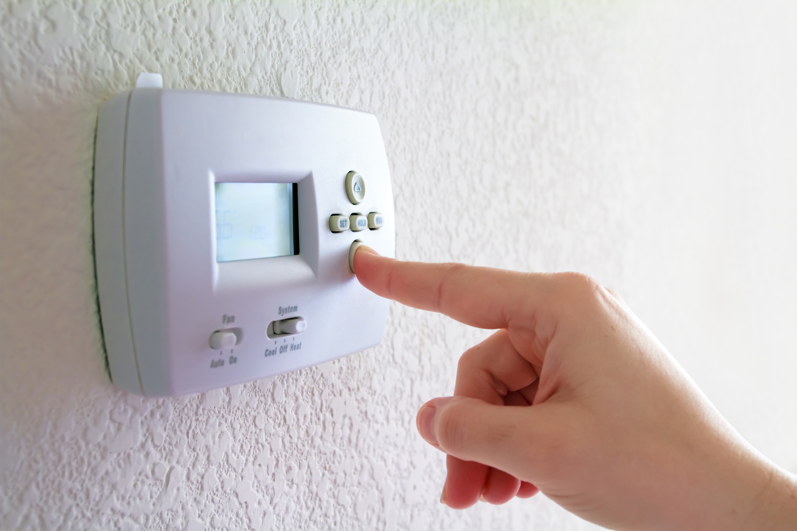
Thermostat Adjustment Initiative
Summer
72°F
Winter
70°F
75°F
69°F
http://blog.doctoroz.com/wp-content/uploads/2014/01/thermostat.jpg
$0 Implementation

Slide 14
Thermostat Adjustment Model
Square Footage
E
E
Outside Temp
S
Cost Savings
Thermostat Setting
Energy Costs
Notes:
Next is kemal with the windows initiative

Slide 15
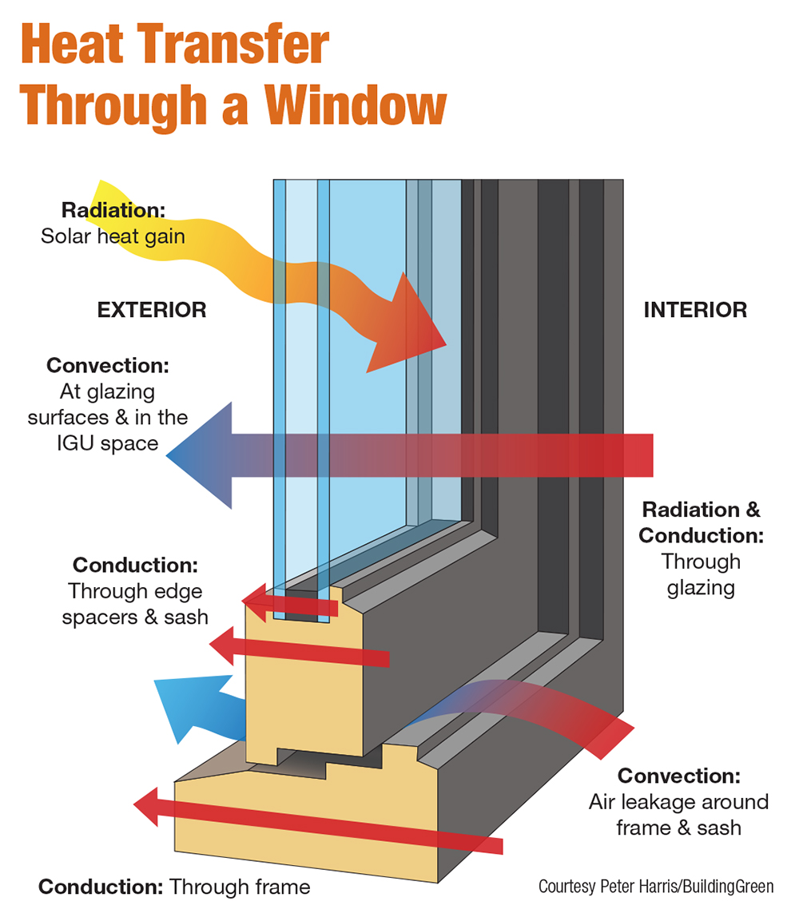
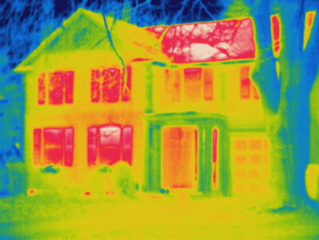
Heat Loss Through Windows
http://www.homepower.com
http://www.bbc.co.uk
Notes:
-One of the main sources for energy loss in a building is through its windows
-Heat loss occurs in windows through convection, conduction, and radiation
-On the right is an infrared image of a typical residential home, which shows that windows leak a large amount of infrared radiation.
-Heat loss can be mitigated by increasing the thermal resistance of a window and also increasing the solar heat gain through the window during the winter, or blocking solar heat gain during the summer.

Slide 16
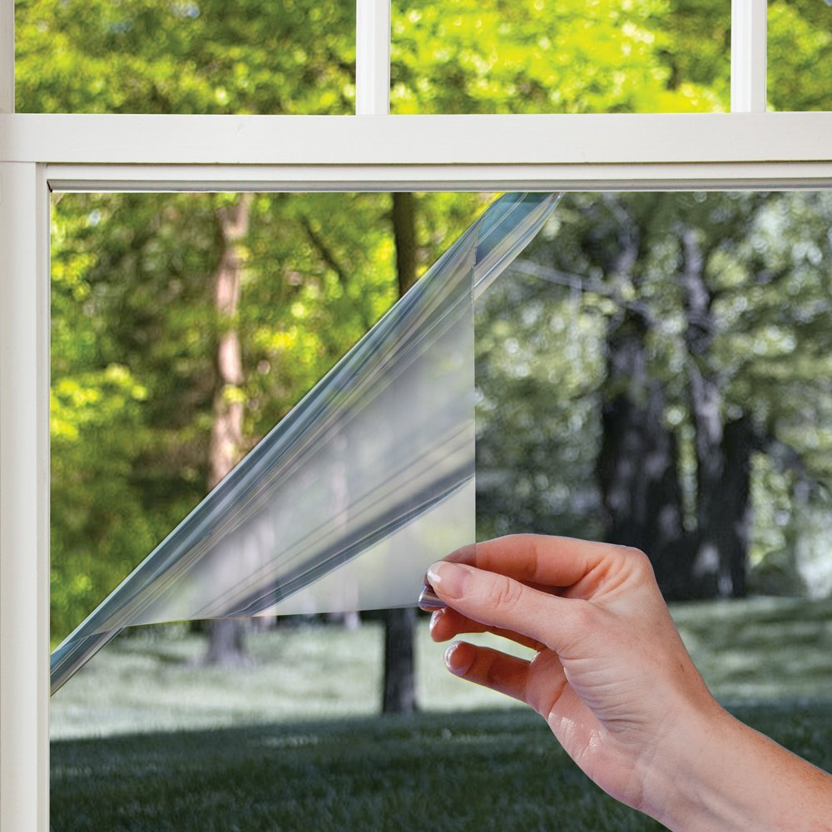
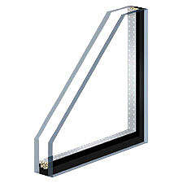
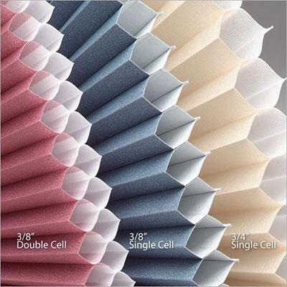
Windows Model Savings
Low-E Coatings
Double Pane Windows
Cell Shades
http://www.delathomes.net
http://www.nachi.org
http://www.colorwiseandmore.com
Notes:
-There are three saving mechanisms for this project
-Switching from single to double pane, installing low emissivity coatings, and installing cell-shades
-Low E coatings block infrared and ultraviolet light while allowing most visible light to pass.
-Double pane windows have a higher thermal resistance
-Cell Shades add another insulating layer

Slide 17
Windows Model
# of Single Panes
E
Heat Flux out
E
# of Windows
Solar Heat Gain
S
Area of Windows
Cost Savings
Directional Window sets (SE, NW, etc.)
Seasonal Outdoor Temperatures
Notes:
-The five inputs into the equation sheet are shown on the left.
ANIMATE
-The cost savings from the project can be determined from the heat flux out and the solar heat gain through all the windows in a building.

Slide 18
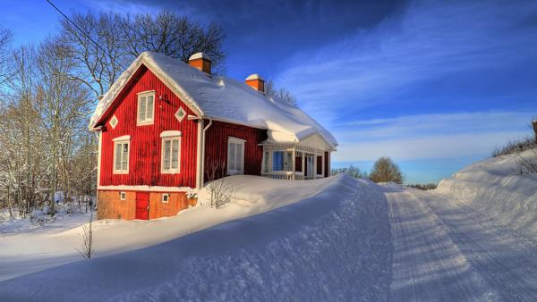
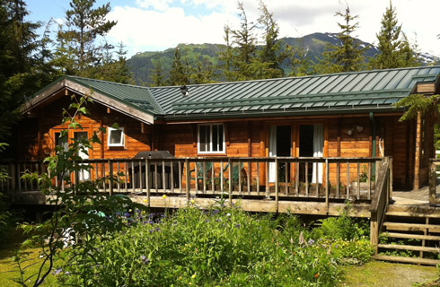
Effectiveness of Cost Savings
✓
http://www.lushome.com
http://innumerablegoods.typepad.com
Notes:
- Savings are computed year round based on heating and cooling costs.
ANIMATE
- Based on the results of the project, the project savings are larger in the winter than in the summer.

Slide 19
Window Improvements: Implementation Suggestion
Recommend low E-coatings only.
Notes:
-After weighing the pros and cons of each savings mechanism of the project, we chose to only propose low-E coatings because of their low upfront cost and fast payback period.
-Double pane windows had a much longer payback period due to their large initial cost.
-Energy savings from Cell-shades were effective if used all the time, but not surprisingly impractical because you cannot force somebody to keep their shades down all the time, which I cannot blame them for, because we have a beautiful campus to look at.

Slide 20
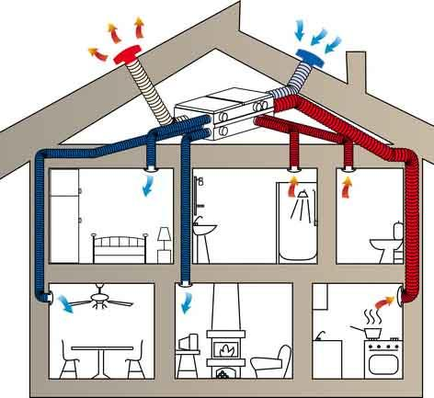
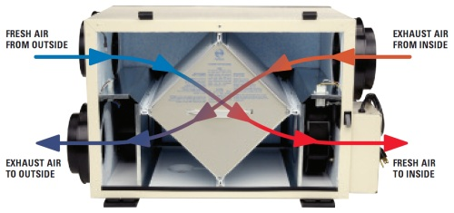
Heat Recovery Process
www.sustainablehomes.ie
www.carnationconstruction.com
Notes:
-The heat recovery process during the winter, is transferring energy from the warm air that leaves a building through its ventilation system to the cold air that is entering the building through the ventilation system. For the summer, the heat transfer is in the opposite direction.
-We pursued this project because the warm air that leaves a building through its exhaust system is energy that can be utilized to save money.
-The heat recovery project is implemented in a building by replacing each exhaust fan with a Heat Recovery Ventilator (HRV).
-A typical heat recovery ventilator is seen on the right. A heat exchanger is in the middle.

Slide 21
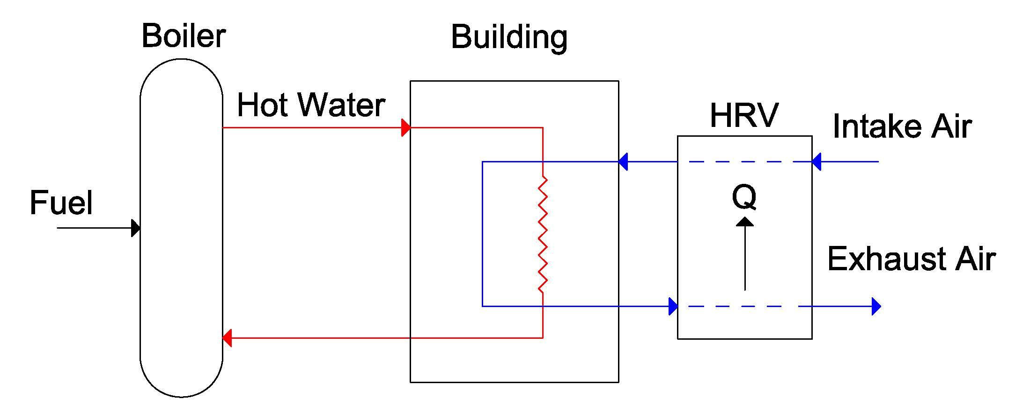
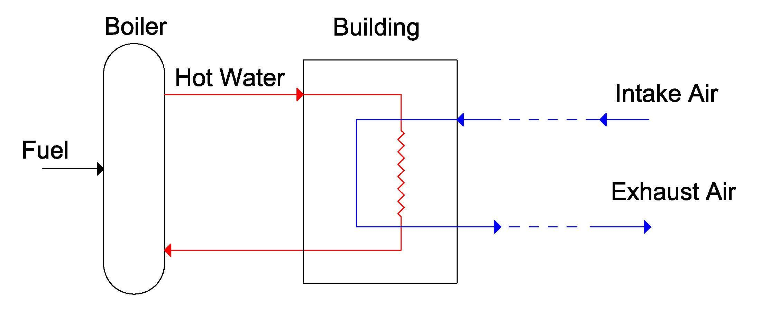
Heat Recovery Model
Fresh Air
Stale Air
Figure 1. Building Model
Notes:
-This is what the the heating process looks like in a typical building on campus.
-We will call air leaving a building ‘stale air’ and air entering a building ‘fresh air’
-The energy used to heat the air comes from the fuel into the boiler.
ANIMATE
-Cost savings are a function of the energy Q transferred to the fresh air from the stale air. Specifically, the fuel energy saved is equal to the heat transfer Q divided by the effectiveness of the boiler.
-Also, the direction of Q changes during the summer. This means the HRV can save money in both heating and cooling costs.

Slide 22
Heat Recovery Ventilator Model
Air Flow Rate
E
E
Q, heat transfer
Interior and Exterior Temps
S
Boiler Effectiveness
Cost Savings
HRV Effectiveness
Notes:
-The four inputs into the equation sheet are shown on the left.
ANIMATE
-The heat transfer Q and cost savings can be determined from these four inputs.

Slide 23
Heating Recovery: Measurement and Implementation
1. Temperature sensors at inlet and outlet of fresh air flow through HRV
2. Flow meter in the fresh air flow
Notes:
-Based on the inputs into the EES worksheet, we believe that the model can be verified by installing temperature sensors at the inlet and outlets of the outside air stream and also flow meters at the outside air stream.

Slide 24
Heat Recovery Ventilation: Implementation Suggestion
Recommend for new building constructions on campus and existing large buildings, such as SFC and CFAC.
Notes:
-Based on the project, we suggest implementing heat recovery ventilators in new building constructions because the energy savings from the HRV will decrease the required overall size of the other HVAC components.
-We also suggest implementing heat recovery ventilators in larger existing buildings on campus, such as the CFAC and the Field house.
-We also strongly recommend HRVs in buildings that both cool and heat during the year.

Slide 25
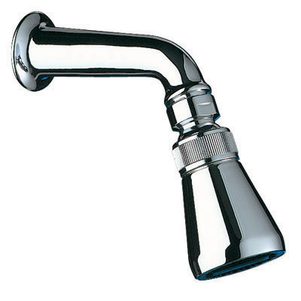
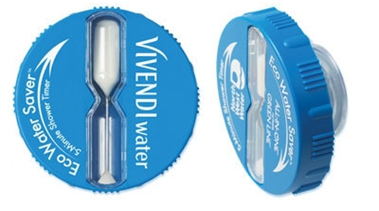
Water: Reduce Shower Times
http://www.macdonaldindustries.co.nz/Cache/Pictures/1177197/6_DE711000-Image.jpg
https://www.inkhead.com/eco-water-saver-shower-timer/14729/?reftypeid=11&adpos=1o2&creative=58961556743&device=c&matchtype=&network=g&gclid=CI7Vv6ezmckCFYM_aQodg_AMAQ
Notes:
o Behavioral change reduce shower times to 5 minutes
o Use shower data from CERF for average shower time, temperature, and flow rate
o Implement in dorms and fieldhouse locker rooms
o Savings from water usage and heating the water
o Initial cost in timers
o A possible rebound effect for count up timers would be students avoiding the 5 minute mark and pushing shower times to see how long they can go
-Propose self-countdown timers

Slide 26
Shower Time Reduction Model
Number of Students
E
E
Student Utilization
S
Cost Savings
Initial Shower Time
Water Heating Cost
Notes:
o Created shower time reduction model
o Inputs (number of students, student utilization, initial average shower time, water heating cost)
o ANIMATE: Outputs of cost savings

Slide 27
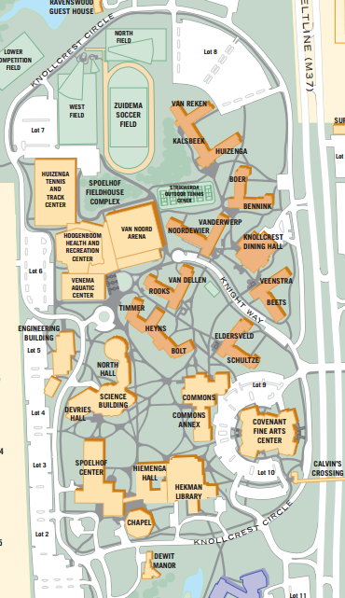
Extra Buildings
Notes:
o Extra buildings team looked at other areas on campus not covered by 5 buildings
o ANIMATE: Hekman Library (lighting/windows), Knollcrest Dining Hall Steam Boilers, Parking Lot Lights

Slide 28
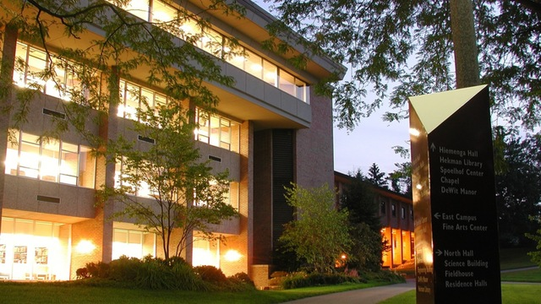
Extra Buildings: Hekman Library
http://www.calvin.edu/chimes/wp-content/uploads/2014/09/hekman-564x272.jpg
Notes:
o As shown in photo, lots of windows and lights with library utilization being significantly high
o Lighting: convert all library lighting to LED’s (5th floor has potential savings of $8,130 alone)
o Windows: add reflective coating to windows
o Annual Savings just under $20,000

Slide 29
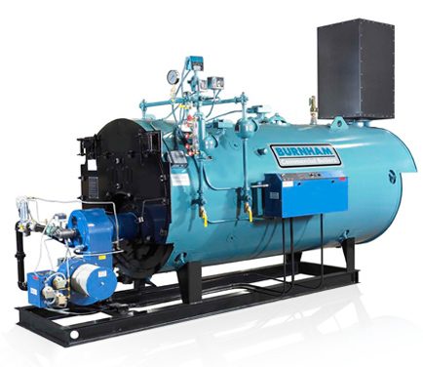
Extra Buildings: KDH Steam Boiler Replacement
http://www.burnhamcommercial.com/assets/images/product-high-eff-steam.jpg
Notes:
o Replace 2 KDH Steam Boilers from 1962
o Steam boilers heat the 4 dorms north of Knight way
o Increase seasonal efficiency from 67% to 79%
o Annual savings $43,542

Slide 30
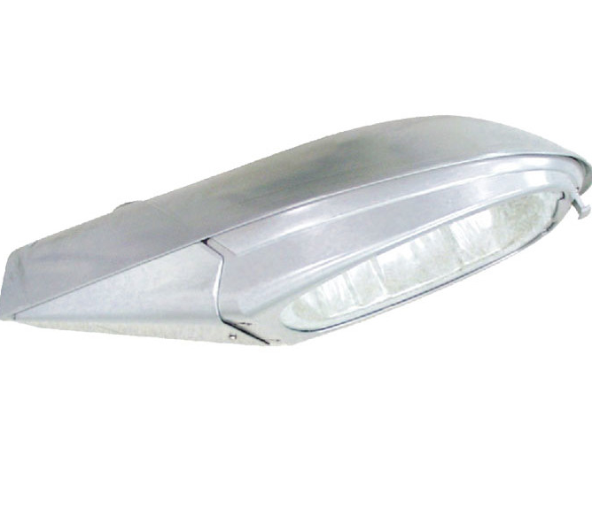
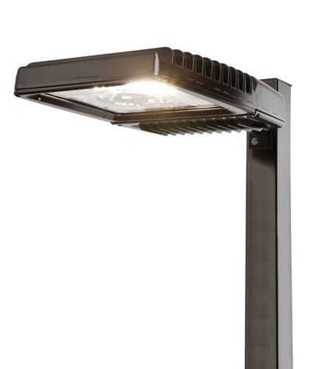
Extra Buildings: Parking Lot Lighting
http://cms.ipressroom.com.s3.amazonaws.com/149/files/20131/512258e629371a50fe000cd1_GE_EvolveScalableAreaLight/GE_EvolveScalableAreaLight_88028037-55d3-4446-9641-a668cb51f827-prv.jpg
http://www.wayfair.com/150w-MHPS-MT-Roadway-Cobra-Post-Head-with-Flat-Glass-in-Gray-DEK1853.html?
Notes:
Replace 364 parking lot halide lights with LED fixtures
ANIMATE - New fixture on click
Annual Savings - $17,086
Initial Cost - $190,736
Rebates - $9,946
Payback - 10.6 years

Slide 31
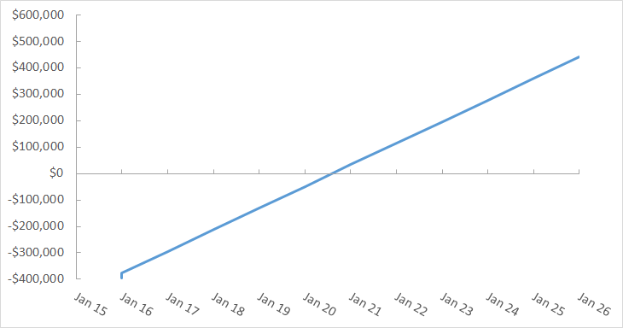
$81,677 /yr
Savings Rate
Annual Savings
Year
Initial Cost
Rebates
Notes:
o Savings graph, x and y axis, savings when cross $0 line
o Initial cost, rebates, savings rate
o $81,677/yr
o Payback period of just under 5 years

Slide 32
Building Team Summaries
Notes:
o Major Project implementation and special projects

Slide 33
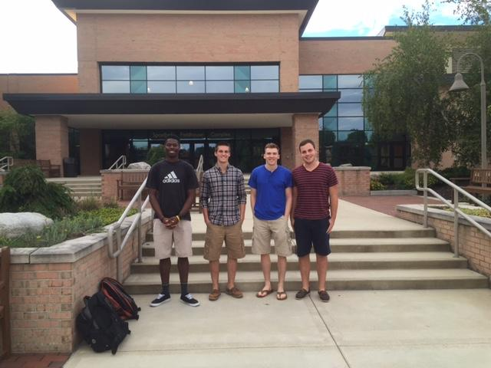
Spoelhof Fieldhouse Complex
Team Members:
Justin Cooper
Ross Tenney
Philip Van Strien
Zach Veenstra

Slide 34
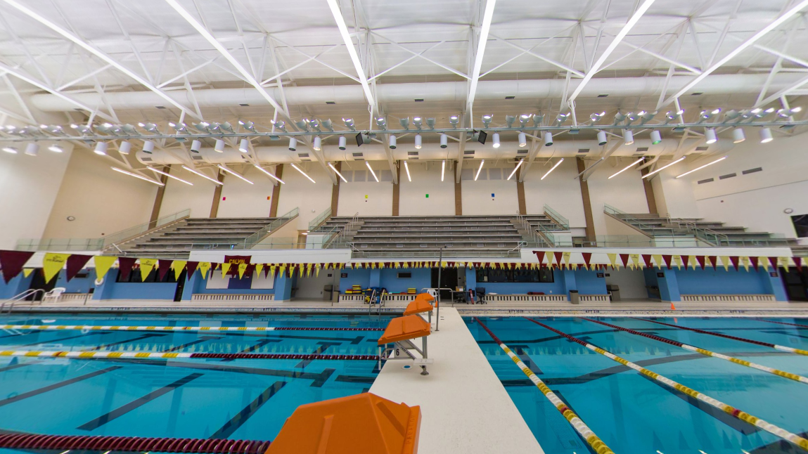
Performance Lights
http://www.youvisit.com/tour/panoramas/calvin/80759?id=24455
Notes:
o Other than major projects, our group looked into special projects
o One is performance lights shown in Aquatic center.
ANIMATE - Red box on click
o Lights use 1 kW power

Slide 35
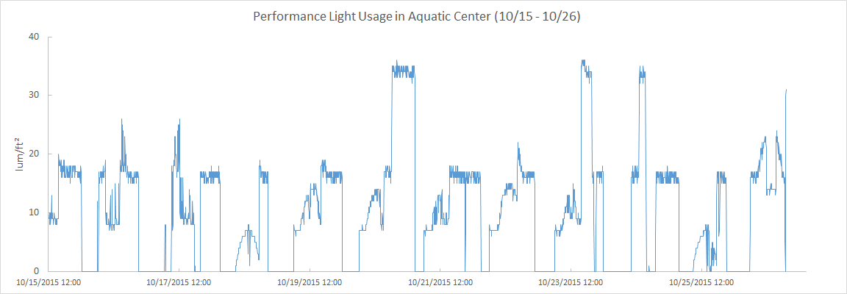
Performance Lights
Performance
Practice
LED’s Only
Notes:
o Inserted a lighting sensor and gained data for over a weeks time
o Y-axis is luminosity and x-axis is over time
o Red line is when all performance lights on during meets/events
o Orange line indicates when practice lights were on. Settings when 2 out of every 5 1kW lights on.

Slide 36
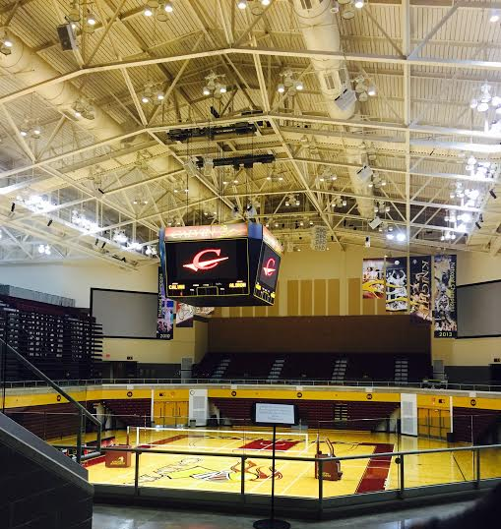
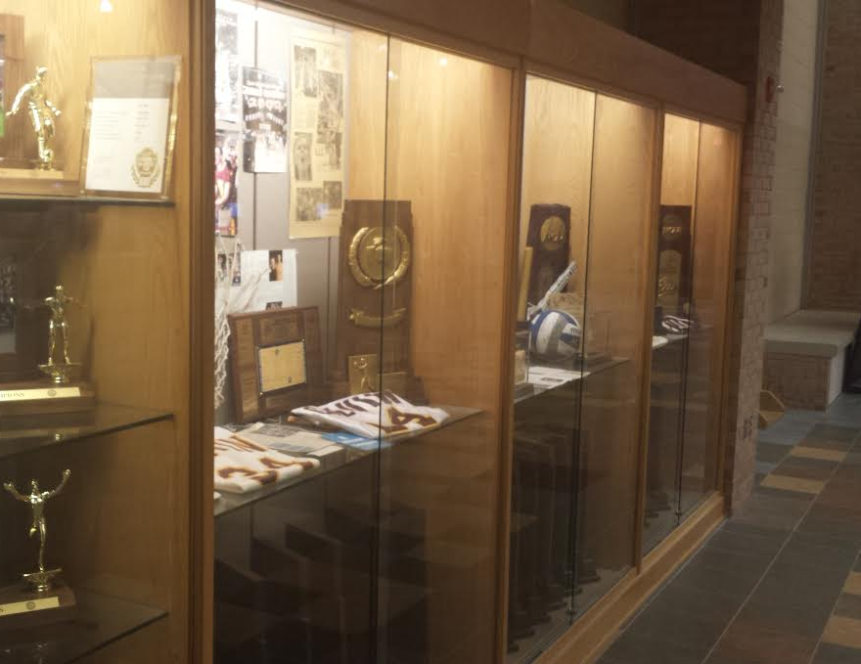
Lighting - Sporting Event Lights
http://www.youvisit.com/tour/panoramas/calvin/80759?id=24455
Notes:
o RECOMMEND: Use 1 kW game/performance lights in the Aquatic Center and Van Noord Arena for games/meets only
o Reduce Aquatic Center practice light usage to only pre-event practices
o Use lights in the trophy case and on sports plaques only during sporting events

Slide 37
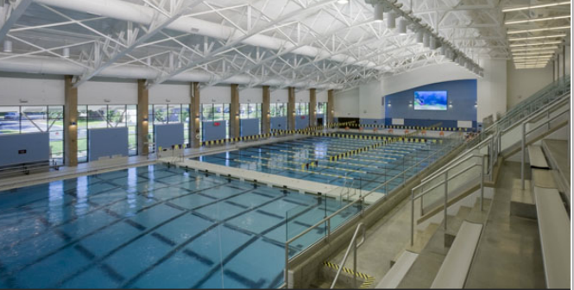
Pool Cover
http://www.calvin.edu/academic/pe/facilities/venema.htm
Notes:
o Implement a pool cover with multiple sections for overnight usage.
o 60% savings in heating cost, ~40% in water reduction, and also ventilation reduction
o Annual Savings of $18,073

Slide 38
Fieldhouse Savings Opportunities
Project | Initial Cost | Rebate | Annual Savings | Payback Period
LED Lighting Conversion | $ 94,120 | $ 14,620 | $ 8,768 | 9.07 years
Windows - Reflective Coating | $ 7,740 | $ 1,461 | $ 9,009 | 0.70 years
Heat Recovery | $ 33,195 | $ 0 | $ 4,732 | 7.02 years
Thermostat Change | $ 0 | $ 0 | $ 31,500 | 0 years
Behavioral- Shower Time Reduction | $ 482 | $ 0 | $ 373 | 1.29 years
Legacy Lighting | $ 0 | $ 0 | $ 750 | 0 years
Game Lighting Restrictions | $ 0 | $ 0 | $ 1,500 | 0 years
Aquatic Center Practice Lighting Reduction | $ 0 | $ 0 | $ 3,374 | 0 years
Pool Cover | $ 27,000 | $ 6,728 | $ 18,073 | 1.12 years
Totals | $ 162,537 | $ 22,809 | $ 78,079 | 1.79 years
Notes:
o Breakdown of savings opportunities
- Include major project initiatives and special projects
- majority of special projects have little to no initial costs and all have short-lived payback periods
o Totals at bottomline (initial cost, rebate, annual savings, and average payback period)

Slide 39
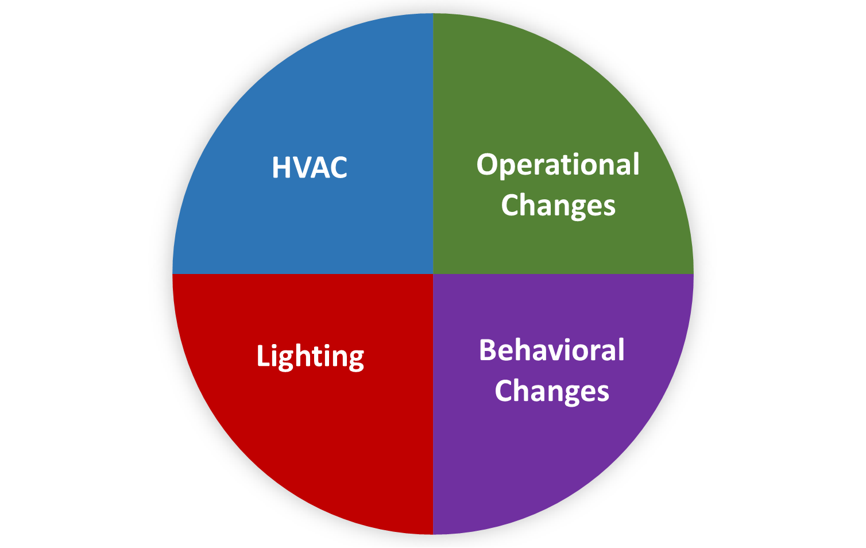
Project Breakdown Chart
Notes:
o Introduce Project Breakdown chart - % breakdown of each buildings savings
- General chart will be broken down color coded into 4 major zones:
· Lighting in red
· HVAC in blue
· Operational changes in Green
· Behavioral changes in Purple

Slide 40
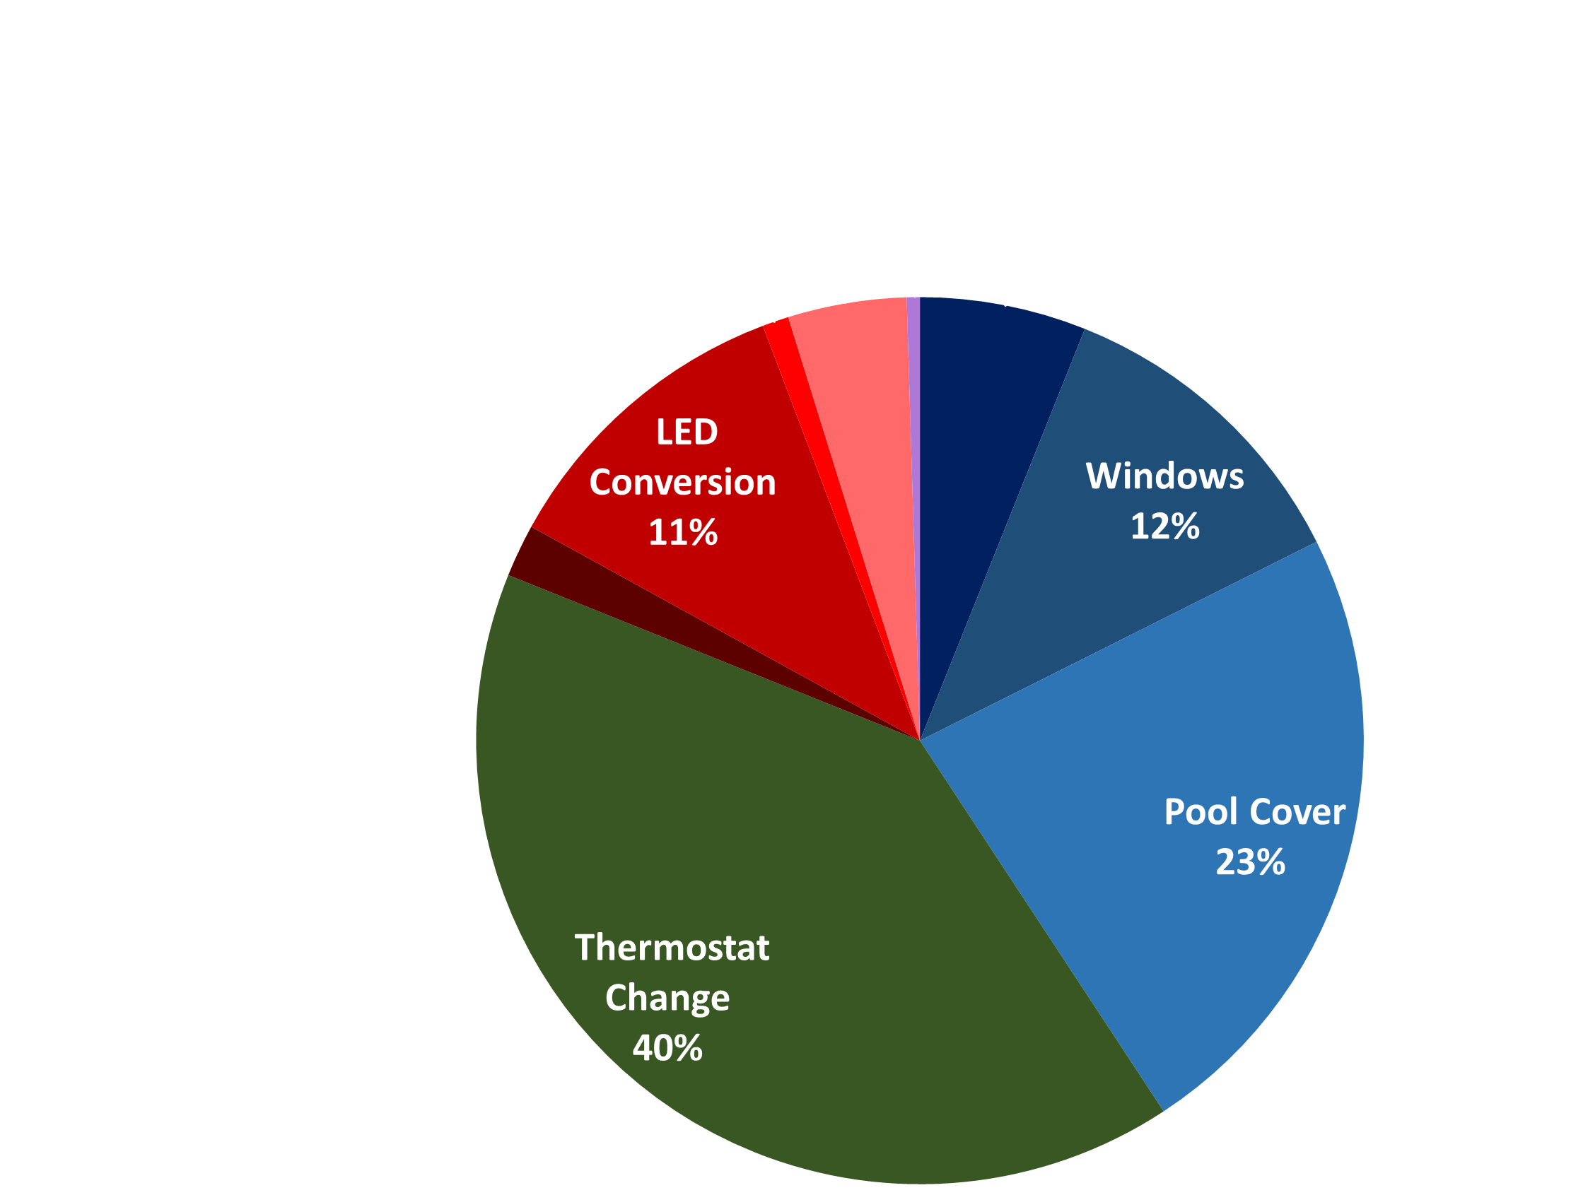
Fieldhouse Savings Opportunities
Notes:
o Specifically broken down chart for fieldhouse
o Major savings from operational of thermostat change (building cubic footage)
o Also significant savings from HVAC including the pool cover and windows (majority of windows savings in aquatic center)
o Significant savings contribution from lighting
(would be higher for LED conversion but CERF already converted many buildings over to LED’s including the aquatic center and Tennis and Track Center)

Slide 41
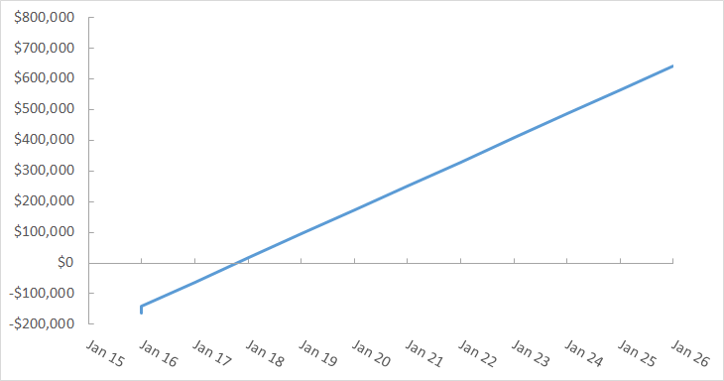
$78,709 /yr
Notes:
o Total savings graph for the fieldhouse
o Significant upfront cost of over $150,000
o ANIMATE: Annual savings of almost $80,000, which means
o Payback period just under 2 years

Slide 42
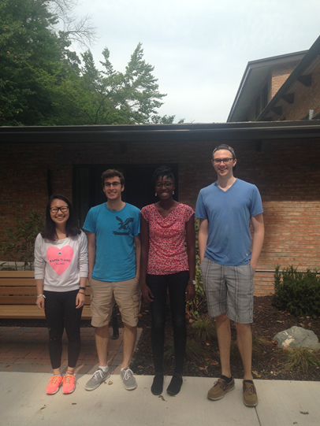
KHvR
Team Members:
Ayo Ayoola
Hanfei Niu
Kemal Talen
Dalton Veurink

Slide 43
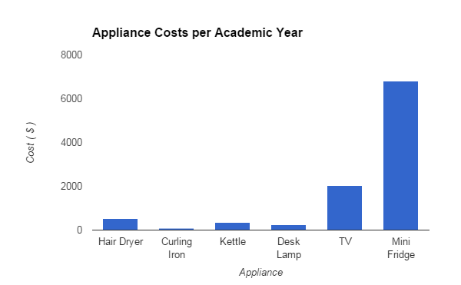
Appliance Costs

Slide 44
KHvR Savings Opportunities
Project | Initial Cost | Rebate | Annual Savings | Payback Period
Lighting - Delamping | $ 33,600 | $ 3,565 | $ 8,522 | 3.52 years
Windows - Reflective Coatings | $ 15,163 | $ 1,859 | $ 6,210 | 2.14 years
Appliances | $ 270 | $ 0 | $ 1,107 | 0.24 years
ID Card Basement Lighting Switch | $ 280 | $ 175 | $ 1,036 | 0.1 years
Washing Machines | $ 0 | $ 0 | $ 219 | 0 years
Totals | $ 49,313 | $ 5,599 | $ 17,094 | 2.56 years

Slide 45
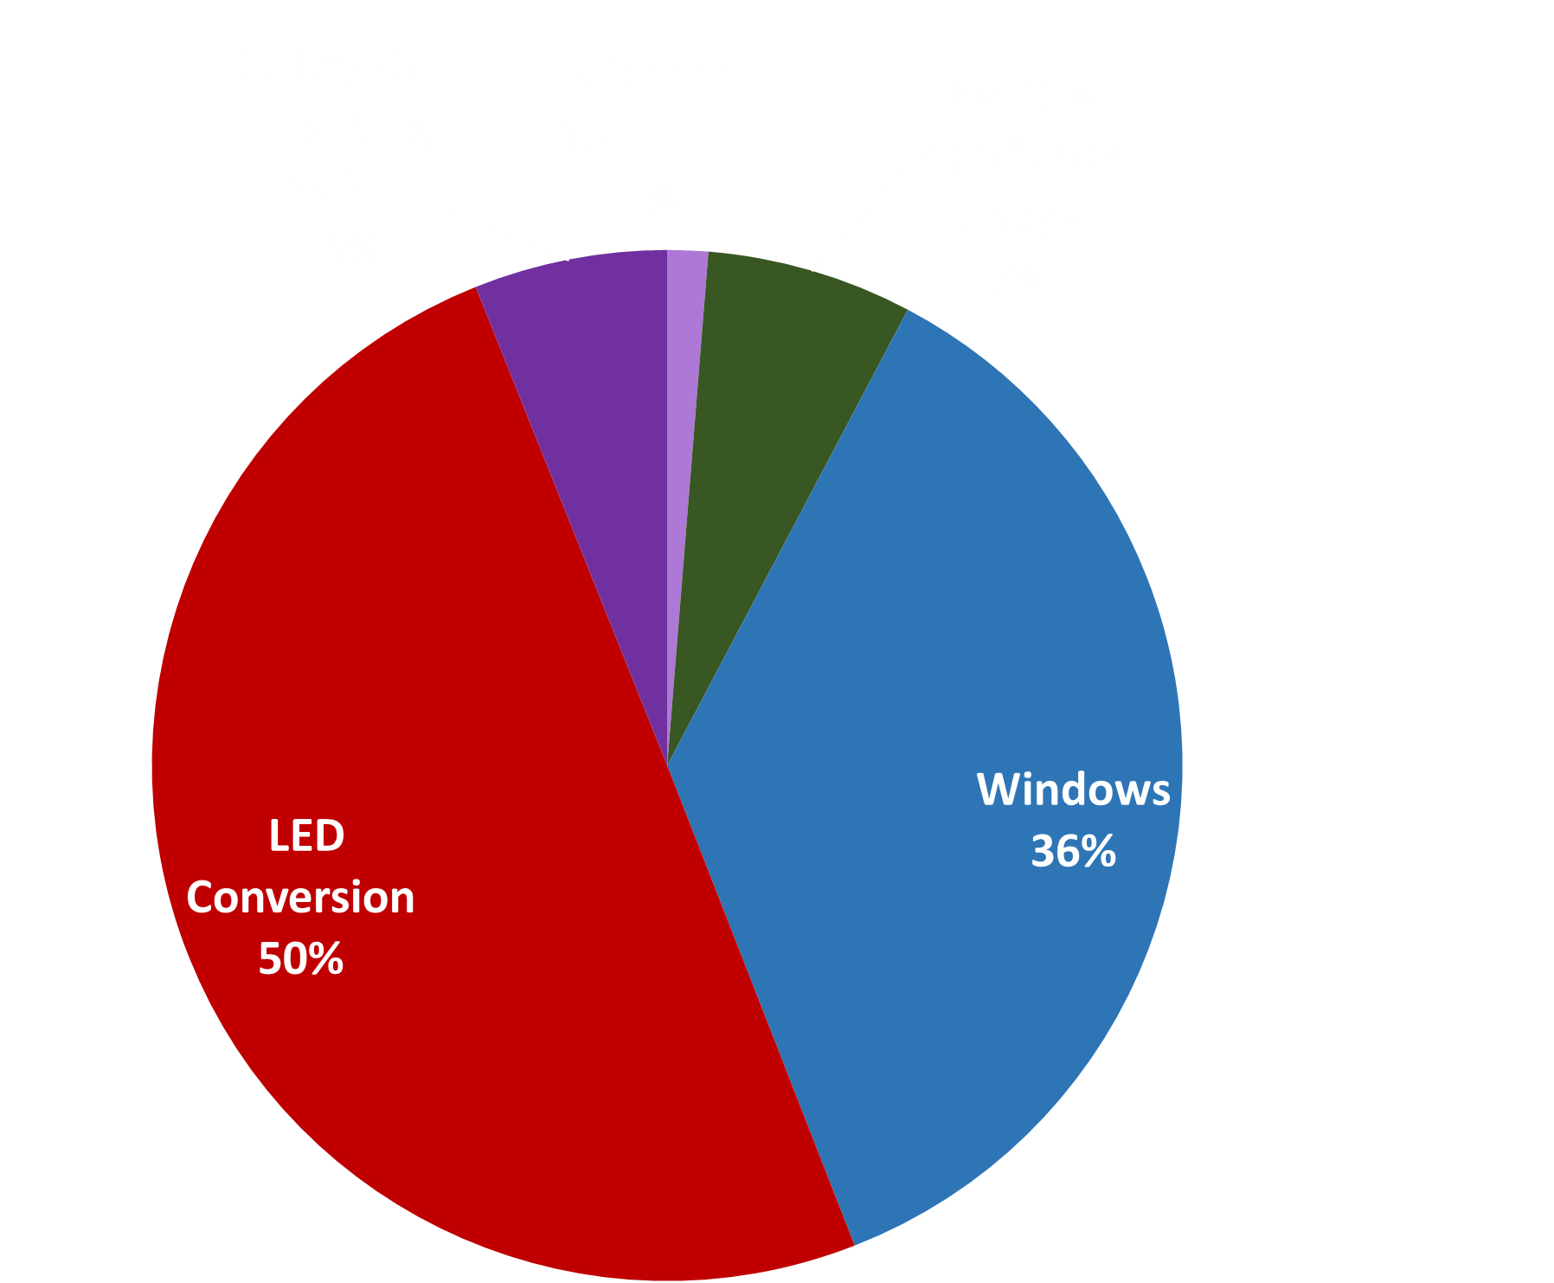
KHvR Savings Opportunities
Notes:
Lesson descriptions should be brief.

Slide 46
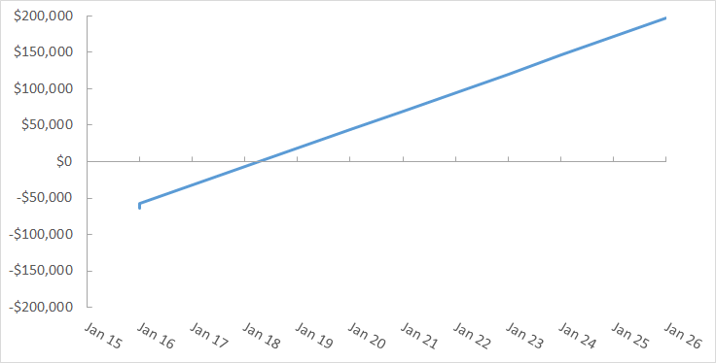
$17,094/yr

Slide 47
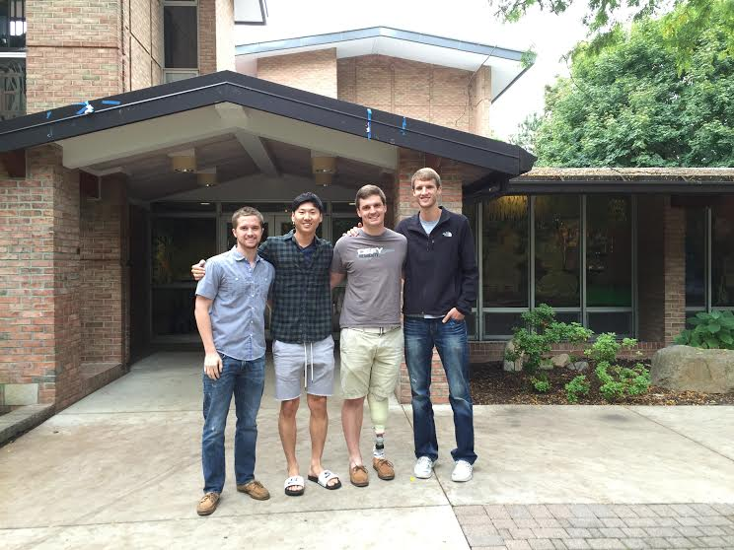
Schultze-Eldersveld
Team Members:
Lance Jensen
Se Ge Jung
Alex Karr
Stephen Lander

Slide 48
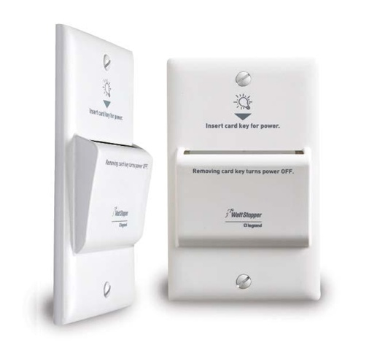
Behavioral - Basement Key Card
https://www.calvin.edu/dotAsset/e93efeff-3daf-4848-8c98-461368e36c18.jpg
http://www.capitalelectricalsupply.com/WATT-STOPPER-HS-150-W-HS-Series-Card
Notes:
Example objectives
At the end of this lesson, you will be able to:
Save files to the team Web server.
Move files to different locations on the team Web server.
Share files on the team Web server.

Slide 49
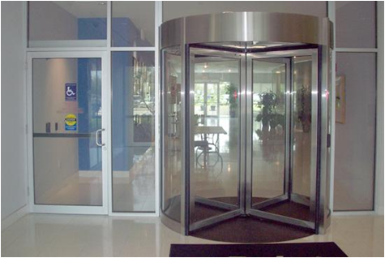
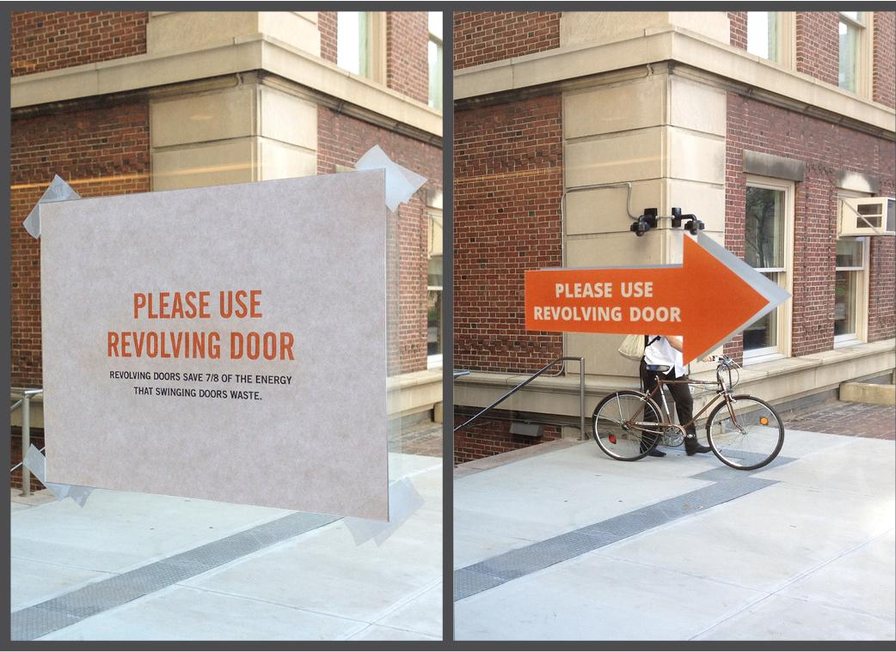
Revolving Door – MIT Study
http://www.smalldisruptions.com/images/revolvingdoors/4_door_signs
http://jnewtonenterprises.com/projects
Notes:
Example objectives
At the end of this lesson, you will be able to:
Save files to the team Web server.
Move files to different locations on the team Web server.
Share files on the team Web server.

Slide 50
SE Savings Opportunities
Project | Initial Cost | Rebate | Annual Savings | Payback Period
Lighting - Delamping | $ 56,835 | $ 8,870 | $ 10,894 | 4.40 years
Windows - Reflective Coating | $ 4,746 | $ 896 | $ 1,843 | 2.09 years
Behavioral - Shower Time Reduction | $ 320 | $ 0 | $ 409 | 0.78 years
ID Card Basement Lighting Switch | $ 280 | $ 175 | $ 1,036 | 0.10 years
Revolving Main Door | $ 5,000 | $ 210 | $ 1,250 | 3.83 years
Behavioral - Appliances | $ 0 | $ 0 | $ 1,036 | 0.1 years
Totals | $ 67,181 | $ 10,151 | $ 16,468 | 3.46 years

Slide 51
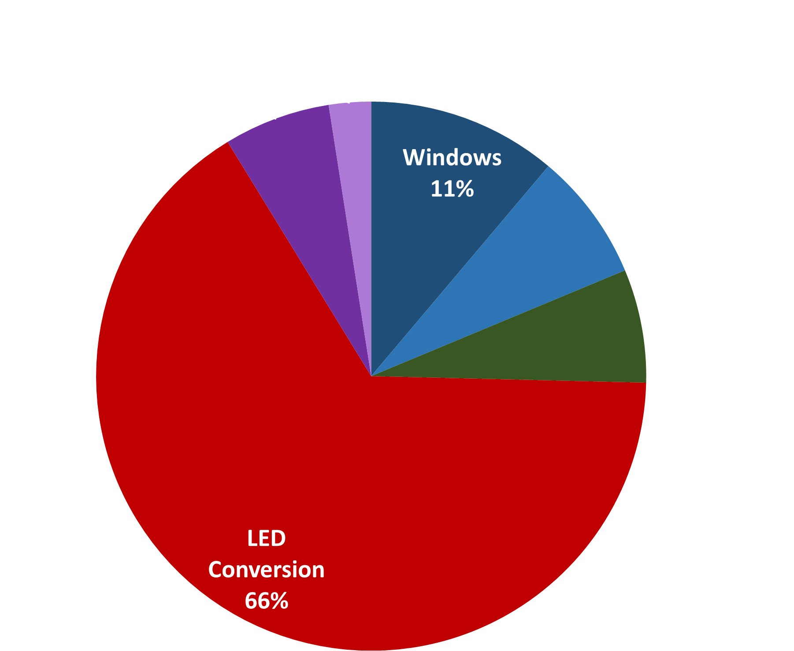
SE Savings Opportunities
Notes:
Lesson descriptions should be brief.

Slide 52
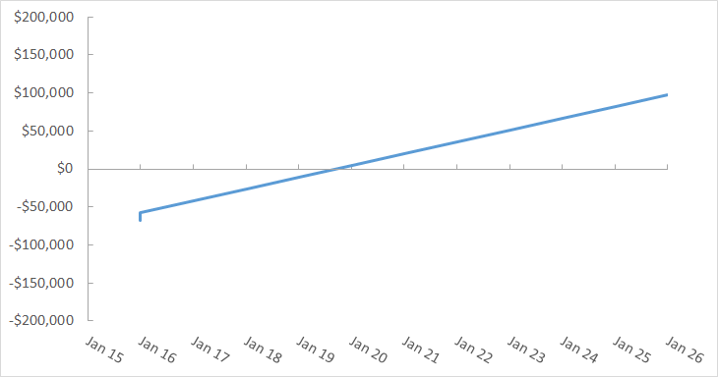
$16,468 /yr

Slide 53
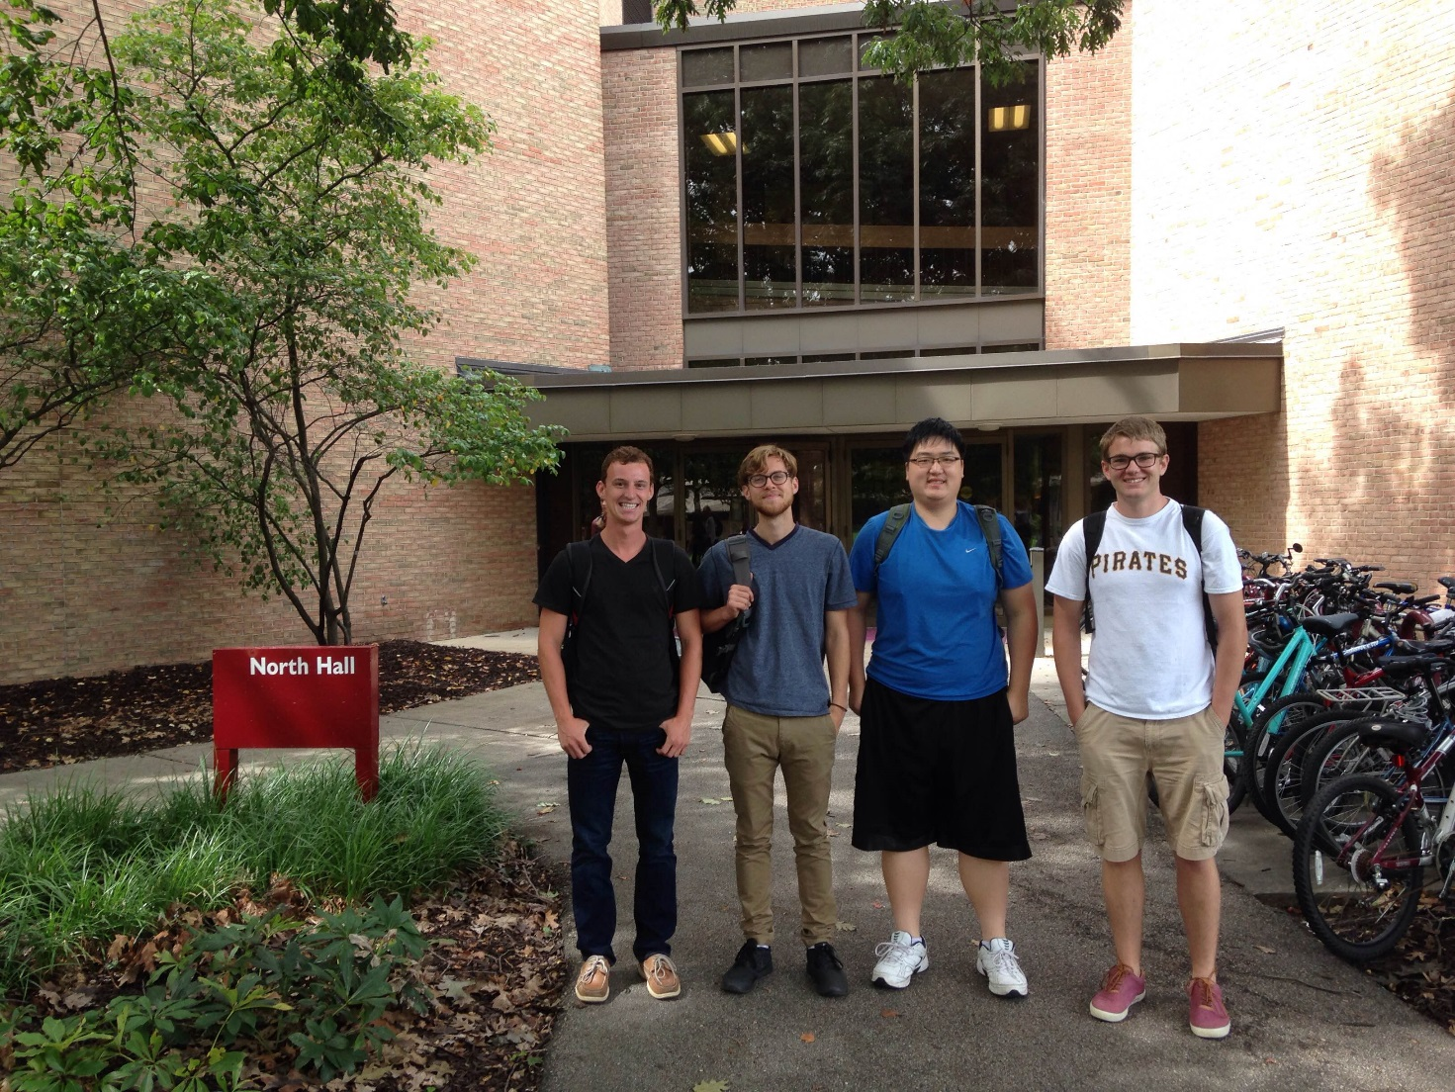
Science Complex
Team Members:
Andrew Bouma
Joseph Cha
Mitch DuBois
Jacob Milhorn

Slide 54
Science Complex Savings Opportunities
Project | Initial Cost | Rebate | Annual Savings | Payback Period
Lighting | $ 156,654 | $ 22,523 | $ 20,759 | 6.46 years
Windows - Reflective Coating | $ 14,223 | $ 3,311 | $ 6,495 | 1.68 years
Heat Recovery | $ 200,190 | $ 2,275 | $ 32,974 | 6 years
Thermostat Change | $ 0 | $ 0 | $ 15,896 | 0 years
Housekeeping Reduction | $ 0 | $ 0 | $ 10,867 | 0 years
Office Appliances | $0 | $ 0 | $ 4,100 | 0 years
Totals | $ 371,067 | $ 28,109 | $ 91,091 | 3.76 years

Slide 55
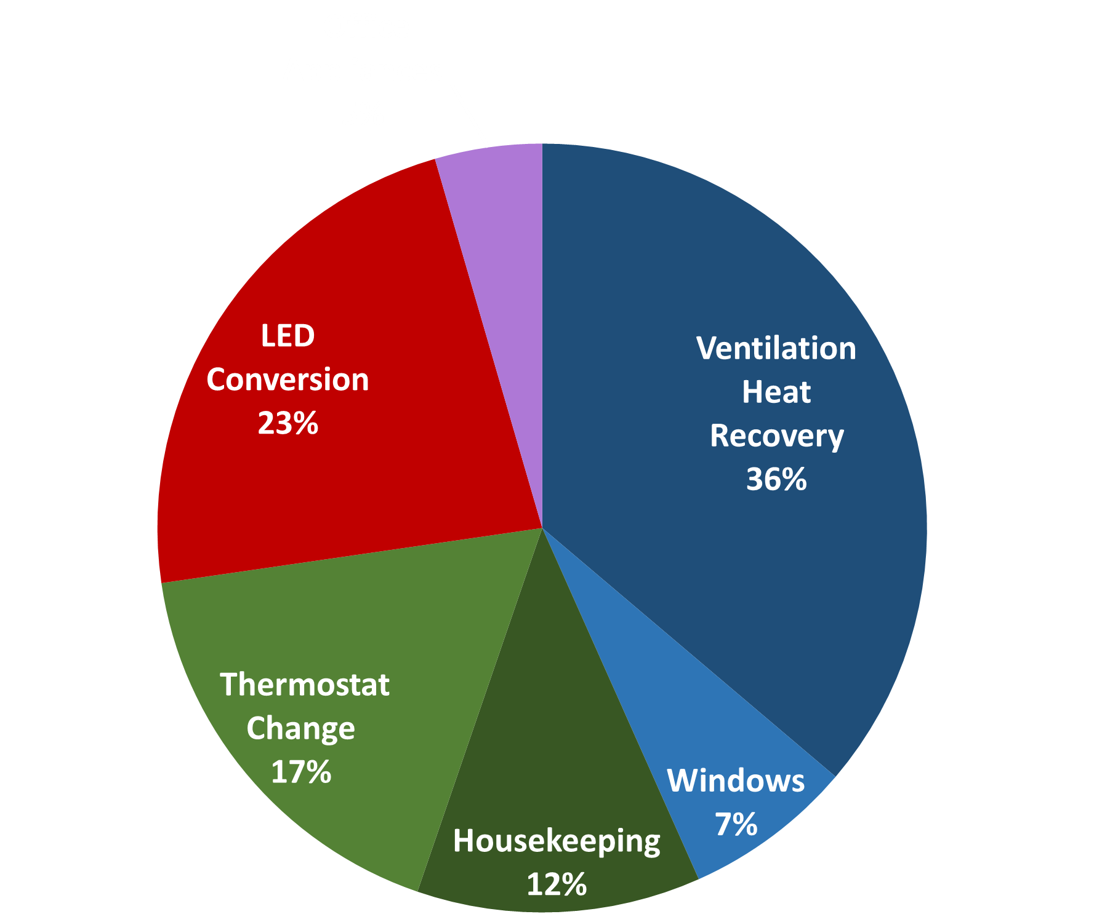
Science Complex Savings Opportunities

Slide 56
$91,091 /yr

Slide 57
CFAC
Team Members:
Caleb Meindertsma
Dan DeVries
Tobin Tarantowski
Zach Carney
Vincent Rovedatti
Notes:
CFAC Building
Covenant Fine Art Center
Names

Slide 58
CFAC Savings Opportunities
Project | Initial Cost | Rebate | Annual Savings | Payback Period
Lighting | $ 54,038 | $ 5,035 | $ 7,233 | 6.77 years
Windows - Reflective Coating | $ 6,354 | $ 1,200 | $ 2,488 | 2.11 years
Heat Recovery | $ 103,522 | $ 0 | $ 20,997 | 4.93 years
Thermostat Change | $ 0 | $ 0 | $ 9,843 | 0 years
Totals | $ 163,914 | $ 6,235 | $ 40,521 | 3.93 years
Notes:
Table
Recommended Projects
Temperature Change
Totals

Slide 59
CFAC Savings Opportunities
Notes:
Pie Chart
HVAC - Heat Recovery and Reflective Coating
Operational - Temperature Change
Lighting - LEDs

Slide 60
$40,521 /yr
Notes:
Graph
Initial Investment
Rebates
Savings Rate
Payback Period

Slide 61
Project Totals and Summary
Notes:
Project Total and Summary

Slide 62
Collective Results
CFAC
$40,521/yr
$324,930/yr
KHVR
$17,094/yr
Science Complex
$91,091/yr
SE
$16,468/yr
SFC
$78,079/yr
Extra Buildings
$81,677/yr
Notes:
Collective Results
CFAC
KHvR
Science Complex
SE
Spoelhof Fieldhouse Complex
Extra Buildings
Grand Total!!! - $324,000 / year :(
I know what you're thinking, “Aren't we supposed to save $600,000???”
Aren’t there more buildings on campus than 6?
Glad you asked

Slide 63
Extrapolating Savings
Prince Conference Center
Spoelhof Center
Hiemenga Hall
Engineering Building
Devos Communications Center
Knollcrest East Apartments
Chapel
Commons and Commons Annex
Knollcrest
Mail and Print Service Buildings
Covenant Fine Arts Center
Science Complex
Spoelhof Complex
SE and KHvR Dorms
Extra Opportunities
Notes:
Extrapolating Savings
On the Left are the Buildings we studied
On the Right are the Building we extrapolated too
using similar buildings and square footage
We added these together to give us!!!!
Wait for it!!!

Slide 64
$ 604,485 /yr
Notes:
Wait for it!!! (Click)
$604,485/yr!!!!!

Slide 65
Best - $703,345 /yr
Nominal - $604,485 /yr
Worst - $505,625 /yr
Notes:
Uncertainty Figure
Based on Initial Cost and Savings Rate
Estimated Uncertainty to be 20%
Nominal - $604,000/yr
Worst - $505,000/yr
Best - $703,000/yr

Slide 66
What would it take for Calvin College to save
$600,000 per year
on campus operations?
Notes:
To answer the Question “What would it take for Calvin College to save $600,000 per year?”

Slide 67
Final Recommendation
$2,144,634 Investment
$250,445 Rebate
$604,485 Annual Savings
3.13 Years Payback Period
Notes:
Our Final Recommendation would be
$2.1 million investment
$250,000 Rebate
$604,485 Annual Savings
3 Year Payback Period

Slide 68
Special Thanks
Professor Heun
Phil Beezhold
Jack Phillips
Lauren Grimley - CERF
ENGR-333 class for all the hard work!
Notes:
Special Thanks
Professor Heun for being an amazing teacher
Phil and Jack giving us this opportunity and bringing us this project and answering our questions
Lauren Grimley for answering all of our questions
ENGR - 333 Class for all the Hard Work

Slide 69
Additional Thanks
Adam Tozer
Ashley Kelver
Caroline Chadderdon
Donald Levy
Jay Wise
John Witte
Justin Tebrake
Larry Van Hoe
Peter Ye
Sandy Palmatter
Tim Bakelaar
Tom Diepstra
Notes:
Additional Thanks
To all the others that helped to succeed in this project.
We really appreciate it!

Slide 70
Questions
Notes:
Question
Any Questions?

Slide 71
Appendices

Slide 72
Non-Recommended Projects
Hair Dryers
Computer shutdown instead of sleep
HRV’s in Dorms
Two-stage flushing toilets
Manual (non-electric) treadmills
Motion Sensors
Human powered machines - harvesting electricity from gym
Key card lights in dorm rooms
Housekeeping vacuum reduction
Notes:
We were cautioned against using motion sensors because they don’t always work and can cause lots of hassle and money to fix and replace them, but we believe implementing them in hallways would be worthy of further investigations

Slide 73
Future Work
Power Plant
Shutting down buildings on Sundays
Optimizing class schedules and shutting down buildings earlier
Motion sensors in hallways
Energy and efficiency live-updating website to educate and inform students
More performance readings for systems
Notes:
We were cautioned against using motion sensors because they don’t always work and can cause lots of hassle and money to fix and replace them, but we believe implementing them in hallways would be worthy of further investigations

Slide 74
Heat Recovery Savings
Notes:
Cost savings are seen in the mass of fuel, which is the fuel saved by the HRV.
In general, buildings in colder climates like Michigan benefit more from HRVs.
Larger buildings benefit more from HRVs.

Slide 75
Reduce Shower Times Model
Notes:
Reduce shower times to 5 minutes
Use shower data from CERF for average shower time, temperature, and flow rate
Implement in dorms and fieldhouse locker rooms
Savings from water usage and heating the water
Initial cost in countdown self timers

Slide 76
LED Conversion Implementation
Biggest savings first
Heavy usage classrooms and labs
Library
Hallways
Smaller savings in phase II
Bathrooms
Closets
Basement labs
Notes:
We suggest going for the biggest savings and fastest paybacks first, which is the SB and DVH hallways. One more thing to note is that we did not do anything with motion sensors on the advice of Jack Phillips (too much hassle, spend more time and money fixing and troubleshooting and replacing sensors than they are worth). However, we think that re-evaluating the possibility of motion-sensors in the hallways would be the next step to take after implementing LED conversions, as hallways had lots of usage time with lots of lights, and motion sensors would make sense in those locations.

Slide 77
Operational Changes - Science Complex
Recommendation: Reduce hours cleaning crew work by 1/6th
Issues
Required student employment
Dirtier buildings
Proposed solution
Add an energy efficiency projects coordinator position

Slide 78
Behavioral Changes
Limiting Usage of Appliances in Faculty Office Space
Recommendation: Restrict faculty appliance usage to faculty lounges except when absolutely necessary.
Rebound Effects
Complaints when HVAC is not evenly distributed
More faculty communication

