Slide 1
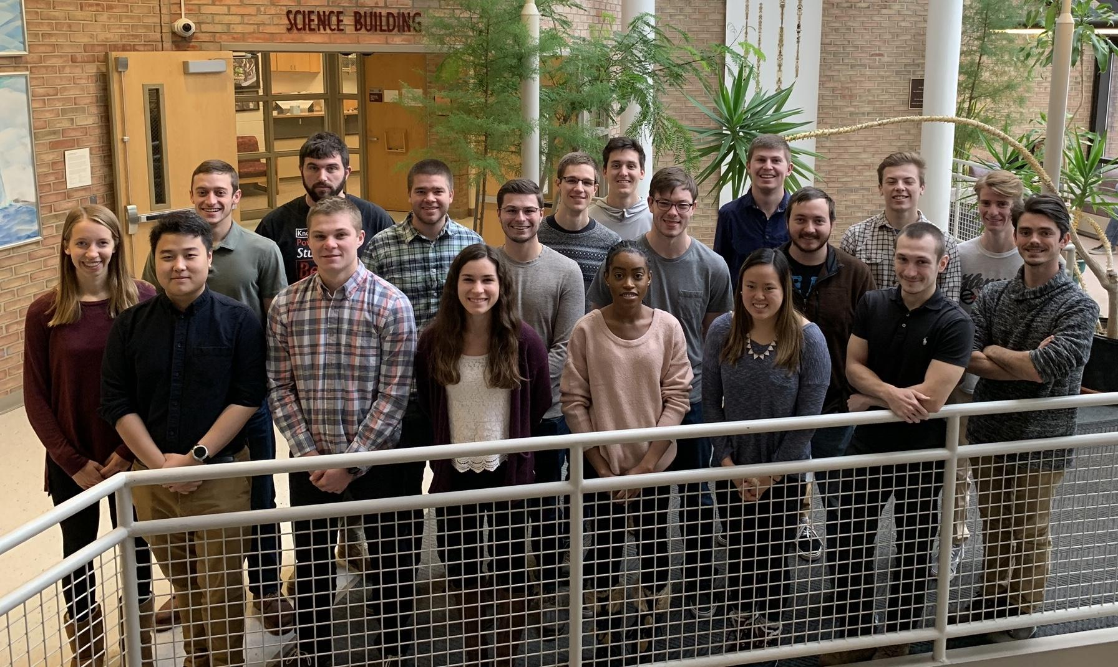
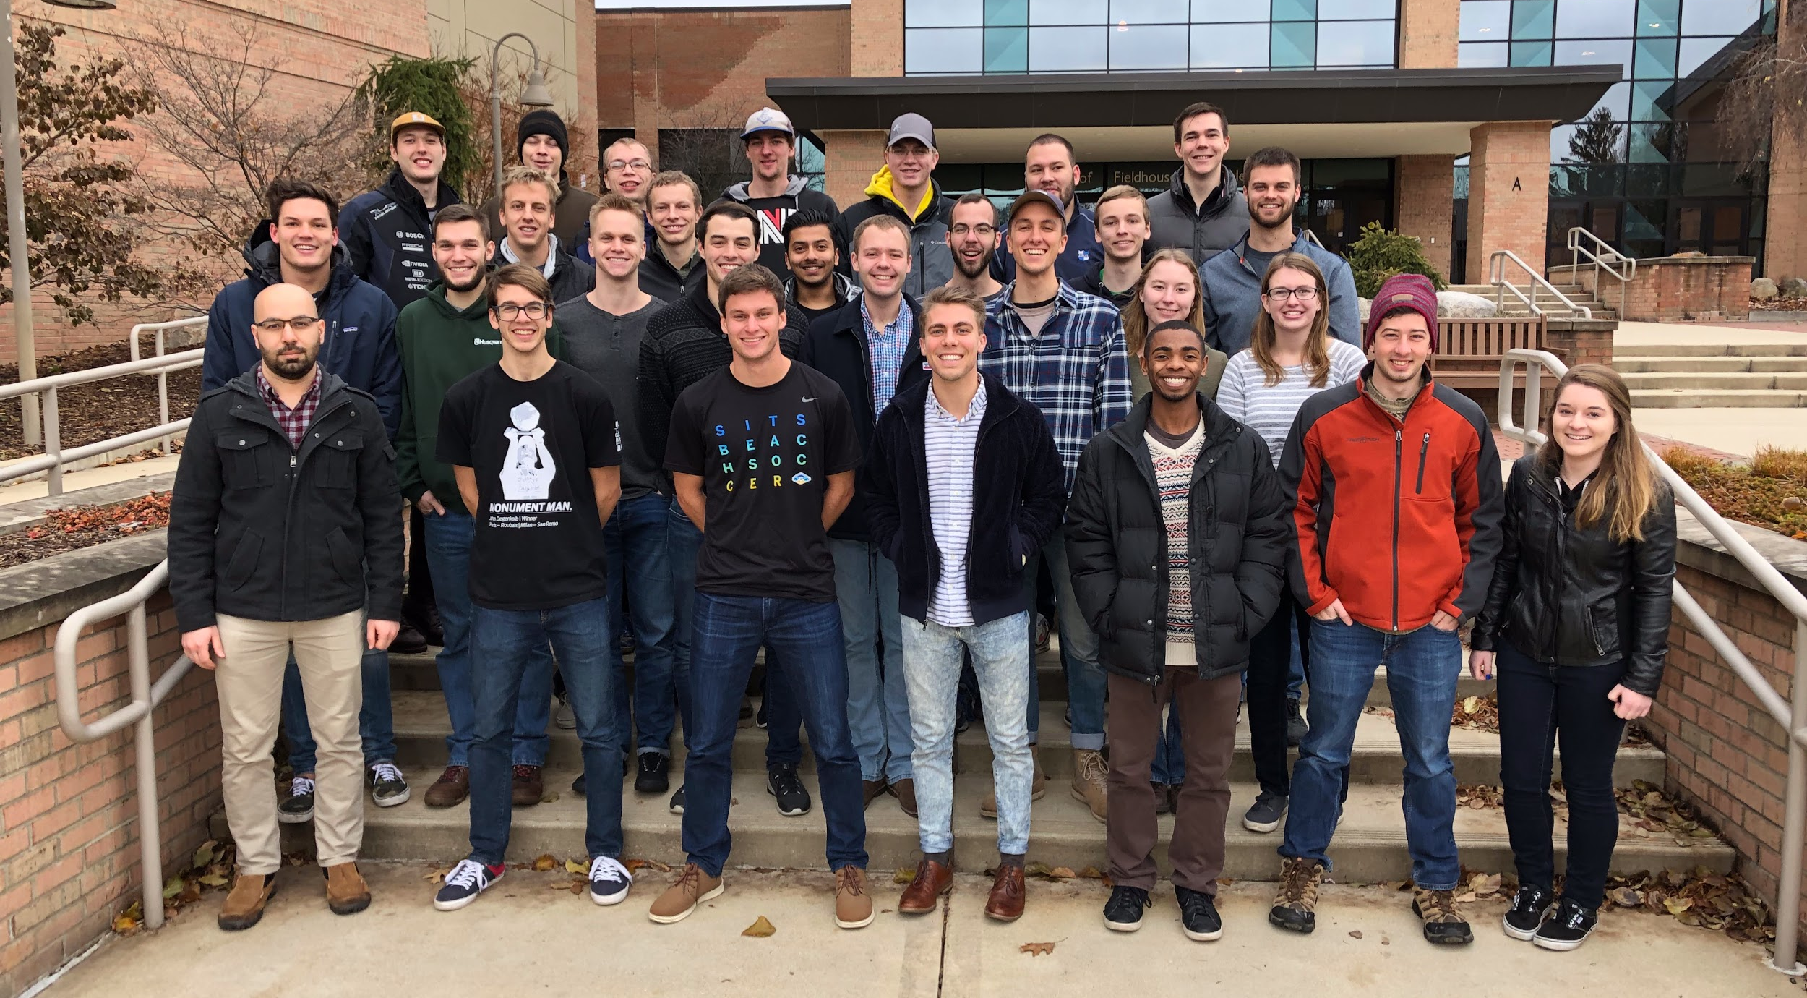
Renewables at Calvin
ENGR 333: Thermal Design and Optimization
Rachel Evans, Alex Gross, Daniella Sugijanto, Jake Shaarda

Slide 2
Problem Statement
What is the largest possible reduction in Calvin’s annual energy expenses from a $5 M investment in renewable energy?
Calvin’s current energy expenses: $3 M/year

Slide 3
Outline
Renewable Energy Technologies
Main Recommendation
Analyses
Options & Alternatives
Conclusion

Slide 4
Renewable Energy Technologies

Slide 5
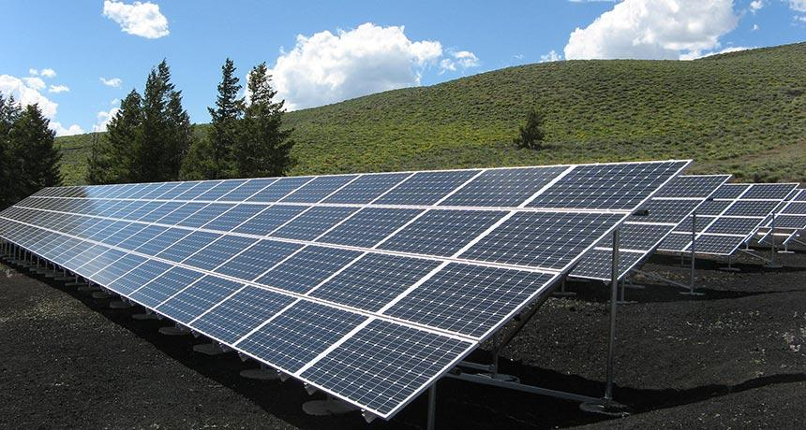
Solar
Energy from sunlight
Focus on photovoltaic (PV) panels
https://www.sciencenews.org/blog/science-ticker/solar-panels-are-poised-be-truly-green

Slide 6
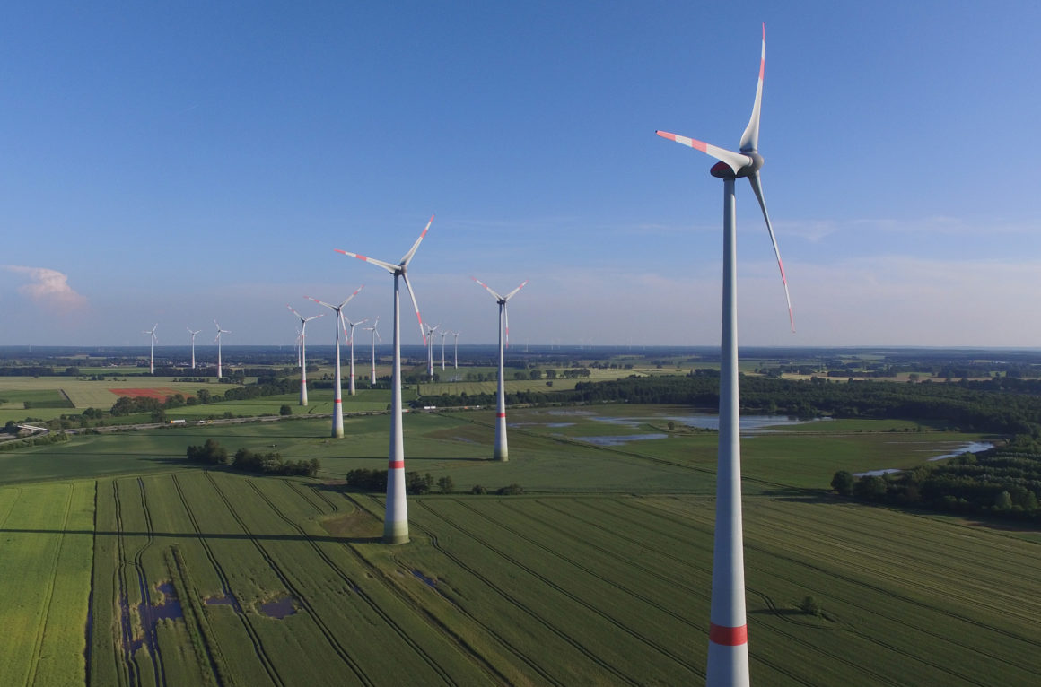
Wind
Electricity from wind
Height restrictions around airport
https://www.politico.eu/article/small-old-wind-towers-make-for-big-new-problems/

Slide 7
Geothermal
Electricity
Heating and Cooling
https://getech.com/plate-tectonics-50/
https://cairhvac.com/geothermal-heat/
Notes:
Use earth as heat source in winter, heat storage in summer

Slide 8
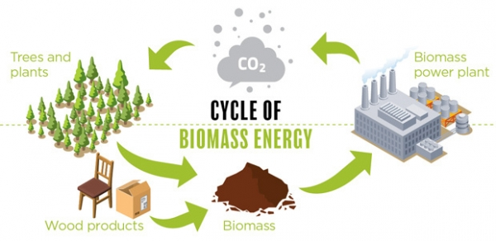
Biomass
Energy from waste/OM
Large implementation costs
Not viable at Calvin
https://www.canadianbiomassmagazine.ca/biofuel/any-renewable-energy-solution-requires-extracting-the-full-value-of-biomass-6499

Slide 9
Main Recommendation

Slide 10
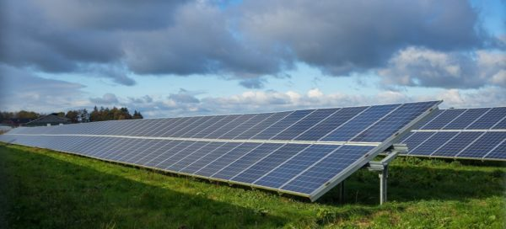
Main Recommendation
Invest into solar technology (~$3.5 M)
Covers 10% of Calvin’s electricity needs
Reduces CO2 emissions by 6.7%
Options available for remaining funds
https://earth911.com/eco-watch/energy/community-solar-farms/
Notes:
Say how both sections reached same conclusion with different analyses
*confirm CO2 emissions %

Slide 11
Analyses

Slide 12
Section B Analysis

Slide 13
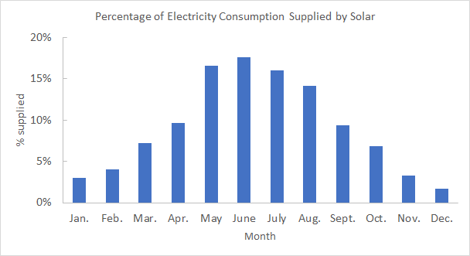
Main Recommendation
Max out rooftops with solar
$3.7 M
5889 solar panels (~5 acres)
2.115 GW-hr/yr
$184 k/year
20-year payback
Notes:
10 percent of Calvin’s energy usage

Slide 14
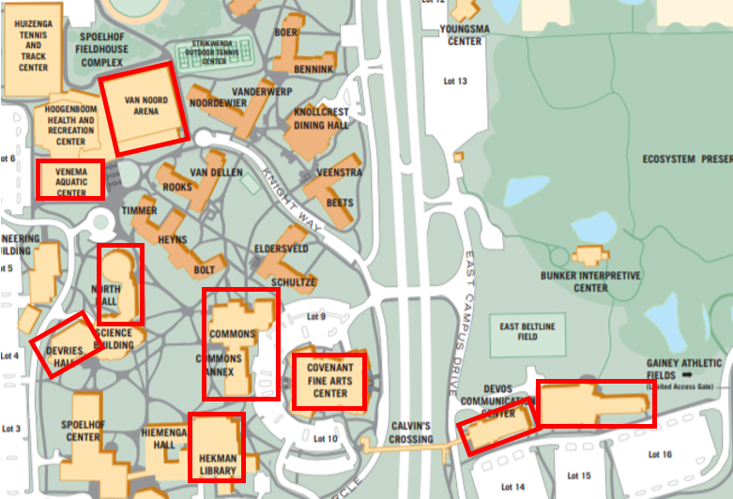
Rooftop Locations
Using all possible available roof space
Weight/loadings
Tree cover
Calvin architecture group
https://calvin.edu/map/campusmap.pdf
Notes:
Discuss unusable roof space (loading, tree cover, sacred spaces, etc.), Calvin architecture group
System advisor model

Slide 15
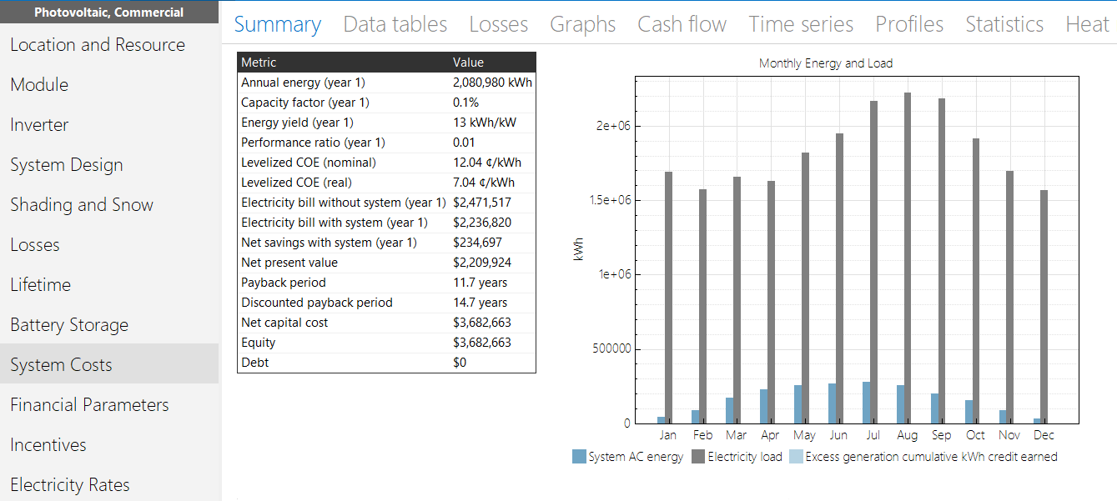
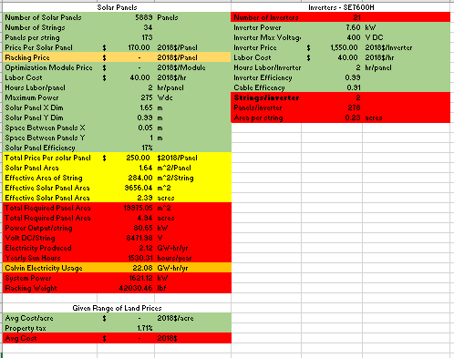
Calculations - SAM vs. Our Model
System Advisor Model (SAM)
NREL
Uses GPS to draw up the entire system
Long processing time
Our model
Built in Excel
Weather data, life cycle analysis, panel orientations
Within 10% of SAM
Notes:
Life cycle analysis = costs, maintenance, end of life, etc.

Slide 16
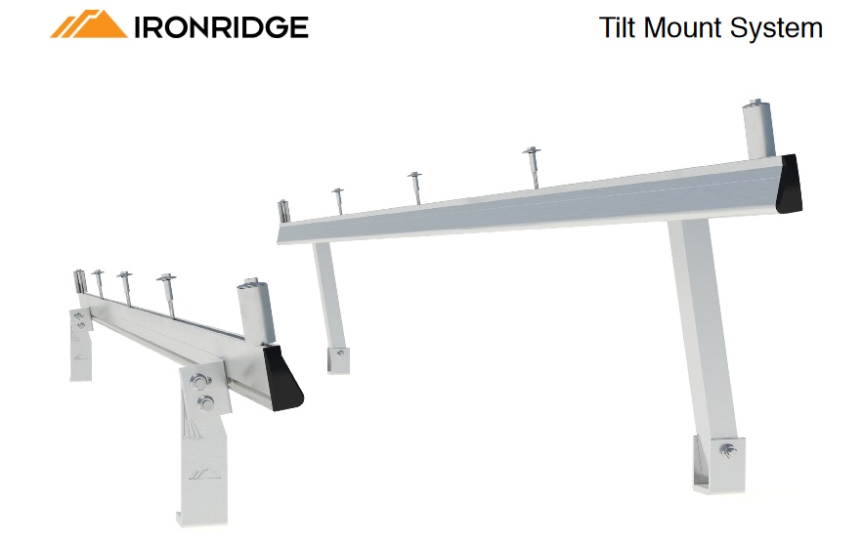
Solar - Equipment Choices
Solar Panel
Inverter
Racking
https://www.civicsolar.com/product/canadian-solar-cs6k-300ms-300w-mono-quintech-blkwht-solar-panel-5bb
https://www.sma-america.com/products/solarinverters/sunny-boy-30-us-38-us-50-us-60-us-70-us-77-us.html
http://files.ironridge.com/flat-roof-mounting/resources/brochures/Tilt_Mount_Data_Sheet.pdf
Notes:
Panels
Canadian Solar, polycrystaline (CS6K-275P)
$0.71/watt
>0.006 m^2/W
Notes
Not the most efficient panel but gives cheapest cost per watt (½ of next closest), comparable area per watt
Inverter
Requirements
input : 200-400 VDC
Output: 240 VAC
Sunnyboy 6.0 SMA kW model
Racking
Angle, loading spacing of beams, snow load, material

Slide 17
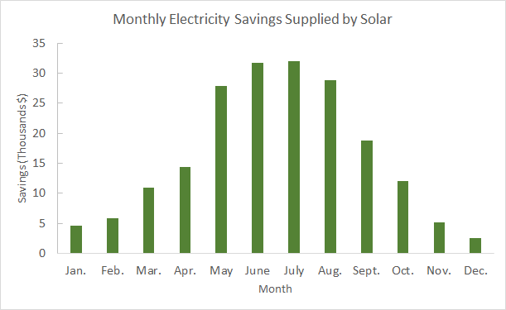
Why Solar?
Financial benefits
$184 k/year
Visual representation
Commitment
Easily scalable
Notes:
Scalable as if the budget shrinks or space availability changes

Slide 18
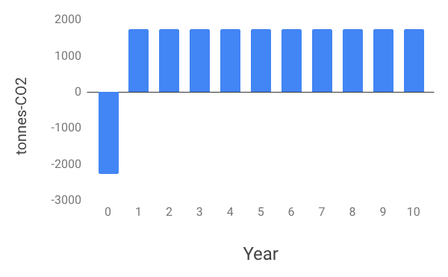
CO2 Emissions
Can payback its embodied CO2 emissions within 1.3 years
Would offset 1800 tonnes CO2 annually (6.8% of emissions)
Notes:
Possibly shorten bullet points
CO2 emitted to produce the product

Slide 19
Section A Analysis

Slide 20
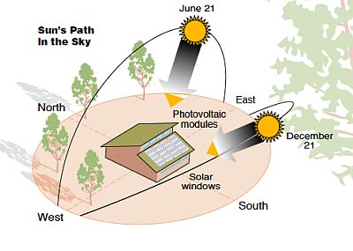
Goals
Goal - not to exceed the baseline electricity usage
Roof direction
Certain roofs - not feasible
Energy storage not practical
https://livingonsolarpower.wordpress.com/2013/03/08/how-the-sun-moves-through-the-sky/
Notes:
My name is Jake Shaarda and I am a member of Section A
As Dani and Alex said, both section A and B reached essentially the same conclusion, but with different kinds of analysis
Section A chose a goal based on the absolute priority of Responsible investment
Money was given to us, use it as wisely as possible
Never wanted a situation where energy or investment was being wasted - why we chose the baseline
Any energy that is produced but not used is a waste
In theory, there is opportunity for calvin to sell back into the grid
Current situation not favorable for buyback
Calculations performed based on electricity usage vs roof space
Effective roof space limited
Wanted to make sure the roofs would outlast the panels
South/Southeast facing roof space
Energy storage extremely expensive for the energy production from the panels- not practical for smaller scale investment like ours

Slide 21
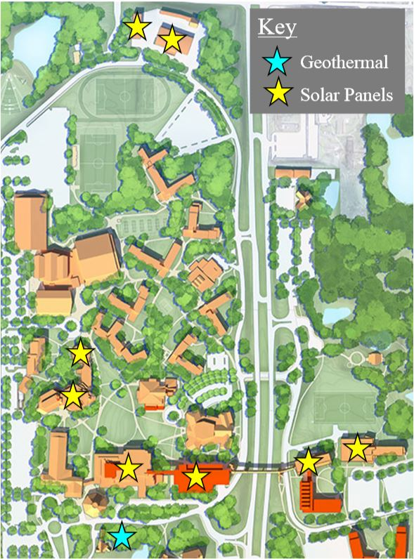
Main Recommendation
$3.34 M: Solar
$0.16 M: Residential geothermal
$225 k/yr savings
2.1 GW-hr/yr solar output
15-year payback
https://calvin.edu/master-plan/
Notes:
Moving on to Specifics
Section A chose to spend $3.34M on solar and $0.16M on residential Geothermal
$225,000 yearly savings - producing 2.1 GW-hr/year
15 year payback period
2 out of 6 geothermal locations

Slide 22
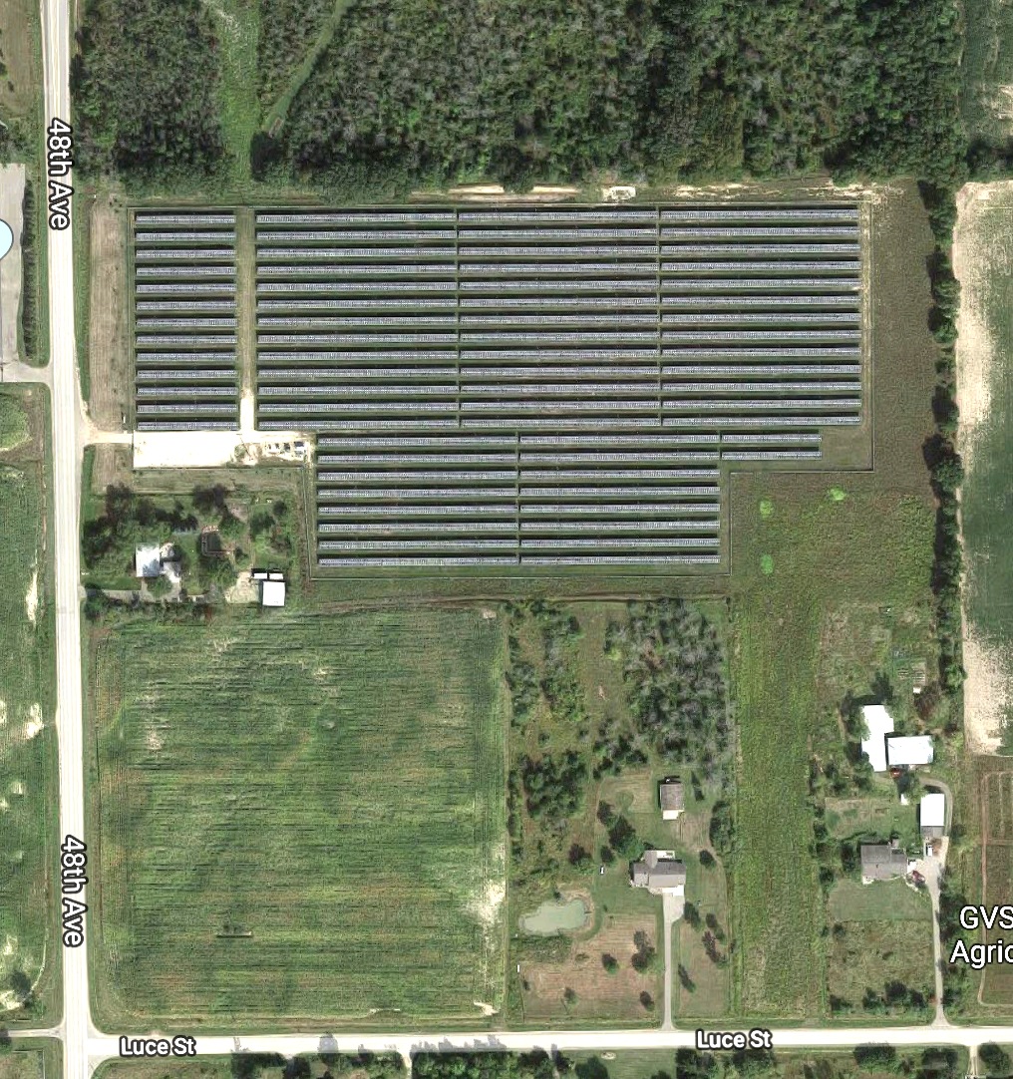
Research
GVSU’s Solar Garden
11,250 solar panels
17 acres of land
3 MW electricity production
Commissioned in 2016
Bunker Interpretive Center - Baseline Information
https://www.google.com/maps/
Notes:
Key: solar scales linearly
Partnership with consumers energy - not owned by GVSU
Bunker: different types of solar panels

Slide 23
Geothermal
Residential vs. commercial
Ventilation standards
Efficiency reduction
Exponential cost growth
http://josephdwalters.com/residential-vs-commercial-power-washing/
Notes:
Two main system distinctions under the heating and cooling system designation
Pretty self explanatory - your house is residential, your classroom or workplace is commercial
Increase heating and cooling load through ventilation
Have to increase system capacity - larger, more expensive
Drilling cost - Deeper holes for commercial
More piping, more expensive maintenance costs
Average cost of $7 vs $35 per square foot
As a result, especially when compared to the costs for the other renewables, specifically solar,
It was determined by Section A that commercial was not practical for an application at Calvin
Section A incorporated residential systems into the main recommendation
However, Section B will discuss a commercial system later on

Slide 24
Geothermal
Notes:
Now even under the scope of residential systems, there are several categories
Horizontal loop
Cheapest - easy maintenance, cheap install, cheap drilling
Area restriction
Pond Loop
Smaller and cheaper because of water’s higher heat capacity
Need a pond or body of water
Share advantages of horizontal loop
Vertical Loop
Optimal for areas with limited space
More expensive - deeper holes done with well drilling rig, not as easy to maintain, sometimes open loop
Section A has chosen to work with Horizontal Loop systems and possibly Pond Loop systems
Section B will go over a vertical loop system later on

Slide 25
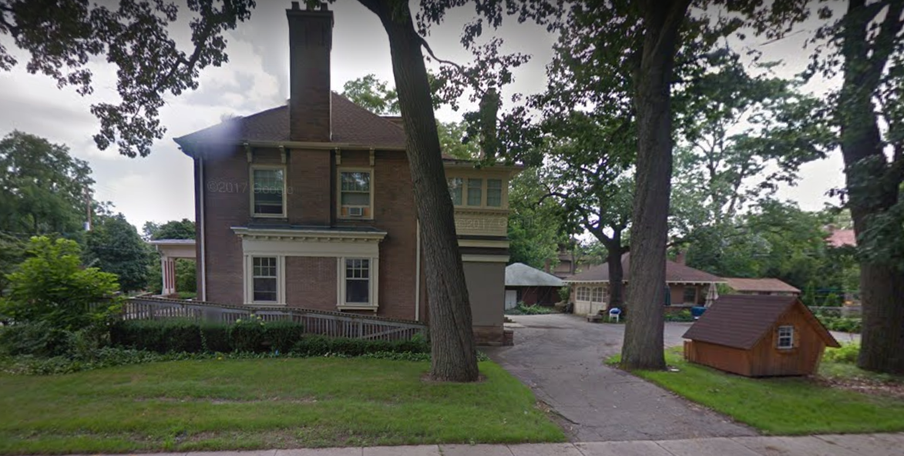
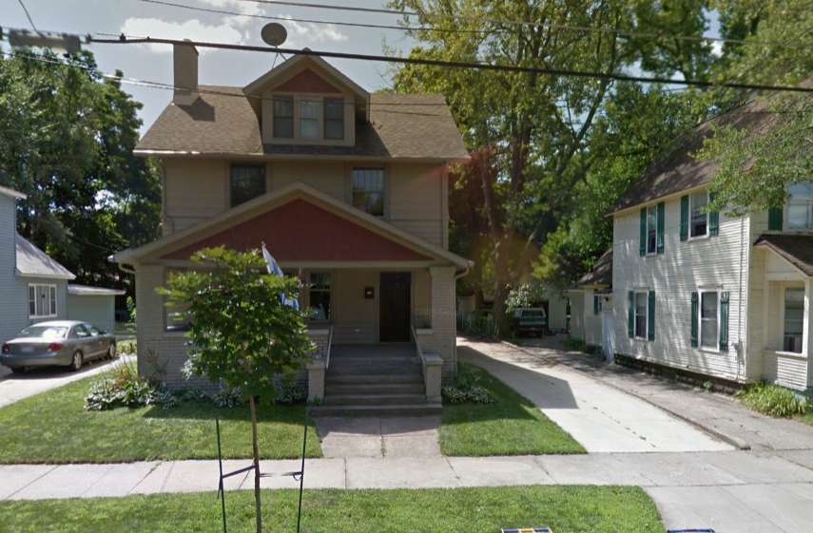
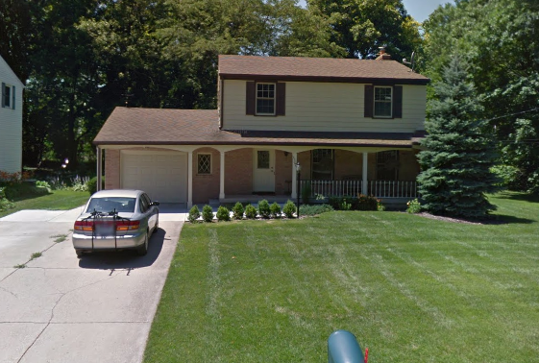
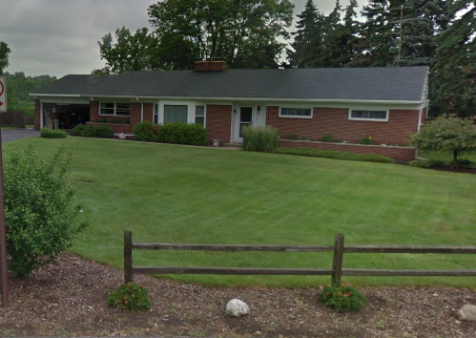
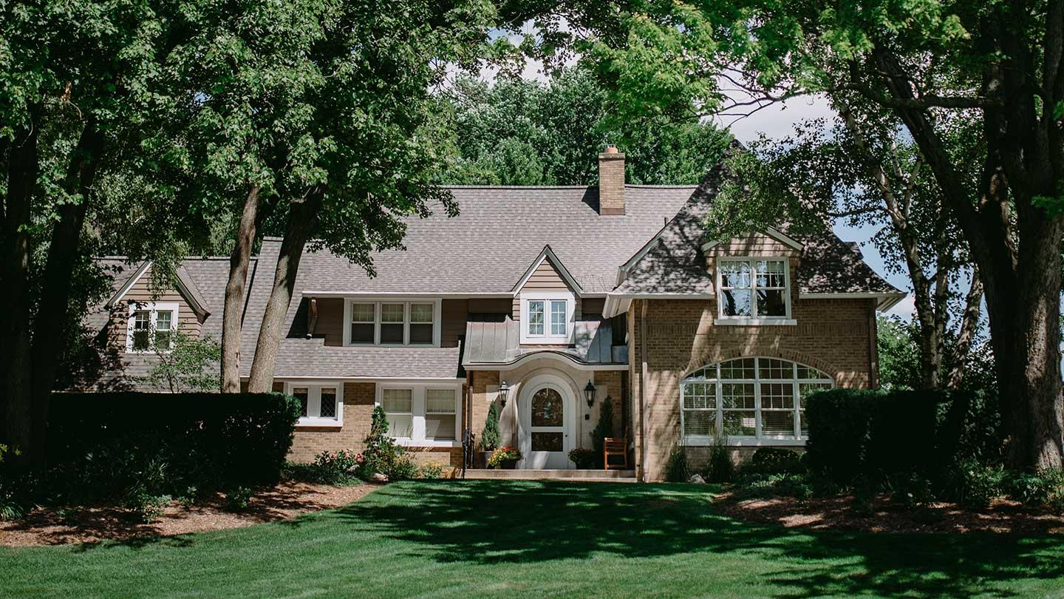
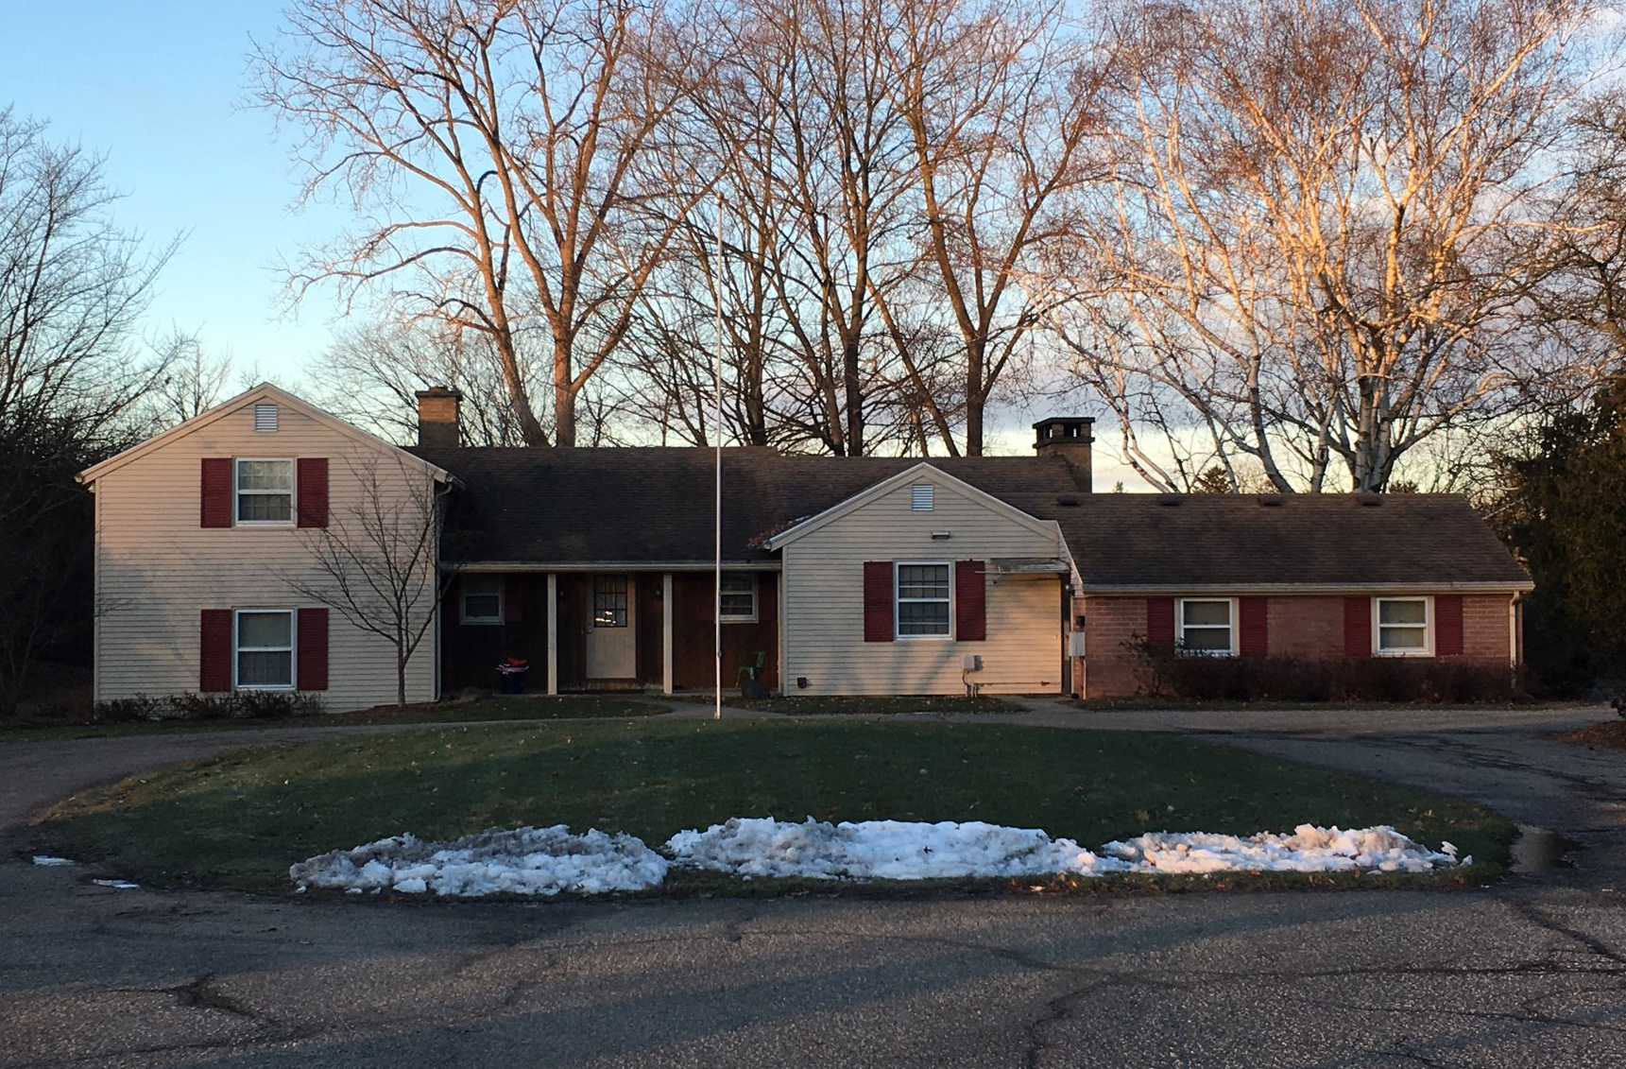
Geothermal Houses
$0.16 M initial investment
Calvin residential homes
Manor House and Perkins House
Potential growth
Total savings
$15 k annually
10-year payback
50-year lifetime
1230 Lake Drive
232 Travis St SE
1807 Observatory
3151 Hampshire
Dewitt Manor
Perkins House
Notes:
Total investment - $160,000
Within section A recommendation there are 6 homes - including the Manor House and the Perkins house
Opportunity for more, but chose these houses because Calvin pays the utilities
Have exact numbers for the yearly utility costs for these houses
Calculated using 3 installed residential systems
Estimated new utility costs - used to calculated payback period
No data for Manor House
2 Project Neighborhood Houses - $2,500 in annual savings
Total savings - $15,000 yearly
50 Year lifetime - system will pay for itself several times over
Space Restrictions for horizontal loop
Variables affecting costs
Estimated data, varying R value
Better estimates for costs if college chooses to go with geo

Slide 26
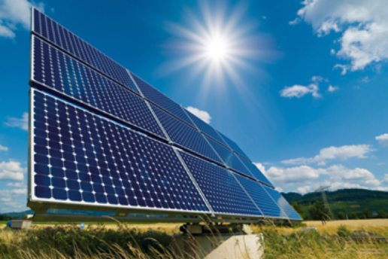
Commonalities
Base case cost: ~$3.5 M on solar
Solar rooftop area: ~5 acres
Payback period: ~17.5 years
Yearly energy production: ~2.11 GW-hr/yr
Annual savings: ~$200,000
https://cleantechnica.com/2015/05/14/todays-solar-panels-can-power-the-world-mit-study-finds/
Notes:
Both decided to spend about 3.5M on solar even though the calculations were performed differently
Both came to 5 acre rooftop space conclusion, but usage varied by section
Averaging out the payback periods we get around 17.5 year payback with about the same yearly energy production
Both sections also averaged a roughly $200,000 yearly payback
never push back to grid - value calculated using minimum electricity use - December
cover all available roof space

Slide 27
Options & Alternatives

Slide 28
Section B Option

Slide 29
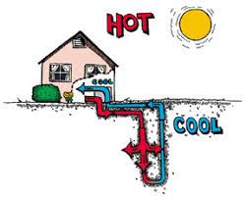
What can we do with $1.3 M?
Small Geothermal System
http://clipart-library.com/clipart/335024.htm
Notes:
Take out carbon credits

Slide 30
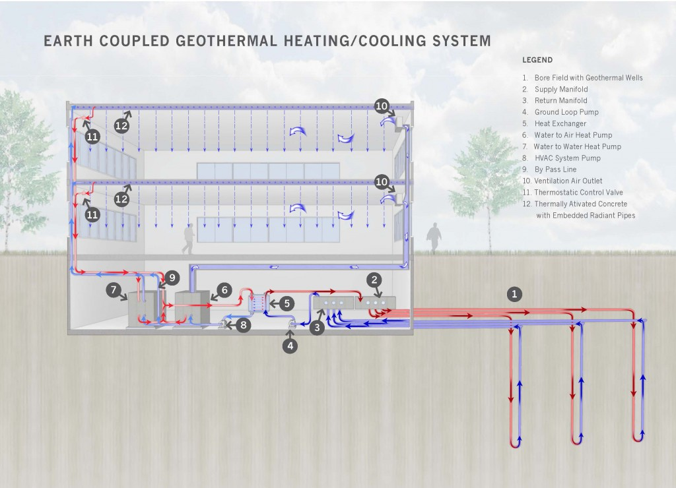
Geothermal
Install geothermal system in Commons lawn
75 400-ft. bores
Supplement the aging Kewanee boilers (65% efficiency)
Replace 11.3% of the Commons power plant capacity
Service 92,000 ft² (the size of BHT)
Total estimated net savings of $4 k/year
https://www.glumac.com/sustainability/design-strategies/share-resources/
Notes:
3.4% of CO2

Slide 31
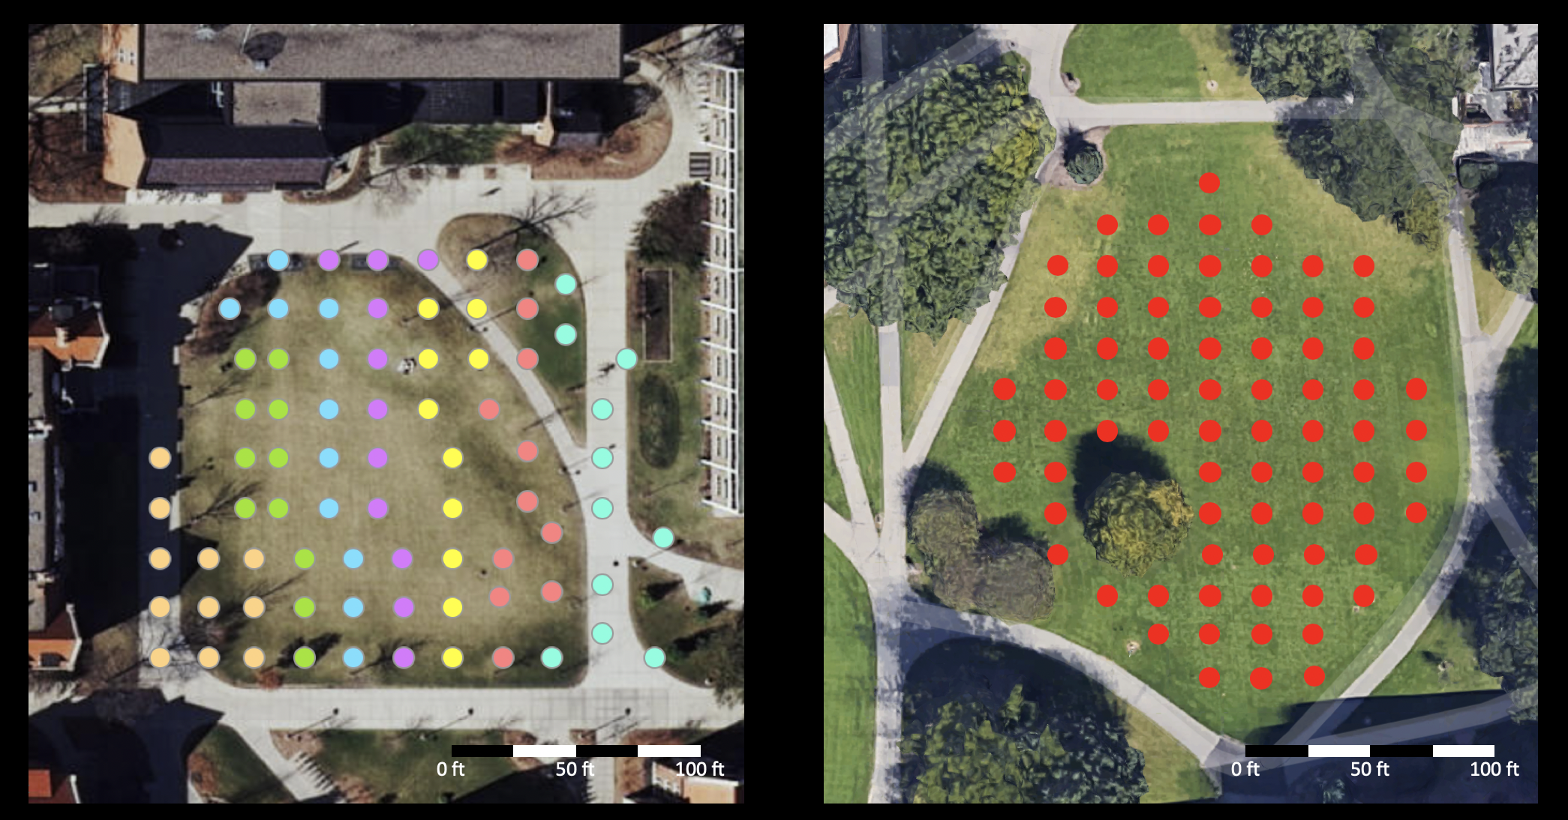
Class B - Option #1 - Geothermal
Carleton College
Commons lawn
https://apps.carleton.edu/geothermal/
https://www.google.com/maps/
Notes:
Left:
Carleton College, 77 bores
Right:
Commons Lawn, 75 bores, can decrease number of bores with drilling depths
-Supplement an aging boiler
Same scale

Slide 32
Section A Alternatives

Slide 33
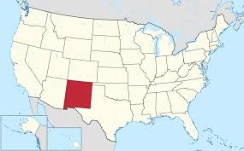
Section A - Alternatives
How can we maximize savings with the $5 M investment?
Alternative #1
Assumption: Grid buy back
On-Campus Solar
Alternative #2
Assumption: Off-site location
On and Off-Campus Solar
Alternative #3
Assumption: Wind is feasible
On-Campus Wind
https://www.consumersenergy.com/
https://en.wikipedia.org/wiki/New_Mexico
https://www.machinedesign.com/

Slide 34
Section A - Alternative #1 - Maximize Solar
Assumption: Michigan allows independent power producers to sell into the grid.
Best scenario for on-campus production
Exceed baseline consumption and sell into grid
$4.48 M on-campus solar
$157 k residential geothermal
Notes:
Assumption
Doesn’t make sense to buy infrastructure (too $$$) - so the best way to maximize the on campus production without overproducing.
Goal: Do not waste energy!!!!

Slide 35
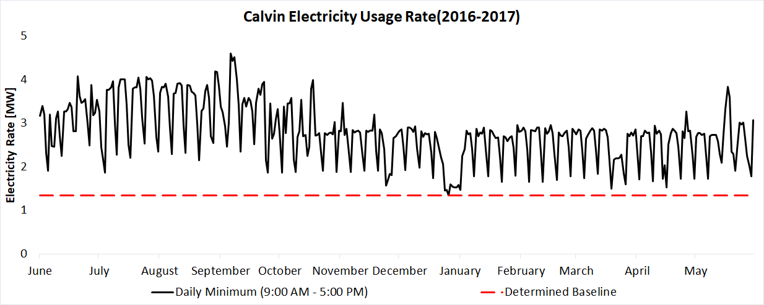
Yearly Electricity Use
Notes:
Explain the graph
Every 15 minutes recorded electricity use.
Vertical axis: MW electricity rate
Horizontal: fiscal year
Lowest point: christmas break. To never waste energy, don’t exceed that point.

Slide 36
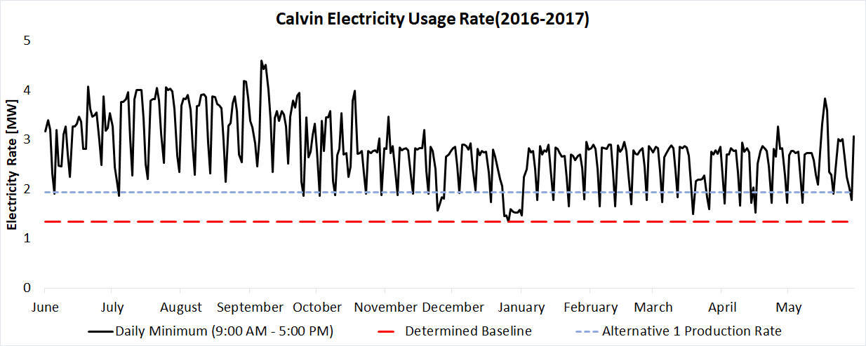
Yearly Electricity Use

Slide 37
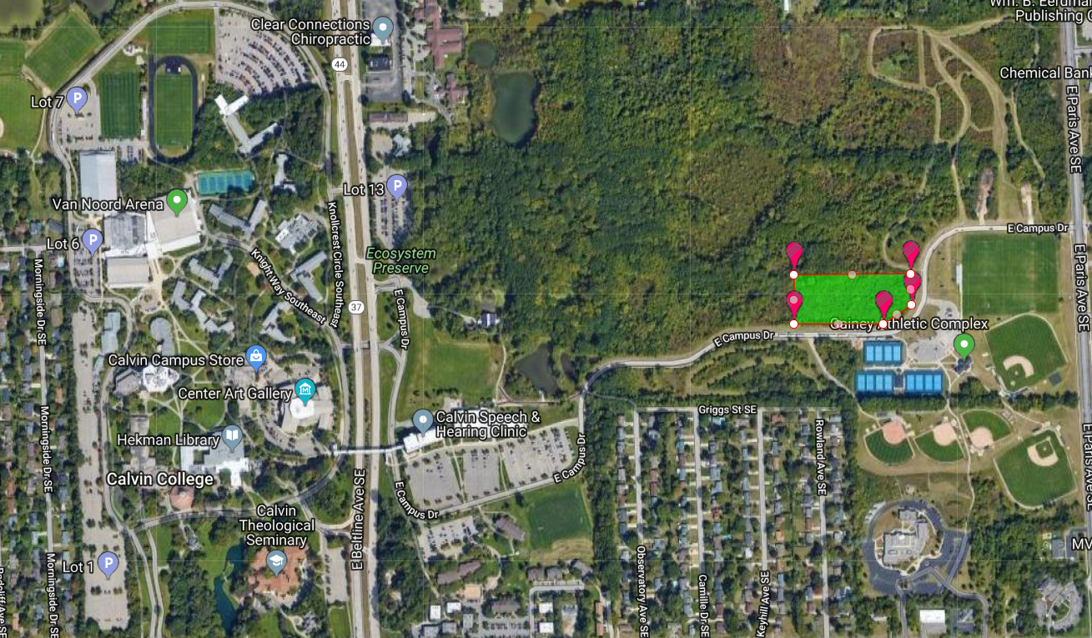
Section A - Alternative #1 - Maximize Solar
$4.84 M budget for an on-campus solar
$318 k/yr electricity savings
15-year payback period
7.41 acres needed
3.8 acres clearcut
3.8 Acres
https://www.google.com/maps/
Notes:
Because we didn’t want want to waste anything, the big assumption was buy back into the grid.
No infrastructure
2.97 GW-hr/yr production

Slide 38
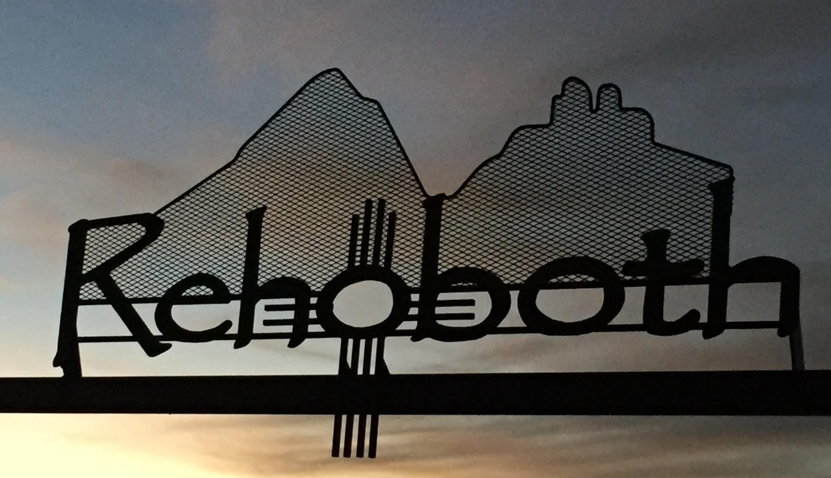
Section A - Alternative #2 - Off-Campus Solar
On-campus
Select roofs that are well displayed
Shows Calvin’s commitment to renewable energy
$1.2 M (24%) of budget would go on-campus
Off-campus
More area, and higher efficiency compared to Michigan solar
Potential partnership with Rehoboth Christian School
$3.6 M (72%) of budget would go on-campus
https://www.denverchristian.org/
Notes:
Roofs: new student union only
Goal: publicity

Slide 39
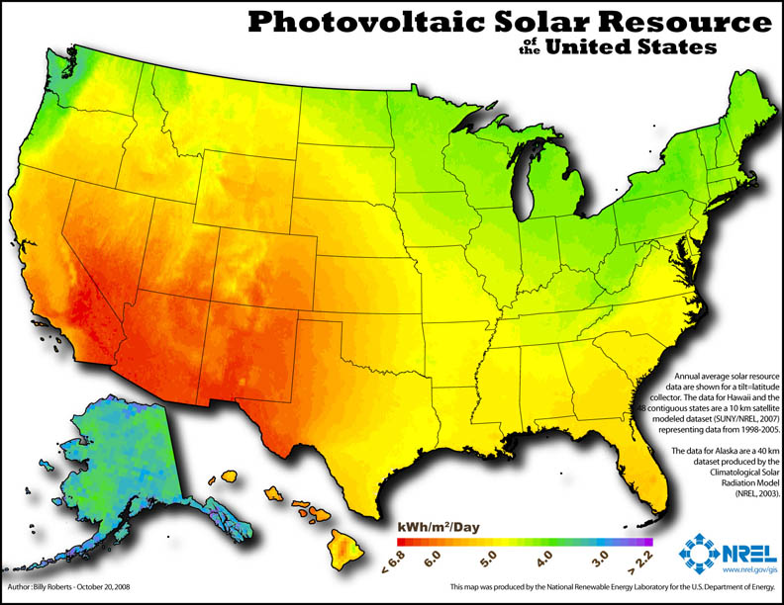
Section A - Alternative #2 - Off-Campus Solar
Rehoboth, NM
1.5x more sun
Increased ROI & payoff
Rehoboth contact
Unknowns
Sell back price → annual savings
https://www.eia.gov/energyexplained/index.php?page=solar_where
Notes:
Land Lease from Rehoboth
Contact is: Ken Zylstra, Director of Advancement of Rehoboth Christian School

Slide 40
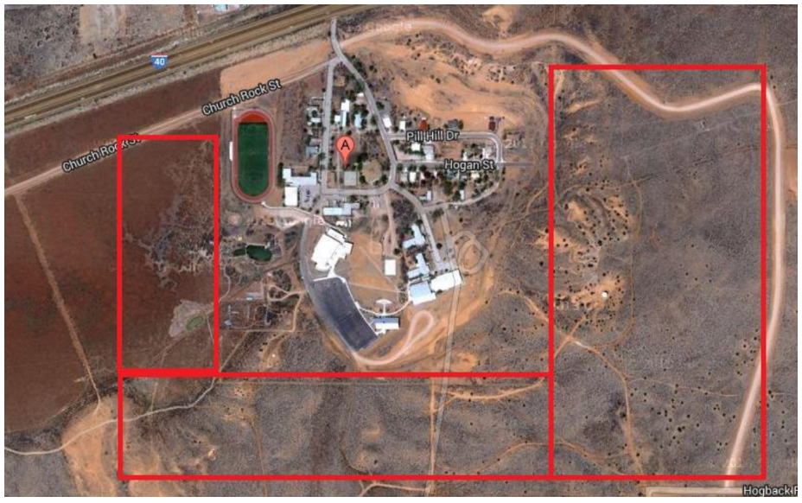
Section A - Alternative #2 - Off-Campus Solar
Rehoboth, NM
1.5x more sun
Increased ROI & payoff
Rehoboth contact
Unknowns
Sell back price → annual savings
https://www.google.com/maps/
Notes:
Land Lease from Rehoboth
Contact is: Ken Zylstra, Director of Advancement of Rehoboth Christian School

Slide 41
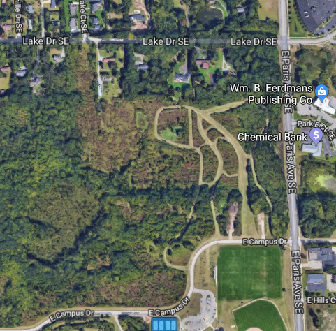
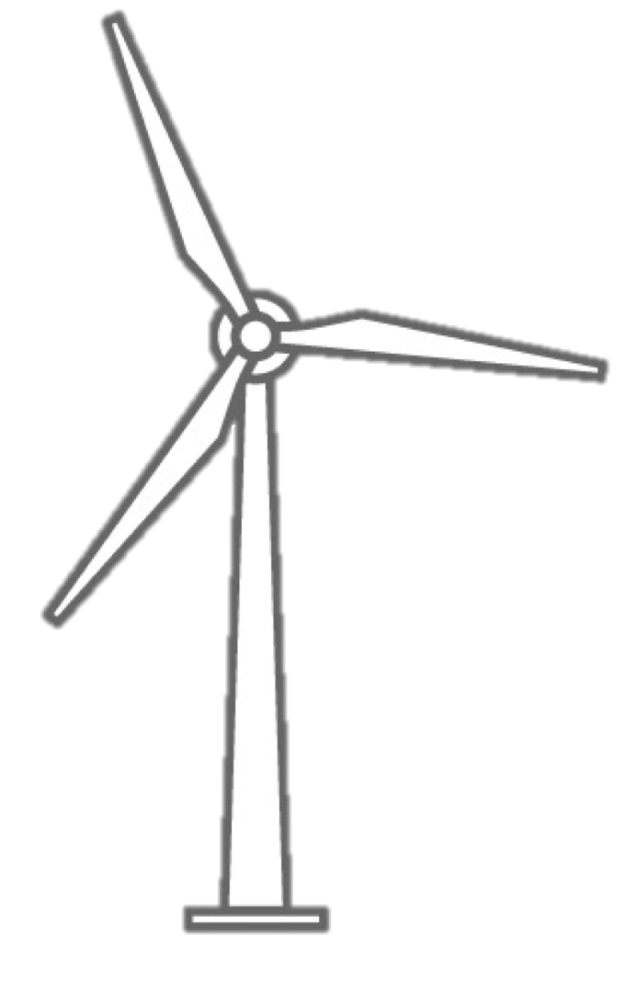
Section A - Alternative #3 - Wind
Assumption: Wind is feasible
$3.34 M on-campus
8 wind turbines
25-year payback
$125 k/yr savings
55 acres
https://www.google.com/maps/
Notes:
Original calculation: overly optimistic data
No data from the height that the turbines would be - 30m
On campus data is from 10m
Airport data is flat with no trees
$1.5Million on investment - carbon credits
Up to the discretion of the administration

Slide 42
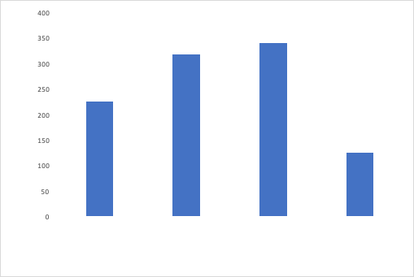
Section A - Cost Savings
Annual Savings
Savings (k$/yr)
Main Recommendation
Maximize Solar On-Campus
Off-Campus Solar
On-Campus Wind
15 yr payback
15 yr payback
14 yr payback
25 yr payback

Slide 43
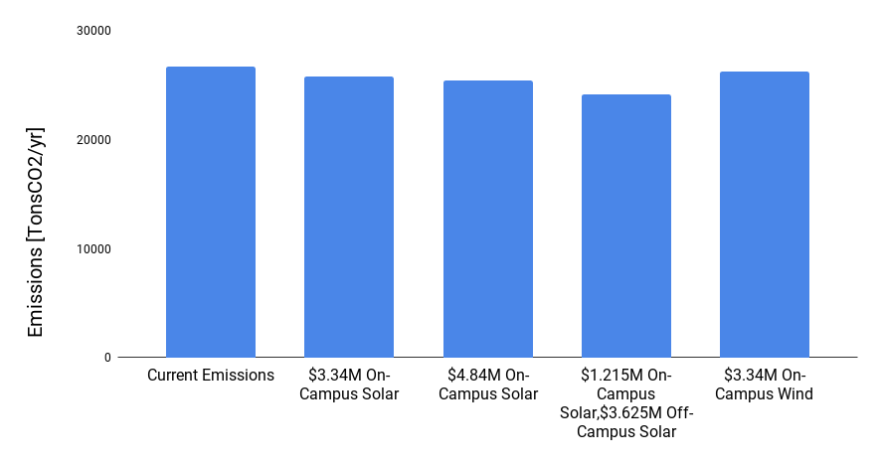
Section A - CO2 Emissions
Overall Emissions

Slide 44
Section A - CO2 Emissions
Overall Emissions

Slide 45
Conclusions

Slide 46
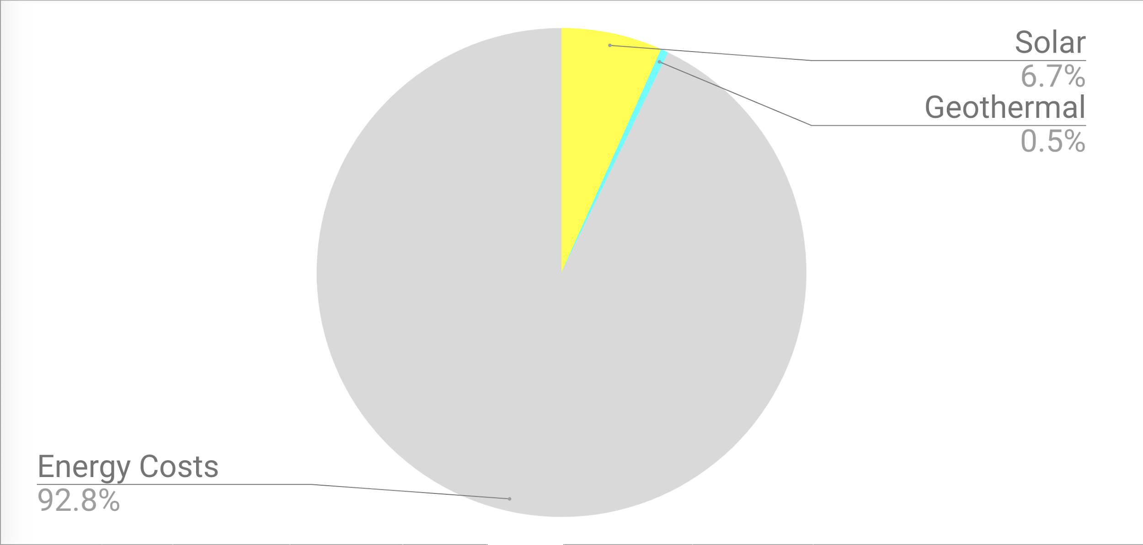
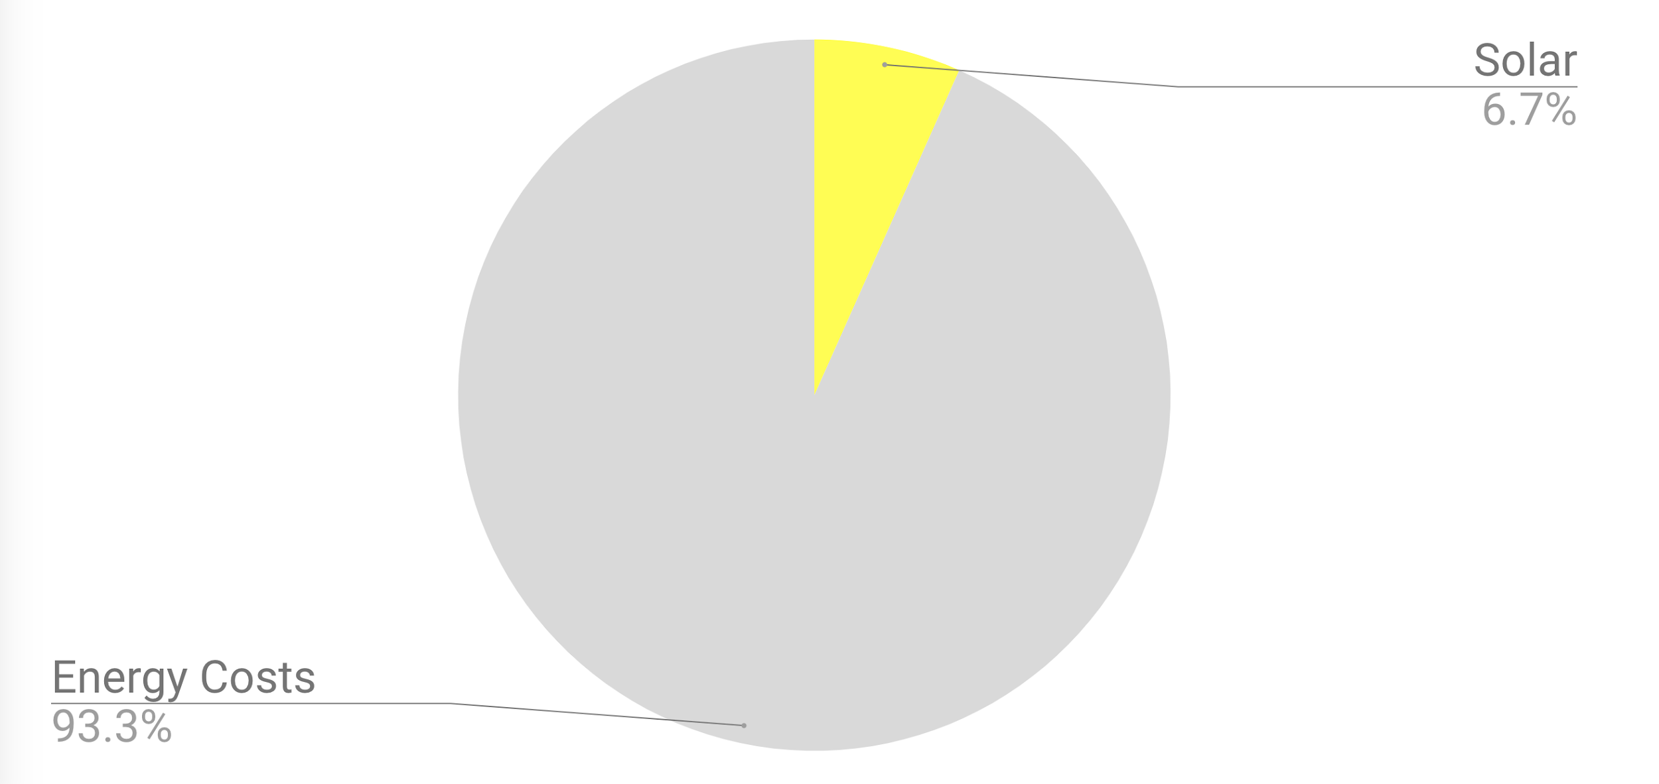
Financial Summary
Notes:
Add Financial Pie Chart
$3.5 M solar investment
Save $200 k/year
Payback time: 17.5 years

Slide 47
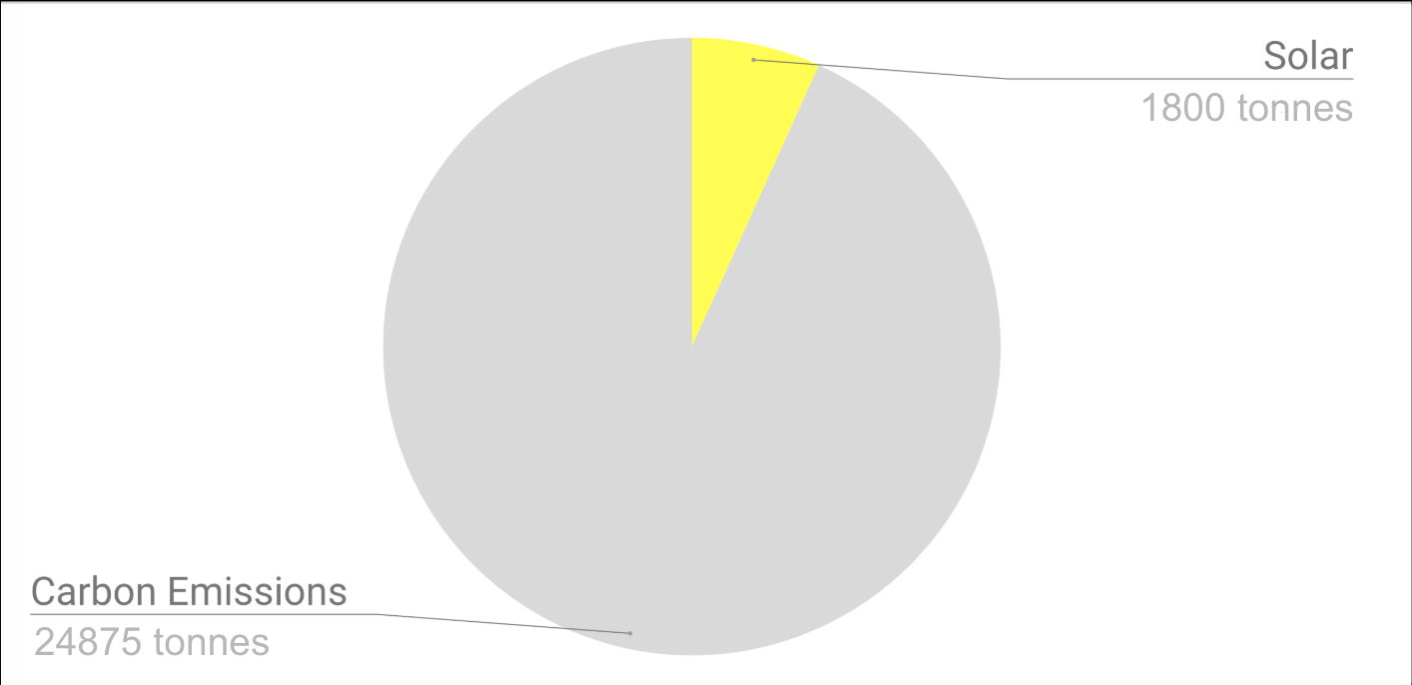
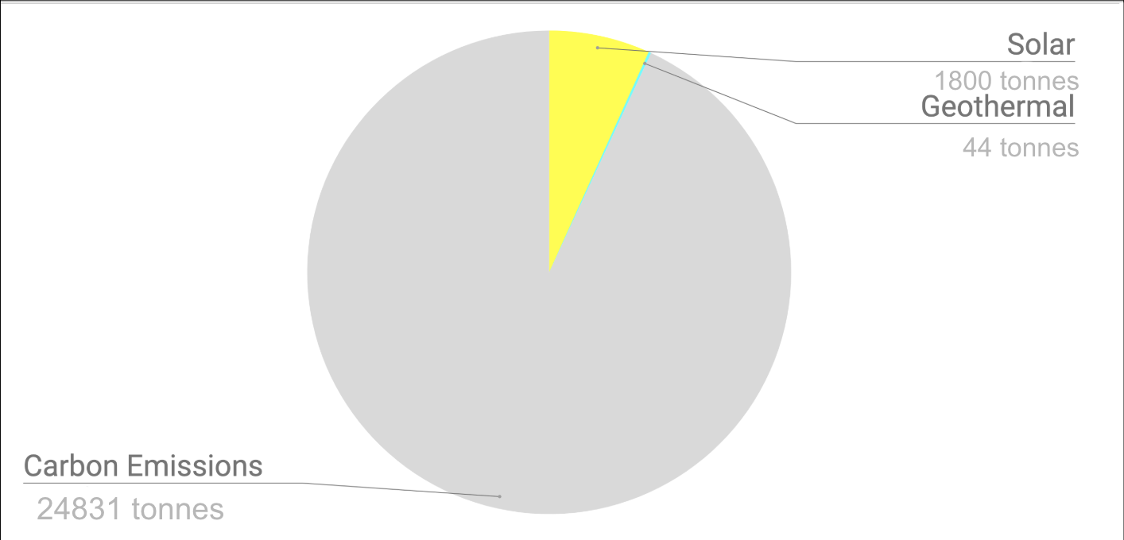
Carbon Impact
26675 tonnes
Notes:
*DO NOT CHANGE
~10% CO2 savings
*tonnes (metric), not tons (english)
*confirm the “3.4%” -> Old 900 tonnes/yr numbers
*for geo. Use B’s system (savings 790 tonnes/yr,) ~3%
*should be 6.7% for solar, (1800 tonnes/yr)/26675 tonnes/yr
Carbon reduction is hard: we have to start somewhere

Slide 48
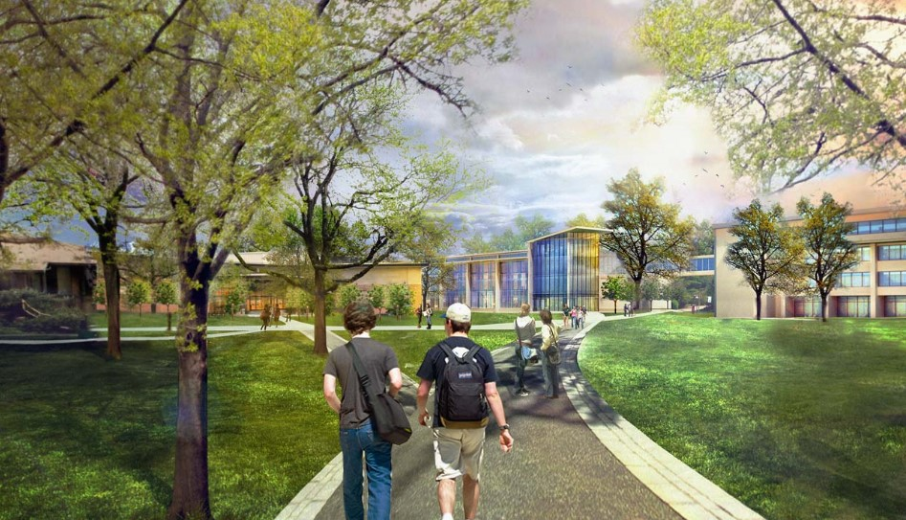
What’s next?
Consider renewables for future buildings
Detailed study of solar options on campus
Wind study

Slide 49
Acknowledgements
Russell Bray - Director of Physical Plant
Ken Zylstra - Rehoboth Christian School
Becky Haney - Economics Department
Rod Boreman - Greensleeves
Leonard DeRooy - Engineering Department
Jack Phillips - Physical Plant

