Slide 1
Low-Carbon Housing Project
Speakers: Anika Huizinga, John Stehouwer, William Terpstra, Duncan Waanders
Engineering Seminar SB010 | December 1st, 2021
Presented by Engineering 333
Notes:
Hello, I am Duncan Waanders and this is the Low-Carbon Housing Project Seminar to present the work from this year’s Engr 333 class project.

Slide 2
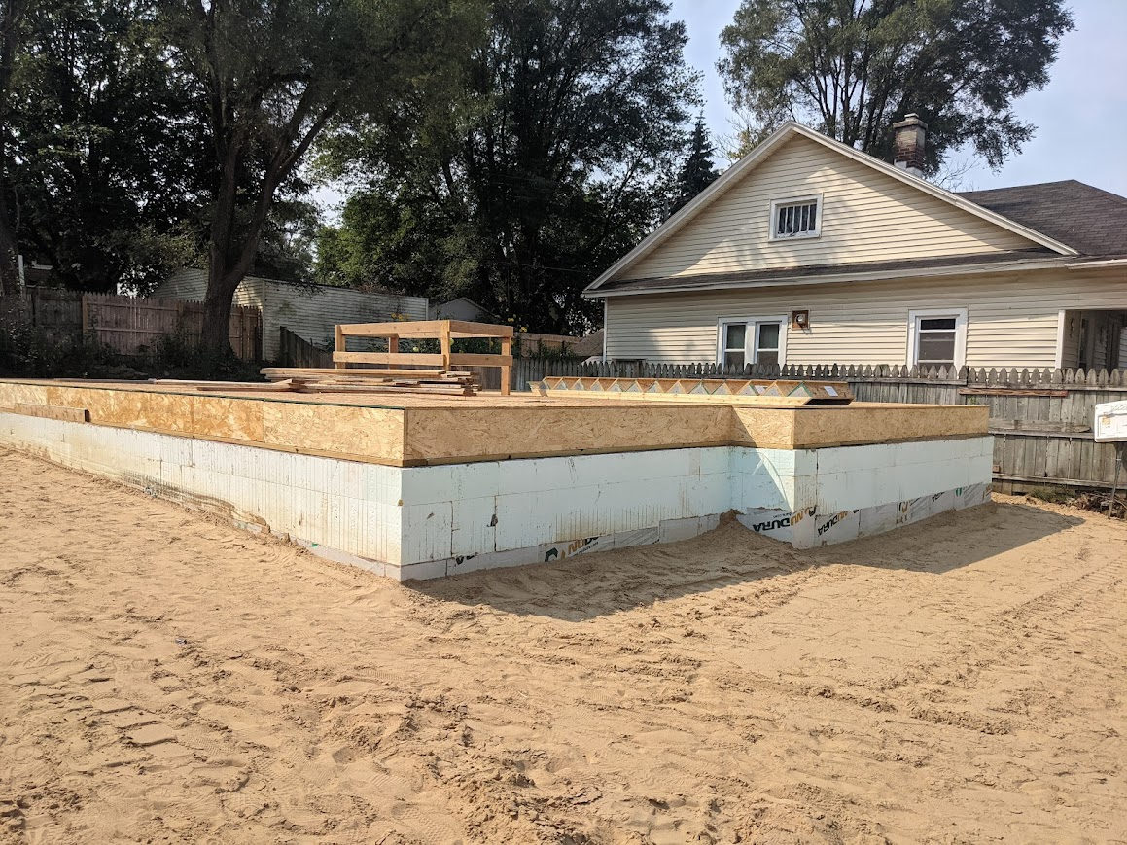
Outline
Overview
Teams
Embodied
Onsite
Utilities
Design
Questions
Notes:
Here’s a quick outline of how this presentation is going to go.
It will start with me giving an introduction and background of the project. Well talk about what this project is, why this project matters, how was it for, and how we decided to handle it.
And then we will hear from the teams within the class. The Analysis teams will talk about their methods and numbers and then the design team will talk about our results and conclusion.
We will then open it up for some questions.
As Professor Huen likes, to say “if you’re ready, I’m ready. Let’s make it happen.”

Slide 3
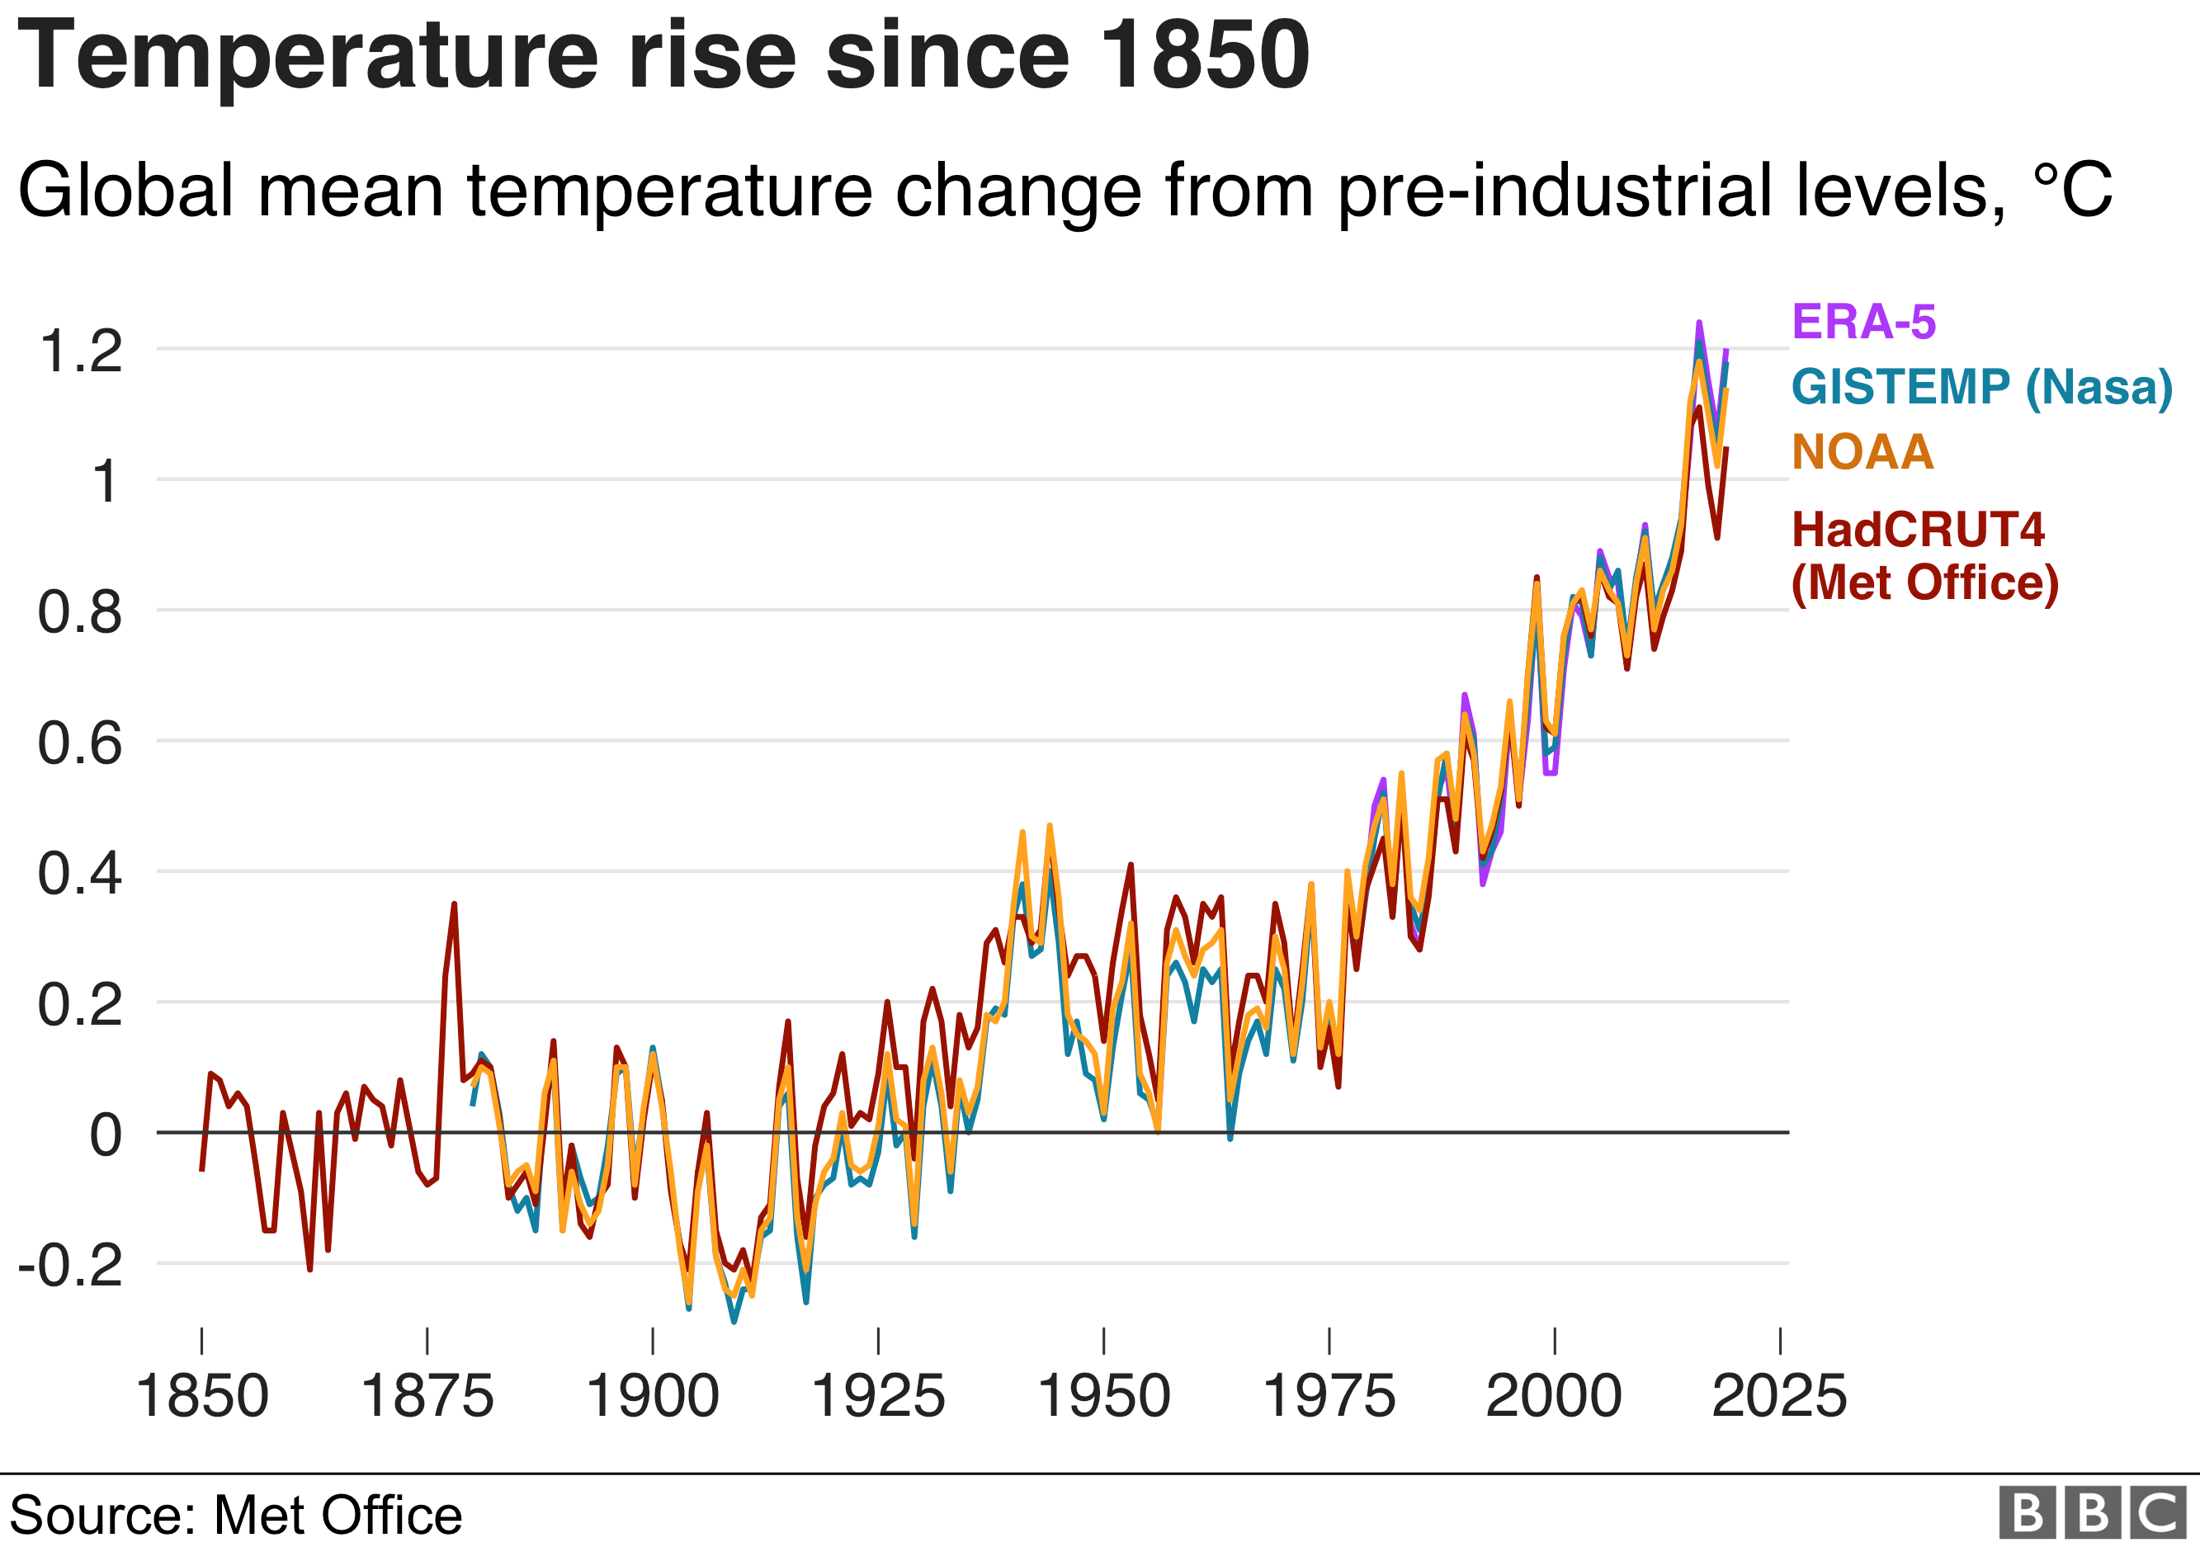
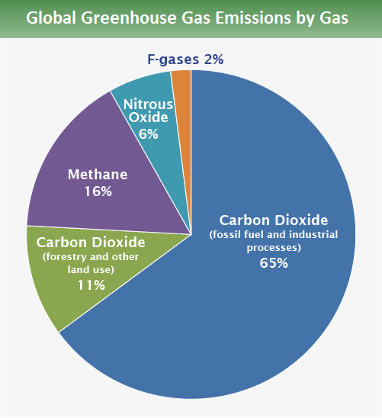
OVERVIEW | EMBODIED | ONSITE | UTILITIES | DESIGN | QUESTIONS
Notes:
You have probably heard about climate change and global warming. You may have even seen a graph like the one in the upper left showing the increase in global temperatures. Global warming is a significant problem that will affect all of society, especially engineering. It certainly has been a prominent political and news topic recently. Just over a month ago, the latest UN climate change conference, also called COP26, was held in Scotland and was a collection of world leaders discussing this very problem.
But what does it have to do with housing.
Global warming is caused by the affects of green house gasses in our atmosphere. As seen in the pie chart on the right, carbon dioxide is significant majority of these troublesome gases. Our project will focus on these carbon dioxide emissions. For shorthand we will refer to these carbon dioxide emission as simply carbon emissions.
The construction and use of a house has associated carbon emissions.
But again, why housing?

Slide 4
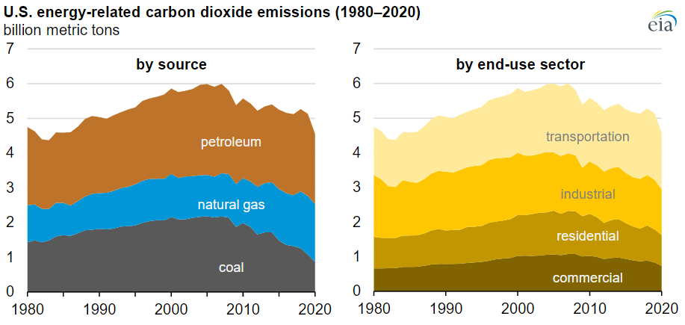
OVERVIEW | EMBODIED | ONSITE | UTILITIES | DESIGN | QUESTIONS
20%
Notes:
As seen in this chart, in the United States, the residential sector accounts for 20% of end-use energy carbon emissions. While not the largest sector, this is a sizeable contribution. It is also something that each one of us contributes to whenever we turn on a light at home.

Slide 5
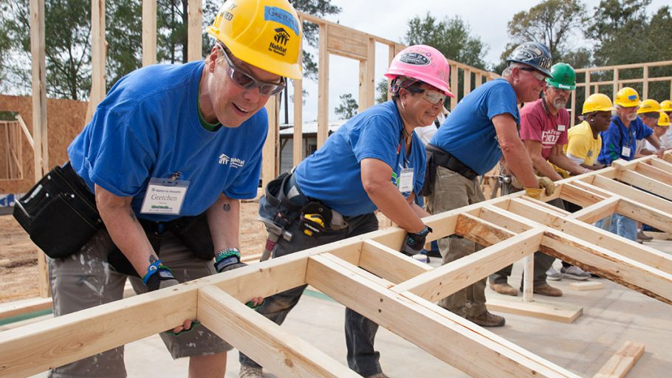
Kent County: ~400 Homes Built since 1983
National: ~350,000 Homes Built since 1976
Notes:
We are working for Habitat for Humanity which is an international non-profit organization focused on creating affordable houses around the world.
Habitat for Humanity is a huge player in housing in the United States. In 2021, they built about 14 thousand new homes. Compared to the total number of houses built in the US last year, that is about 3% of all new houses. That’s a lot of houses!
Kent County has its own branch of Habitat for Humanity and helps many families around our area. They are notable among Habitat branches for their increased efforts at reducing carbon emission.
They are interested in reducing the emissions of houses. They have already a new low carbon footprint house. In order to fully understand the impact of this new house they came to us and asked us two questions.

Slide 6
Project Introduction – 08.31.2021
OVERVIEW | EMBODIED | ONSITE | UTILITIES | DESIGN | QUESTIONS
What is the expected carbon emission savings of the carbon footprint house?
If the carbon footprint build house is not carbon-neutral, how can carbon emissions be reduced by a further 20%?
Notes:
What is the expected carbon emissions saving of this new carbon footprint house? This involve quantifying all associated carbon emissions of both this new house and previous comparison houses.
If we found the low carbon house was not carbon neutral, we were tasked with finding options that Habitat could implement to decrease the emissions by a further 20%.
This was assigned the first week of class and has been a key aspect of our class through out the semester, but what does this have to do with the class?

Slide 7
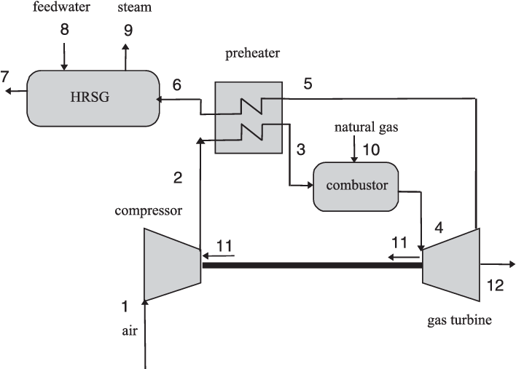
Connections to Thermal Systems Design
OVERVIEW | EMBODIED | ONSITE | UTILITIES | DESIGN | QUESTIONS
Heat Transfer
Energy Usage
Material Properties
Specification Research
Unit Continuity
Notes:
Engineering 333 is officially titled Thermal System Design. Its primary focus is analysis of thermal systems such as power plants or engines. The picture on the left is one such power plant that we study throughout the semester, so your non-senior mechanical have that to look forward to. Have fun!
But how does the carbon emissions of a house relate to the analysis of a power plant?
Surprisingly, there is a lot in common. Through our analysis of the houses, we analyzed heat transfer, energy usage and material properties, almost as if this was just another power plant.
Furthermore, we he did detailed research regarding the specifications of the house. We also had to be careful with units. This may seem like an odd choice, unit problems are very common and balancing them across a large project did take effort, especially a project employing both metric and imperial units such as this.
So that’s what the project is and other background, but here’s some specific.

Slide 8
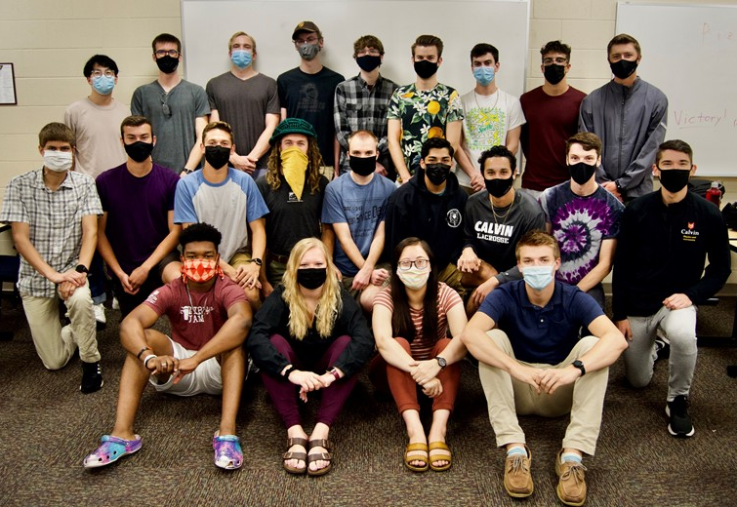
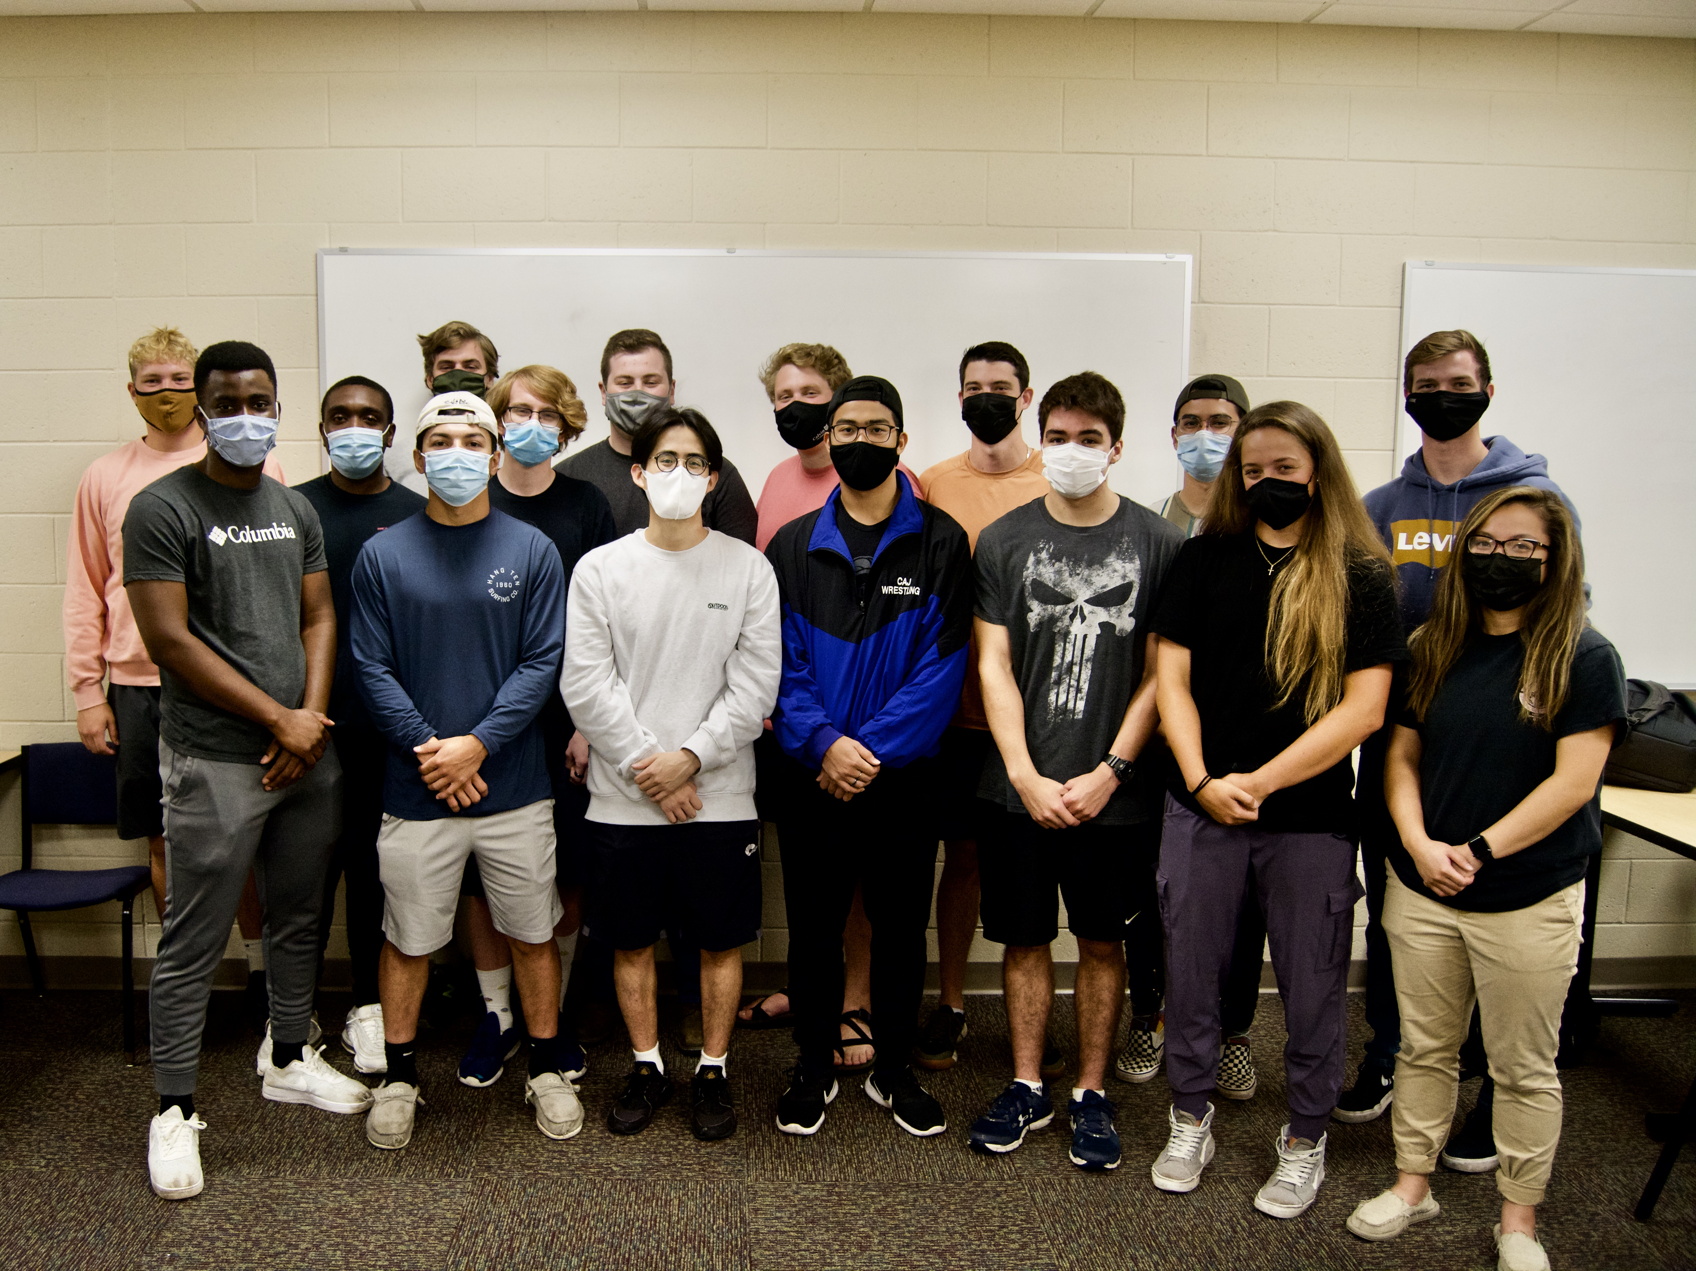
Sections
OVERVIEW | EMBODIED | ONSITE | UTILITIES | DESIGN | QUESTIONS
Section A
Section B
Case Study: 536 Stolpe St SW
Case Study: 930 Woolsey Dr SW
Both Sections:
Low-Carbon Build: 726 London St SW
Notes:
The project was divided between the two class sections as it appears on our class schedule.
Each section analyzed the new low carbon home located on London street , but the sections were assigned different case study house for comparison. These case study houses represent a traditional habitat for humanity home in the area and had some distinctions.

Slide 9
Section Organization
OVERVIEW | EMBODIED | ONSITE | UTILITIES | DESIGN | QUESTIONS
Analysis
Design
Embodied
Onsite
Electricity
Heating
Utilities
Notes:
Each section then broke down further into team allowing for in depth focus on a topic.
There are two main types of team, analysis and design. Analysis worked to create models and calculator for the houses primarily focusing on the first question of quantifying the carbon emission. The design team focused on the second question of reducing the emissions by 20% through the creation of design options.
Analysis was one by 3 or 4 subteams. The different number comes from the different number of students in each section. For the sake of this presentation, we will be focusing only on 3, embodied, onsite, and utilities.
Embodied analyzed the amount of carbon emissions associated with the extraction and processing of materials.
Onsite analyzed the among of carbon emissions associated with construction activated.
Utilities, the combination of the electricity and heating teams, analyzed the amount of carbon emissions associated with the use of the house.

Slide 10
Progress Updates
OVERVIEW | EMBODIED | ONSITE | UTILITIES | DESIGN | QUESTIONS
Mark Ogland-Hand
(Client)
Status to Schedule
Work Accomplished
Issues / Concerns
Work Planned
Each team member presented
Professor Heun
(Consultant)
Notes:
As you may have guessed we were organized very similarly to a company.
Also like a company, we had numerous progress update presentations throughout the semester, where each group informed the others about their status versus schedule, work accomplished, current issues, and work planned.
Teams had the opportunity to learn from and help each other, while each student got a change to practice facilitating and presenting.
Furthering the company similarities, we also had a client and consultant.
We were blessed to have Mark Ogland-Hand be a habitat for humanity reperesenative for us throughout the semester. He provided us with information and set expectations.
Professor Huen acted as a consultant. We did our work complete independently, but he was always providing guidance and assistance when necessary.

Slide 11
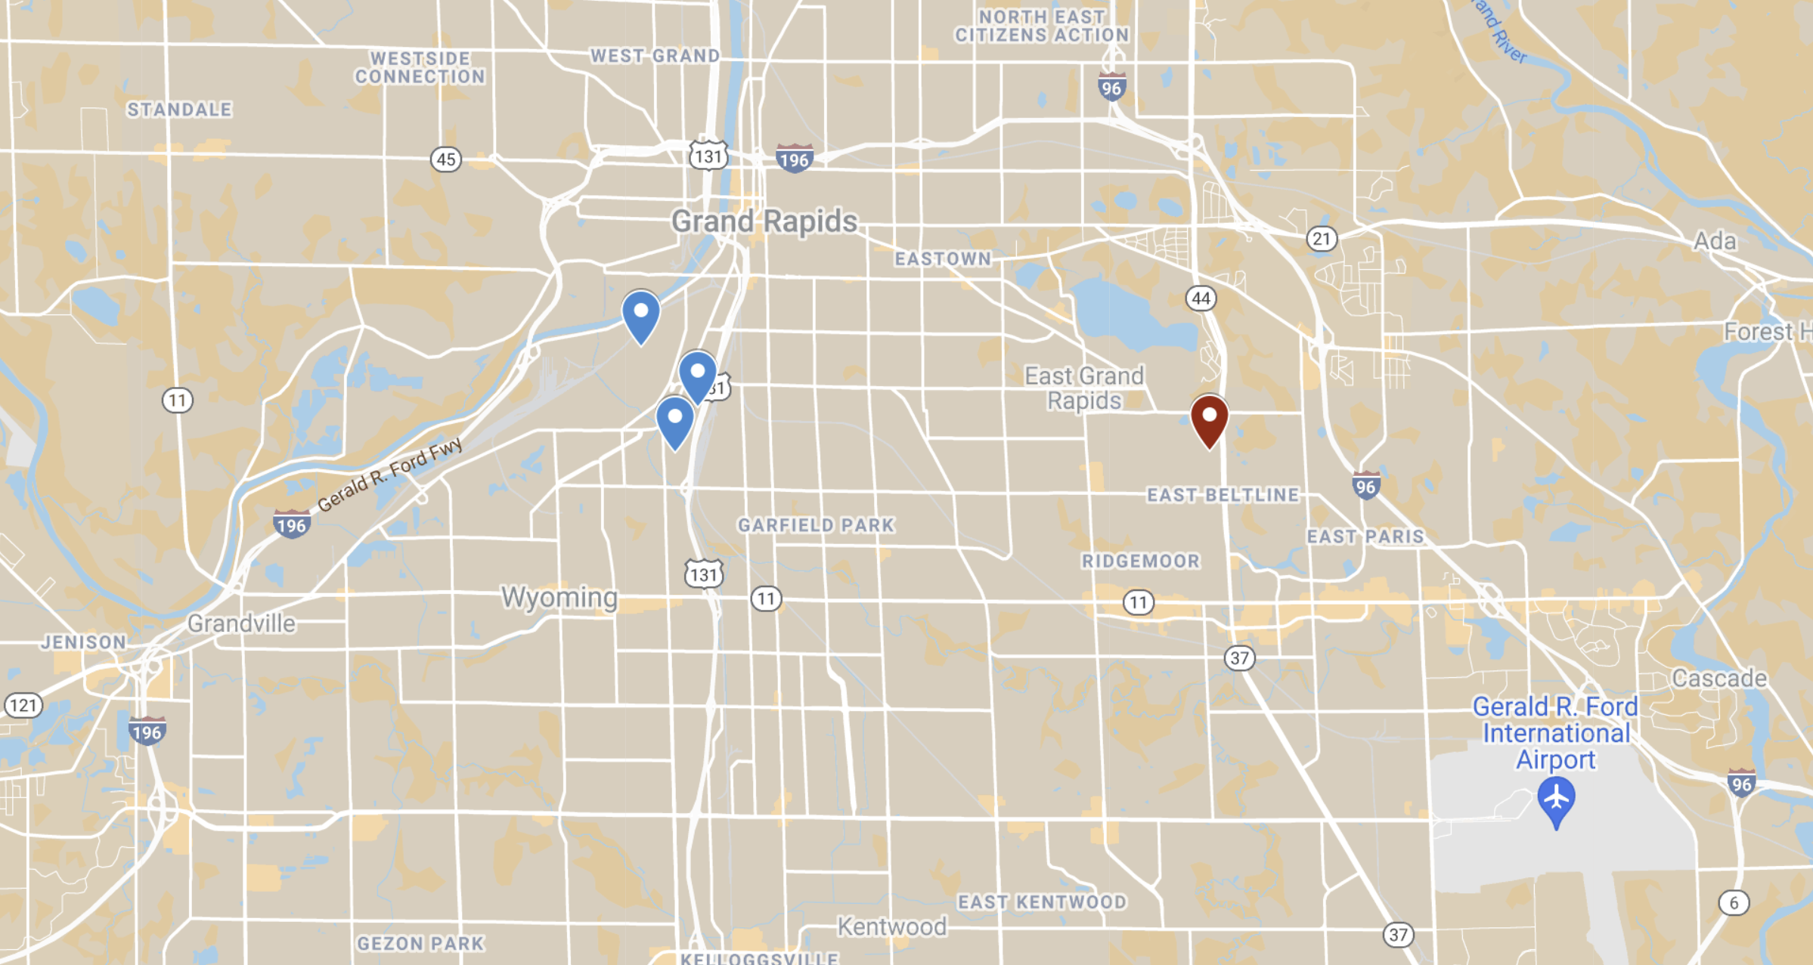
OVERVIEW | EMBODIED | ONSITE | UTILITIES | DESIGN | QUESTIONS
Woolsey
(Section B Case Study)
Stolpe
(Section A Case Study
Calvin University
London
(Low-Carbon Build)
Notes:
Here’s a little more information on the houses.
First, here is a place you likely heard of (click) Calvin University. Hopefully that helps you get your bearings.
Here is Stolpe, section A’s case study, and Here is Woolsey, section B’s case study.
Finally, here is London, the new low carbon build.
As you can see all of these houses are incredibly local and beneficial to our immediate area.

Slide 12
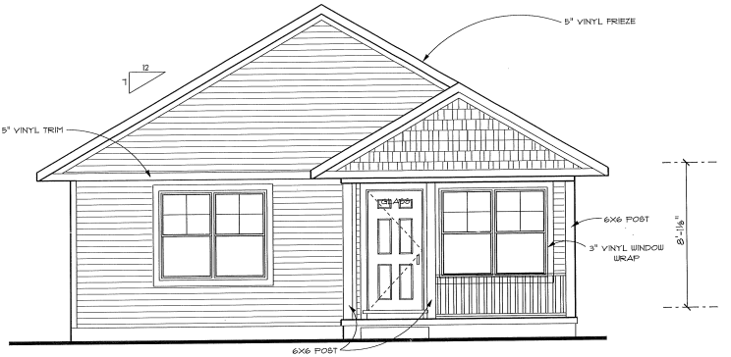
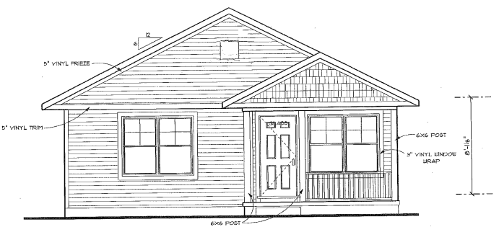
Team Differences
OVERVIEW | EMBODIED | ONSITE | UTILITIES | DESIGN | QUESTIONS
Section A
Section B
536 Stolpe Ave
930 Woolsey SW
~2019
~2015
Notes:
Let’s talk a little about the differences between Stople and Woolsey.
Beyond different addresses and assignement to different class sections, the houses do not have too much different. The look incredibly similar.
Lets play a little bit of spot the difference.
You may notice that the house is a different slope
There is an additional window.
You may have guessed they were built in different years.
Ultimately the houses were incredibly similar, both have the same size of roughly 22 hundred square feet and both have similar appliances.
For the sake of this presentation, we will be focused on the Woolsey to limit the number of names and numbers flying around.

Slide 13
Note on Charts and Units
OVERVIEW | EMBODIED | ONSITE | UTILITIES | DESIGN | QUESTIONS
Vertical Bar Charts: Carbon Emissions
Horizontal Bar Charts:
Usage Rates
Carbon Emission listed as Metric Tonnes
(1 Tonne = 1000 kg ≠ 2000 lbs)
Notes:
Speaking of names and numbers, here are some more conventions for the presentations.
Engineers love charts and we want them to be easily understood, so like in many things from Right hand rule to variable names, we will follow a simple convention.
Vertical bar charts like that on the left is about carbon emissions.
Horizontal bar charts like that on the right is about usage rates of utilities.
Simple enough?
Finally, unit convention.
We will express all numbers of carbon emissions in terms of metric tonnes often denoted as “Tonnes”. This is equivalent to 1000 kg and should not be confused with English tons which are 2 thousand pounds.
Got it?

Slide 14
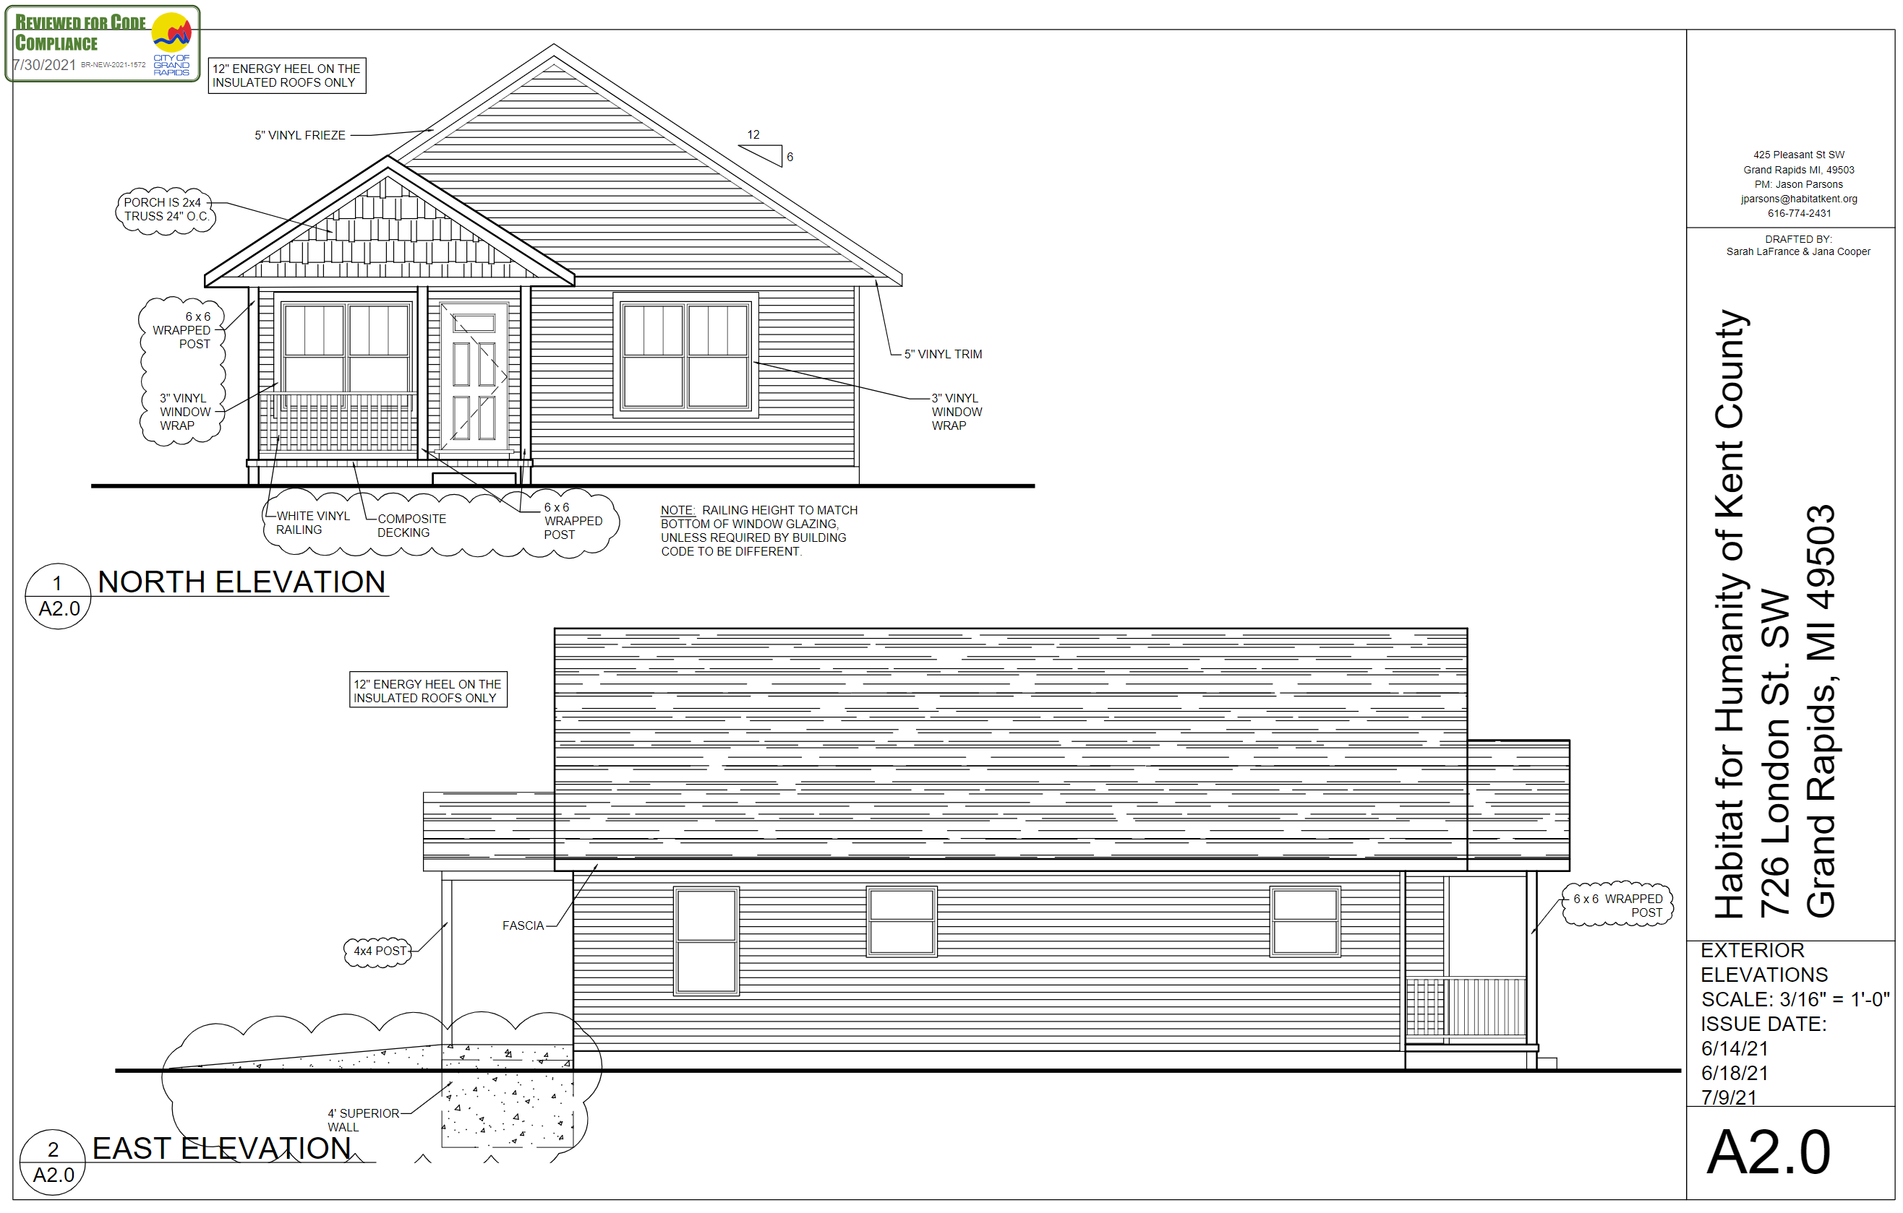
London: Low-Carbon Build House
OVERVIEW | EMBODIED | ONSITE | UTILITIES | DESIGN | QUESTIONS
Insulated Concrete Forms Foundation
All Electric
Heat pump
Water Heater
Other Appliances
Courtesy of Habitat for Humanity Grand Rapids
Move Heat
(Rather than Generate Heat)
Notes:
Both sections studied the low-carbon build house located on London street.
This house, will still like the case study houses, has some influential differences.
First, instead of pouring concrete for the foundation, it used prefabricated insulated concrete forms. This required higher embodied carbon but also was more thermally insulating.
The big change between the houses was that this house is all electric. This means that the house does not use natural gas or other fuel source but relies strictly on electricity. This affects numerous appliances, but mainly affects the heat pump and water heater. The heat pump works to replace the furnace. Instead of generating heat by burning fuel, the heat pump pulls heat from outside air to warm the house much like how an air conditioner pulls heat from inside air to cool the house. Basically, think AC unit installed backwards. The water heater uses the same concept.

Slide 15
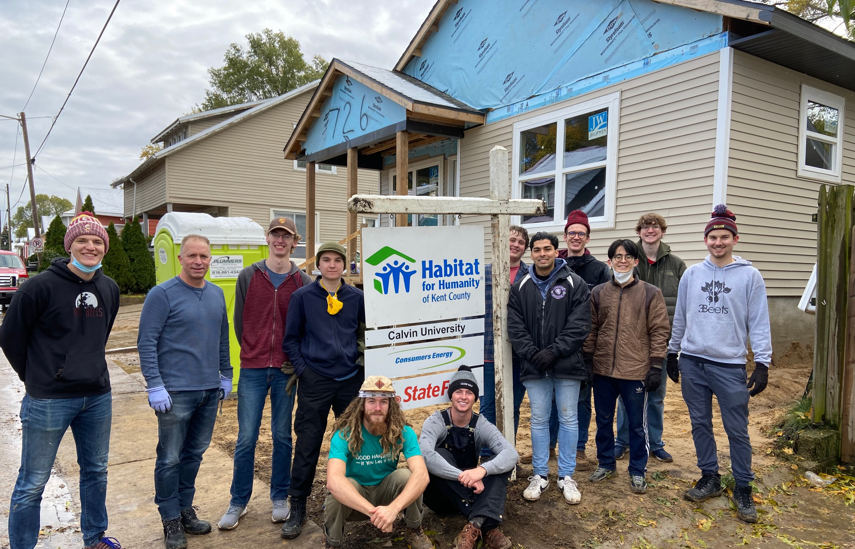
09/07/2021
OVERVIEW | EMBODIED | ONSITE | UTILITIES | DESIGN | QUESTIONS
London Progress
11/13/2021
Notes:
I will conclude my section with something to demonstrate Habitat’s speed.
We had the opportunity to do a site visit at the start of the semester and saw a plot with little more than a foundation.
Two months later some of the class returned for a volunteer day and saw an almost completed house.
Before we dive into the analysis teams, remember that this a house to help those who need one. Beyond that, Habitat is working to protect our planet and all of us. We really appreciated this real service-learning opportunity.
Now I will hand it over to Annika for the analysis team part.

Slide 16
What is “Embodied”?
OVERVIEW | EMBODIED | ONSITE | UTILITIES | DESIGN | QUESTIONS

Slide 17
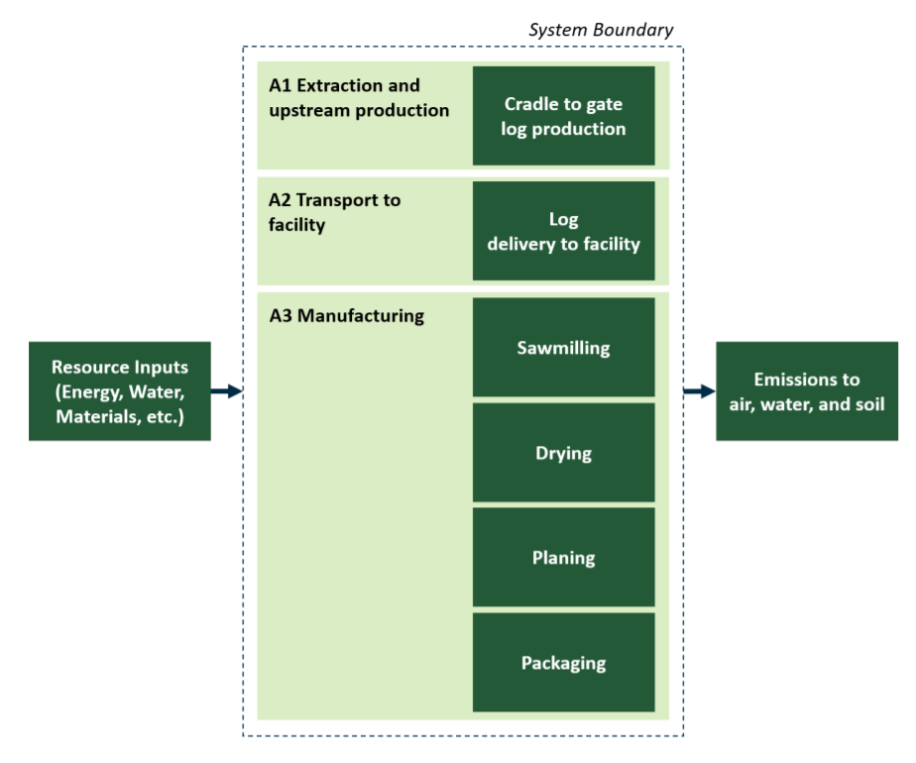
Strategy
OVERVIEW | EMBODIED | ONSITE | UTILITIES | DESIGN | QUESTIONS
Inventory of Carbon and Energy
Environmental Product Declaration
Embodied Carbon in Construction Calculator

Slide 18
OVERVIEW | EMBODIED | ONSITE | UTILITIES | DESIGN | QUESTIONS
Outdoor
Concrete
$$×$$
22.5 ${yd}^{3}$
$$×$$
$$320{{kgCO}_{2}}/{{yd}^{3}}$$
$$≈$$
$${7000 kgCO}_{2}$$
Material
Quantity
Carbon
Coefficient
Total Embodied Carbon

Slide 19
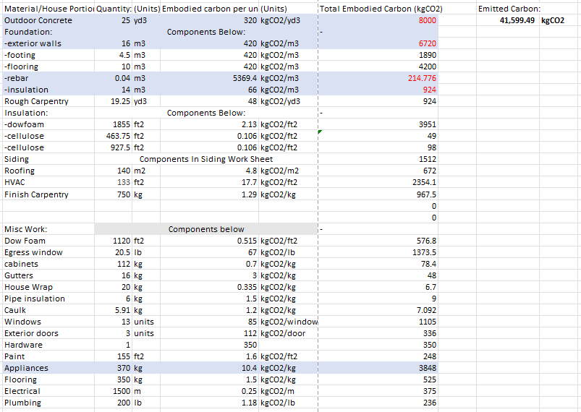
OVERVIEW | EMBODIED | ONSITE | UTILITIES | DESIGN | QUESTIONS

Slide 20
Embodied Carbon Comparison
OVERVIEW | EMBODIED | ONSITE | UTILITIES | DESIGN | QUESTIONS

Slide 21
OVERVIEW | EMBODIED | ONSITE | UTILITIES | DESIGN | QUESTIONS
Insulated Concrete Forms (ICF)
Poured Concrete

Slide 22
OVERVIEW | EMBODIED | ONSITE | UTILITIES | DESIGN | QUESTIONS

Slide 23
What is “Onsite”?
OVERVIEW | EMBODIED | ONSITE | UTILITIES | DESIGN | QUESTIONS

Slide 24
Strategy
OVERVIEW | EMBODIED | ONSITE | UTILITIES | DESIGN | QUESTIONS
Transportation
Construction Equipment

Slide 25
OVERVIEW | EMBODIED | ONSITE | UTILITIES | DESIGN | QUESTIONS
$$3{{gal}_{fuel}}/{hr}$$
$$8.5{{kgCO}_{2}}/{{gal}_{fuel}}$$
$$8.0 {hrs}_{(Air Compressor)}$$
$$×$$
$$×$$
$$≈$$
$$204 {kgCO}_{2}$$
Activity Duration
Fuel Rate
Carbon
Coefficient
Total ${CO}_{2}$
Emissions

Slide 26
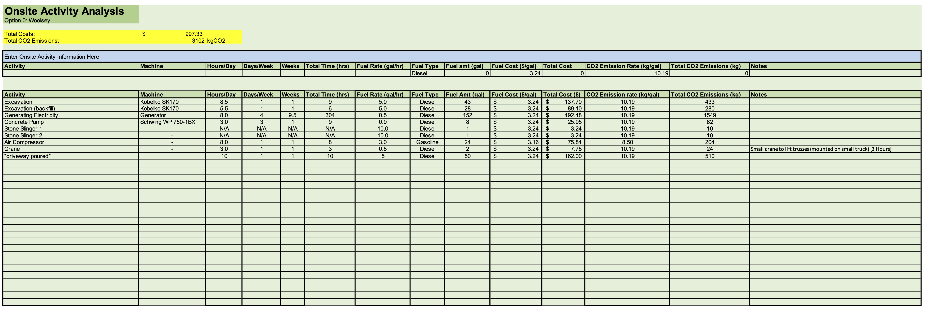
OVERVIEW | EMBODIED | ONSITE | UTILITIES | DESIGN | QUESTIONS

Slide 27
Onsite Carbon Emissions Comparison
OVERVIEW | EMBODIED | ONSITE | UTILITIES | DESIGN | QUESTIONS

Slide 28
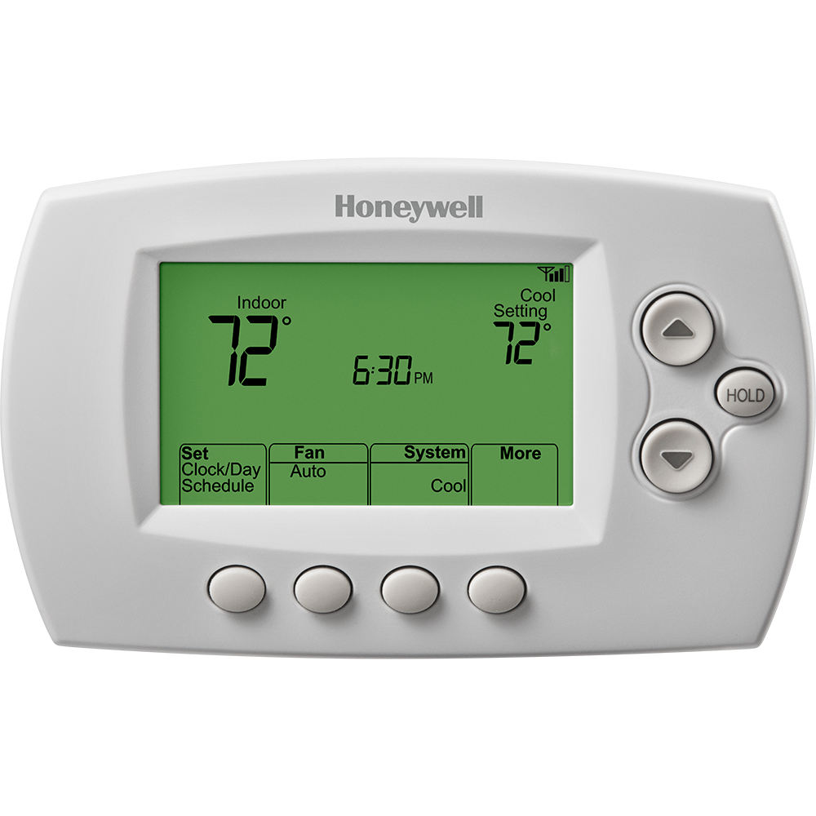
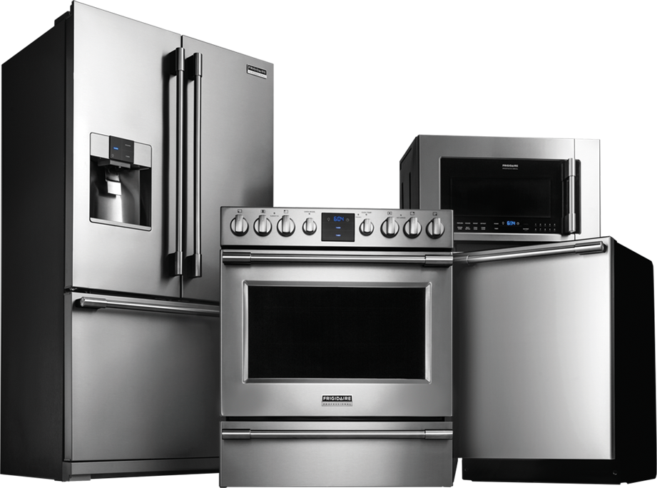
What are “Utilities”?
OVERVIEW | EMBODIED | ONSITE | UTILITIES | DESIGN | QUESTIONS
Utilities include:
Heating
Natural Gas
Electricity
Main Appliances
Lighting
Notes:
3 main areas: heating and then appliances/lighting
Going to go into detail on each of the three
Heating is most involved, then appliances, and easiest are lights

Slide 29
Utilities – Fundamentally Different
OVERVIEW | EMBODIED | ONSITE | UTILITIES | DESIGN | QUESTIONS
Embodied & Onsite: One-time
Utilities
Reoccurring annually
25-year period
Notes:
Key Difference:
Time frame of embodied and onsite:
Construction phase: One-time
Time frame of Utilities:
Operations phase: 25 years

Slide 30
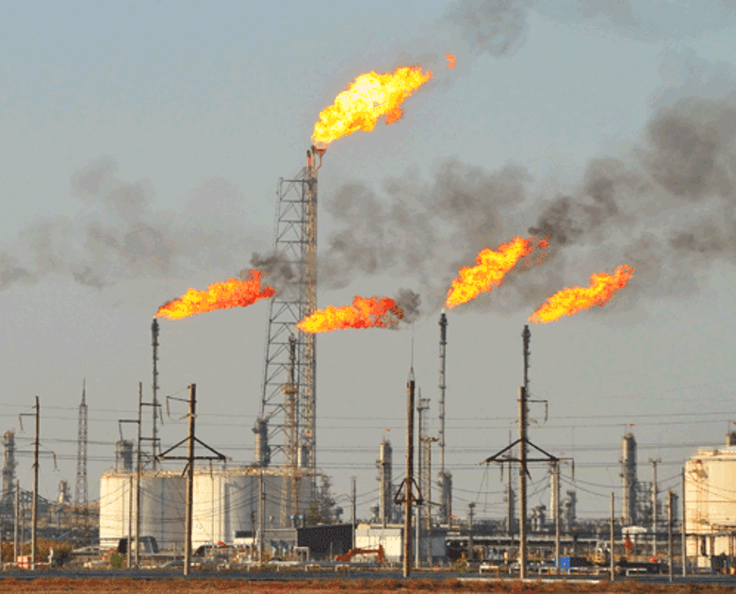
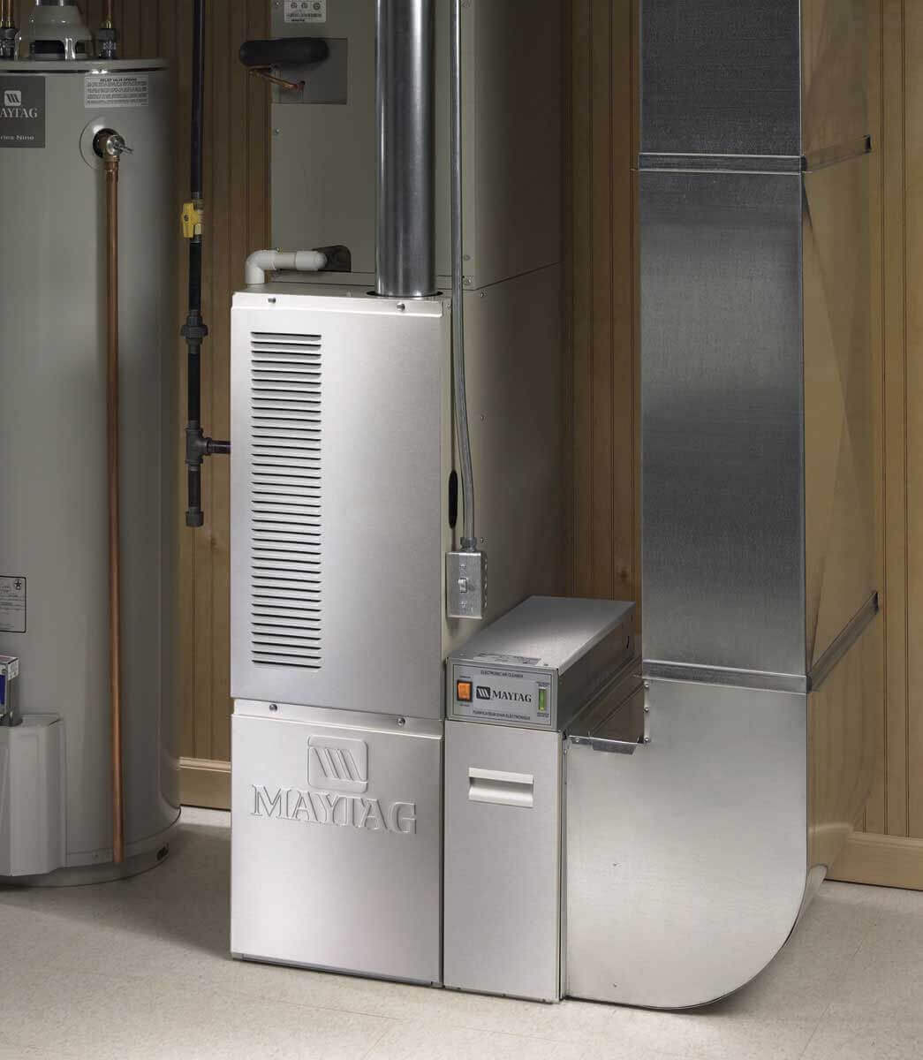
Heating Analysis Procedure
OVERVIEW | EMBODIED | ONSITE | UTILITIES | DESIGN | QUESTIONS
$${CO}_{2}$$
Base Case
Heat
“Leak”
Low-Carbon Build
Quantity of Natural Gas or kWh
$${CO}_{2}$$
Notes:
We all know burning natural gas, coal, and petroleum are very green ways to produce energy as displayed by the picture in the upper left
Natural gas: burn and use energy to heat air
Heat Pump: Takes heat from the outside air and deposits it into the home → reverses the natural flow of heat from hot to cold

Slide 31
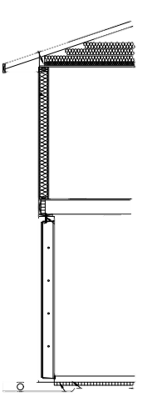
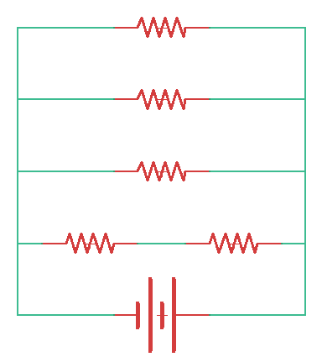
Thermal Resistance Model – “Leak”
OVERVIEW | EMBODIED | ONSITE | UTILITIES | DESIGN | QUESTIONS
Roof
Walls
Outside
Air
Temperature
Inside Temperature
68̊ F
Windows
Basement
Soil
$$\dot{Q}$$
ΔT

Slide 32
Thermal Resistance Model
OVERVIEW | EMBODIED | ONSITE | UTILITIES | DESIGN | QUESTIONS
Roof
Ohm’s Law
I = ΔV/R
ΔV ~ ΔT (Heating Degree Day)
R ~ 1 / (U∙A)
Walls
Windows
Basement
Soil
Thermal Equation:
$\dot{Q}$_{loss} = U ∙ A_{cross-section} ∙ (T_{inside} – T_{outside})
$$\dot{Q}$$
ΔT
Notes:
HDD → how much to heat house based on outside temperatures

Slide 33
Heat Loss during Non-Summer Months
OVERVIEW | EMBODIED | ONSITE | UTILITIES | DESIGN | QUESTIONS
-19%
Windows & Walls
Windows & Walls
Notes:
Horizontal Bar → because not showing carbon data
During summer -> no heat loss and no heating
Non-summer -> heat loss average per month
Low carbon build:
BTU/month: 3000
Base Case:
BTU/month: 3300
Low carbon:
19% decrease in heat loss → good → better insulation and less heating needed
decrease partially due to foundation (base – prefab, low carbon – poured & insulated)
Nearly half of heat leak occurs through main level: walls and windows
Cost/month: Base Case → 40$/month (for the 7 months)

Slide 34
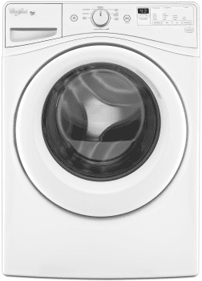
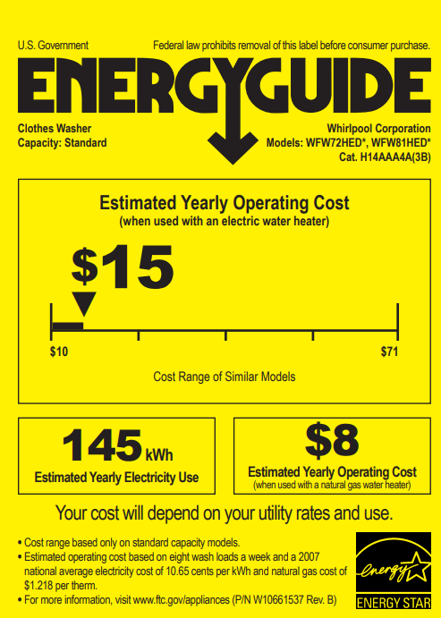
Appliances Procedure
OVERVIEW | EMBODIED | ONSITE | UTILITIES | DESIGN | QUESTIONS
Notes:
Go appliance shopping, see yellow tags!
You might ignore them, but they’re helpful!!

Slide 35
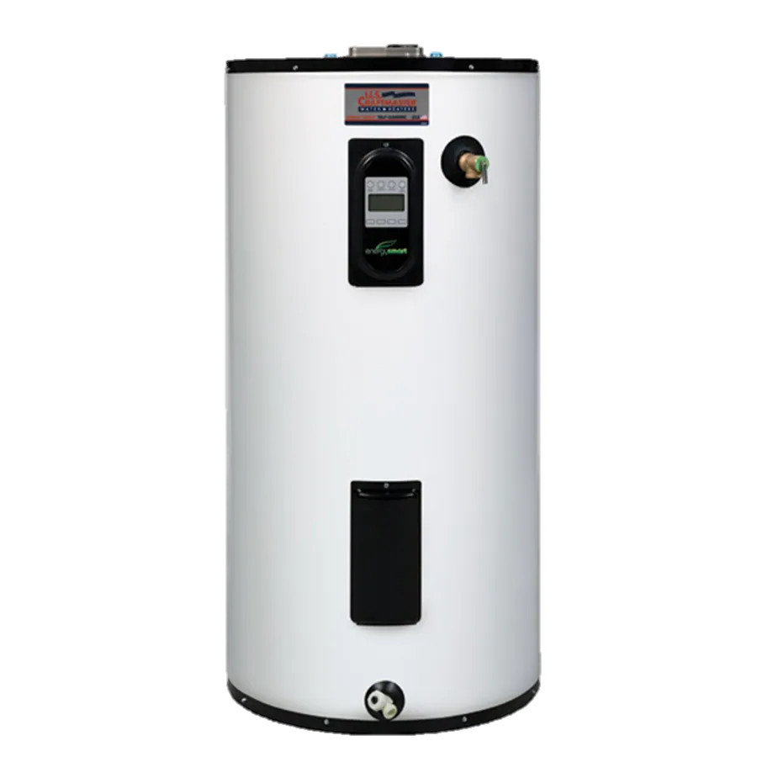
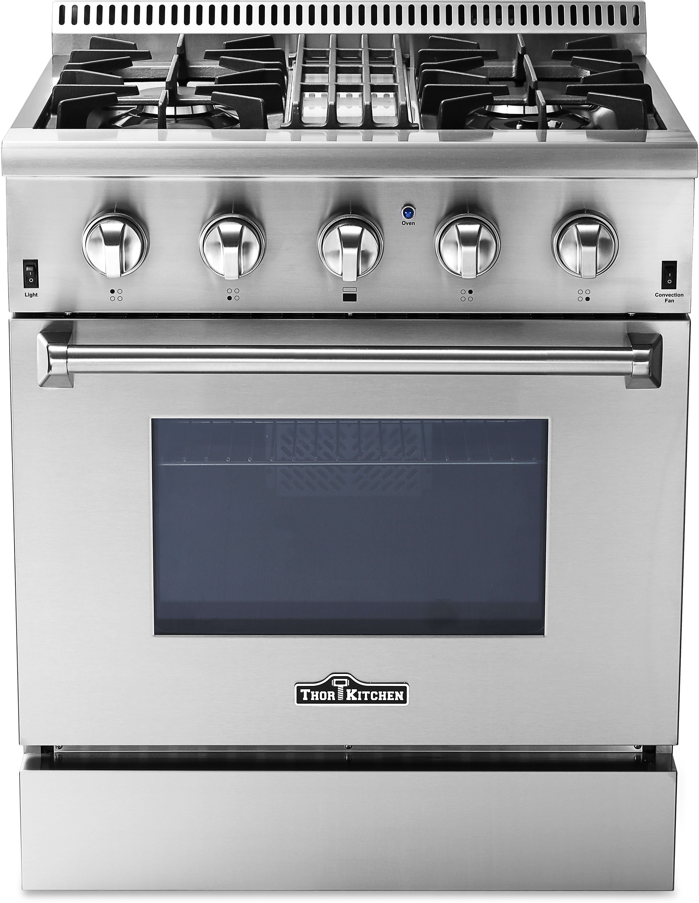
Appliances Procedure
OVERVIEW | EMBODIED | ONSITE | UTILITIES | DESIGN | QUESTIONS
Range (Stovetop & Oven)
Water Heater
Notes:
Range → Expected use
Water Heater → Efficiency information from manufacturer and product specs

Slide 36
Lighting Procedure
OVERVIEW | EMBODIED | ONSITE | UTILITIES | DESIGN | QUESTIONS
Number of Lights
Wattage of Light(s)
Duty Cycle
Carbon Emissions from Lighting

Slide 37
Yearly Electricity Use (Lighting & Appliances)
OVERVIEW | EMBODIED | ONSITE | UTILITIES | DESIGN | QUESTIONS
-24%
1295
2561
Notes:
Water Heater:
Low-Carbon: Heat pump system
Base Case: Boiler system (also natural gas)
This leads to 24% reduction in annual kWh use

Slide 38
Carbon Emissions from Utilities
OVERVIEW | EMBODIED | ONSITE | UTILITIES | DESIGN | QUESTIONS
Notes:
Base Case:
a touch over 80 metric tons
Low-Carbon:
around 70 metric tons
~10 metric tons savings
from lower heating & lower appliances (mainly water heater)
Ok, we have system to find carbon emissions for embodied, onsite, and utilities.
What now?
How can we optimize the carbon footprint and further reduce emissions?
Hand off to John, he’ll cover this by discussing design options

Slide 39
OVERVIEW | EMBODIED | ONSITE | UTILITIES | DESIGN | QUESTIONS
Analysis
Design
Embodied
Onsite
Electricity
Heating
Utilities
Notes:
Up to this point analysis team s
Meanwhile design in corner what are we supposed to do?
It was a lot like this at the beginning of the project. House to design a future home?
Even if could Wait on calculations from analysis
So we made a strategy

Slide 40
Strategy
OVERVIEW | EMBODIED | ONSITE | UTILITIES | DESIGN | QUESTIONS
Research
Design Options
Selection
Calculation
Optimization
Notes:
Research – look online for common design characteristics used in residential applications
Narrow down to appropriate options for our client HFH
Provide variables for analysis calculations
Identify best design options and optimize

Slide 41
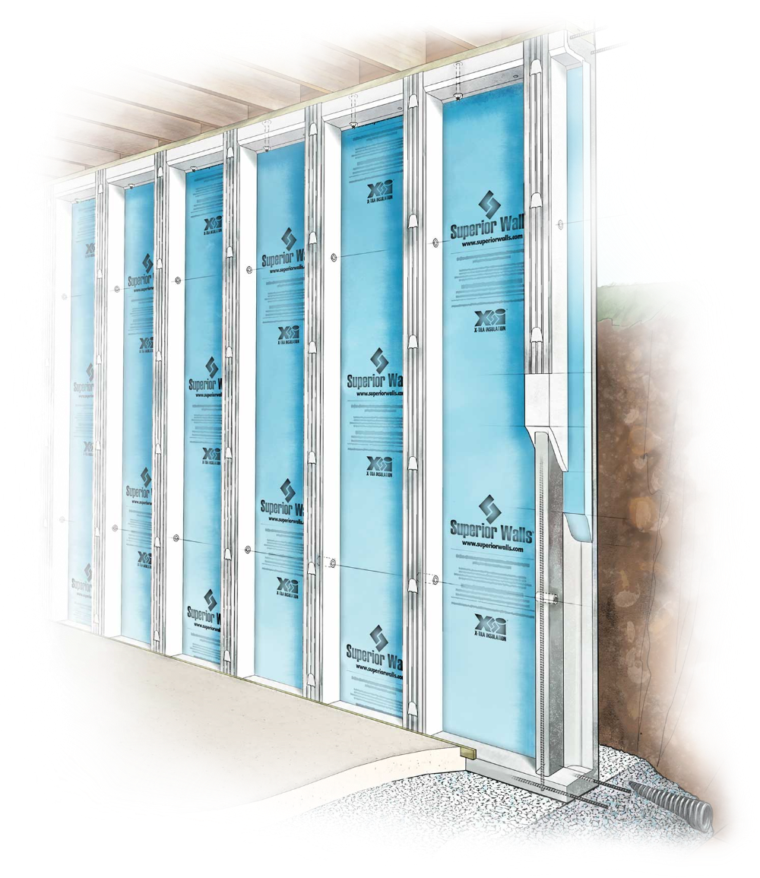
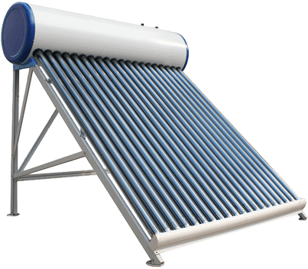
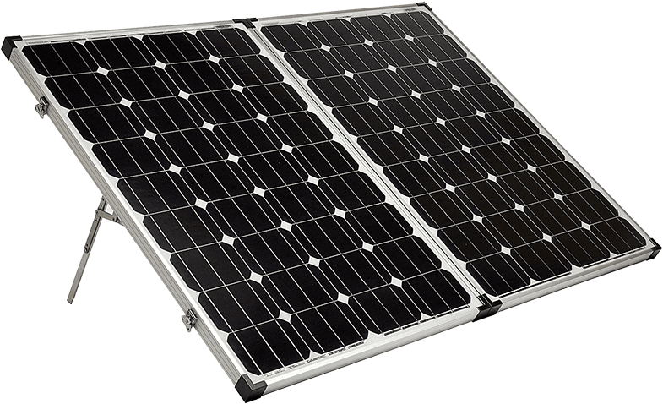
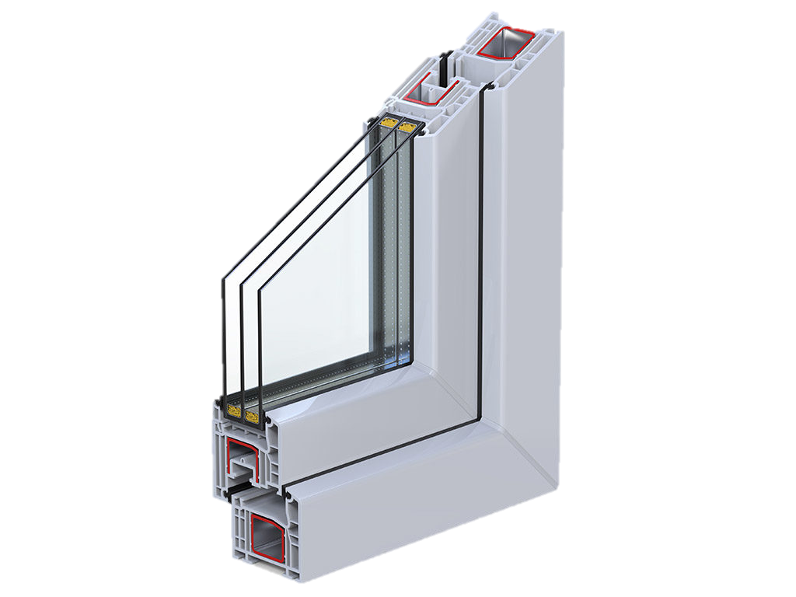
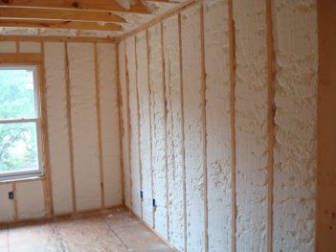
Design Options
OVERVIEW | EMBODIED | ONSITE | UTILITIES | DESIGN | QUESTIONS
Prefabricated Concrete Basement
10 x 425-Watt Solar Panels
Solar Water Heater
Triple Pane Windows
Insulation – type and thickness (6x)
Notes:
Design options – what is it? Alteration of current build design that will lower carbon emissions
When we created design options made options “targeted towards”
We organized our options around the analysis teams. *go in order”
No options onsite – research showed low emissions and HFH uses volunteer labor
Prefab – great lakes superior walls – reduced concrete volume tf less carbon intensive
Solar panels – chose tesla panels for available specs, sold as groups of 10, 425kW but electric team acted for Michigan
Solar water heater – same manufacturer as regular water heater, stated 50% reduction in electricity usage
Windows – Jeld Win one for one swap
Insulation – see impacts of increasing thermal resistance
With all these design options, we were not sure which options would make an impact. Evident in next two graphs

Slide 42
Low Carbon Design Options
OVERVIEW | EMBODIED | ONSITE | UTILITIES | DESIGN | QUESTIONS
Notes:
Just one option with significant impact

Slide 43
Low Carbon Design Options
OVERVIEW | EMBODIED | ONSITE | UTILITIES | DESIGN | QUESTIONS
??
Notes:
Similaraly, just one option with significant impact.
Which? Why? And how much?
Looking back on our calculations we can see why. The design option was…

Slide 44
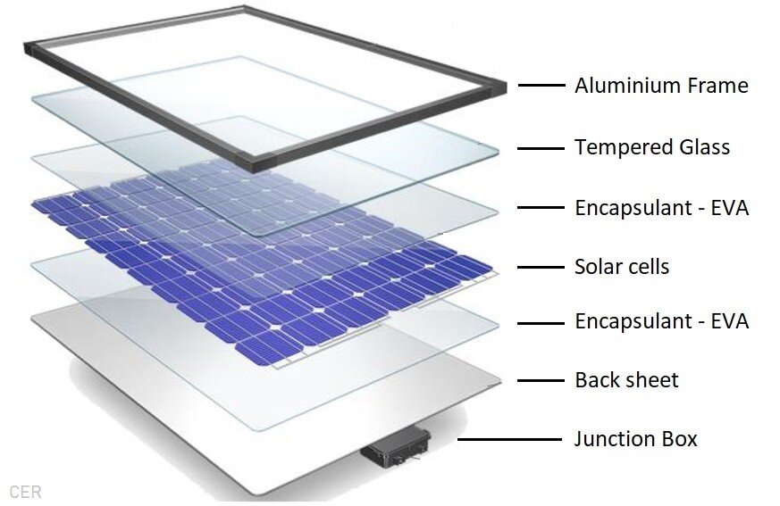
Solar Power Tradeoffs
OVERVIEW | EMBODIED | ONSITE | UTILITIES | DESIGN | QUESTIONS
Negatives
Carbon Intensive Steps
Need pure Silicon
Positives
Renewable Energy
Lifetime benefits
Notes:
Tradeoff – increase embodied but decrease cabron emissions during the operations of the house (aka. utilities)
Key Q: is this trade off worth it in Michigan?
Carbon intensive steps,
Silicone in solar cells is carbon intense with high temperatures to reach pure silicon
BUT solar is a renewable energy source used for the lifetime of house, subtracts from use of electricity from consumer’s grid
With this design option in mind, I want to show you how the analysis team homes and our solar panel design home turned out
Each Solar panel has from 32 to 96 cells. The cells are made from silicone.
The silicon comes from quartz. It is crushed then put through high temperature electric arcs to get to 99% purity. From here it is brough to 100% purity by repeatedly being put through a hot tube.
Silicon shape is done by etching out a pyramid shape into the surface of the cell.
Cell numbers - https://economictimes.indiatimes.com/small-biz/productline/power-generation/solar-power-panel-assembly-of-solar-cells-that-can-generate-230-to-275-watts-of-power/articleshow/69131072.cms
Silicon creation - https://sinovoltaics.com/solar-basics/solar-cell-production-from-silicon-wafer-to-cell/
Temperature - https://www.simtec-silicone.com/how-is-silicone-produced/

Slide 45
OVERVIEW | EMBODIED | ONSITE | UTILITIES | DESIGN | QUESTIONS
$$−10\%$$
$$−51\%$$
$$−41\%$$
Notes:
For all the homes, we can confirm that onsite has low impact, and changes negligible
With embodied we may see a slight rise
But with utilities over the lifetime of the house we see the real impact.
From base case to low-carbon 10%, further 41% with solar panels, combined at 51% reduction compared to base case
But our task for Professor huen was to analyze impact of improving the low-carbon house, so lets look at that more in depth.

Slide 46
OVERVIEW | EMBODIED | ONSITE | UTILITIES | DESIGN | QUESTIONS
$$−45\%$$
72%
6%
~0%
Notes:
Talk through numbers as they enter
The benefit in the design home comes from using renewable electrical energy over the lifetime of the home.
Interestingly enough, Consumers’ energy understands time-sensitive these carbon emissions and has made a commitment to increasing renewable energy in power production

Slide 47
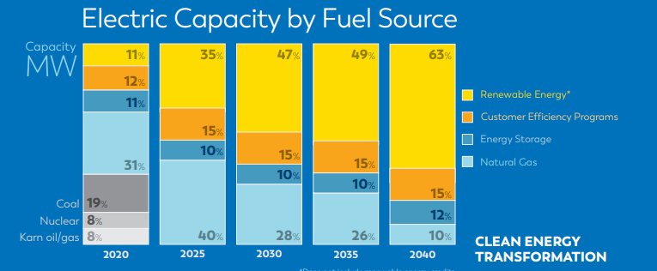
Consumers’ Clean Energy Grid
OVERVIEW | EMBODIED | ONSITE | UTILITIES | DESIGN | QUESTIONS
https://www.consumersenergy.com/-/media/CE/Documents/company/IRP-2021.ashx
Notes:
Consumers put out report to clean their energy grid by 2040.
This involves removal of Coal, nuclear gas, and karn oil/gas
Decrease natural gas from 31 to 10%
Increase renewables from 11 to 63%
These changes in the carbon emissions of the grid had impacts on our analyzed homes because they emit carbon based on the carbon intensity per kW-hr of electricity

Slide 48
Clean Energy Grid Impacts
OVERVIEW | EMBODIED | ONSITE | UTILITIES | DESIGN | QUESTIONS
$$−5\%$$
$$−17\%$$
$$−9\%$$
Notes:
For this this and this, has 5 17 and 9 change.
Change is dependant on the electrical energy usage in each home.
Greater in low-carbon builds BUT less in solar panel bc
Less in solar bc greater portion of electric grid renewable
As we think about the future of this project, there are more ways to have this project go forward

Slide 49
OVERVIEW | EMBODIED | ONSITE | UTILITIES | DESIGN | QUESTIONS
Financial Analysis
Additional design options
Future Directions
Honorable Mentions
Prefab Basement → $−4\%$
Solar Water Heater → $−6\%$
Triple Pane Windows → $−3\%$
Increased Insulation → $−3\%$
Notes:
Design options not applicable to a HFH home

Slide 50
OVERVIEW | EMBODIED | ONSITE | UTILITIES | DESIGN | QUESTIONS
Large Teams are Unwieldy and Need Management
Intergroup Communication is Necessary for Cohesive Results
Boundaries are Important
Lessons Learned
Notes:
Large teams are unwieldy and need management -- some members of this class had the opportunities to use management gifts
Intergroup com necessary for cohesive results – some members did this
Analysis boundaries – go beyond construction and analyze the use phase
Analysis boundary was on these homes but implications of this project will permeate through HFH
Habitat as a organization beyond Kent county, beyond Michigan, nationwide and further, has interest in this project for the future of their homes

Slide 51
Special Acknowledgements
OVERVIEW | EMBODIED | ONSITE | UTILITIES | DESIGN | QUESTIONS
John Marek
Mark Ogland-Hand
Notes:
Engr service work – we got to participate, habitat gave us the gift to have the space to serve
habitat does this for lots of people – volunteer labor
Mark told touching story
everytime we build a house, Mark said he hears from the family moving into that home “I did not know someone cared”
Through our engineering, we were able to care. To care for people.
“I did not know someone cared”

Slide 52
OVERVIEW | EMBODIED | ONSITE | UTILITIES | DESIGN | QUESTIONS
Questions

